Slide 1
Epidemiological study design part 2

Slide 2
Types of epidemiological studies
Descriptive studies
Ecological studies.
Case reports or case series
Cross-sectional surveys
Etiologic studies
Case- control studies
Observational
Prospective cohort studies
Experiments
Notes:
The different types of epidemiologic studies that are used to study the relationship between diet and disease are divided into two main categories- descriptive studies, which are used in describing patterns and in generating hypothesis but not in testing them: and these include ecological studies, special exposure groups and migrant studies and secular trends. And etiological studies, in which data is collected from individuals and so they are used to test hypothesis concening the etiology of the disease. And these include case-control and prospective studies ( which are obervational studies) and randomized trials. A discription of each study type with strengths and weaknesses follows.

Slide 3
Study designs
The relative strengths of studies for identifying risk factors
Establishing cause
Experiments
High
Cohort studies
Case-control
Source of hypothesis
Cross sectional
Case series
Case report
Low
Ecological
strength

Slide 4
Etiologic studies Case-control studies
Exposure Disease Investigator
(dietary intake)

?
?
Odds of exposure among cases
OR =
Odds of exposure among controls
Notes:
Analytic studies – in these studies dietary information is obtained for the individuals actually affected by disease rather than using the average intake in the population as a whole,as is the case with descriptive studies..
Case-control studies-here the criteria for entering a study is the disease status. The investigator selects patients and controls and the information about previous diet is obtained from diseased patients and compared with that from subjects without the disease.
the relationship between exposure and disease is presented in case control studies by the ODDs Ratio which is basically the odds of exposure among cases divided by the odds of exposure among controls.

Slide 5
Case-control studies
Strengths
Information obtained for the individuals actually affected by disease- information is efficient and rapid.
Can adjust for confounding factors either in the design or in the analysis.
Weaknesses
Bias (recall).
Selection of control group is problematic
- patients with other diseases
- sample from general population
Temporal relationship
Notes:
Strengths-
Information obtained for the individuals actually affected by disease- information is efficient and rapid.
Can adjust for known confounding factors either in the design or in the analysis of the study.
Weaknesses
Valid results maybe difficult to obain from case-control studies because of the limited range of variation in diet within most populations and some inevitable error in measuring intake due to the method of dietary assessment itself so realistic RR is likely to be modest.
Recall bias is a specially important problem in case-control studies since cases will systematically over or under report past dietary practices compared to controls.
Also the selection of control group can be problematic-
patients with another disease with the assuming that the exposure under study is unrelated to the condition of this control group. However because diet may effect many diseases, it is often difficult to identify disease groups that are definitely urelated to the aspect of diet under investigation.
The other alternative is to have a sample from the general population as the control group, but then the participation rate will be low... And also diet is related with the level of general health consciousness, so diets of those who participate may differ from those who don’t.
The third weakness has to do with the temporal relationship.... Since in these studies the exposure (dietary intake) is assessed after the occurance of disease, this is especially important when biochemical indicators are used as surrogates for diet, since you cannot exclude the possibility that the difference in the level of nutrient is not due to the disease itself or to treatment.

Slide 6
Case-control studies
The purpose of the control group is to determine the relative size of the exposed and unexposed components of the source population.
So control group is used to estimate the distribution of exposure in the source population, so controls should be sampled independently of exposure status.

Slide 7
Control selection
Population controls
Neighborhood controls
Random-digit dialing
Hospital or clinic based controls
Dead people-

Slide 8
Control selection
Hospital or clinic based controls
problem- possibility that they are not selected independently of exposure in the source population.
Using a variety of diagnosis has the advantage of diluting any bias that might result from including a specific diagnostic group that is in fact related to the exposure.

Slide 9
Control selection
Dead people- not members of source population!!ok if have same exposure distribution as source population.(but sometimes exposure is the cause of death).

Slide 10
Prospective cohort studies
Etiologic studies
Exposure Investigator Disease

?
?
Risk of disease in exposed
RR =
Risk of disease in non-exposed
Notes:
Prospective cohort study- in this study exposure is the criteria for intering the study- information on diet is obtained from disease-free subjects who are then followed to determine disease rates according to levels of dietary factors.
The relative risk which is the the ratio between the risk of disease in exposed to the risk of disease in the non-exposed is the measurement of association used in these studies.

Slide 11
Prospective cohort studies
Strengths
Information on exposure is collected before the disease occurs
so illness cannot affect the recall of exposure or the biochemical indicators of exposure.
The opportunity to obtain repeated information on the exposure over time.
The opportunity to examine the effect of exposure on a wide variety of diseases simultaneously.
Weaknesses
The necessity of enrolling tens of thousands of subjects (use of self
admininstered questionnaires has made studies of this size possible).
Not good for rare diseases even if study includes a large number of people.
Expensive/time consuming- many years.
Notes:
Strengths-
Information on exposure (diet) is collected before the disease occurs
so illness cannot affect the recall of diet or the biochemical indicators of diet.
The oprtunity to obtain repeated information on diet over time, so cahnges in diet can be assessed...
The opportunity to examine the effect of diet on a wide variety of diseases simultaneously.
Weaknesses-
The necessity of enrolling tens of thousands of subjects (use of self
admininstered questionnaires has made studies of this size possible.
not good for rare diseases even if study includes a large number of people.
Cohort studies are expensive and time consuming and can go on for many years.

Slide 12
Cohort studies
Complications
Who is eligible to be followed?
What should count as an instance of disease?
measure risk or incidence rates?
How to define exposure?

Slide 13
Cohort studies
2. There was insufficient time for the disease to be related to an exposure –induction time.
There are two reasonable options for dealing with this time: ignore it or combine it with the follow-up time of people who were never exposed.

Slide 14
Example
*
12
exposed
20
15
*
2
*
10
20
18
unexposed
20
*
11
20
0
5
10
15
20
years

Slide 15
Cohort vs. Case-control
Cohort study | Case-control study
Complete source population | Sampling from source population
Can calculate incidence rates or risks | Can only calculate the ratio of incidence rates or risks.
expensive | Less expensive
Convenient for studying many diseases | Convenient for studying many exposures

Slide 16
Cohort studies- experiments
Experiments are the golden standard!!!
All experiments are cohort studies but not all cohort studies are experiments!!!
1. Randomization
2. control and intervention group.

Slide 17
Schematic design of a Experimental clinical study

Slide 18
Randomized controlled trials
Strengths
Potential and unknown confounders are distributed at random between the treatment and control groups (minimizing possibility of confounding by known and unknown factors).
Possibility of creating a larger contrast between the groups being compared.
Unique information on the latent period between change in an exposure and change in disease.
Notes:
Stregnths
The principle strength of a randomized trial is that potential and unknown confounders should be distributed at random between the treatment and the control group., thus minimizing the possibility of confounding by these extraneous factors.
Possibility of creating a larger contrast between the groups being compared.
Particulary practical for evaluating hypothesis concerning minor components of diet, such as trace elements or vitamins.
Because it is easy to put the nutrient in a form of capsule.
Unique information on the latent period between change in an exposure and change in disease.

Slide 19
Randomized controlled trials
Weaknesses
Time between change in level of exposure and disease is uncertain (trials should have long duration).
Compliance with treatment is likely to decrease during an extended trial.
Participants who enroll are usually health conscious and are motivated, so people with highest risk are seriously underrepresented.
Some trials are impossible due to ethical or practical reasons.
Notes:
Weaknesses
Time between change in level of exposure and disease is uncertain (trials should have long duration). But even then RCT might not yield any results because from some disease perhaps exposure early in childhood may determine the disease in adulthood.
Compliance with treatment diet is likely to decrease during an extended trial specially if treatment involves a real change in food intake.
Participants who enroll are usually health conscious and are motivated, so people with highest risk (on the basis of their dietary intake) are seriously underrepresented.
Some trials are impossible due to ethical or practical reasons.

Slide 20
Cohort studies- experiments
Randomization tends to produce comparability between the cohorts with respect to factors that might affect the rate of complications (clinical trials).
1. clinical trials- aims to study complication of disease.
2. field trials- participants are not patients and the goal is to study the primary prevention of disease (e.g- salk vaccine-1954)
3. community intervention trial- exposure assigned to a group of people rather than singly.(e.g- community flouridation trials in 1940’s and 1950s)

Slide 21
STUDY DESIGNS IN EPIDEMIOLOGY
Considerations in choosing a study design
Nature of the disease
Type of exposure
Available resources
Logistic of time
Availability documentation
Results of previous studies
Gaps in knowledge that remained to be filled

Slide 22
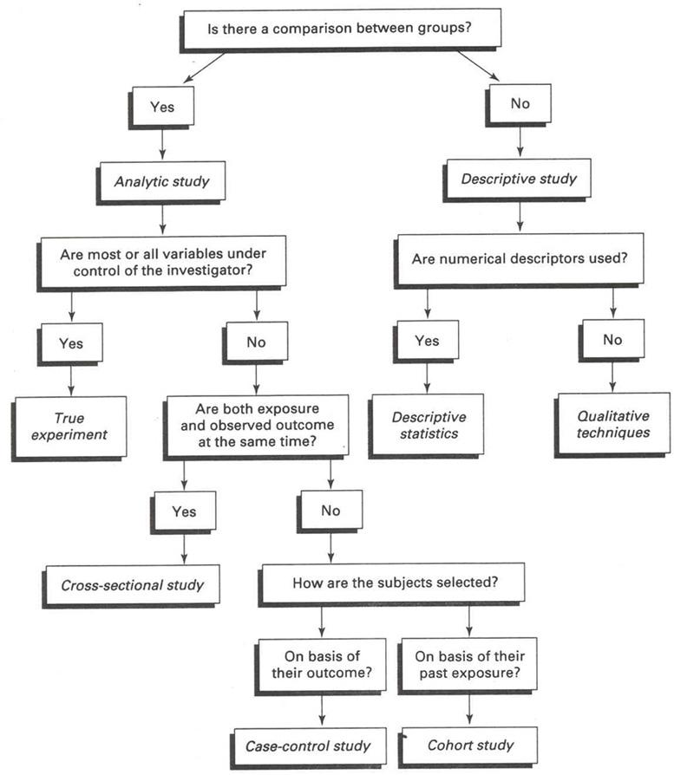
STUDY DESIGNS IN EPIDEMIOLOGY A scheme of selecting or identifying a study design

Slide 23
STUDY DESIGNS IN EPIDEMIOLOGY
Generally, in epidemiology, the observational analytic studies are the most common performed by epidemiologists because they are cheaper than the clinical trials, and also they give much more information than the descriptive studies.

Slide 24
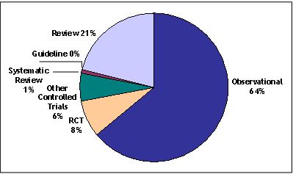
STUDY DESIGNS IN EPIDEMIOLOGY

