Slide 1
Chapter 3 Selections

Slide 2
Relational Operators

Slide 3
The boolean Type and Operators
Often in a program you need to compare two values, such as whether i is greater than j. Java provides six comparison operators (also known as relational operators) that can be used to compare two values. The result of the comparison is a Boolean value: true or false.
boolean b = (1 > 2);

Slide 4
Problem: A Simple Math Learning Tool
This example creates a program to let a first grader practice additions. The program randomly generates two single-digit integers number1 and number2 and displays a question such as “What is 7 + 9?” to the student. After the student types the answer, the program displays a message to indicate whether the answer is true or false.
AdditionQuiz
Run

Slide 5
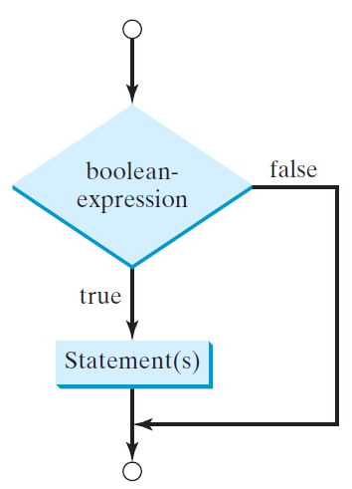
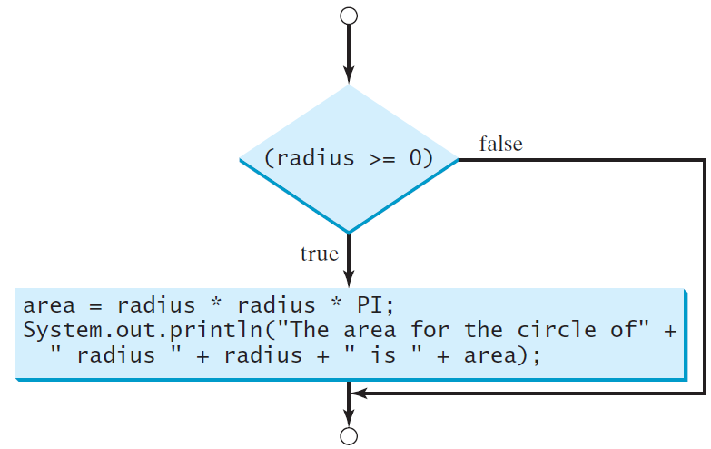
One-way if Statements
if (radius >= 0) {
area = radius * radius * PI;
System.out.println("The area"
+ " for the circle of radius "
+ radius + " is " + area);
}
if (boolean-expression) {
statement(s);
}

Slide 6
Simple if Demo
Write a program that prompts the user to enter an integer. If the number is a multiple of 5, print HiFive. If the number is divisible by 2, print HiEven.
SimpleIfDemo
Run

Slide 7
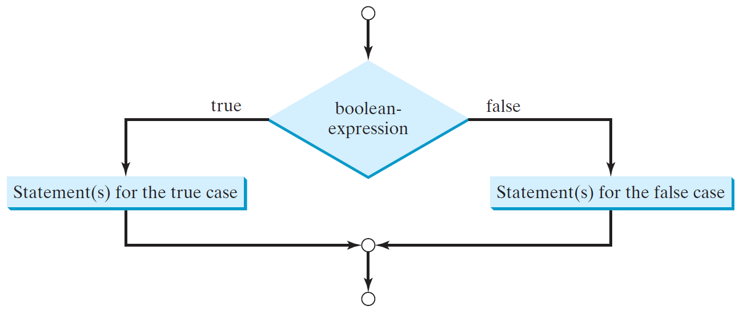
The Two-way if Statement
if (boolean-expression) {
statement(s)-for-the-true-case;
}
else {
statement(s)-for-the-false-case;
}

Slide 8
if-else Example
if (radius >= 0) {
area = radius * radius * 3.14159;
System.out.println("The area for the “
+ “circle of radius " + radius +
" is " + area);
}
else {
System.out.println("Negative input");
}

Slide 9
Multiple Alternative if Statements

Slide 10
TIP

Slide 11
CAUTION

Slide 12
Problem: An Improved Math Learning Tool
This example creates a program to teach a first grade child how to learn subtractions. The program randomly generates two single-digit integers number1 and number2 with number1 >= number2 and displays a question such as “What is 9 – 2?” to the student. After the student types the answer, the program displays whether the answer is correct.
SubtractionQuiz
Run

Slide 13
Logical Operators
Operator | Name | Description
! | not | logical negation
&& | and | logical conjunction
|| | or | logical disjunction
^ | exclusive or | logical exclusion

Slide 14
Truth Table for Operator !
p | !p | Example (assume age = 24, weight = 140)
true | false | !(age > 18) is false, because (age > 18) is true.
false | true | !(weight == 150) is true, because (weight == 150) is false.

Slide 15
Truth Table for Operator &&
p₁ | p₂ | p₁ && p₂ | Example (assume age = 24, weight = 140)
false | false | false | (age <= 18) && (weight < 140) is false, because both conditions are both false.
false | true | false
true | false | false | (age > 18) && (weight > 140) is false, because (weight > 140) is false.
true | true | true | (age > 18) && (weight >= 140) is true, because both (age > 18) and (weight >= 140) are true.

Slide 16
Truth Table for Operator ||
p₁ | p₂ | p₁ || p₂ | Example (assume age = 24, weihgt = 140)
false | false | false
false | true | true | (age > 34) || (weight <= 140) is true, because (age > 34) is false, but (weight <= 140) is true.
true | false | true | (age > 14) || (weight >= 150) is false, because (age > 14) is true.
true | true | true

Slide 17
Truth Table for Operator ^
p₁ | p₂ | p₁ ^ p₂ | Example (assume age = 24, weight = 140)
false | false | false | (age > 34) ^ (weight > 140) is true, because (age > 34) is false and (weight > 140) is false.
false | true | true | (age > 34) ^ (weight >= 140) is true, because (age > 34) is false but (weight >= 140) is true.
true | false | true | (age > 14) ^ (weight > 140) is true, because (age > 14) is true and (weight > 140) is false.
true | true | false

Slide 18
Examples
System.out.println("Is " + number + " divisible by 2 and 3? " +
((number % 2 == 0) && (number % 3 == 0)));
System.out.println("Is " + number + " divisible by 2 or 3? " +
((number % 2 == 0) || (number % 3 == 0)));
System.out.println("Is " + number +
" divisible by 2 or 3, but not both? " +
((number % 2 == 0) ^ (number % 3 == 0)));
TestBooleanOperators
Run

Slide 19
Problem: Determining Leap Year?
This program first prompts the user to enter a year as an int value and checks if it is a leap year.
A year is a leap year if it is divisible by 4 but not by 100, or it is divisible by 400.
(year % 4 == 0 && year % 100 != 0) || (year % 400 == 0)
LeapYear
Run

Slide 20
switch Statement Rules
The switch-expression must yield a value of char, byte, short, or int type and must always be enclosed in parentheses.
switch (switch-expression) {
case value1: statement(s)1;
break;
case value2: statement(s)2;
break;
…
case valueN: statement(s)N;
break;
default: statement(s)-for-default;
}
The value1, ..., and valueN must have the same data type as the value of the switch-expression. The resulting statements in the case statement are executed when the value in the case statement matches the value of the switch-expression. Note that value1, ..., and valueN are constant expressions, meaning that they cannot contain variables in the expression, such as 1 + x.

Slide 21
switch Statement Rules
The keyword break is optional, but it should be used at the end of each case in order to terminate the remainder of the switch statement. If the break statement is not present, the next case statement will be executed.
switch (switch-expression) {
case value1: statement(s)1;
break;
case value2: statement(s)2;
break;
…
case valueN: statement(s)N;
break;
default: statement(s)-for-default;
}
The default case, which is optional, can be used to perform actions when none of the specified cases matches the switch-expression.
When the value in a case statement matches the value of the switch-expression, the statements starting from this case are executed until either a break statement or the end of the switch statement is reached.

Slide 22
Trace switch statement
animation
Suppose day is 2:
switch (day) {
case 1:
case 2:
case 3:
case 4:
case 5: System.out.println("Weekday"); break;
case 0:
case 6: System.out.println("Weekend");
}

Slide 23
Conditional Operators
if (x > 0)
y = 1
else
y = -1;
is equivalent to
y = (x > 0) ? 1 : -1;
(boolean-expression) ? expression1 : expression2

Slide 24
Conditional Operator
if (num % 2 == 0)
System.out.println(num + “is even”);
else
System.out.println(num + “is odd”);
System.out.println(
(num % 2 == 0)? num + “is even” :
num + “is odd”);

Slide 25
Operator Precedence
var++, var--
+, - (Unary plus and minus), ++var,--var
(type) Casting
! (Not)
*, /, % (Multiplication, division, and remainder)
+, - (Binary addition and subtraction)
<, <=, >, >= (Relational operators)
==, !=; (Equality)
^ (Exclusive OR)
&& (Conditional AND) Short-circuit AND
|| (Conditional OR) Short-circuit OR
=, +=, -=, *=, /=, %= (Assignment operator)

Slide 26
Operator Precedence and Associativity
The expression in the parentheses is evaluated first. (Parentheses can be nested, in which case the expression in the inner parentheses is executed first.) When evaluating an expression without parentheses, the operators are applied according to the precedence rule and the associativity rule.
If operators with the same precedence are next to each other, their associativity determines the order of evaluation. All binary operators except assignment operators are left-associative.

Slide 27
Operator Associativity
When two operators with the same precedence are evaluated, the associativity of the operators determines the order of evaluation. All binary operators except assignment operators are left-associative.
a – b + c – d is equivalent to ((a – b) + c) – d
Assignment operators are right-associative. Therefore, the expression
a = b += c = 5 is equivalent to a = (b += (c = 5))

Slide 28
Example
Applying the operator precedence and associativity rule, the expression 3 + 4 * 4 > 5 * (4 + 3) - 1 is evaluated as follows:

