Slide 1
JavaScript: Client-Side Scripting
Dr. Yousef Hassouneh
Chapter 6

Slide 2
Objectives
1
2
What is JavaScript
JavaScript Design
3
4
Using
JavaScript
Syntax
5
6
JavaScript
Objects
The DOM
7
7
JavaScript
Events
8
Forms

Slide 3
What IS Javascript
Section 1 of 8

Slide 4
What is JavaScript
JavaScript runs right inside the browser
JavaScript is dynamically typed
JavaScript is object oriented in that almost everything in the language is an object
  the objects in JavaScript are prototype-based rather than class-based, which means that while JavaScript shares some syntactic features of PHP, Java or C#, it is also quite different from those languages

Slide 5
What isn’t JavaScript
It’s not Java
Although it contains the word Java, JavaScript and Java are vastly different programming languages with different uses. Java is a full-fledged compiled, object-oriented language, popular for its ability to run on any platform with a JVM installed.
Conversely, JavaScript is one of the world’s most popular languages, with fewer of the object-oriented features of Java, and runs directly inside the browser, without the need for the JVM.

Slide 6
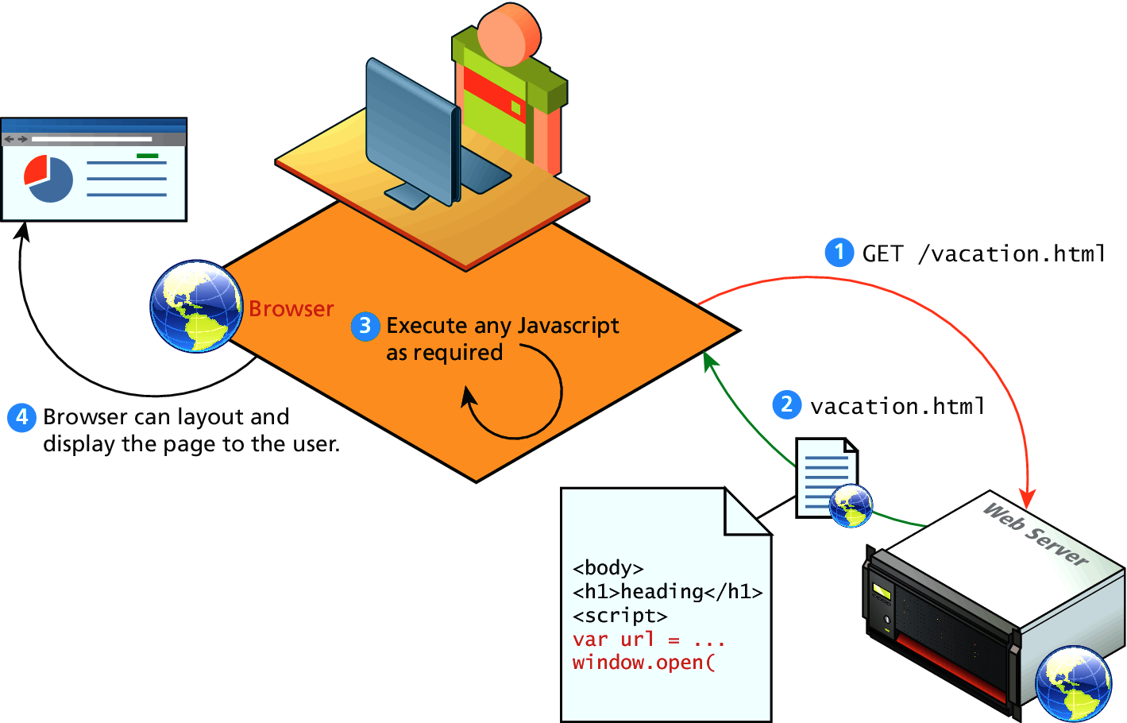
Client-Side Scripting
Let the client compute

Slide 7
Client-Side Scripting
It’s good
There are many advantages of client-side scripting:
Processing can be offloaded from the server to client machines, thereby reducing the load on the server.
The browser can respond more rapidly to user events than a request to a remote server ever could, which improves the user experience.
Notes:
JavaScript can interact with the downloaded HTML in a way that the server cannot, creating a user experience more like desktop software than simple HTML ever could.

Slide 8
Client-Side Scripting
There are challenges
The disadvantages of client-side scripting are mostly related to how programmers use JavaScript in their applications.
There is no guarantee that the client has JavaScript enabled
What works in one browser, may generate an error in another.
Complicated to debug and maintain.
Notes:
The idiosyncrasies between various browsers and operating systems make it difficult to test for all potential client configurations.

Slide 9
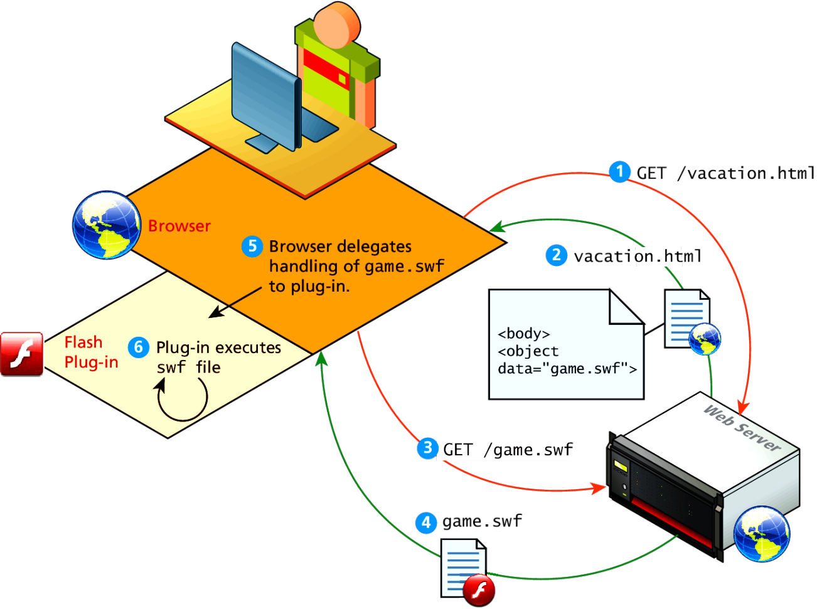
Client-Side Flash
JavaScript is not the only type of client-side scripting.
Browser Plug-ins
  Flash

Slide 10
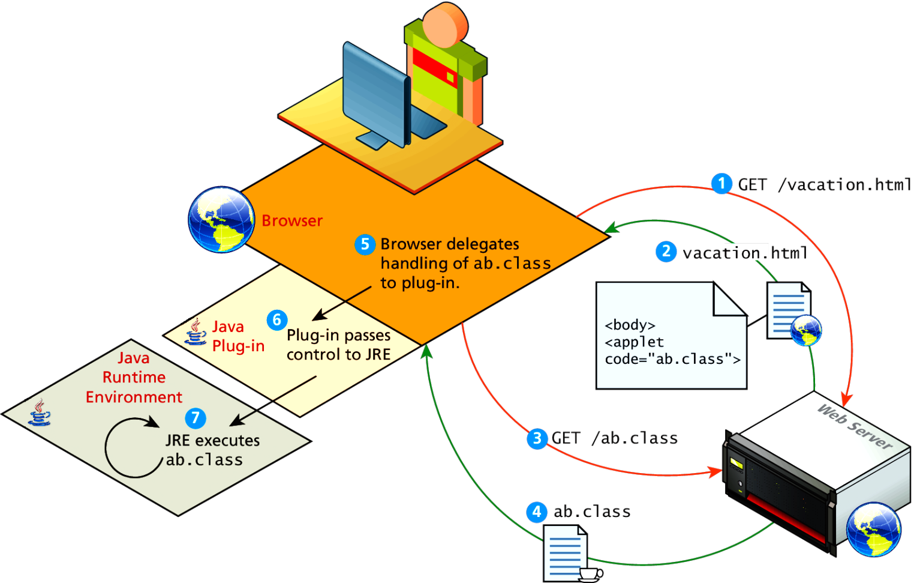
Client-Side Applets
Java Applets
Java applets are written in and are separate objects included within an HTML document via the <applet> tag

Slide 11
JavaScript History
JavaScript was introduced by Netscape in their Navigator browser back in 1996.
JavaScript is in fact an implementation of a standardized scripting language called ECMAScript
Notes:
JavaScript was only slightly useful, and quite often, very annoying to many users

Slide 12
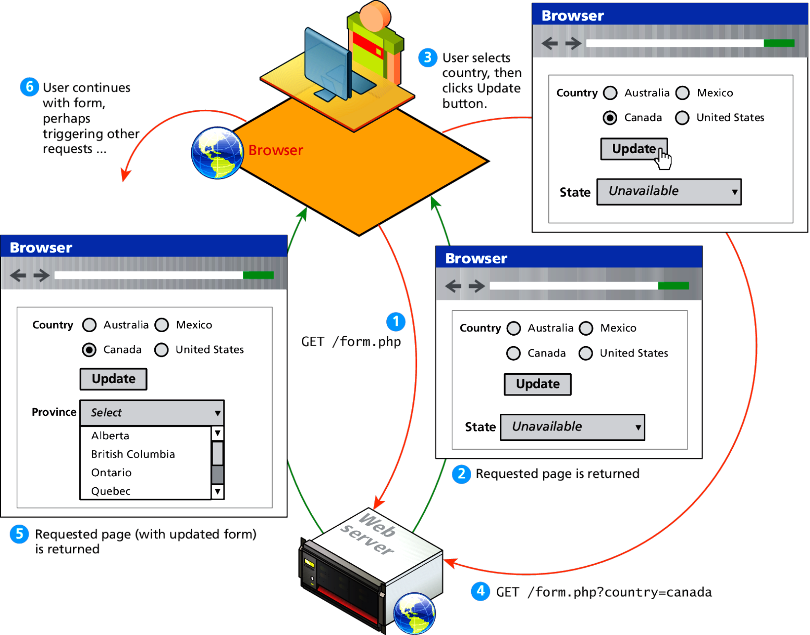
HTTP request-reponse loop
Without JavaScript

Slide 13
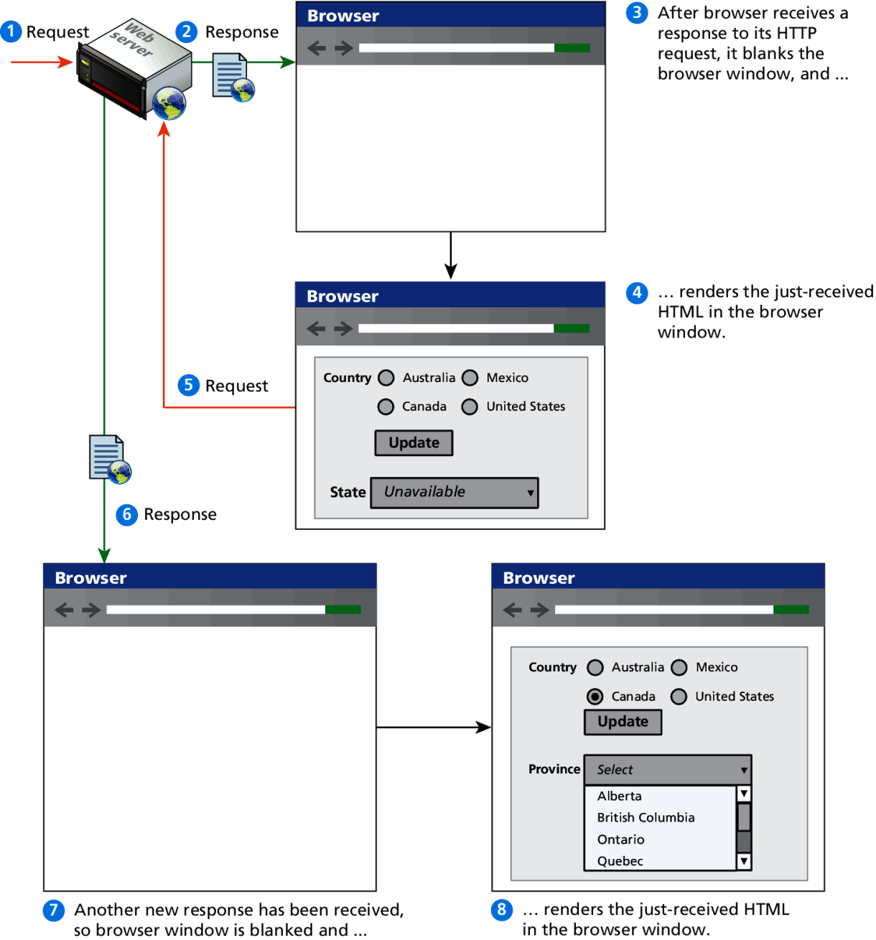
HTTP request-reponse loop
Detail

Slide 14
JavaScript in Modern Times
AJAX
AJAX is both an acronym as well as a general term.
As an acronym it means Asynchronous JavaScript And XML.
Notes:
JavaScript became a much more important part of web development in the mid 2000s with AJAX.
The most important feature of AJAX sites is the asynchronous data requests.
Ajax panel
Chatting system

Slide 15
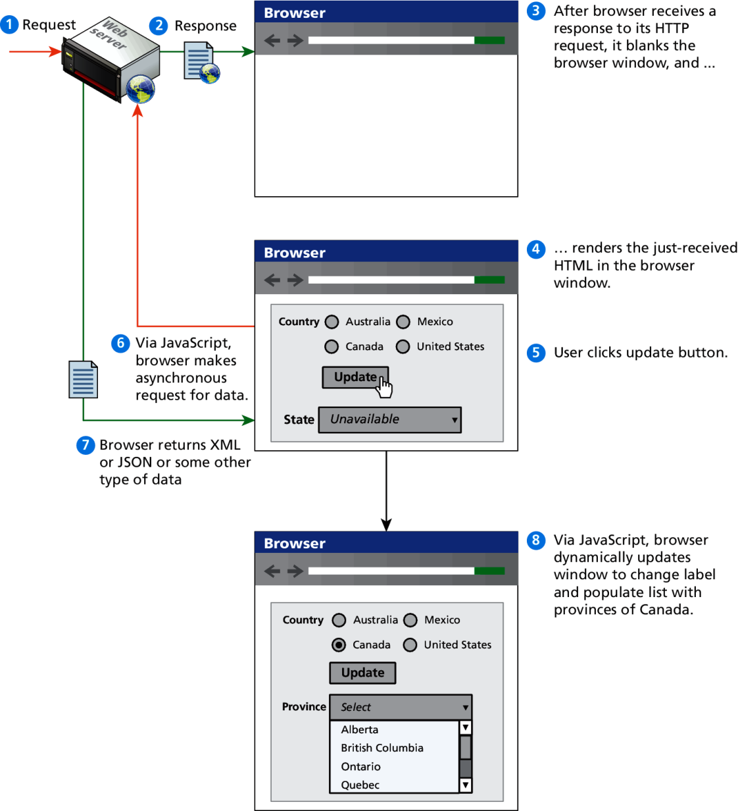
Asynchronous data requests
The better AJAX way
Notes:
Without blanking the page, only parts of the page are updated

Slide 16
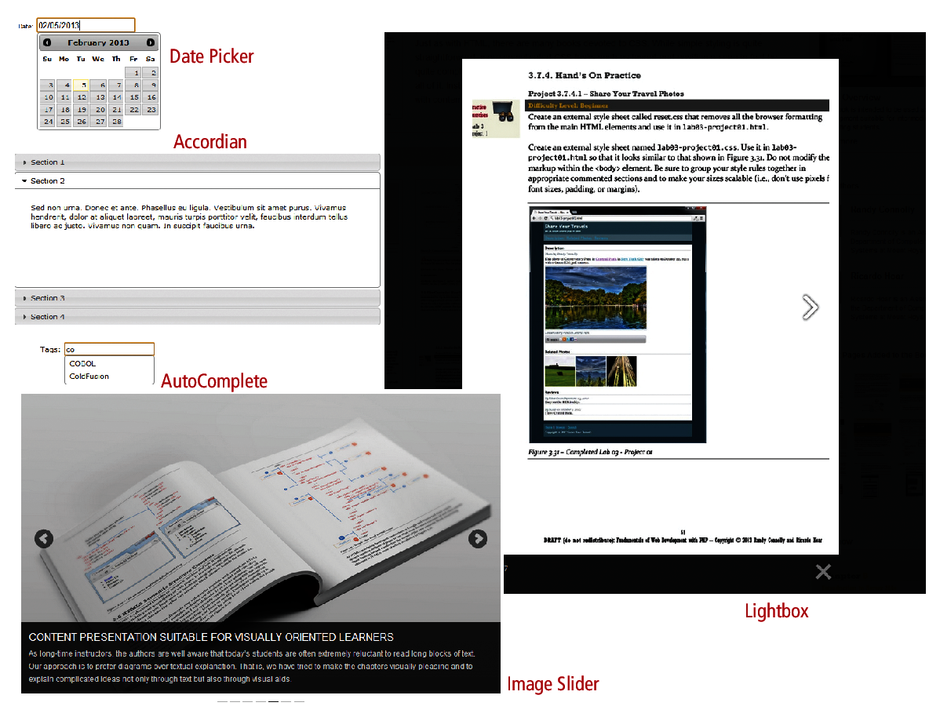
Frameworks
Lots of this is done for you, once you get the basics

Slide 17
Javascript Design Principles
Section 2 of 8

Slide 18
Layers
They help organize
When designing software to solve a problem, it is often helpful to abstract the solution a little bit to help build a cognitive model in your mind that you can then implement.
Perhaps the most common way of articulating such a cognitive model is via the term layer.
In object-oriented programming, a software layer is a way of conceptually grouping programming classes that have similar functionality and dependencies.

Slide 19
Layers
Common Layers
Presentation layer. Classes focused on the user interface.
Business layer. Classes that model real-world entities, such as customers, products, and sales.
Data layer. Classes that handle the interaction with the data sources.
Notes:
In java (OO) applications

Slide 20
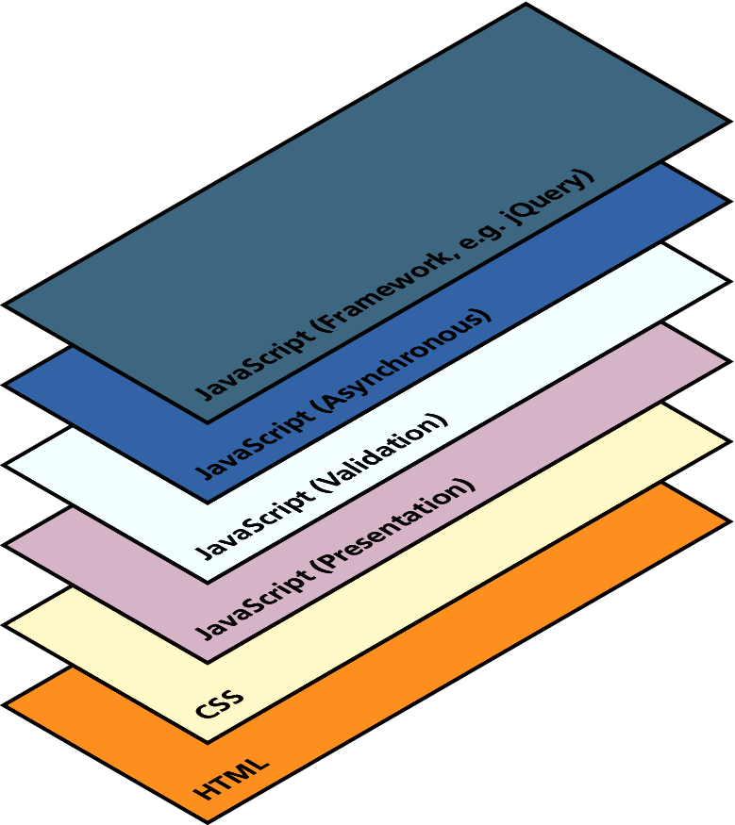
Layers
Just a conceptual idea
Notes:
Javascript layers:
Presentation Layer
This type of programming focuses on the display of information. JavaScript can
alter the HTML of a page, which results in a change, visible to the user. These presentation
layer applications include common things like creating, hiding, and showing
divs, using tabs to show multiple views, or having arrows to page through result
sets. This layer is most closely related to the user experience and the most visible to
the end user.
Validation Layer
JavaScript can be also used to validate logical aspects of the user’s experience. This
could include, for example, validating a form to make sure the email entered is valid
before sending it along. It is often used in conjunction with the presentation layer to create a coherent user experience, where a message to the presentation layer
highlights bad fields. Both layers exist on the client machine, although the intention
is to prevalidate forms before making transmissions back to the server.
Asynchronous Layers
Normally, JavaScript operates in a synchronous manner where a request sent to the
server requires a response before the next lines of code can be executed. During the
wait between request and response the browser sits in a loading state and only
updates upon receiving the response. In contrast, an asynchronous layer can route
requests to the server in the background. In this model, as certain events are triggered,
the JavaScript sends the HTTP requests to the server, but while waiting for
the response, the rest of the application functions normally, and the browser isn’t in
a loading state. When the response arrives JavaScript will (perhaps) update a portion
of the page. Asynchronous layers are considered advanced versions of the
presentation and validation layers above.

Slide 21
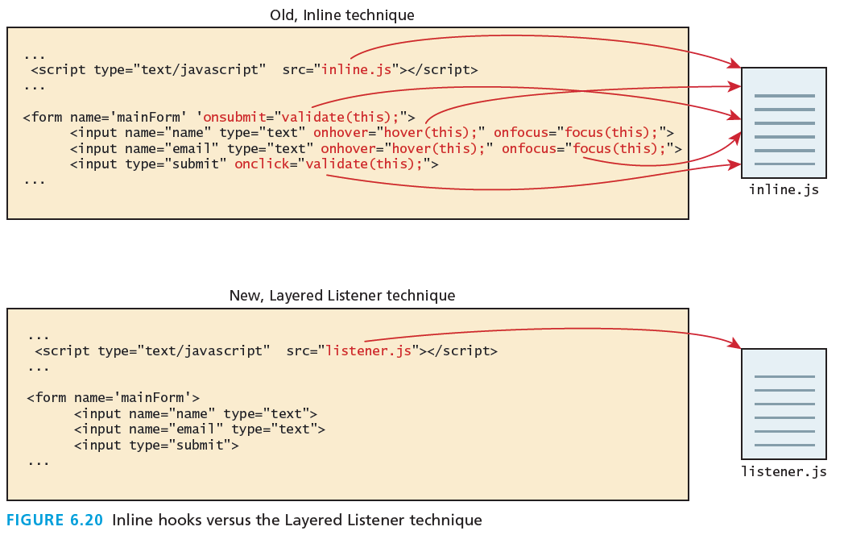
Layers
Just a conceptual idea
Notes:
Javascript layers:
Note how the old method weaves the JavaScript right inside the HTML, while the
listener technique has removed JavaScript from the markup, resulting in cleaner,
easier to maintain HTML code.
Typically developers work on a single file or application, weaving aspects of
logic and presentation together. Although this is a common practice, separating the
presentation and logic in your code is a powerful technique worth keeping in mind
as you code. Having separate presentation and logic functions/classes will help you
achieve more reusable code, which also happens to be easier to understand and
maintain as illustrated in the Figure above

Slide 22
Users Without Javascript
They do exist
Web crawler. A web crawler is a client running on behalf of a search engine to download your site, so that it can eventually be featured in their search results.
Browser plug-in. A browser plug-in is a piece of software that works within the browser, that might interfere with JavaScript.
Text-based client. Some clients are using a text-based browser.
Visually disabled client. A visually disabled client will use special web browsing software to read the contents of a web page out loud to them.

Slide 23
Users Without Javascript
Lynx, and WebIE

Slide 24
The <noscript> tag
Mechanism to speak to those with JavaScript
Any text between the opening and closing tags will only be displayed to users without the ability to load JavaScript.
It is often used to prompt users to enable JavaScript, but can also be used to show additional text to search engines.
Requiring JavaScript (or Flash) for the basic operation of your site will cause problems eventually and should be avoided.
The <noscript> tag defines an alternate content for users that have disabled scripts in their browser or have a browser that doesn't support script.
Notes:
Now that we know there are many sets of users that may have JavaScript disabled,
we may want to make use of a simple mechanism to show them special HTML content
that will not be seen by those with JavaScript. That mechanism is the HTML tag
<noscript>.
This approach of adding functional replacements for those without JavaScript is also referred to as fail-safe design, which is a phrase with a meaning beyond web development.

Slide 25
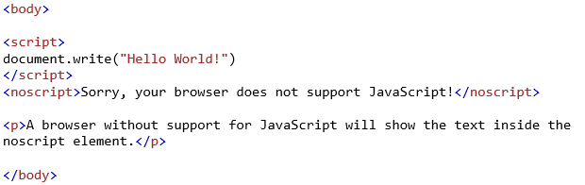

The <noscript> tag
Mechanism to speak to those with JavaScript
Notes:
Now that we know there are many sets of users that may have JavaScript disabled,
we may want to make use of a simple mechanism to show them special HTML content
that will not be seen by those with JavaScript. That mechanism is the HTML tag
<noscript>.
This approach of adding functional replacements for those without JavaScript is also referred to as fail-safe design, which is a phrase with a meaning beyond web development.

Slide 26
Where Does Javascript GO?
Section 3 of 8

Slide 27
Where does JavaScript go?
JavaScript can be linked to an HTML page in a number of ways.
Inline
Embedded
External

Slide 28
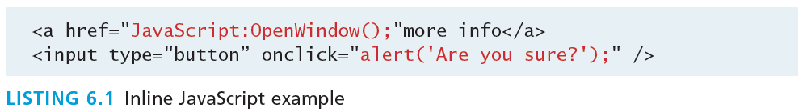
Inline JavaScript
Mash it in
Inline JavaScript refers to the practice of including JavaScript code directly within certain HTML attributes
Inline JavaScript is a real maintenance nightmare
Code

Slide 29
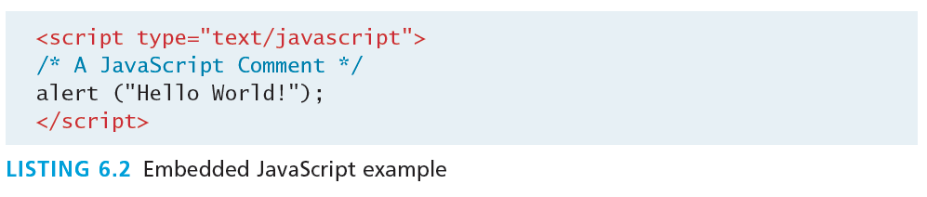
Embedded JavaScript
Better
Embedded JavaScript refers to the practice of placing JavaScript code within a <script> element
Code

Slide 30
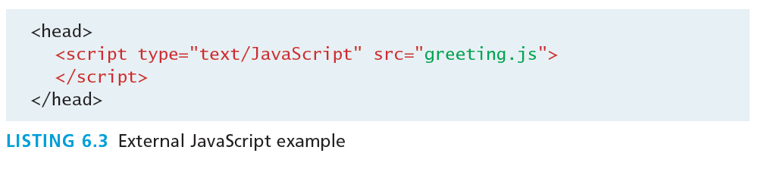
External JavaScript
Better
JavaScript supports this separation by allowing links to an external file that contains the JavaScript.
By convention, JavaScript external files have the extension .js.
Code
Notes:
Modern websites often have links to several, maybe even dozens, of external JavaScript files (also called libraries).
the link to the external JavaScript file is placed within the <head>
element, just as was the case with links to external CSS files. While this is convention,
it is in fact possible to place these links anywhere within the <body> element.
We certainly recommend placing them either in the <head> element or the very bottom
of the <body> element.
The argument for placing external scripts at the bottom of the <body> has to do
with performance. A JavaScript file has to be loaded completely before the browser
can begin any other downloads (including images). For sites with multiple external
JavaScript files, this can cause a noticeable delay in initial page rendering. Similarly,
if your page is loading a third-party JavaScript library from an external site, and
that site becomes

Slide 31
Syntax
Section 4 of 8

Slide 32
JavaScript Syntax
We will briefly cover the fundamental syntax for the most common programming constructs including
variables,
assignment,
conditionals,
loops, and
arrays
before moving on to advanced topics such as events and classes.

Slide 33
JavaScript’s Reputation
Precedes it?
JavaScript’s reputation for being quirky not only stems from its strange way of implementing object-oriented principles but also from some odd syntactic gotchas:
Everything is type sensitive, including function, class, and variable names.
The scope of variables in blocks is not supported. This means variables declared inside a loop may be accessible outside of the loop, counter to what one would expect.
There is a === operator, which tests not only for equality but type equivalence.
Null and undefined are two distinctly different states for a variable.
Semicolons are not required, but are permitted (and encouraged).
There is no integer type, only number, which means floating-point rounding errors are prevalent even with values intended to be integers.

Slide 34
Variables
var
Variables in JavaScript are dynamically typed, meaning a variable can be an integer, and then later a string, then later an object, if so desired.
This simplifies variable declarations, so that we do not require the familiar type fields like int, char, and String. Instead we use var
Assignment can happen at declaration-time by appending the value to the declaration, or at run time with a simple right-to-left assignment

Slide 35
Variables
JavaScript allows you to declare and use variables to store values.
How to assign a name to a variable?
  Include uppercase and lowercase letters
  Digits from 0 through 9
  The underscore _ and the dollar sign $
  No space and punctuation characters
  First character must be alphabetic letter or underscore
  Case-sensitive
  No reserved words or keywords
Tuesday, November 6, 2018
Abdallah Karakra
Notes:
Semicolons in javascript
http://inimino.org/~inimino/blog/javascript_semicolons

Slide 36
Which one is legal ?
My_variable
$my_variable
1my_example
_my_variable
@my_variable
My_variable_example
++my_variable
%my_variable
#my_variable
~my_variable
myVariableExample
Legal
Illegal
Tuesday, November 6, 2018
Abdallah Karakra

Slide 37
Variables and Data Types
Example variable declarations and Assignments

Slide 38
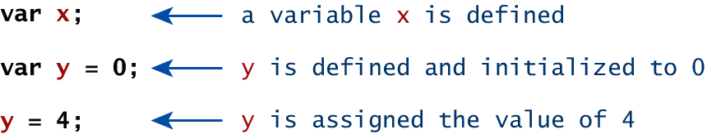
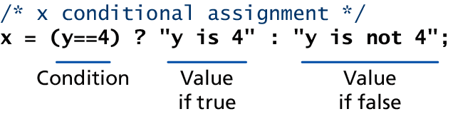
Variables
Assignment

Slide 39
Variables and Data Types
Data Types
two basic data types:
reference types (usually referred to as objects) and
primitive types
Primitive types represent simple forms of data.
Boolean, Number, String, …

Slide 40
Variables and Data Types
Reference Types

Slide 41
JavaScript Output
alert("Hello world");

Slide 42
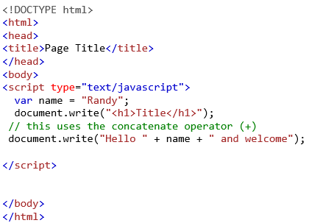

JavaScript Output
var name = "Randy";
document.write("<h1>Title</h1>");
// this uses the concatenate operator (+)
document.write("Hello " + name + " and welcome");

Slide 43
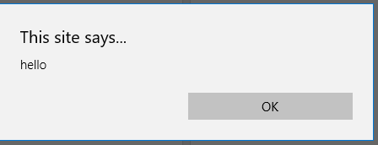
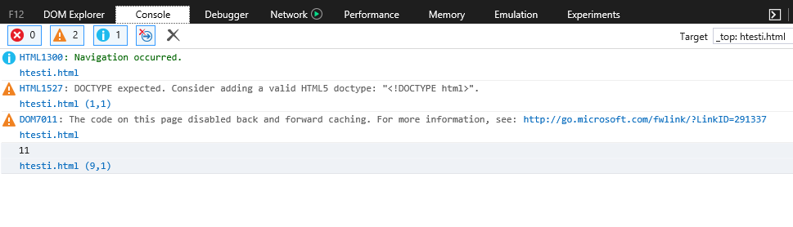

JavaScript Output
alert() Displays content within a pop-up box.
console.log() Displays content in the Browser’s JavaScript console.
document.write() Outputs the content (as markup) directly to the HTML document.

Slide 44
JavaScript Output
Chrome JavaScript Console

Slide 45
JavaScript Output
Fun with document.write()

Slide 46
Chapter 8
1
JavaScript 1: Language Fundamentals
2
Where Does JavaScript Go?
3
Variables and Data Types
4
JavaScript Output
5
Conditionals
6
Loops
7
Arrays
8
Objects

Slide 47
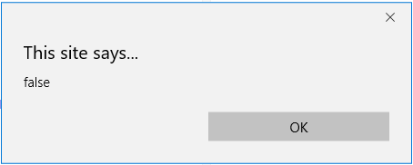
Comparison Operators
True or not True
Operator | Description | Matches (x=9)
== | Equals | (x==9) is true (x=="9") is true
=== | Exactly equals, including type | (x==="9") is false (x===9) is true
< , > | Less than, Greater Than | (x<5) is false
<= , >= | Less than or equal, greater than or equal | (x<=9) is true
!= | Not equal | (4!=x) is true
!== | Not equal in either value or type | (x!=="9") is true (x!==9) is false
var x=2;
var y="2";
alert(x===y);

Slide 48
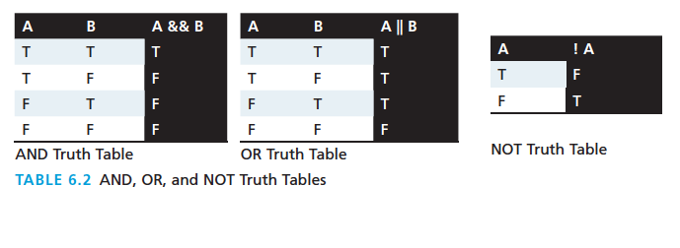
Logical Operators
The Boolean operators and, or, and not and their truth tables are listed in Table 6.2. Syntactically they are represented with && (and), || (or), and ! (not).

Slide 49
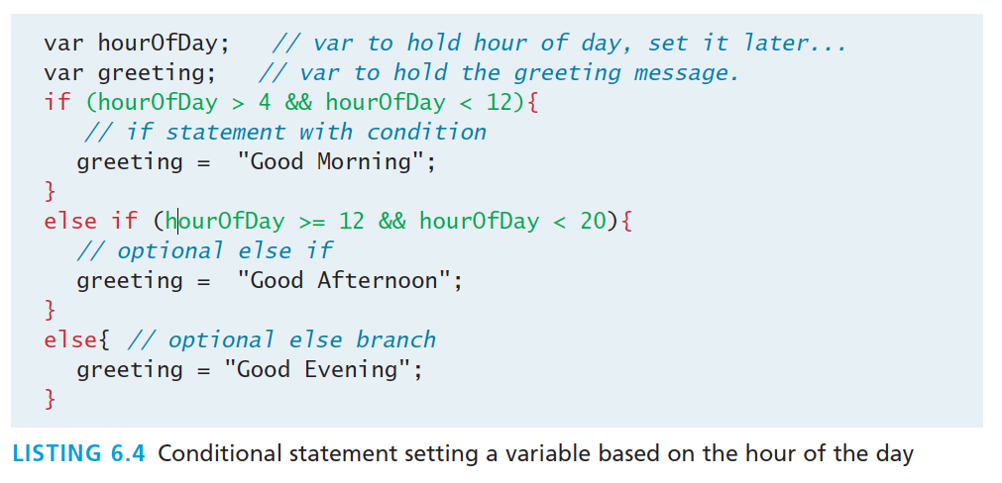
Conditionals
If, else if, …, else
JavaScript’s syntax is almost identical to that of PHP, Java, or C when it comes to conditional structures such as if and if else statements. In this syntax the condition to test is contained within ( ) brackets with the body contained in { } blocks.
Code

Slide 50
Conditionals
switch
switch (type) {
case "PT":
output = "Painting";
break;
case “DO":
output = " Doctor ";
break;
default:
output = "Other";
}

Slide 51
Conditionals
Conditional Assignment

Slide 52
Conditionals
Truthy and Falsy
In JavaScript, a value is said to be truthy if it translates to true, while a value is said to be falsy if it translates to false.
Almost all values in JavaScript are truthy
false, null, "", '', 0, NaN, and undefined are falsy

Slide 53
Chapter 8
1
JavaScript 1: Language Fundamentals
2
Where Does JavaScript Go?
3
Variables and Data Types
4
JavaScript Output
5
Conditionals
6
Loops
7
Arrays
8
Objects

Slide 54
Loops
While and do . . . while Loops
var count = 0;
while (count < 10) {
// do something
// ...
count++;
}
count = 0;
do {
// do something
// ...
count++;
} while (count < 10);

Slide 55
Loops
For Loops

Slide 56
Chapter 8
1
JavaScript 1: Language Fundamentals
2
Where Does JavaScript Go?
3
Variables and Data Types
4
JavaScript Output
5
Conditionals
6
Loops
7
Arrays
8
Objects

Slide 57
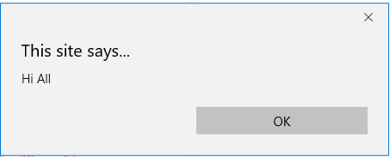
A JavaScript statement: alert
a JS command that pops up a dialog box with a message
alert("message");
alert(“Hi All");

Slide 58
Arrays
Arrays are one of the most commonly used data structures in programming.
JavaScript provides two main ways to define an array.
object literal notation
use the Array() constructor

Slide 59
Arrays
The following code creates a new, empty array named greetings:
var greetings = new Array(); //length=0
Notes:
Arrays are one of the most used data structures. In practice, this class is defined to behave more like a linked list in that it can be resized dynamically, but the implementation is browser specific, meaning the efficiency of insert and delete operations is unknown

Slide 60
Arrays
Initialize with values
To initialize the array with values, the variable declaration would look like the following:
var greetings = new Array("Good Morning", "Good Afternoon");//length=2
or, using the square bracket notation:
var greetings = ["Good Morning", "Good Afternoon"];// array literal notation

Slide 61
Arrays
object literal notation
The literal notation approach is generally preferred since it involves less typing, is more readable, and executes a little bit quicker
var years = [1855, 1648, 1420];
var countries = ["Canada", "France",
"Germany", "Nigeria",
"Thailand", "United States"];
var mess = [53, "Canada", true, 1420];

Slide 62
Arrays
Access and Traverse
To access an element in the array you use the familiar square bracket notation from Java and C-style languages, with the index you wish to access inside the brackets.
alert ( greetings[0] );
One of the most common actions on an array is to traverse through the items sequentially. Using the Array object’s length property to determine the maximum valid index. We have:
for (var i = 0; i < greetings.length; i++){
alert(greetings[i]);
}

Slide 63
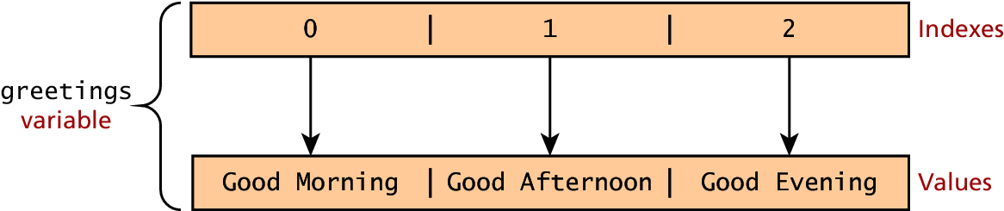
Arrays
Index and Value

Slide 64
Arrays
Modifying an array
To add an item to an existing array, you can use the push method.
greetings.push("Good Evening");
The pop () method can be used to remove an item from the back of an array.
Additional methods:
concat(), slice(), join(), reverse(), shift(), and sort()
Notes:
The slice() method returns the selected elements in an array, as a new array object.
The slice() method selects the elements starting at the given start argument, and ends at, but does not include, the given end argument.
The shift() method removes the first item of an array.
Note: This method changes the length of the array.
Note: The return value of the shift method is the removed item.
Tip: To remove the last item of an array, use the pop() method.
The join() method joins the elements of an array into a string, and returns the string.
The elements will be separated by a specified separator. The default separator is comma (,).
The shift() method removes the first element from an array and returns that removed element. This method changes the length of the array.

Slide 65
Arrays
Modifying an array
Before
var fruits = ["Banana", "Orange", "Apple", "Mango"];
var x= fruits.pop();// remove the last item of an array
After
fruits// Banana, Orange, Apple
x// Mango
fruits.push("Mango");
fruits // Banana, Orange , Apple, Mango
Notes:
The slice() method returns the selected elements in an array, as a new array object.
The slice() method selects the elements starting at the given start argument, and ends at, but does not include, the given end argument.
The shift() method removes the first item of an array.
Note: This method changes the length of the array.
Note: The return value of the shift method is the removed item.
Tip: To remove the last item of an array, use the pop() method.
The join() method joins the elements of an array into a string, and returns the string.
The elements will be separated by a specified separator. The default separator is comma (,).
The shift() method removes the first element from an array and returns that removed element. This method changes the length of the array.

Slide 66
Arrays
var a1 = [“rami", “khaled"];
var a2 = [“sandy", “ali", “lina"];
var a3 = a1.concat(a2);
//a3: rami Khaled sandy ali lina
var fruits = ["Banana", "Orange", "Lemon", "Apple", "Mango"];
var newArray = fruits.slice(1, 3);
//slice method selects the elements starting at the given start argument, and ends at, but does not include, the given end argument(method returns the selected elements in an array, as a new array object.).
//newArray: Orange,Lemon
var fruits = ["Banana", "Orange", "Apple", "Mango"];
fruits.shift(); // method removes the first item of an array.
// Orange , Apple, Mango
Notes:
The slice() method returns the selected elements in an array, as a new array object.
The slice() method selects the elements starting at the given start argument, and ends at, but does not include, the given end argument.
The shift() method removes the first item of an array.
Note: This method changes the length of the array.
Note: The return value of the shift method is the removed item.
Tip: To remove the last item of an array, use the pop() method.
The join() method joins the elements of an array into a string, and returns the string.
The elements will be separated by a specified separator. The default separator is comma (,).
The shift() method removes the first element from an array and returns that removed element. This method changes the length of the array.
https://developer.mozilla.org/en-US/docs/Web/JavaScript/Reference/Global_Objects/Array/shift

Slide 67
Arrays
Arrays Illustrated
Notes:
Math and other functions????

Slide 68

Functions
Functions are the building block for modular code in JavaScript, and are even used to build pseudo-classes, which you will learn about later.
They are defined by using the reserved word function and then the function name and (optional) parameters.
Since JavaScript is dynamically typed, functions do not require a return type, nor do the parameters require type.
Notes:
, functions do not require a return type, nor do the parameters require type.

Slide 69
JavaScript Functions
Defining functions
function name() {
statement ;
statement ;
...
statement ;
}
function myFunction() {
alert("Hello!");
alert("How are you?");
}

Slide 70
Functions
Example
Therefore a function to raise x to the yth power might be defined as:
function power(x,y){
var pow=1;
for (var i=0;i<y;i++){
pow = pow*x;
}
return pow;
}
And called as
power(2,10);

Slide 71
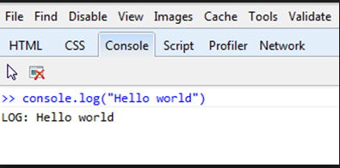
Alert
Not really used anymore, console instead
The alert() function makes the browser show a pop-up to the user, with whatever is passed being the message displayed. The following JavaScript code displays a simple hello world message in a pop-up:
alert ( "Good Morning" );
Using alerts can get tedious fast. When using debugger tools in your browser you can write output to a log with:
console.log("Put Messages Here");
And then use the debugger to access those logs.

Slide 72
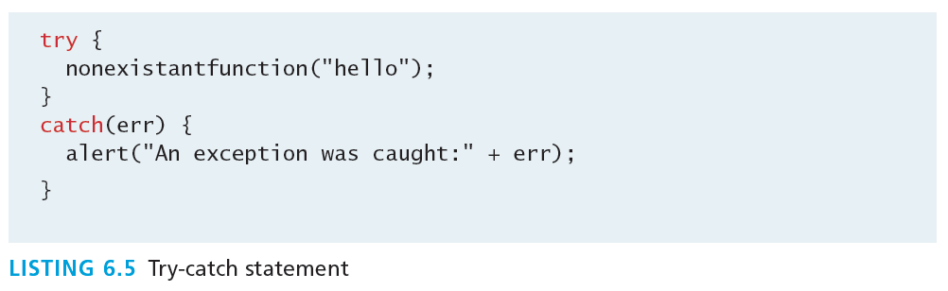
Errors using try and catch
When the browser’s JavaScript engine encounters an error, it will throw an exception. These exceptions interrupt the regular, sequential execution of the program and can stop the JavaScript engine altogether. However, you can optionally catch these errors preventing disruption of the program using the try–catch block
Notes:
try {
tryCode - Block of code to try
}
catch(err) {
catchCode - Block of code to handle errors
}
finally {
finallyCode - Block of code to be executed regardless of the try / catch result
}

Slide 73
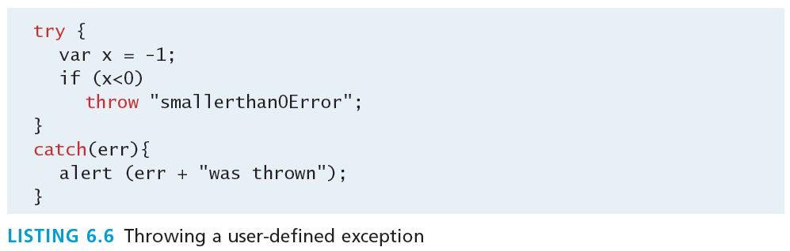
Throw your own
Exceptions that is.
Although try-catch can be used exclusively to catch built-in JavaScript errors, it can also be used by your programs, to throw your own messages. The throw keyword stops normal sequential execution, just like the built-in exceptions
https://www.w3schools.com/js/tryit.asp?filename=tryjs_throw_error

Slide 74
Tips
With Exceptions
Try-catch and throw statements should be used for abnormal or exceptional cases in your program.
Throwing an exception disrupts the sequential execution of a program. When the exception is thrown all subsequent code is not executed until the catch statement is reached.
This reinforces why try-catch is for exceptional cases.

Slide 75
Javascript Functions

Slide 76
JavaScript Functions
Defining functions
function name() {
statement ;
statement ;
...
statement ;
}
function myFunction() {
alert("Hello!");
alert("How are you?");
}

Slide 77
Javascript Objects
Section 5 of 8

Slide 78
JavaScript Objects
Objects not Classes
JavaScript is not a full-fledged object-oriented programming language.
it does not support many of the patterns you’d expect from an object-oriented language like inheritance and polymorphism.
The language does, however, support objects.
Notes:
It does not have classes per se, and

Slide 79
JavaScript Objects
Not full-fledged O.O.
There are objects that are included in the JavaScript language; you can also define your own kind of objects.
Notes:
Objects can have constructors, properties, and methods associated with them.

Slide 80
Constructors
create a new object we use the new keyword, the class name, and ( ) brackets with n optional parameters inside, comma delimited as follows:
var someObject = new ObjectName(p1,p2,..., pn);
For some classes, shortcut constructors are defined
var greeting = "Good Morning";
vs the formal:
var greeting = new String("Good Morning");
Notes:
String Object

Slide 81
Properties
Use the dot
Each object might have properties that can be accessed, depending on its definition.
When a property exists, it can be accessed using dot notation where a dot between the instance name and the property references that property.
//show someObject.property to the user
alert(someObject.property);

Slide 82
Methods
Use the dot, with brackets
Objects can also have methods, which are functions associated with an instance of an object. These methods are called using the same dot notation as for properties, but instead of accessing a variable, we are calling a method.
someObject.doSomething();
Methods may produce different output depending on the object they are associated with because they can utilize the internal properties of the object.

Slide 83
Special values: null and undefined
var x = null;
var y = 9;
var z;
// at this point in the code,
// x is null
// y is 9
// z is undefined
undefined : has not been declared, does not exist
null : exists, but was specifically assigned an empty or null value
Notes:
undefined : has not been declared, does not exist
null : exists, but was specifically assigned an empty or null value

Slide 84
Objects Included in JavaScript
A number of useful objects are included with JavaScript including:
Array
Boolean
Date
Math
String
Dom objects

Slide 85
Math
Reference List
The Math class allows one to access common mathematic functions and common values quickly in one place.
This static class contains methods such as max(), min(), pow(), sqrt(), and exp(), and trigonometric functions such as sin(), cos(), and arctan().
Many mathematical constants are defined such as PI, E, SQRT2, and some others
Math.PI; // 3.141592657
Math.sqrt(4); // square root of 4 is 2.
Math.random(); // random number between 0 and 1

Slide 86
Math
var rand1to10 = Math.floor(Math.random() * 10 + 1);
var three = Math.floor(Math.PI);
Reference List
Notes:
Math.round()
Math.abs()
Math.ceil()
Math.floor()
Math.sin(): the sine (a value between -1 and 1) of the angle x (given in radians).
Math.min() and Math.max() can be used to find the lowest or highest value in a list of arguments

Slide 87
String
The String class has already been used without us even knowing it.
Constructor usage
var greet = new String("Good"); // long form constructor
var greet = "Good"; // shortcut constructor
Length of a string
alert (greet.length); // will display "4"

Slide 88
String
Lab
Concatenation and so much more
var str = greet.concat("Morning"); // Long form concatenation
var str = greet + "Morning"; // + operator concatenation
Many other useful methods exist within the String class, such as
accessing a single character using charAt()
searching for one using indexOf().
Strings allow splitting a string into an array, searching and matching with split(), search(), and match() methods.

Slide 89
Date
The Date class is yet another helpful included object you should be aware of. It allows you to quickly calculate the current date or create date objects for particular dates.
To display today’s date as a string, we would simply create a new object and use the toString() method.
var d = new Date();
// This outputs Today is Mon Nov 12 2012 15:40:19 GMT-0700
alert ("Today is "+ d.toString());

Slide 90

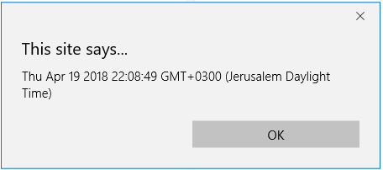
Date

Slide 91

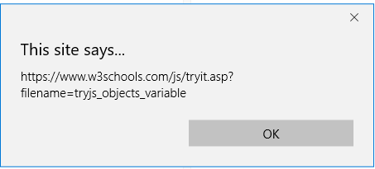
Window
The window object in JavaScript corresponds to the browser itself. Through it, you can access the current page’s URL, the browser’s history, and what’s being displayed in the status bar, as well as opening new browser windows.
In fact, the alert() function mentioned earlier is actually a method of the window object.

Slide 92
Window
The window object in JavaScript corresponds to the browser itself. Through it, you can access the current page’s URL, the browser’s history, and what’s being displayed in the status bar, as well as opening new browser windows.
In fact, the alert() function mentioned earlier is actually a method of the window object.
Other window functions:
window.alert()
window.prompt()
window.confirm()

Slide 93
window.prompt()
To ask the user a question and give the user a way to respond, we could use the prompt method of the window object:
window.prompt(question,default);
The method takes two arguments: the question to ask the user and a default answer, both string type values. We separate arguments with a comma.

Slide 94

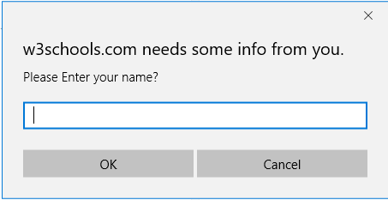

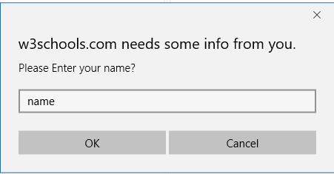
window.prompt()
Prompt example
We capture a user’s answer to a question posed by window.prompt() by assigning the method to a variable:
var answer = window.prompt(…);
The resulting value is always a string data-type.
var person = prompt("Please enter your name", "Harry Potter");
Notes:
Prompt example

Slide 95

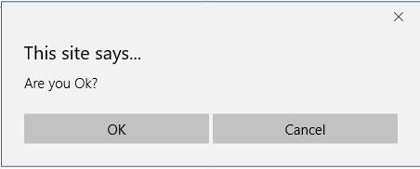
window.confirm()
We can also get user input by using the confirm method of the window object:
window.confirm(question);
The method takes one arguments: the question to ask the user. Just like window.prompt(), we can assign its return value to a variable. The data type, however, is boolean, not string!

Slide 96
window.confirm()
When we use window.confirm(), the user will see a dialogue box with a question and two buttons: an OK button and a Cancel button.
If the user clicks OK, the return value is true.
If the user clicks Cancel, the return value is false.
Confirm example

Slide 97
The Document Object Model (DOM)
Section 6 of 8

Slide 98
The DOM
Document Object Model
JavaScript is almost always used to interact with the HTML document in which it is contained.
This is accomplished through a programming interface (API) called the Document Object Model.
According to the W3C, the DOM is a:
Platform- and language-neutral interface that will allow programs and scripts to dynamically access and update the content, structure and style of documents.

Slide 99
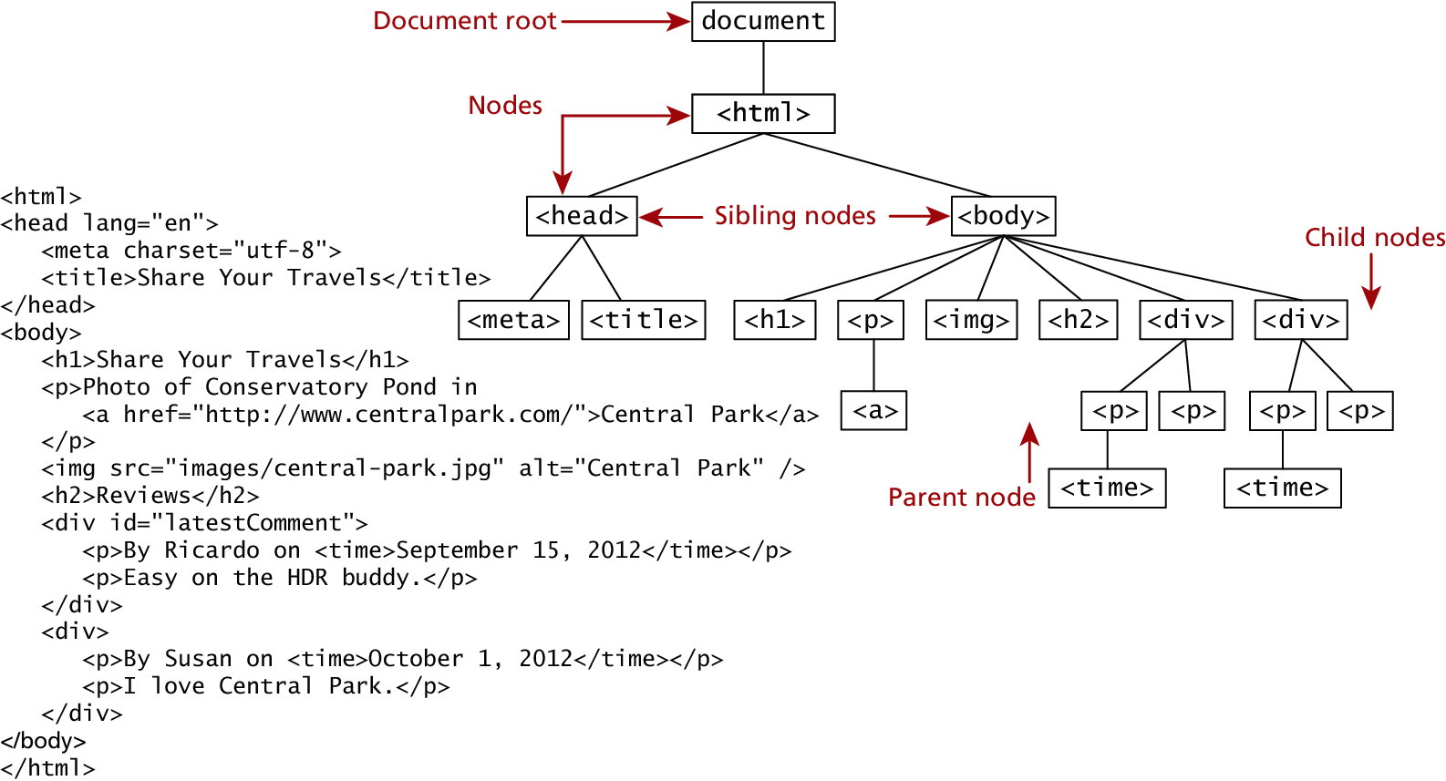
The DOM
The tree structure of the (HTML) is formally called the DOM Tree with the root, or top most object called the Document Root.
Notes:
We already know all about the DOM, but by another name.
from Chapter 2

Slide 100
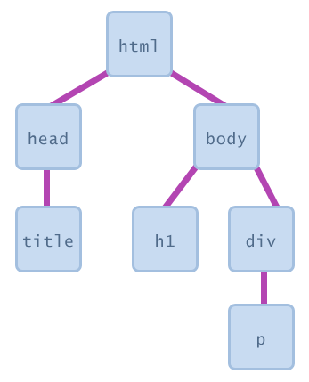
DOM Nodes
Document Object Model
In the DOM, each element within the HTML document is called a node. If the DOM is a tree, then each node is an individual branch.
There are:
element nodes,
text nodes, and
attribute nodes
Notes:
All nodes in the DOM share a common set of properties and methods.

Slide 101
Document Object Model (DOM)
a set of JavaScript objects that represent each element on the page
most JS code manipulates elements on an HTML page
we can examine elements' state
  e.g. see whether a box is checked
we can change state
  e.g. insert some new text into a div
we can change styles
  e.g. make a paragraph red

Slide 102
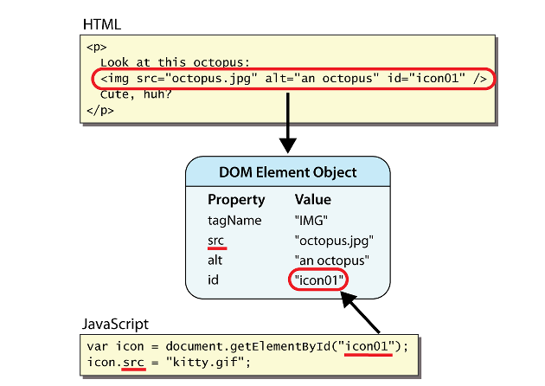
DOM Nodes
document.getElementById
returns the DOM object for an element with a given id

Slide 103
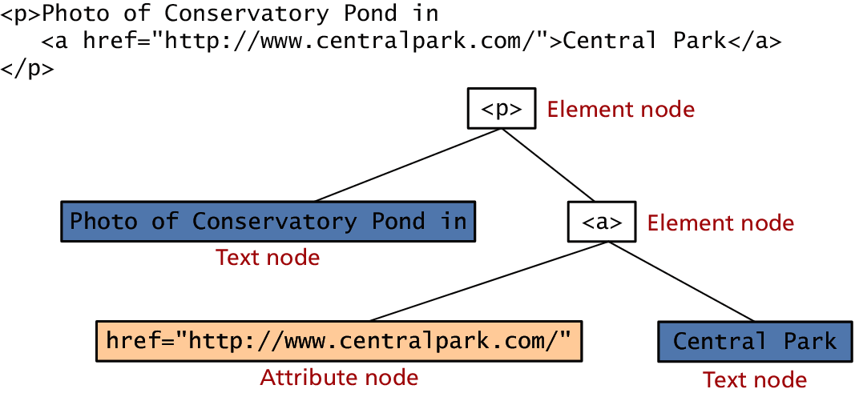
DOM Nodes
Element, text and attribute nodes

Slide 104

Accessing elements: document.getElementById
var name = document.getElementById("id");
<button onclick="changeText();">Click me!</button>
<input id="output" type="text" value="replace me" />
function changeText() {
var textbox = document.getElementById("output"); textbox.value = "Hello, world!";
}
document.getElementById returns the DOM object for an element with a given id
can change the text in most form controls by setting the value property
Notes:
var name = document.getElementById("id");
document.getElementById returns the DOM object for an element with a given id
can change the text in most form controls by setting the value property

Slide 105
More advanced example
<button onclick="swapText();">Click me!</button>
<span id="output2">Hello</span>
<input id="textbox2" type="text" value="Goodbye" />
function swapText() {
var span = document.getElementById("output2");
var textBox = document.getElementById("textbox2");
var temp = span.innerHTML;
span.innerHTML = textBox.value;
textBox.value = temp;
}
can change the text inside most elements by setting the innerHTML property
Notes:
can change the text inside most elements by setting the innerHTML property

Slide 106
DOM Nodes
Essential Node Object properties
Property | Description
attributes | Collection of node attributes
childNodes | A NodeList of child nodes for this node
firstChild | First child node of this node.
lastChild | Last child of this node.
nextSibling | Next sibling node for this node.
nodeName | Name of the node
nodeType | Type of the node
nodeValue | Value of the node
parentNode | Parent node for this node.
previousSibling | Previous sibling node for this node.

Slide 107
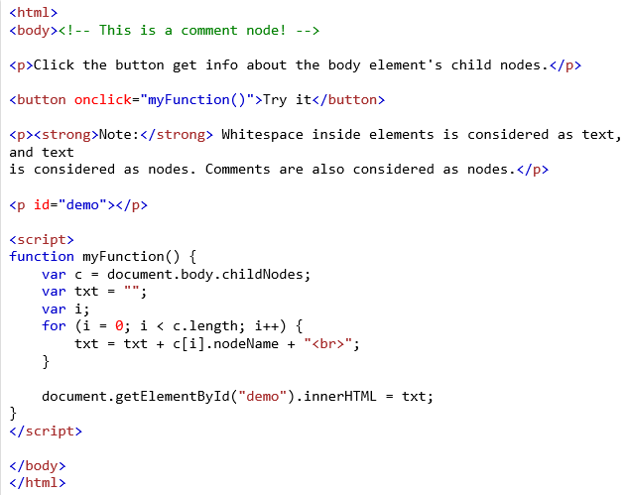
Document Object
One root to ground them all
The DOM document object is the root JavaScript object representing the entire HTML document.
It contains some properties and methods that we will use extensively in our development and is globally accessible as document.
// specify the doctype, for example html
var a = document.doctype.name;
// specify the page encoding, for example ISO-8859-1
var b = document.inputEncoding;
#comment
#text
P
#text
BUTTON
#text
P
#text
P
#text
SCRIPT
#text
View on Browser

Slide 108
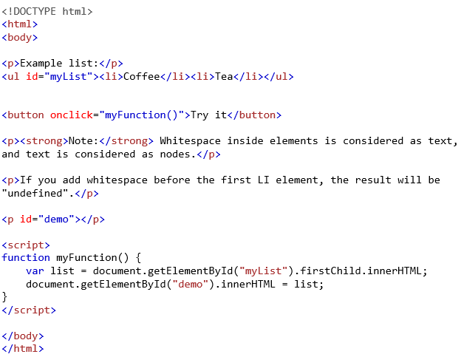
Document Object
One root to ground them all
The DOM document object is the root JavaScript object representing the entire HTML document.
It contains some properties and methods that we will use extensively in our development and is globally accessible as document.
// specify the doctype, for example html
var a = document.doctype.name;
// specify the page encoding, for example ISO-8859-1
var b = document.inputEncoding;
#comment
#text
P
#text
BUTTON
#text
P
#text
P
#text
SCRIPT
#text
Coffee
View on Browser
View on Browser

Slide 109

Document Object
One root to ground them all
The DOM document object is the root JavaScript object representing the entire HTML document.
It contains some properties and methods that we will use extensively in our development and is globally accessible as document.
// specify the doctype, for example html
var a = document.doctype.name;
// specify the page encoding, for example ISO-8859-1
var b = document.inputEncoding;
#comment
#text
P
#text
BUTTON
#text
P
#text
P
#text
SCRIPT
#text
Coffee
undefined
View on Browser
View on Browser

Slide 110

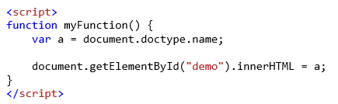
Document Object
One root to ground them all
The DOM document object is the root JavaScript object representing the entire HTML document.
It contains some properties and methods that we will use extensively in our development and is globally accessible as document.
// specify the doctype, for example html
var a = document.doctype.name;
// specify the page encoding, for example ISO-8859-1, or WINDOWS-1256
var b = document.inputEncoding;
html

Slide 111
Document Object
Document Object Methods
Method | Description
createAttribute() | Creates an attribute node
createElement() | Creates an element node
createTextNode() | Create a text node
getElementById(id) | Returns the element node whose id attribute matches the passed id parameter.
getElementsByTagName(name) | Returns a nodeList of elements whose tag name matches the passed name parameter.

Slide 112
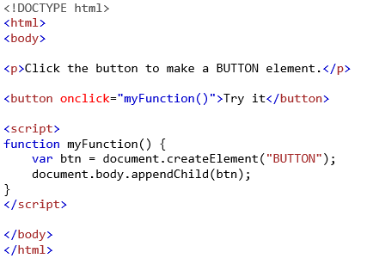


Accessing nodes

Slide 113
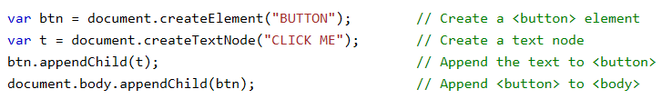
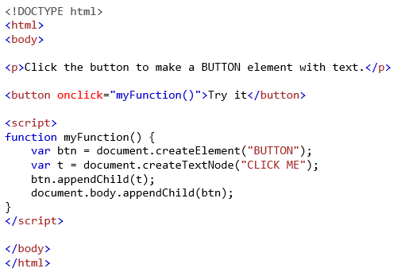


Accessing nodes
New button

Slide 114
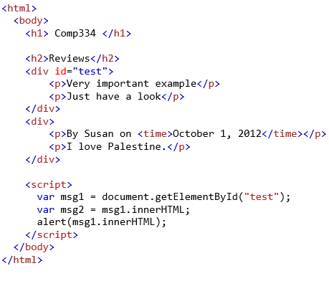
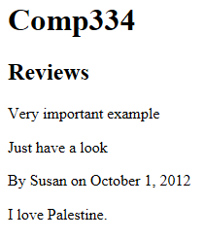
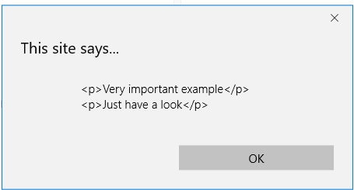
Accessing nodes
<html>
<body>
<h1> Comp334 </h1>
<h2>Reviews</h2>
<div id="test">
<p>Very important example</p>
<p>Just have a look</p>
</div>
<div>
<p>By Susan on <time>October 1, 2012</time></p>
<p> I love Palestine.</p>
</div>
<script>
var msg1 = document.getElementById("test");
var msg2 = msg1.innerHTML;
alert(msg1.innerHTML);
</script>
</body>
</html>

Slide 115
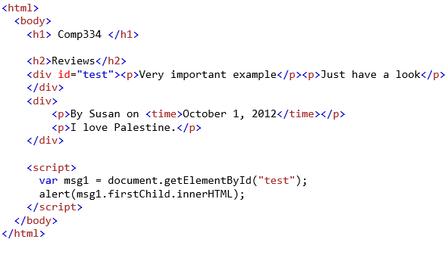
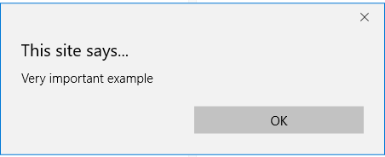
Accessing nodes
<html>
<body>
<h1> Comp334 </h1>
<h2>Reviews</h2>
<div id="test">
<p>Very important example</p>
<p>Just have a look</p>
</div>
<div>
<p>By Susan on <time>October 1, 2012</time></p>
<p> I love Palestine.</p>
</div>
<script>
var msg1 = document.getElementById("test");
var msg2 = msg1.innerHTML;
alert(msg1.innerHTML);
</script>
</body>
</html>

Slide 116
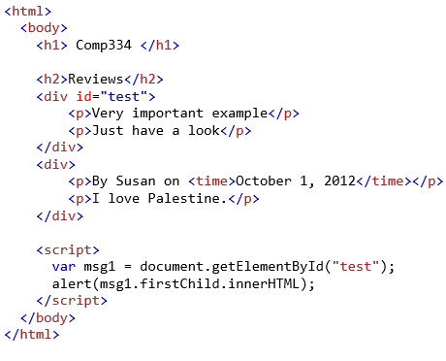
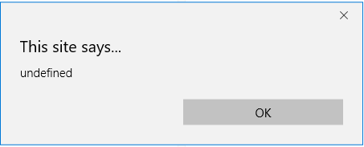
Accessing nodes
space

Slide 117
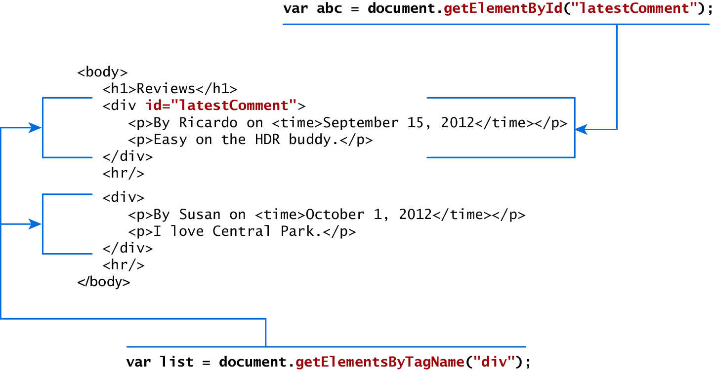
Accessing nodes
getElementById(), getElementsByTagName()

Slide 118
Element node Object
The type of object returned by the method document.getElementById() described in the previous section is an element node object.
This represents an HTML element in the hierarchy, contained between the opening <> and closing </> tags for this element.
can itself contain more elements

Slide 119
Element node Object
Essential Element Node Properties
Property | Description
className | The current value for the class attribute of this HTML element.
id | The current value for the id of this element.
innerHTML | Represents all the things inside of the tags. This can be read or written to and is the primary way which we update particular div's using JS.
style | The style attribute of an element. We can read and modify this property.
tagName | The tag name for the element.

Slide 120
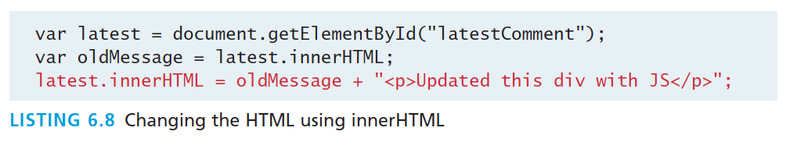
Modifying a DOM element
The document.write() method is used to create output to the HTML page from JavaScript.
The modern JavaScript programmer will want to write to the HTML page, but in a particular location
Using the DOM document and HTML DOM element objects, we can do exactly that using the innerHTML property
<script>
document.write("Hello World!");
</script>
document.write("<h1>Hello World</h1>");
Notes:
The modern JavaScript programmer will want to write to the HTML page, but in a particular location, not always at the bottom

Slide 121


Modifying a DOM element

Slide 122
Modifying a DOM element
Result
<div id="latestComment">
<p>By Ricardo on <time>September 15, 2012</time></p>
<p>Easy on the HDR buddy.</p>
<p>Updated this div with JS</p>
</div>

Slide 123



Modifying a DOM element
More verbosely, and validated
Although the innerHTML technique works well (and is very fast), there is a more verbose technique available to us that builds output using the DOM.
DOM functions createTextNode(), removeChild(), and appendChild() allow us to modify an element in a more rigorous way
Before
After
Notes:
<html>
<body>
<h1> Comp334 </h1>
<h2>Reviews</h2>
<div id="test"><p>Very important example</p><p>Just have a look</p>
</div>
<div>
<p>By Susan on <time>October 1, 2012</time></p>
<p>I love Palestine.</p>
</div>
<script>
var msg1 = document.getElementById("test");
msg1.removeChild(msg1.firstChild);
</script>
</body>
</html>

Slide 124


Modifying a DOM element
More verbosely, and validated
Although the innerHTML technique works well (and is very fast), there is a more verbose technique available to us that builds output using the DOM.
DOM functions createTextNode(), removeChild(), and appendChild() allow us to modify an element in a more rigorous way

Slide 125
Modifying a DOM element
More verbosely, and validated
Although the innerHTML technique works well (and is very fast), there is a more verbose technique available to us that builds output using the DOM.
DOM functions createTextNode(), removeChild(), and appendChild() allow us to modify an element in a more rigorous way

Slide 126
Changing an element’s style
We can add or remove any style using the style or className property of the Element node.
document.getElementById(id).style.property = new style
Example:
document.getElementById("p2").style.color = "blue";
Notes:
Armed with knowledge of CSS attributes you can easily change any style
attribute. Note that the style property is itself an object,

Slide 127
Changing an element’s style
We can add or remove any style using the style or className property of the Element node.
Its usage is shown below to change a node’s background color and add a three-pixel border.
var commentTag = document.getElementById("specificTag");
commentTag.style.backgroundColour = "#FFFF00";
commentTag.style.borderWidth="3px";
Example

Slide 128
Changing an element’s style
With class
The className property is normally a better choice, because it allows the styles to be created outside the code, and thus be better accessible to designers.
var commentTag = document.getElementById("specificTag");
commentTag.className = "someClassName";
HTML5 introduces the classList element, which allows you to add, remove, or toggle a CSS class on an element.
label.classList.addClass("someClassName");
Example (styling an element with a specific class)
Example (adding a class to an element)
Example (selecting elements by className)

Slide 129



Changing an element’s style
Notes:
<!DOCTYPE html>
<html>
<head>
<style>
.mystyle {
width: 300px;
height: 50px;
background-color: coral;
font-size: 25px;
}
.newStyle{color: white;}
</style>
</head>
<body>
<p>Click the button to add the "mystyle" class to DIV.</p>
<button onclick="myFunction()">Try it</button>
<div id="myDIV">
I am a DIV element
</div>
<script>
function myFunction() {
document.getElementById("myDIV").classList.add("mystyle");
document.getElementById("myDIV").classList.add("newStyle");
}
</script>
</body>
</html>

Slide 130
Common DOM styling errors
many students forget to write .style when setting styles
var clickMe = document.getElementById("clickme");
clickMe.color = "red"; //wrong
clickMe.style.color = "red"; //true
style properties are capitalized like This, not like-this
clickMe.style.font-size = "14pt"; //wrong
clickMe.style.fontSize = "14pt"; //true
style properties must be set as strings, often with units at the end
clickMe.style.width = 200; //wrong
clickMe.style.width = "200px";
clickMe.style.padding = "0.5em";
write exactly the value you would have written in the CSS, but in quotes

Slide 131
More Properties
Some Specific HTML DOM Element Properties for Certain Tag Types
Property | Description | Tags
href | The href attribute used in a tags to specify a URL to link to. | a
name | The name property is a bookmark to identify this tag. Unlike id which is available to all tags, name is limited to certain form related tags. | a, input, textarea, form
src | Links to an external URL that should be loaded into the page (as opposed to href which is a link to follow when clicked) | img, input, iframe, script
value | The value is related tot he value attribute of input tags. Often the value of an input field is user defined, and we use value to get that user input. | Input, textarea, submit

Slide 132
JavaScript Events
Section 7 of 8

Slide 133

JavaScript Events
A JavaScript event is an action that can be detected by JavaScript.
We say then that an event is triggered and then it can be caught by JavaScript functions, which then do something in response.

Slide 134


JavaScript Events
A brave new world
Comp334
This is bad style (HTML is cluttered with JS code)
Goal: remove all JavaScript code from the HTML body
Notes:
In the original JavaScript world, events could be specified right in the HTML markup with hooks to the JavaScript code (and still can).
As more powerful frameworks were developed, and website design and best practices were refined, this original mechanism was supplanted by the listener approach.

Slide 135

JavaScript Events
Two approaches

Slide 136

Inline Event Handler Approach
For example, if you wanted an alert to pop-up when clicking a <div> you might program:
<div id="example1" onclick="alert('hello')">Click for pop-up</div>
The problem with this type of programming is that the HTML markup and the corresponding JavaScript logic are woven together. It does not make use of layers; that is, it does not separate content from behavior.
Notes:
Javascript layers:
Presentation Layer
This type of programming focuses on the display of information. JavaScript can
alter the HTML of a page, which results in a change, visible to the user. These presentation
layer applications include common things like creating, hiding, and showing
divs, using tabs to show multiple views, or having arrows to page through result
sets. This layer is most closely related to the user experience and the most visible to
the end user.
Validation Layer
JavaScript can be also used to validate logical aspects of the user’s experience. This
could include, for example, validating a form to make sure the email entered is valid
before sending it along. It is often used in conjunction with the presentation layer to create a coherent user experience, where a message to the presentation layer
highlights bad fields. Both layers exist on the client machine, although the intention
is to prevalidate forms before making transmissions back to the server.
Asynchronous Layers
Normally, JavaScript operates in a synchronous manner where a request sent to the
server requires a response before the next lines of code can be executed. During the
wait between request and response the browser sits in a loading state and only
updates upon receiving the response. In contrast, an asynchronous layer can route
requests to the server in the background. In this model, as certain events are triggered,
the JavaScript sends the HTTP requests to the server, but while waiting for
the response, the rest of the application functions normally, and the browser isn’t in
a loading state. When the response arrives JavaScript will (perhaps) update a portion
of the page. Asynchronous layers are considered advanced versions of the
presentation and validation layers above.

Slide 137


Listener Approach
Two ways to set up listeners
Notes:
1.document.addEventListener("click", myFunction);
2.document.addEventListener("click", mySecondFunction);
//execute 1 & 2
1.document.onclick=mySecondFunction;
2.document.onclick=myFunction;
// execute just the second
1.document.onclick=mySecondFunction;
2.document.onmouseover=myFunction;
//execute 1 & 2

Slide 138



Listener Approach
Before
After

Slide 139

Listener Approach
Using functions
Notes:
What if we wanted to do something more elaborate when an event is triggered? In such a case, the behavior would have to be encapsulated within a function, as shown in Listing 6.12.

Slide 140




Listener Approach
Show
An alternative to that shown in Listing 6.12 is to use an anonymous function (that is, one without a name), as shown in Listing 6.13.
You can add events of different types to the document.
This example demonstrates how to add many events to the document
Notes:
<!DOCTYPE html>
<html>
<body>
<p id="demo"></p>
<script>
document.addEventListener("mouseover", myFunction);
document.addEventListener("click", mySecondFunction);
document.addEventListener("mouseout", myThirdFunction);
function myFunction() {
document.getElementById("demo").innerHTML += "Moused over!<br>"
}
function mySecondFunction() {
document.getElementById("demo").innerHTML += "Clicked!<br>"
}
function myThirdFunction() {
document.getElementById("demo").innerHTML += "Moused out!<br>"
}
</script>
</body>
</html>

Slide 141
Listener Approach
Anonymous functions
An alternative to that shown in Listing 6.12 is to use an anonymous function (that is, one without a name), as shown in Listing 6.13.
document.onclick=function() {
document.getElementById("demo").innerHTML += "Clicked!<br>"
}

Slide 142



Event Object
Example
No matter which type of event we encounter, they are all DOM event objects and the event handlers associated with them can access and manipulate them. Typically we see the events passed to the function handler as a parameter named e.
function someHandler(e) {
// e is the event that triggered this handler.
}
Before
After

Slide 143
Event Object
No matter which type of event we encounter, they are all DOM event objects and the event handlers associated with them can access and manipulate them. Typically we see the events passed to the function handler as a parameter named e.
function someHandler(e) {
// e is the event that triggered this handler.
}

Slide 144


Event Object
Several Options
Notes:
The preventDefault() method cancels the event if it is cancelable, meaning that the default action that belongs to the event will not occur.
For example, this can be useful when:
Clicking on a "Submit" button, prevent it from submitting a form
Clicking on a link, prevent the link from following the URL
Note: Not all events are cancelable. Use the cancelable property to find out if an event is cancelable.
Note: The preventDefault() method does not prevent further propagation of an event through the DOM. Use the stopPropagation() method to handle this.
<!DOCTYPE html>
<html>
<body>
<a id="ref" href="http://www.ritaj.birzeit.edu"> Ritaj</a>
<script>
var obj=document.getElementById("ref");
obj.addEventListener("click",function(event){
event.preventDefault()
})
</script>
</body>
</html>

Slide 145

Event Object
Prevent the default behaviour

Slide 146
Event Types
There are several classes of event, with several types of event within each class specified by the W3C:
mouse events
keyboard events
form events
frame events

Slide 147
Mouse events
Event | Description
onclick | The mouse was clicked on an element
ondblclick | The mouse was double clicked on an element
onmousedown | The mouse was pressed down over an element
onmouseup | The mouse was released over an element
onmouseover | The mouse was moved (not clicked) over an element
onmouseout | The mouse was moved off of an element
onmousemove | The mouse was moved while over an element

Slide 148



Mouse events
Before
Mouse move
Mouse out
Show
After

Slide 149
Keyboard events
Event | Description
onkeydown | The user is pressing a key (this happens first)
onkeypress | The user presses a key (this happens after onkeydown)
onkeyup | The user releases a key that was down (this happens last)

Slide 150

Keyboard events
Example
<input type="text" id="keyExample">
The input box above, for example, could be listened to and each key pressed echoed back to the user as an alert as shown in Listing 6.15.
Example
Get the Unicode value of the pressed keyboard key:
var x = event.keyCode;
Example
Convert a Unicode number into a character:
var res = String.fromCharCode(65);
Notes:
<!DOCTYPE html>
<html>
<body>
<p>A function is triggered when the user is pressing a key in the input field.</p>
<input type="text" id="txt">
<script>
var obj=document.getElementById("txt");
obj.onkeydown=function myFunction(e) {
var keyPress=e.keyCode;
var character=String.fromCharCode(keyPress);
alert(character);
}
</script>
</body>
</html>

Slide 151




Keyboard events
Example
<input type="text" id="keyExample">
The input box above, for example, could be listened to and each key pressed echoed back to the user as an alert as shown in Listing 6.15.
(e){
Notes:
<!DOCTYPE html>
<html>
<body>
<p>A function is triggered when the user is pressing a key in the input field.</p>
<input type="text" id="txt">
<script>
var obj=document.getElementById("txt");
obj.onkeydown=function myFunction(e) {
var keyPress=e.keyCode;
var character=String.fromCharCode(keyPress);
alert(character);
}
</script>
</body>
</html>

Slide 152
Form Events
Event | Description
onblur | A form element has lost focus (that is, control has moved to a different element, perhaps due to a click or Tab key press.
onchange | Some <input>, <textarea> or <select> field had their value change. This could mean the user typed something, or selected a new choice.
onfocus | Complementing the onblur event, this is triggered when an element gets focus (the user clicks in the field or tabs to it)
onreset | HTML forms have the ability to be reset. This event is triggered when that happens.
onselect | When the users selects some text. This is often used to try and prevent copy/paste.
onsubmit | When the form is submitted this event is triggered. We can do some pre-validation when the user submits the form in JavaScript before sending the data on to the server.

Slide 153



Form Events
Example
Before
After
Notes:
https://www.w3schools.com/jsref/event_onfocus.asp

Slide 154



Form Events
Example
Before
After

Slide 155

Form Events
Example

Slide 156
Frame Events
Frame events are the events related to the browser frame that contains your web page.
The most important event is the onload event, which tells us an object is loaded and therefore ready to work with. If the code attempts to set up a listener on this not-yet-loaded <div>, then an error will be triggered.
window.onload= function(){
//all JavaScript initialization here.
}

Slide 157
Frame Events
Table of frame events
Event | Description
onabort | An object was stopped from loading
onerror | An object or image did not properly load
onload | When a document or object has been loaded
onresize | The document view was resized
onscroll | The document view was scrolled
onunload | The document has unloaded

Slide 158



Frame Events
Before
After
https://www.w3schools.com/jsref/tryit.asp?filename=tryjsref_onload_addeventlistener

Slide 159



Example
After
https://www.w3schools.com/jsref/tryit.asp?filename=tryjsref_onerror

Slide 160
Forms
Section 8 of 8

Slide 161
Validating Forms
You mean pre-validating right?
Writing code to prevalidate forms on the client side will reduce the number of incorrect submissions, thereby reducing server load.
There are a number of common validation activities including email validation, number validation, and data validation.

Slide 162





Validating
Forms
show

Slide 163
Validating Forms
Empty field
If you want to ensure a checkbox is ticked, use code like that below.
var inputField=document.getElementByID("license");
if (inputField.type=="checkbox"){
if (inputField.checked)
//Now we know the box is checked
}

Slide 164

Validating Forms
Number Validation
The isNaN() function determines whether a value
is an illegal number (Not-a-Number).
isNaN(123) //false
isNaN(-1.23) //false
isNaN(5-2) //false
isNaN(0) //false
isNaN('123') //false
isNaN('Hello') //true
isNaN('2005/12/12') //true
isNaN('') //false
isNaN(true) //false
isNaN(undefined) //true
isNaN('NaN') //true
isNaN(NaN) //true
isNaN(0 / 0) //true
The isFinite() function returns false if the value is +infinity, -infinity, or NaN, otherwise it returns true.
var a = isFinite(123); //true
var d = isFinite(3/0) ;//false
var g = isFinite("2005/12/12"); //false
Example
Example

Slide 165
Validating Forms
More to come in Chapter 12
Form validation uses regular expressions, covered in Chapter 12

Slide 166
Submitting Forms
Submitting a form using JavaScript requires having a node variable for the form element. Once the variable, say, formExample is acquired, one can simply call the submit() method:
var formExample = document.getElementById("loginForm");
formExample.submit();
This is often done in conjunction with calling preventDefault() on the onsubmit event.

Slide 167
Event Object
1
2
What is JavaScript
JavaScript Design
3
4
Using
JavaScript
Syntax
5
6
JavaScript
Objects
The DOM
7
7
JavaScript
Events
8
Forms

Slide 168
Event Object
Several Options
Bubbles. If an event’s bubbles property is set to true then there must be an event handler in place to handle the event or it will bubble up to its parent and trigger an event handler there.
Cancelable. The Cancelable property is also a Boolean value that indicates whether or not the event can be cancelled.
preventDefault. A cancelable default action for an event can be stopped using the preventDefault() method in the next slide
Notes:
Definition and Usage. The bubbles event property returns a Boolean value that indicates whether or not an event is a bubbling event. Event bubbling directs an event to its intended target, it works like this: A button is clicked and the event is directed to the button; If an event handler is set for that object, the event is triggered
The preventDefault() method cancels the event if it is cancelable, meaning that the default action that belongs to the event will not occur.
For example, this can be useful when:
Clicking on a "Submit" button, prevent it from submitting a form
Clicking on a link, prevent the link from following the URL
Note: Not all events are cancelable. Use the cancelable property to find out if an event is cancelable.
Note: The preventDefault() method does not prevent further propagation of an event through the DOM. Use the stopPropagation() method to handle this.
<!DOCTYPE html>
<html>
<body>
<a id="ref" href="http://www.ritaj.birzeit.edu"> Ritaj</a>
<script>
var obj=document.getElementById("ref");
obj.addEventListener("click",function(event){
event.preventDefault()
})
</script>
</body>
</html>

Slide 169



we have 3 nested elements FORM > DIV > P with a handler on each of them:
Notes:
we have 3 nested elements FORM > DIV > P with a handler on each of them:

Slide 170
Event Object
Several Options
Notes:
The preventDefault() method cancels the event if it is cancelable, meaning that the default action that belongs to the event will not occur.
For example, this can be useful when:
Clicking on a "Submit" button, prevent it from submitting a form
Clicking on a link, prevent the link from following the URL
Note: Not all events are cancelable. Use the cancelable property to find out if an event is cancelable.
Note: The preventDefault() method does not prevent further propagation of an event through the DOM. Use the stopPropagation() method to handle this.
<!DOCTYPE html>
<html>
<body>
<a id="ref" href="http://www.ritaj.birzeit.edu"> Ritaj</a>
<script>
var obj=document.getElementById("ref");
obj.addEventListener("click",function(event){
event.preventDefault()
})
</script>
</body>
</html>

Slide 171
Event Object
Prevent the default behaviour

