Slide 1
Vitamin D

Slide 2
Overview
Only vitamin can be synthesized in the body
  Sun exposure
Limited number of foods
Very powerful hormone

Slide 3
Sources
Richest in vitamin D
  Salt water fish
    Sardines, Herring, mackarel, and salmon
    Fish Liver oil
  Fortified cereals
Low levels of vitamin D
  Milk, eggs, dairy, meat, and butter
  Ice cream, cheese, yoghurt
Not vitamin D
  Fruits, nuts, vegetables

Slide 4
Sources
Sun
  Skin color affect vitamin D synthesis
    The darkest the skin the more exposure time for sun rays is needed
    Age, 7 dehydrcolcholesterol (7DHC) level decrease with age
      7HDC requires heat to be converted to vitamin D
    Environment and pollution
      Fog, smog, level of darkness

Slide 5
Needs
600 IU/day or 15 mcg/day
  > 12 months till 69 years old
  AI only 0 t 6 months 400 IU or 10 mcg
  > 70 years old 800 IU or 20 mcg
Upper Limit
  0 to 6 mnths 1000 IU
  6 to 12 mnths 1500 IU
  1 to 3 years 2000 IU
  4 to 8 years 3000 IU
  > 8years old 4000 IU

Slide 6
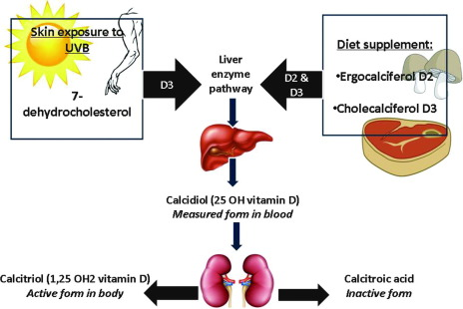
Vitamin D metabolism
Source: https://www.sciencedirect.com/science/article/pii/S209012321400023X

Slide 7
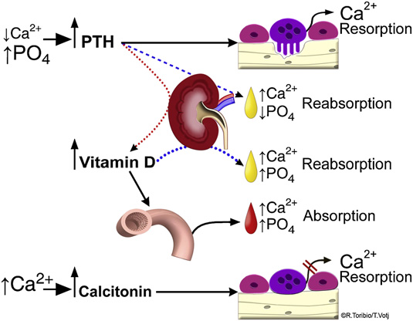

Slide 8
Vitamin D functions
Regulation of Calcium and Phosphorus blood level
  Low levels of Ca are sensed by the Parathyroid gland resulting parathyroid hormone (PTH) release
  PTH causes the kideny to increase vitamin D active form conversion
  Vitamin D increases calcium absorption by increasing calbindin protein synthesis and localization at the intestinal mucosa membrane
  Increase kindey calcium reabsorption and P excretion
  Osteoclasts release of calcium from the bones

Slide 9
Vitamin D function
Increases the expression of protein channel in the intestine that allows increased calcium absorption
Other functions not fully understood
  Important immune function
  Muscle function
  Cell differentiation

Slide 10
Vitamin D deficiency and toxicity
Deficiency
  Rickets in children
  Osteomalacia (soft bones) in adults
  Muscle spasms and weakness in adults
Toxicity
  Calcification of soft tissue
  Increase fractures (above calcium absorption results in increased calcium excretion and reduced calcium levels in blood and bone resorption.

