Slide 1
Ch 6: Quantum Harmonic Oscillator

Slide 2
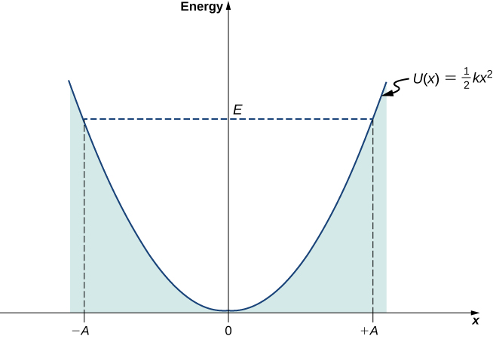
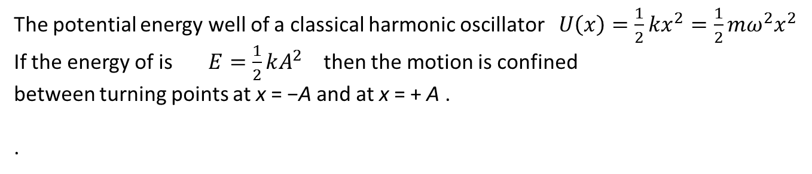
The potential energy well of a classical harmonic oscillator $U\left(x\right)=\frac{1}{2}kx^{2}=\frac{1}{2}mω^{2}x^{2}$
If the energy of is $E=\frac{1}{2}kA^{2}$ then the motion is confined between turning points at x = −A and at x = + A .
.

Slide 3
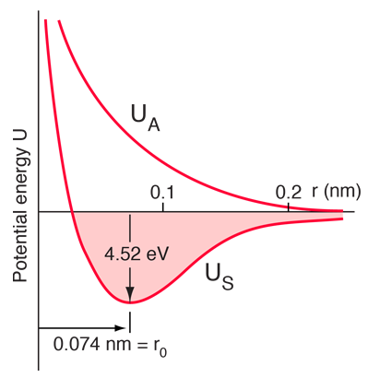
U(r) for the H₂ molecule as a function of the distance r between the centers (nuclei) of the two atoms

Slide 4
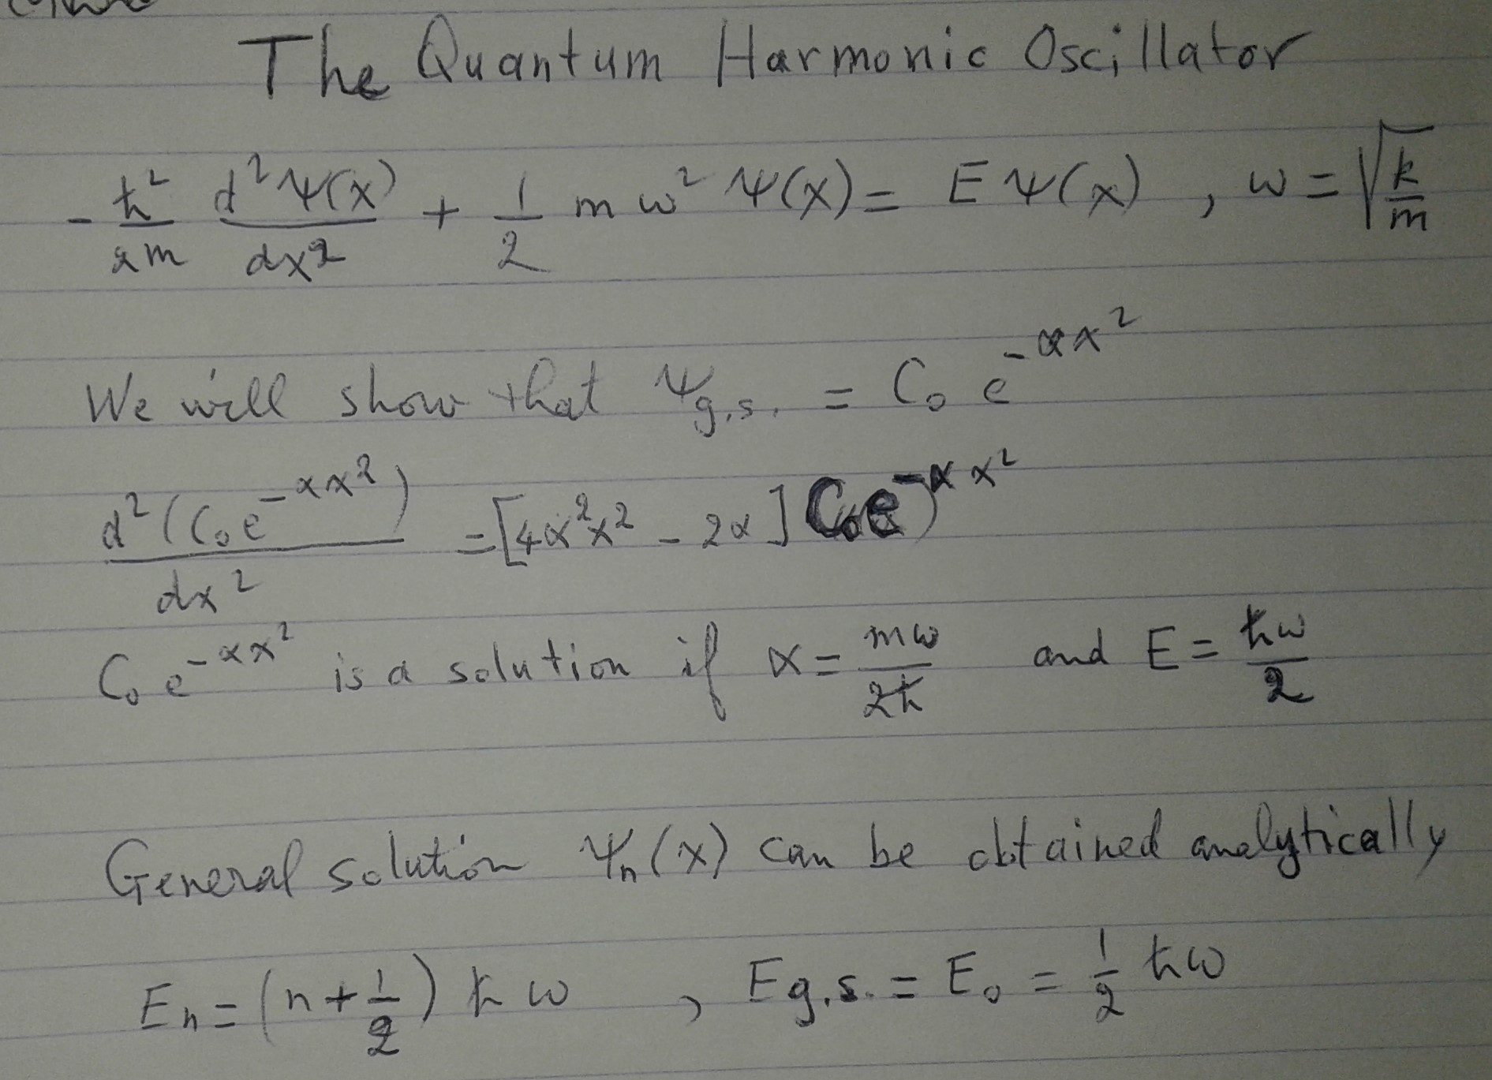

Slide 5
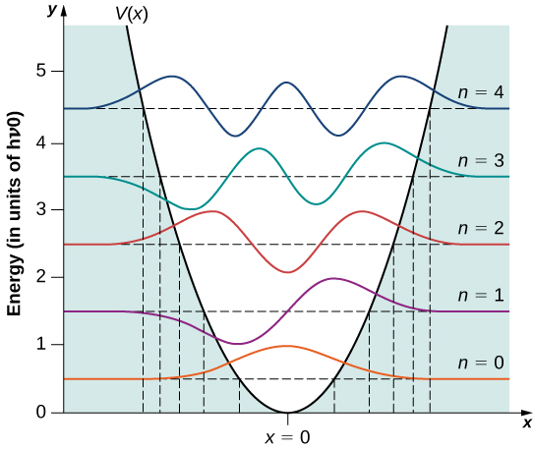
The first five wave functions of the quantum harmonic oscillator.
The classical limits of the oscillator’s motion are indicated by vertical lines,

Slide 6
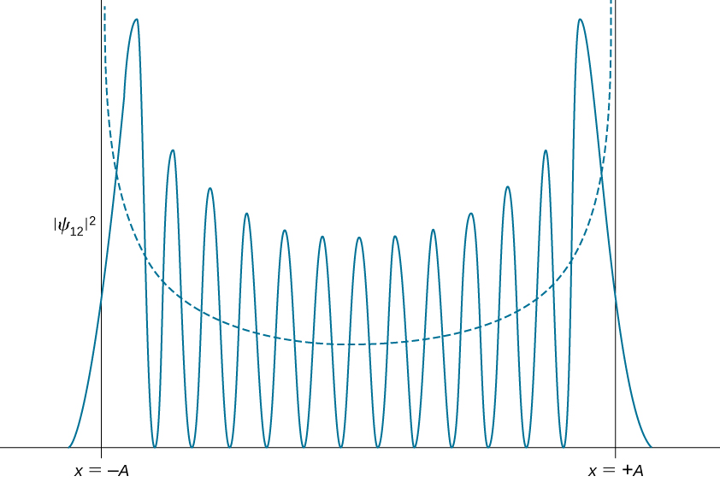
The probability density distribution for the quantum harmonic oscillator in its n = 12 quantum state. The dashed curve shows the probability density distribution of a classical oscillator with the same energy.

Slide 7
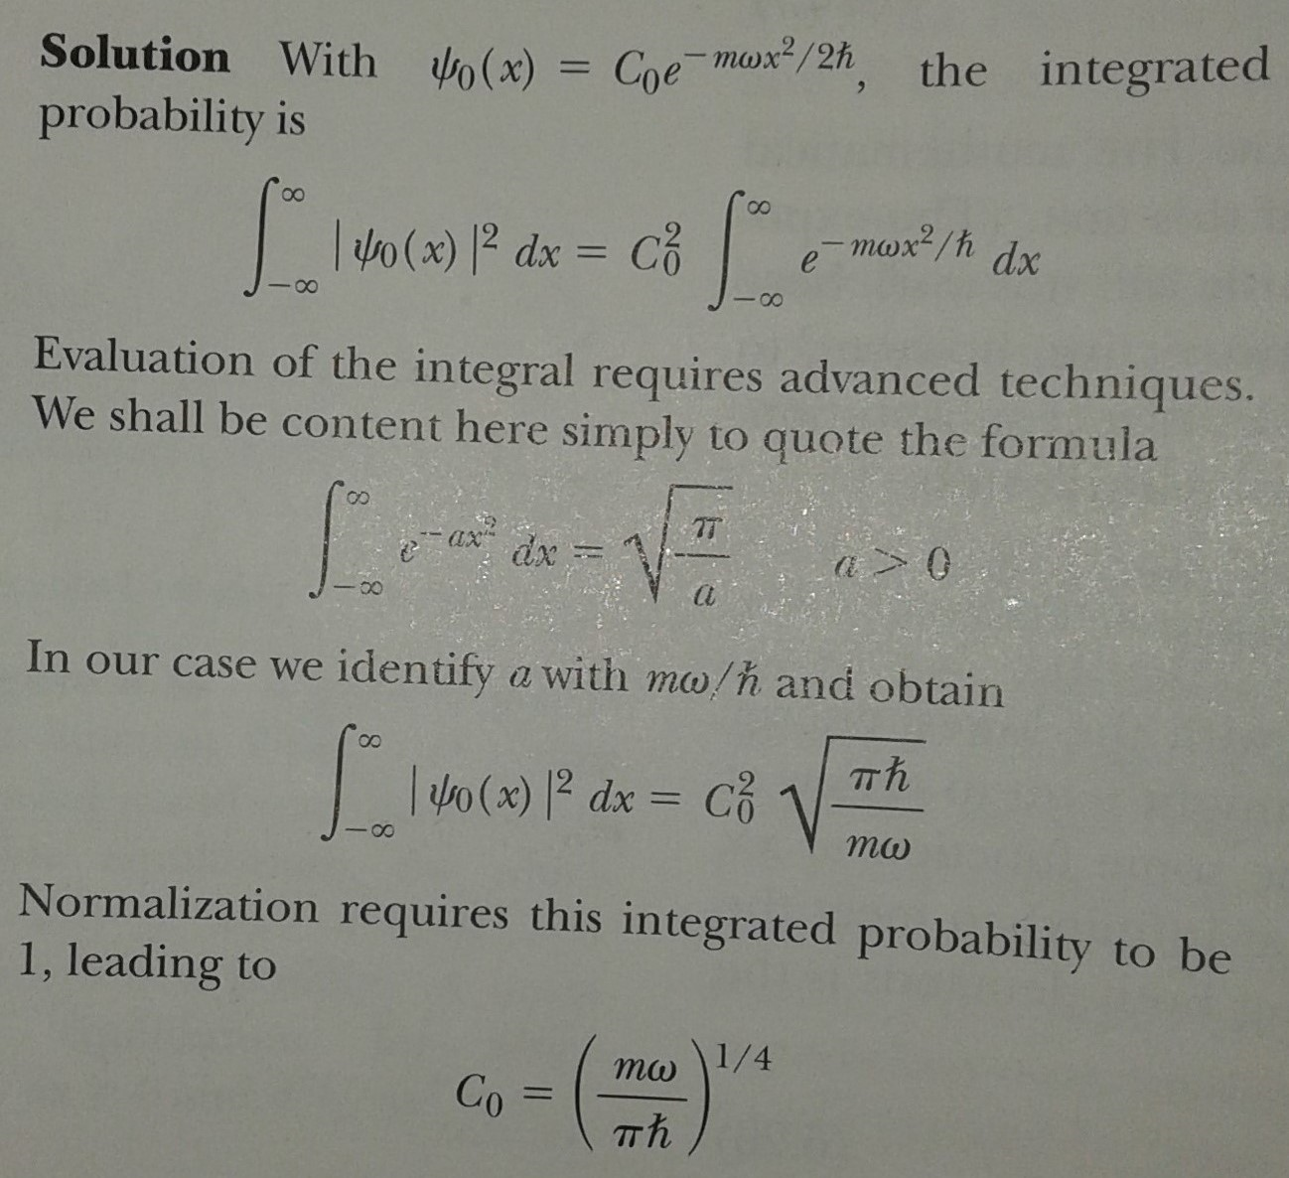
Example 6.10
Normalize the wavefunction for the ground state of the Harmonic Oscillator

Slide 8
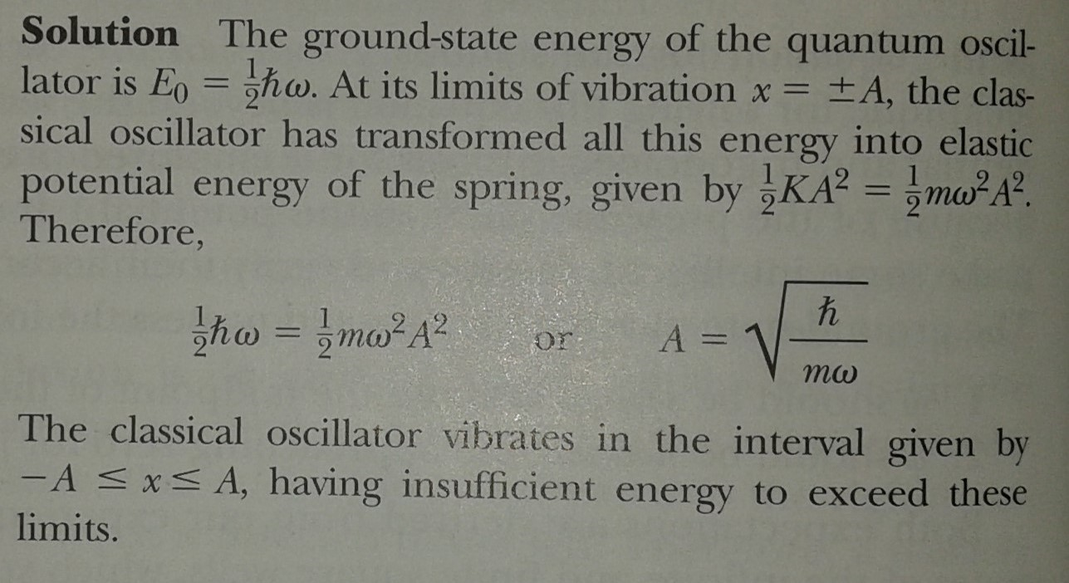

Turning points for a classical oscillator with
$$E=E_{0}=\frac{1}{2}ħω$$

Slide 9
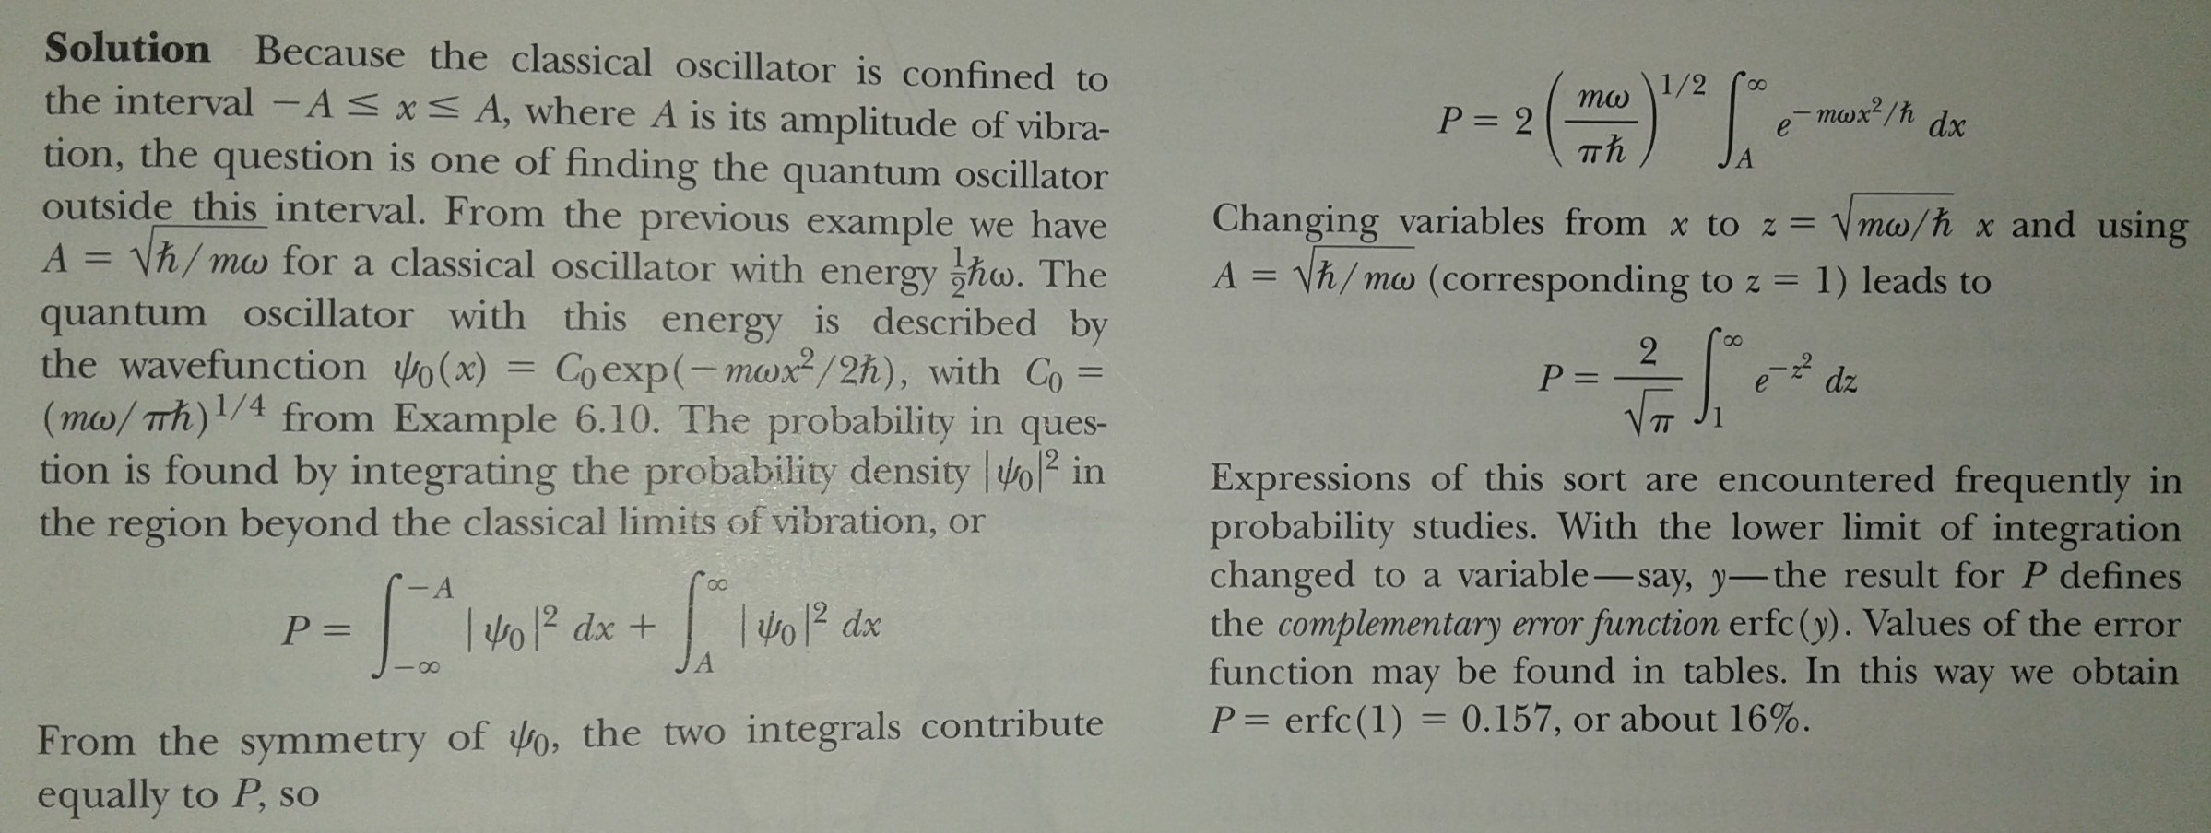
Ex 6.12: Probability that a quantum oscillator in its ground state is outside the classical region

