Slide 1
Percentage, Ratio Strength and, other Expressions of Concentration
Chap 6

Slide 2

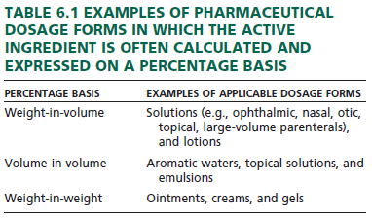

Slide 3
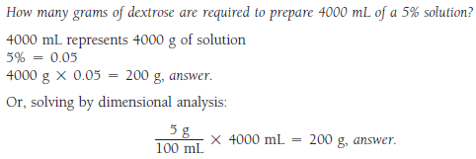

Slide 4
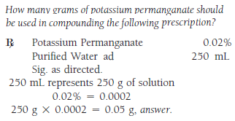

Slide 5


Slide 6



Slide 7
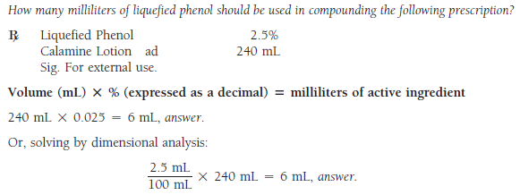

Slide 8

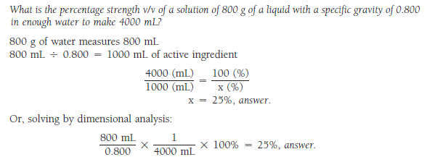

Slide 9

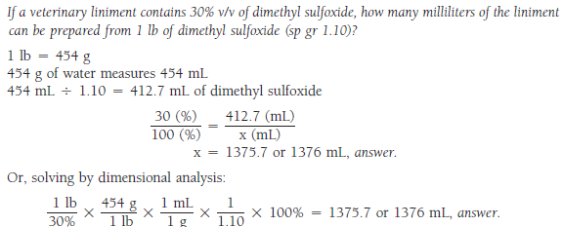

Slide 10



Slide 11

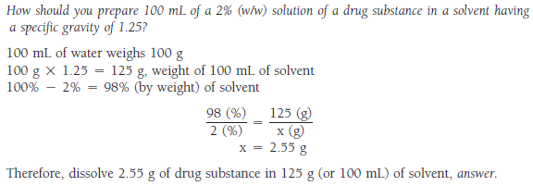

Slide 12
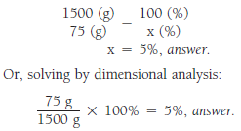


Slide 13



Slide 14



Slide 15
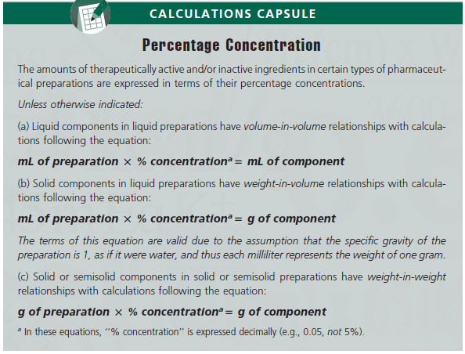

Slide 16
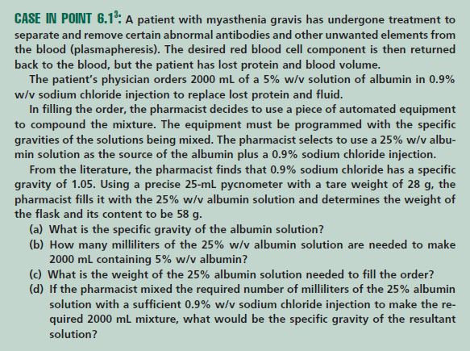

Slide 17
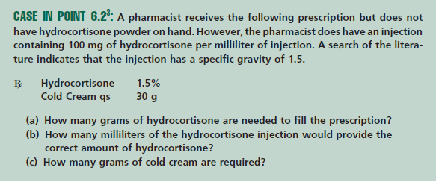

Slide 18
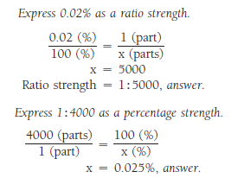



Slide 19



Slide 20


Slide 21
An ointment contains 1% w/w calamine. Which of the following is the amount of calamine powder that should be added to 200 g of the ointment to produce a 4% w/w calamine ointment? (6.250 g)

