Slide 1
Vitamin A

Slide 2
Vitamin A deficiency is one that is common in low income countries
Vitamin A can come from Animal and plant sources
Retinol in animal linked to fatty acids as retinyl esters
Provitamin A carotenoids or beta carotene in plants
In the small intestine beta carotene is converted to retinol

Slide 3
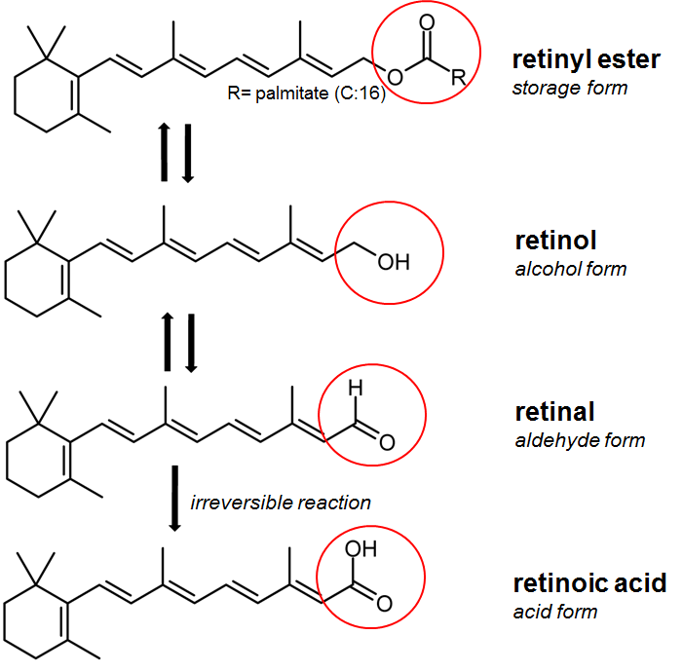
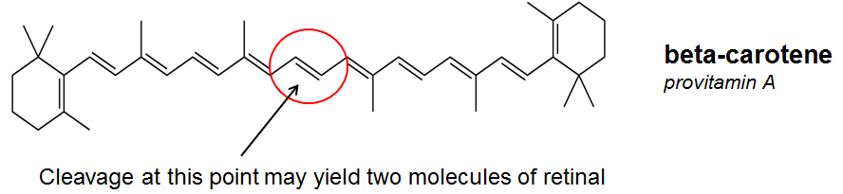
Vitamin A and structures
Vitamin A (animal)
Retinyl ester
Retinoic acids
Retinal
Retinol
Beta carotene (plant)
Provitamin A carotenoids and most common vitamin A in our food
Notes:
Retinol is the major form of vitamin A
Retinyl ester is the storage form as it is the most stable
The body can convert retinal to retinol and vice versa but the conversion of retinal to retinoic acid is irreversible. The reason that vitamin A is found in different forms such as retinal, retinol, retinoic acid is that each can perform a specific task and needed for a specific fuction in the body that the other cannot perform.

Slide 4
Food sources and needs
Highest is liver
Fish oil, while milk and dairy, fortified cereals, egg yolk are good sources
Green leafy vergetable, carrots, apricots, canterloup, broccli, squash, are good sources too
The most biactive form of vitamin A is retinol,
To achieve 1 mcg of retinol you need to absorb its equivalency in other forms.
12 mcg beta carotene from food
24 mcg Provitamin A from food
2 mcg of beta carotene from supplement equals 1 mcy of retinol

Slide 5
Vitamin A needs
RDA in mcg RAE (retinol activity equivilant)
1 to 3 yres 300
4 to 8 yrs 400
9 to 13 yrs old 600
14 to 51 yrs old 900 (males) and 700 (females)
Prgnany770
Lacation 1300
UL
2800 for women,3000 for men (19 years and above)
3000 for pregnancy and lactation

Slide 6
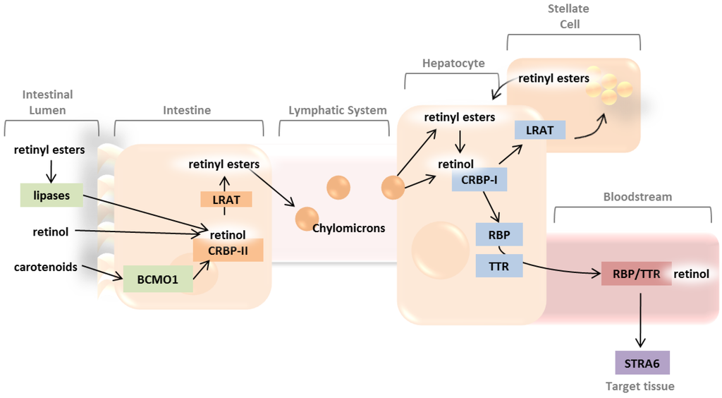
Vitamin A metablism
Source: http://www.mdpi.com/2072-6643/5/7/2646/htm
Notes:
Retinol is conusmed in food bound fat

Slide 7
Functions
Vision (retinal)
11 cis retinal is found in the vision pigments bound to OPSIN protein of photoreceptor cells in the retina of the eye
Once light hits 11 cis retinal, it is converted to 11 trans retinal leaving OPSIN protein. The is process is called leaching and stimulate several nerve impulses to the brain vision center resulting in vision
11 trans retinal is further converted to 11 cis retinal swiftly to bind to again to OPSIN and ready for another cycle

Slide 8
Vitamin A functions
Reproduction and growth (retinol)
Vitamin A helps is integral for the development of sperm, fetus
Children deficient in vitamin A don’t grow properly
Important for bone development
Immune system development
Red blood cells development

Slide 9
Vitamin A functions
Synthesis and cell differentiation
Retinoic Acid acts as a hormone to affect gene regulation responsible for cell differentiation and maintenance of the structure and function of several organs such as
lungs, trachea, skin, gastrointestinal tract, blood vessel walls, and the cornea.

Slide 10
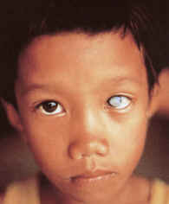
Vitamin A deficiency
The most preventable cause of childhood blindness
In 2012 the WHO reported 250 million preschool children suffering from Vitamin A deficiency
670000 death of children under 5 yrs old
It affects infants, children, pregnant and lactating women
The first sign of vitamin A deficiency is night vision adaptation.
If left untreated leads to
xeropthalmia (see image)

Slide 11
Vitamin A deficiency
Other diseases that affect the liver (vitamin A metabolism) or the GI tract (absorption takes place) can affect vitamin A status and leads to deficiency
Can you name some of these conditions?

Slide 12
Vitamin A toxicity
In a single dose of 300 mg acute toxicity can happen
Vomiting, nausea, headache followed by diarrhea, itching, skin exfoliation if not teated leads to death
Chronic toxicity can take place if taking 7500 to 9000 mcg of vitamin for a long time
Causes liver enlargement, loss of appetite, and decalcification of bones

Slide 13
Vitamin A toxicity
Excessive vitamin A consumption can lead to death of spinal cord cells in the fetus
Avoiding vitamin A supplements and rich sources such as liver is important before 7th week of pregnancy
Use of acne treatment whether ingest or topical can lead to toxicity if combined with vitamin A supplementation and food sources
Carotenoids don’t lead to toxicity due to low conversion rate to retinol
Leads to cartonemia, coloring of the skin which disappears once beta carotene sources is stopped for a while
Look for cartonemia picture

