Slide 1
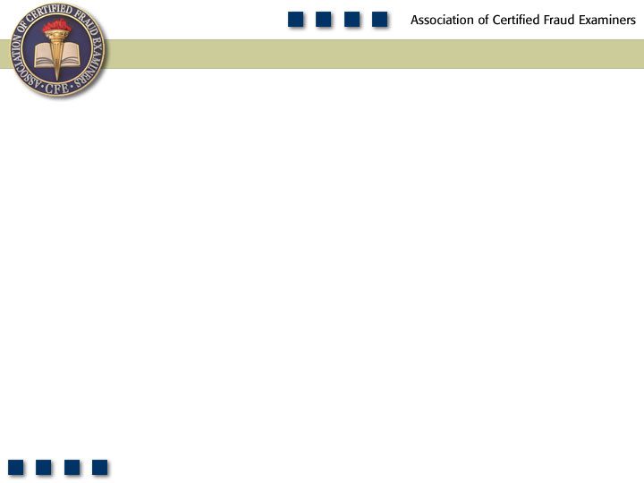
Chapter 3
Cash Larceny

Slide 2

Pop Quiz
What is the difference between larceny and skimming?

Slide 3
Learning Objectives
Define cash larceny.
Understand how cash receipts schemes differ from fraudulent disbursements.
Recognize the difference between cash larceny and skimming.
Understand the relative frequency and cost of cash larceny schemes as opposed to other forms of cash misappropriations.
Identify weaknesses in internal controls as inducing factors to cash larceny schemes.
Understand how cash larceny is committed at the point of sale.

Slide 4
Learning Objectives
Discuss measures that can be used to prevent and detect cash larceny at the point of sale.
Understand and identify various methods used by fraudsters to conceal cash larceny of receivables.
Understand schemes involving cash larceny from deposits including lapping and deposits in transit.
Understand controls and procedures that can be used to prevent and detect cash larceny from bank deposits.
Be familiar with proactive audit tests that can be used to detect cash larceny schemes.

Slide 5
Larceny
Of Cash on
Hand
From the
Deposit
Other

Slide 6
Cash Larceny
Intentional taking away of an employer’s cash without the consent and against the will of the employer
Fraudulent disbursements
Cash receipt schemes

Slide 7
Frequency – Cash Misappropriations

Slide 8
Median Loss – Cash Misappropriations

Slide 9
Cash Larceny Schemes
Can occur under any circumstance in which an employee has access to cash
  At the point of sale
  From incoming receivables
  From the victim organization’s bank deposits

Slide 10
Larceny at The Point of Sale
It’s where the money is
Most common point of access to ready cash
Results in an imbalance between the register tape and cash drawer

Slide 11
Larceny Schemes
Theft from other registers
  Using another cashier’s register or access code
Death by a thousand cuts
  Stealing small amounts over an extended period of time
Reversing transactions
  Using false voids or refunds
  Causes the cash register tape to balance to the cash drawer
Altering cash counts or cash register tapes
Destroying register tapes

Slide 12
Preventing and Detecting Cash Larceny at the Point of Sale
Enforce separation of duties
Independent checks over the receipting and recording of incoming cash
Upon reconciliation of cash and register tape, cash should go directly to the cashier’s office
Discrepancies should be checked, especially if a pattern is identified
Periodically run reports showing discounts, returns, adjustments, and write-offs by employee, department, and location to identify unusual patterns

Slide 13
Larceny of Receivables
Theft occurs after the payment has been recorded
Force balancing
  Having total control of the accounting system can overcome the problem of out-of-balance accounts
  Can make unsupported entries in the books to produce a fictitious balance between receipts and ledgers
Reversing entries
  Post the payment and then reverse the entry through “discounts”
Destruction of records
  Destroying the records can conceal the identity of the perpetrator even though the fraud has been discovered

Slide 14
Cash Larceny From The Deposit
Whoever takes the deposit to the bank has an opportunity to steal a portion of it
Having controls—such as matching the receipted deposit slip to the originally prepared slip—does not always prevent theft
Failure to reconcile the slips can foster an environment leading to theft
Lack of security over the deposit before it goes to the bank can also lead to theft

Slide 15
Cash Larceny From The Deposit
Deposit lapping
  Day one’s deposit is stolen and is replaced by day two’s deposit . . . .
Deposits in transit
  The missing money is carried as a deposit in transit but it never clears the bank statement

Slide 16
Preventing and Detecting
Cash Larceny From The Deposit
Separation of duties is the most important factor
All incoming revenues should be delivered to a centralized department
Compare the authenticated deposit slip with the company’s copy of the deposit slip, the remittance list, and the general ledger posting of the day’s receipts
Two copies of the bank statement should be delivered to different persons in the organization
Require that deposits be made at a night drop at the bank

