Slide 1
Concussion
Amal Abu Kteish
aabukteish@birzeit.edu

Slide 2
Epidemiology of sport concussion
The temperatures in their helmets get up to about 120 degrees and at such temperature the pad loses almost all of its protection.

Slide 3
Concussion definition
An injury to the brain that results in temporary loss of normal brain function.
A concussion is a type of traumatic brain injury-or TBI- caused by a bump, blow to the head or by a hit to the body that causes the head and brain to move rapidly back and forth.

Slide 4
Concussion statistics
TBI contributed to the deaths of nearly 50,000 people.
In 2013, falls were the leading cause of TBI. Falls accounted for 47% of all TBI-related ED visits, hospitalizations, and deaths in the united states.
Rates were highest for persons 75 years of age and older.

Slide 5
Sports and concussion
Approximately 2.8 million TBI-related ED visits, hospitalizations, and deaths occurred in the US in 2013.
5-10% of athletes will experience a concussion in any given sport season.
Fewer than 10% of sport related concussions involve a loss of Consciousness
Football is the most common sport with concussion risk for male (75% chance for concussion0
Soccer is the most common sport with concussion risk for females (50% chance for concussion).
78% of concussion occur during games.

Slide 6
Structural vs metabolic
Concussions usually do not involve structural injuries
Often, no “visible” structural injuries are apparent, even using sophisticated imaging techniques
Metabolic injuries can involve the complex pathways involved in neuronal metabolism and have widespread effects

Slide 7
Concussion (metabolic)
Changes in glucose metabolism
Requires increased oxygen
Altered cerebral blood flow
Impaired axonal function

Slide 8
Cerebral hemorrhaging
If the head impact is severe enough, cerebral hemorrhaging can occur
Symptoms can vary based on location of bleeding

Slide 9
2nd Impact Syndrome
A 2nd concussion is sustained prior to full recovery of initial concussion.
Can occur within same activity/game, day, week, etc.
Increased swelling and exacerbated neurological symptoms arise.
Can result in unconsciousness, respiratory failure, and death.

Slide 10
Chronic Traumatic Encephalopathy (CTE)
Chronic Traumatic Encephalopathy (CTE) is a progressive degenerative disease of the brain found in people with a history of repetitive brain trauma.
Include symptomatic concussions as well as asymptomatic sub-concussive hits to the head that do not cause symptoms.
The repeated brain trauma triggers progressive degeneration of the brain tissue, including the build-up of an abnormal protein called tau
Common symptoms of CTE include memory loss, confusion, impaired judgment, impulse control problems, aggression, depression, suicidality, parkinsonism, and eventually progressive dementia.

Slide 11
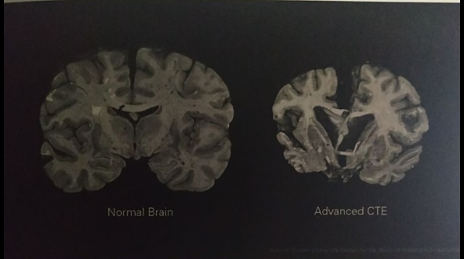

Slide 12
Elevated tau Levels Predict Recovery Time
Elevated plasma Tau levels within 6 hours post concussion put the patient at increased risk of prolonged recovery.
Tau can be a biomarker for those who will take longer (>10 days) to recover from a concussion.

Slide 13
Concussion related symptoms may include:
Dizziness: increased within movement, it is reported in 23-81% of cases in the first days post injury, with as high as a 32% prevalence after 5 years.
Oscillopsia: reading difficulty or blurred vision with active head movement- typically direction and frequency specific.
Imbalance: correlated with dysfunction in sensory integration

