Slide 1
Overweight and obesity

Slide 2
Overweight and obesity
Overweight and obesity are very common conditions in developed societies, and are becoming more common in developing countries

Slide 3
Definitions and measurements
Obesity: Fat stores are excessive for an individual’s height, weight, gender, and race to an extent that produces adverse health outcomes.
Obesity usually identified by body mass index (BMI)
Remember BMI is derived by dividing weight in kilograms by height in meters squared (kg/ m2)
BMI between 25 and 29.9kg/m² overweight
BMI greater than 30kg/m² are categorized as obese
BMI cut-offs were based on mainly American epidemiological studies
For some ethnic groups, BMI cut off may differ

Slide 4
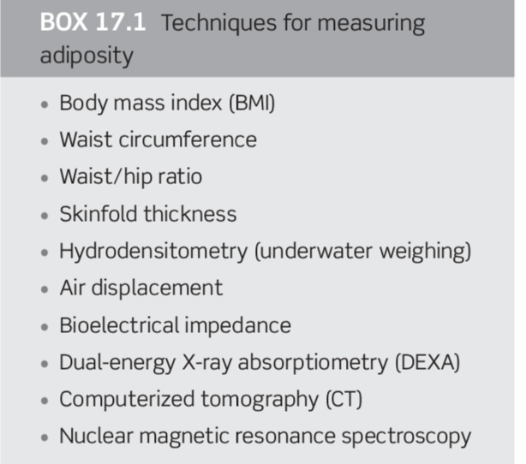

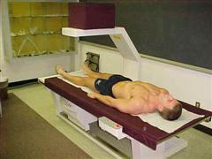
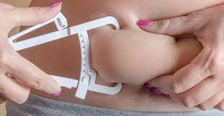
Other Techniques for measuring adiposity
Body density is the difference between the dry weight and the underwater weight when the body is completely submerged.
a person with more body fat will weigh less underwater because fat is less dense than lean body mass
Dual x-ray absorptiometry (DEXA)- The body is scanned by 2 X-ray beams

Slide 5
The site of the increased fat tissue is important in identifying individuals at increased risk of obesity- related disease.
Excess abdominal (visceral) adipose tissue is associated with risk of cardiovascular disease and metabolic disorders such as diabetes, dyslipidemia, and the metabolic syndrome
measuring waist circumference provides is used to measure abdominal fat
Measurements >102 cm in Men
Measurement >88 cm in Women
Greatly increased risk of metabolic disease

Slide 6
Prevalence
Obesity prevalence has been increasing steadily in most countries over the past few decades.
In the developed world, prevalence is greater amongst lower socioeconomic groups
According to the WHO
“Worldwide obesity has nearly tripled since 1975”
“ 39% of adults aged 18 years and over were overweight in 2016, and 13% were obese”
“38 million children under the age of 5 were overweight or obese in 2019”
“Most of the world's population live in countries where overweight and obesity kills more people than underweight”
“Obesity is preventable”
https://www.who.int/news-room/fact-sheets/detail/obesity-and-overweight

Slide 7
Genetics of obesity
Genetics play a role in obesity
Adoption, twin, and family studies indicate that adiposity is highly heritable.
However, families share environments as well as genes and the estimated genetic and shared environment contribution to BMI ranges between 60% and 84%
Many genes are involved in body weight regulation
Only a few single gene mutations that cause obesity have been discovered.
These findings suggest an important role for genetics in determining a person’s susceptibility to obesity

Slide 8
Gene-Environment Interaction
epigenetics—the influence of environmental factors, such as diet and physical activity, on gene expression has a stronger effect than one single gene polymorphism on obesity
For instance: even identical twins with identical genes become different over the years as epigenetic changes accumulate ( our lifestyle can influence gene expression)!
Genes can influence eating behaviors AND food and activity behaviors influence the genes that regulate body weight

Slide 9
Adipose tissue
Mass for energy storage
+ an endocrine organ: releasing hormones and cytokines (signaling molecules , play a role in inflammation) that influence the body’s energy, and immune system ,nervous system
Hormones released by adipose tissues influence satiety ( feeling of fullness) and energy balance

Slide 10
Hormones involved appetite control, energy regulation, and obesity development
Leptin
a polypeptide protein produced by adipocytes( fat cells) and secreted in direct proportion to adipose tissue mass and the individual’s nutritional status
Leptin levels are high in obese individuals and low in lean people,
Leptin maintains homeostasis by regulating food intake and energy expenditure
When body fat increases, leptin increases—which suppresses appetite. When body fat decreases, leptin decreases—which stimulates appetite and suppresses energy expenditure

Slide 11
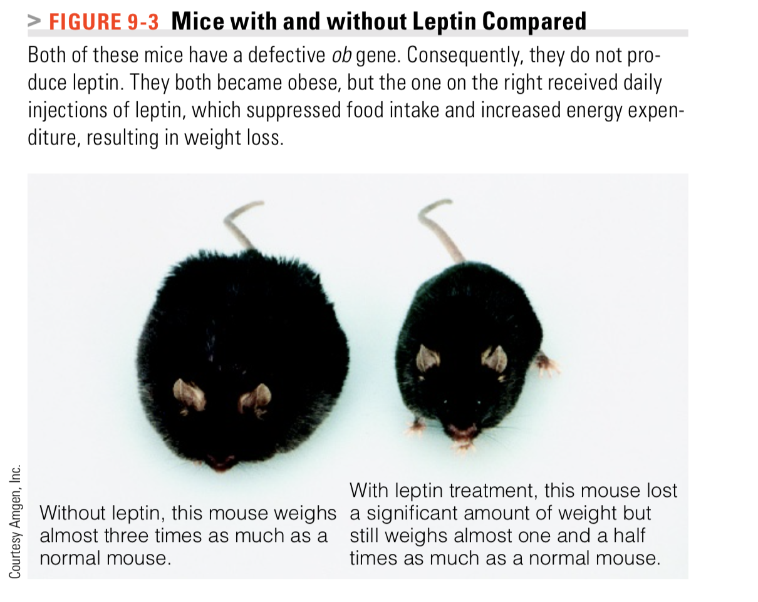
Leptin deficiency is rare humans
But leptin resistance occurs- Leptin rises but fails to suppress appetite or enhance energy expenditure
With weight loss- leptin decreases, making the maintenance of weight loss difficult

Slide 12
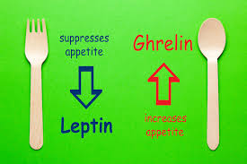

Ghrelin
Ghrelin is secreted mainly by the stomach cells and promotes eating and weight gain - stimulating appetite and energy storage
Blood levels of ghrelin typically rise before a meal
Ghrelin levels fall after a meal
Ghrelin triggers the desire to eat
Ghrelin levels are high whenever the body is in negative energy balance ( low kcal diets and difficulty to maintain weight loss?)
A person’s mindset also influences ghrelin’s response to a meal ( The two milkshakes experiment)
Notes:
Ghrelin’s rise in anticipation of drinking the indulgent milkshake and its decline afterward was much steeper than for the sensible milkshake. In reality, though, the two milk- shakes were identical (380 calories). Not only was the ghrelin response different, but the participants’ satiety differed

Slide 13
Adiponectin
A polypeptide hormone secreted by adipocytes ( fat cells)
Adiponectin is inversely associated with adipose tissue mass
In obese, levels of adiponectin are reduced
Weight loss and improvement in insulin sensitivity are associated with increasing levels of adiponectin
Adiponectin works by
Improving cells sensitivity to insulin
Reducing inflammation
Deceasing production of glucose in the liver ( gluconeogenesis)

Slide 14
Environmental and lifestyle factors
Studies show that environmental factors overpower genetic effects
Example: Two groups of Pima Indians:
Group 1: living in reservations in Arizona , USA
little physical activity and consume energy-dense food
high rates of obesity and comorbidities.
Group 2 : Pima Indians living in Mexico mountains have low rates of obesity and associated diseases
Transition from traditional to more Western ways of life (increased food energy density and a sedentary lifestyle)

Slide 15
Food intake
A high intake of energy-dense foods (not a good source of micro nutrients )
Energy-dense foods are high in fat, sugar, and starches
may be more easily overconsumed than other foods
May disrupt satiety signals
High intakes of sugars, sweetened soft drinks, and fruit juices
Environment plays a role on what we eat:
Heavy marketing of energy dense foods vs. home and school environment that supports healthy food choices
Energy dense foods are cheaper and have a longer shelf life

Slide 16
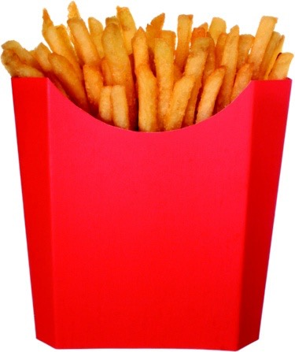
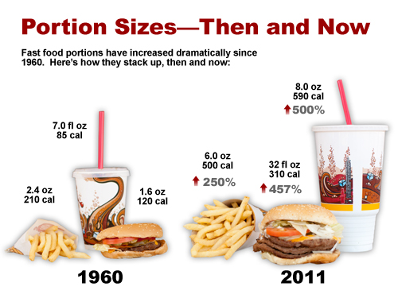
Eating large portion sizes multiple times a day accounts for much of the weight increase seen over the decades
COMBO meals for a good price
Portion sizes of virtually all foods and beverages have increased in the past several decades, especially at fast-food restaurants
Portion sizes are now two to eight times larger than standard serving sizes
“Want fries with that?” A supersize portion delivers more than 600 calories.
https://sites.psu.edu/kgotwalt/2016/03/27/choosing-the-right-portion-sizes/

Slide 17
Reducing portions
Reducing calories by consuming less energy dense foods
Low-energy-dense foods such as fruits and vegetables

Slide 18
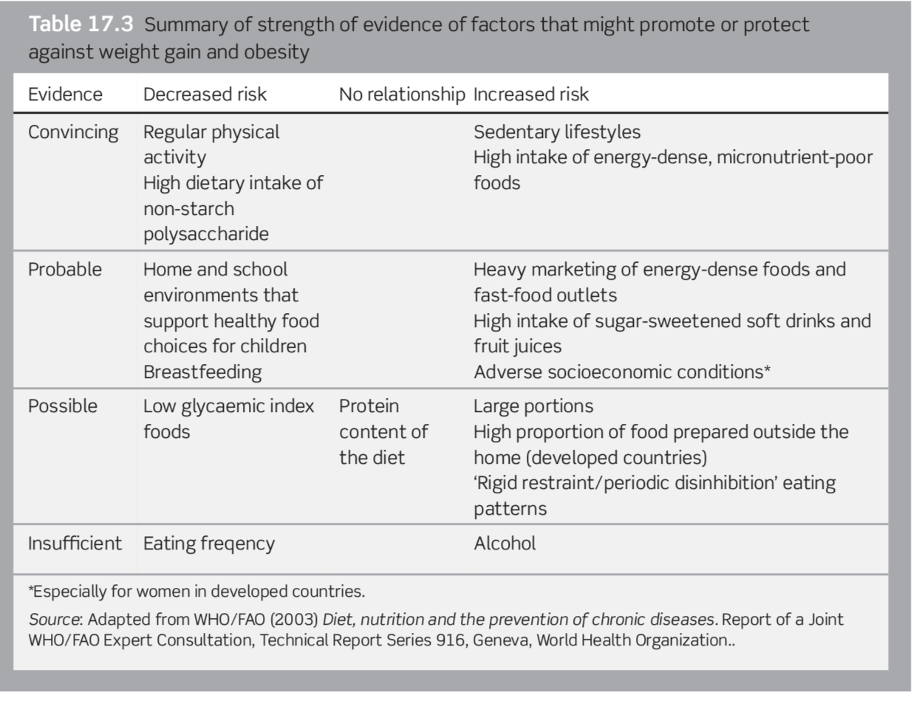

Slide 19
Physical inactivity
Today’s environment promotes little physical activity
Escalators instead of climbing stairs
Cars
remote controls
Office work
People spend more time doing sedentary activities such as watching television, playing video games, and using the computer
watching television influences food purchases and often includes snacking on high-calorie, solid fat and added sugars foods and beverages

Slide 20
Physical activity
To prevent weight gain
DRI suggests an accumulation of 60 minutes of moderately intense physical activities every day in addition to the less intense activities of daily living
To lose weight
You will need a high amount of physical activity unless you also adjust your diet and reduce the amount of calories you’re eating and drinking

Slide 21
Other factors
Endocrine conditions (hypothyroidism, Cushing’s Syndrome (excess cortisol production)
Type 2 diabetes mellitus
Pregnancy
Cessation of smoking
Some medication
Notes:
low thyroid hormone levels were associated with low energy metabolism

Slide 22
Clinical consequences of obesity
With a BMI >30 kg/m², total mortality rates are approximately two times greater than for those with a BMI in the healthy range
Metabolic complications of obesity that are associated with increased visceral fat, even if the BMI is within the desirable range
These include : Insulin resistance
Impaired glucose tolerance and type 2 diabetes
Dyslipidemia – Increased VLDL, triglyceride, increased LDL cholesterol – Reduced HDL cholesterol

Slide 23
Consequences of obesity
Cardiovascular consequences
Metabolic and other abnormalities associated with visceral fat
Obesity-associated cancer
Tumors that are hormone-dependent given the hormonal function of adipose tissue
Obstructive sleep apnea
Social consequences : low self-esteem, reduced quality of life, bullying , discrimination

Slide 24
Treatment
Lifestyle changes that have to be maintained long term
There are two phases of therapy, active weight loss and weight maintenance.
Set achievable goals for each individual
Even a modest weight loss (of the order of 5–10% of original weight) results in clinically important benefits
An ‘eating plan’ rather than a ‘diet’ is recommended. Eating plans should be realistic and designed so that they can be sustained in the long- term.

Slide 25
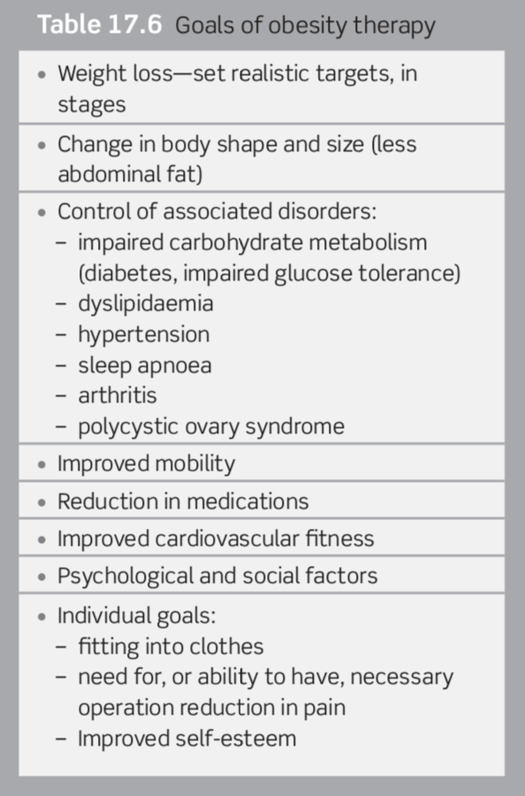

Slide 26
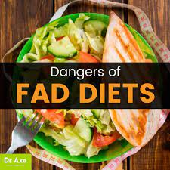
Fad diets: Advertised as best and fastest approach to losing weight
often sound good, but they typically fall short of delivering on their promises
May eliminate foods that contain necessary nutrients that your body needs to maintain good health

Slide 27
Treatment
Evaluate the patient’s understanding of: Causes of Obesity; Complications of Obesity; Patient motivation
A comprehensive lifestyle approach that includes low- calorie, nutrient-dense foods and regular physical activity supports both weight loss and health benefits.
No single food plan is magical, and no specific food must be included or avoided in a weight-management program.

Slide 28
Treatment
Diet therapy: Calorie restricted diet ( decreased energy intake):
What matters with weight loss is the amount of Calories consumed; Diet should be based on the general diet recommendations:
CHO ≥ 55%
≤ 30% from fat
Protein about 15 %
Increase physical activity in order to spend more Calories.
Behavioral therapy: lifestyle (therapy or modification)
A reasonable suggestion for overweight and obese adults is to increase activity and reduce food intake enough to create a deficit of 500 to 750 calories per day

Slide 29
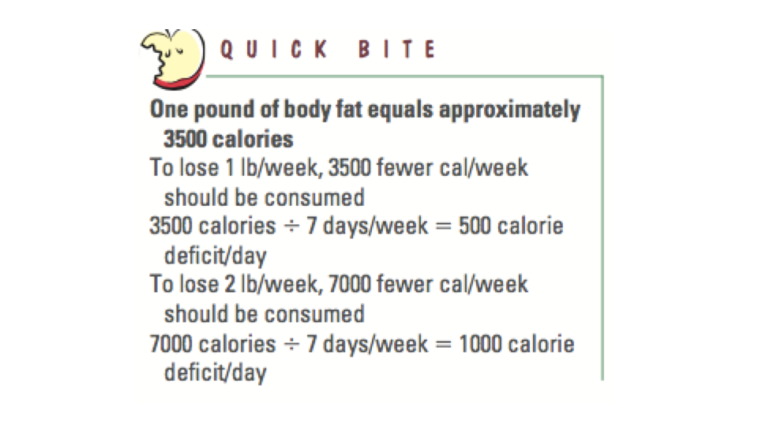

Slide 30
Macronutrient Composition
Low-carbohydrate diets severely limit fruit, vegetables, and whole grains, and may be deficient in micronutrients and fiber. The long- term effects of a low-carbohydrate diet are unknown
High protein: Promotes short-term weight loss; protein increases satiety:
leaving people feeling fuller and better able to adhere to a low calorie intake, which causes weight loss

Slide 31
The Practical Guide recommends weight loss diets to be com- posed of 55% or greater of total calories from carbohydrate, 30% or lesser of total calories from fat, and approximately 15% from protein, which could be achieved by following MyPyramid intake patterns
Diets should be individualized!

Slide 32
Diets that are severely restricted in a given macronutrient or food group may be:
Lacking in certain vitamins, minerals, fiber, or phytonutrients, increasing the risk of nutrient inadequacies or deficiencies
Restrictive eating may create stress or foster unhealthy behaviors of eating disorders
Nutrition Education
Eat smaller portions at meals and snacks. Choose healthy fat—in moderation Use cooking techniques that do not add additional calories • Modify recipes to lower the calorie content. Read “Nutrition Facts” Choose nutrient-dense foods to lower calorie density

Slide 33
Behavior Modification
Self-monitoring
Goal setting
Specific calorie, fat gram, and physical activity goals designed to achieve a -1- to 2-pound weight loss per week!
Understanding eating behaviors and working to improve them
Stimulus control
Restructuring the environment to avoid or change cues that trigger undesirable behaviors
Keeping “problem” foods out of sight or out of the house)
Instituting new cues to elicit positive behaviors (e.g., putting walking shoes by the front door as a reminder to go walking)
Problem solving
Relapse Prevention
Teaching clients how to prevent relapses

Slide 34
Pharmacotherapy/ Drugs
Much research effort has focused on drug treatments for obesity.
Weight-loss drugs should be prescribed only to those with medical risks—not for cosmetic reasons
When used as part of a long-term, comprehensive weight-loss program, drugs can help with modest weight loss
BUT with long term use side effects and risks
With short term use, weight gain is usually experienced once the patient discontinues the drug

Slide 35
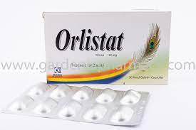
Pharmacotherapy/ Drugs
Orlistat : An intestinal lipase inhibitor , reduces fat absorption
Associated with reductions in cholesterol, falls in blood pressure, and serum triglycerides, and improvement of insulin sensitivity.
Side effects:
Diarrhea
Bloating
Abdominal pain

Slide 36
Pharmacotherapy/ Drugs
Phentermine/ diethylpropion
Enhances the release of the neurotransmitter norepinephrine, which suppresses appetite
Side effects: Increased blood pressure and heart rate, insomnia, nervousness, dizziness, headache

Slide 37
Pharmacotherapy/ Drugs
Other drugs work by Interacting with brain serotonin receptors to increase satiety and reduce food intake
Have many side effects

Slide 38
Surgery
Surgery may be an option for people with all of the following conditions:
Unable to achieve adequate weight loss with diet and exercise
BMI ≥40 or BMI ≥35 with weight-related health problems (such as diabetes or hypertension)
No medical or psychological contraindications
Understanding of risks and strong motivation to comply with post-surgery treatment plan

Slide 39
Surgery
Two common types of surgeries
Gastric bypass
Gastric banding
Both limit food intake by reducing the capacity of the stomach.
Results are significant: depending on the type of surgery, nearly 50 percent of the excess weight remains lost after 15 years.
Additionally , most people experience dramatic and lasting improvements in their diabetes, blood lipids, and blood pressure

Slide 40
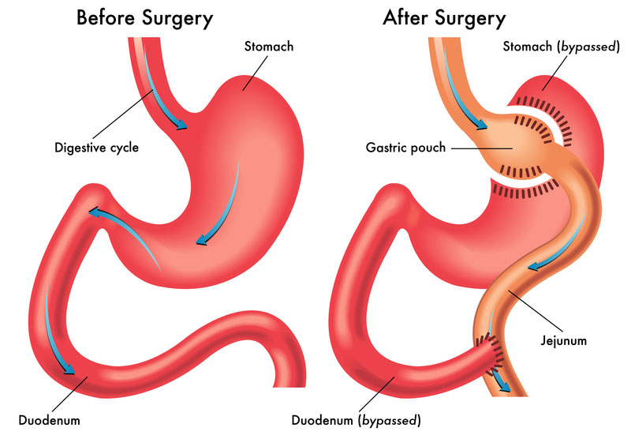
Surgery
changes to your stomach and small intestine to change the way they absorb and digest food
the surgeon constructs a small stomach pouch and creates an outlet directly to the small intestine, bypassing most of the stomach, the entire duodenum, and some of the jejunum.
Changes in production of gastrointestinal hormones
Suppression of hunger
Because food will bypass your stomach AND parts of the small intestines body does not absorb as many calories
http://surgery.ucla.edu/bariatrics-gastric-bypass

Slide 41
Surgery
Dumping syndrome
food gets “dumped” directly from your stomach pouch into your small intestine without being digested
Side effects: Abdominal cramps and diarrhea, sweating, weakness, rapid heart rate
Dietary Management of Dumping Syndrome ,Small frequent meals (SFM), Liquids between (instead of during meals) ,Limit simple sugars, Eat slowly, moderate fat intake.

Slide 42
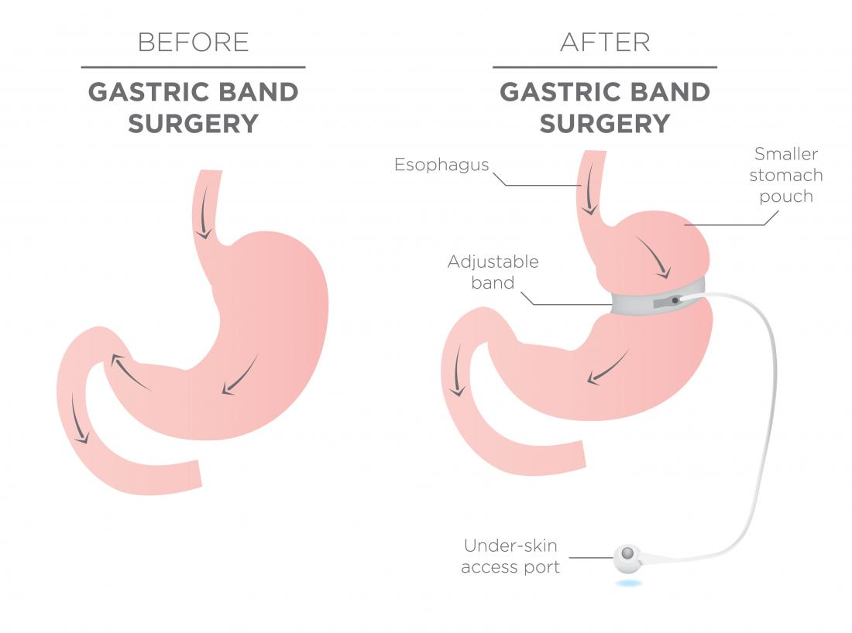
Surgery
Gastric banding
The surgeon uses a gastric band to create a small stomach pouch. The size of the opening can be adjusted by inflating or deflating the band by way of a port placed in the abdomen just beneath the skin.

Slide 43
Surgery
Other complications:
Vitamin deficiencies
For example, Anemia from low iron absorption , B-12 deficiency

