Slide 1
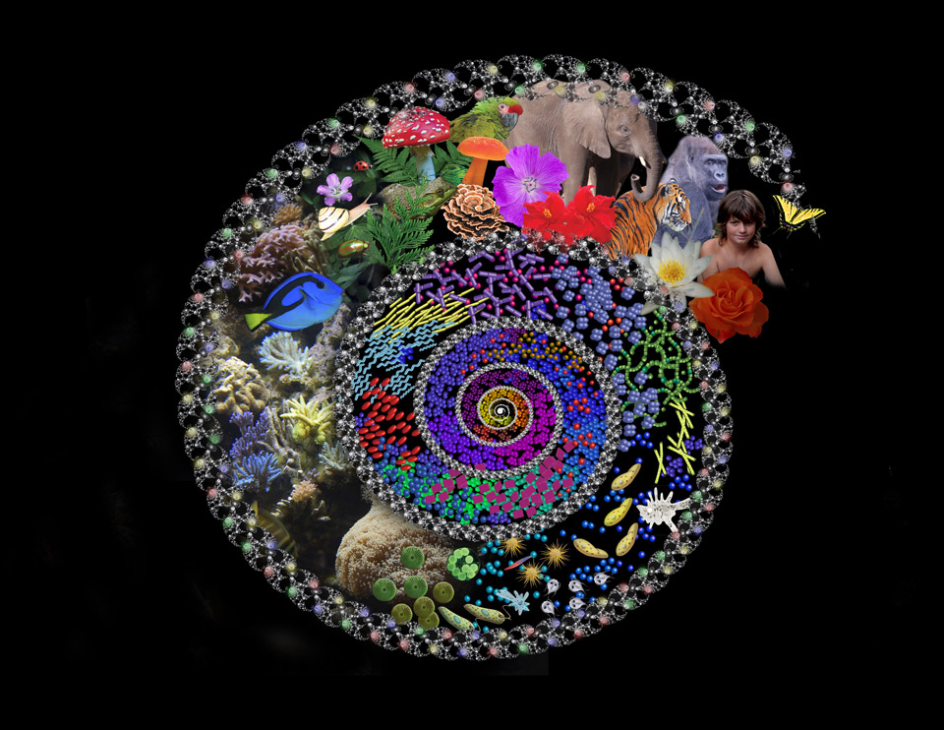
The Diversity of Life

Slide 2
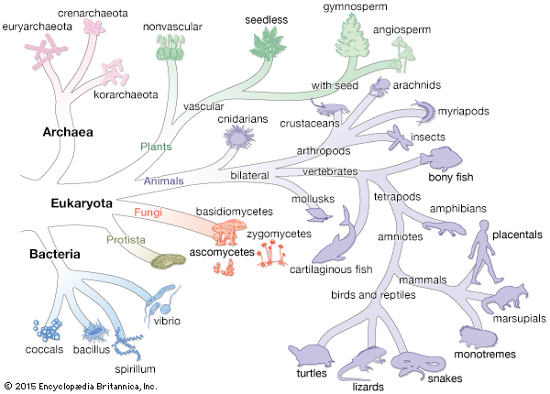
Objective
To be introduced to the general characteristics of each domain of life

Slide 3
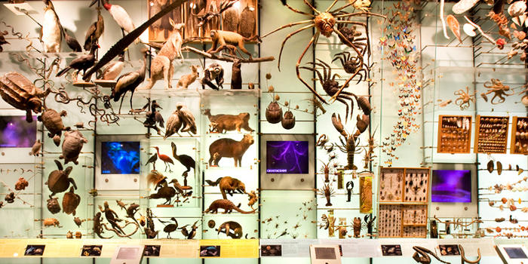
Biological systematic : The study of biological diversity in an evolutionary basis
Taxonomy: Is the naming and classification of the species.

Slide 4
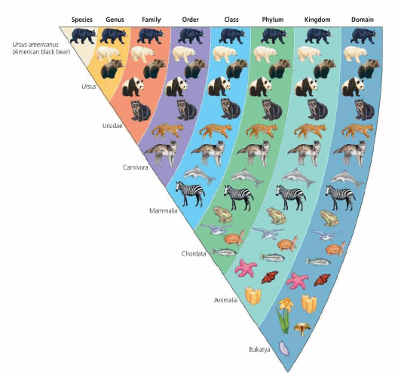
Taxonomic levels as follows: species genus family order class phylum kingdom domain.
Most Specific
Most General

Slide 5
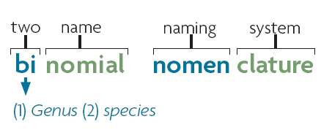
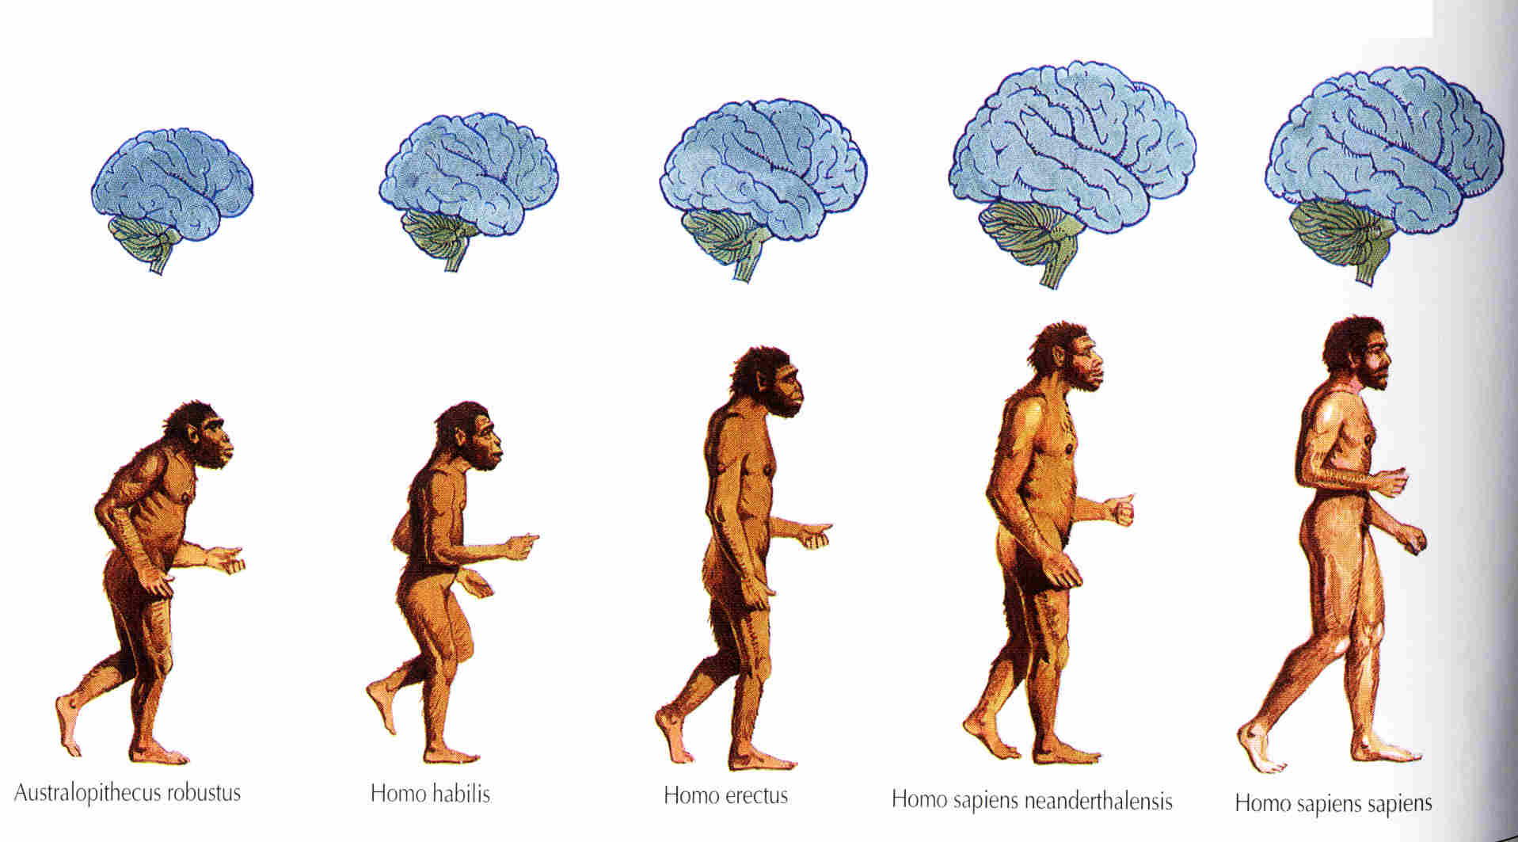
Binomial Nomenclature
Homo sapiens

Slide 6
Binomial Nomenclature- each species is assigned a two part name
always written in italics
first word is always CAPATILIZED (Genus)
second word is always lower case (species)

Slide 7
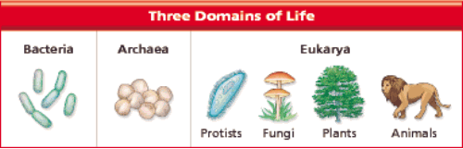
Domains of Life
All organisms on Earth can be classified into one of the following domains
  Domain Bacteria (= Kingdom Eubacteria)
  Domain Archaea (= Kingdom Archaebacteria)
  Domain Eukarya (Plants, Animals, Fungi, Protists)

Slide 8
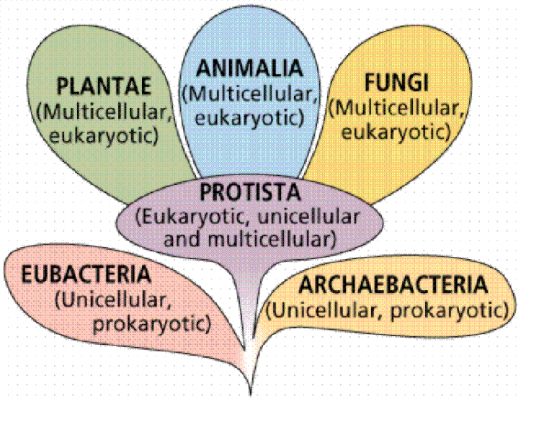
SIX KINGDOMS of LIFE

Slide 9
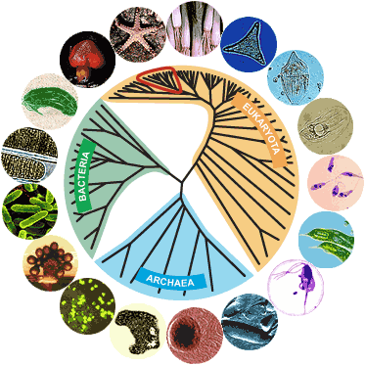
In this lab we will introduced the general characteristics of each domain.

Slide 10
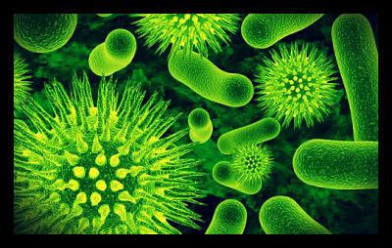
Domain Eubacteria
Domain Eubacteria
Consists of prokaryotic unicellular organisms.
The cells of most Eubacteria can be classified based on their shape:
coccus (spherical shape),
bacillus (rod shaped),
spirillus (helical shape).
Organisms in this domain can be classified according to their modes of nutrition

Slide 11
Mode of nutrition
Mode of nutrition | Energy source | Carbon source
Photoautotrophs | Light | CO2
Chemoautotrophs | Chemical | CO2
Photoheterotrophs | Light | Organic
Chemoheterotrophs | Organic compounds | Organic compounds

Slide 12

Domain Archaea
Domain Archaea
Species of the domain Archaea are considered extremophiles, they “love” to live in extreme environments.
Archaea can be classified into three groups as follows:
1- Methanogens
2- Halophiles:
3- Thermoacidophiles:

Slide 13
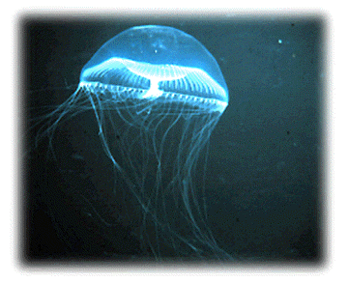
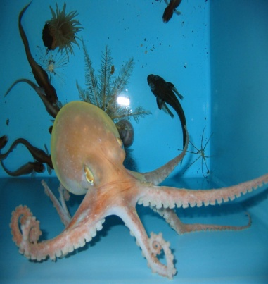
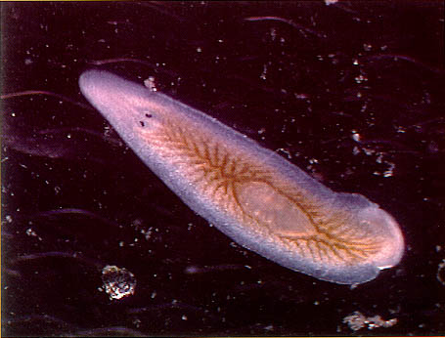
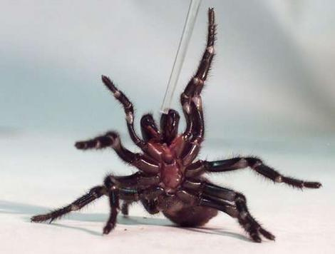
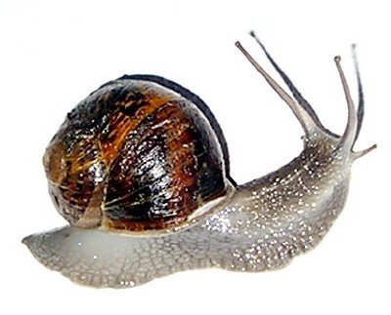
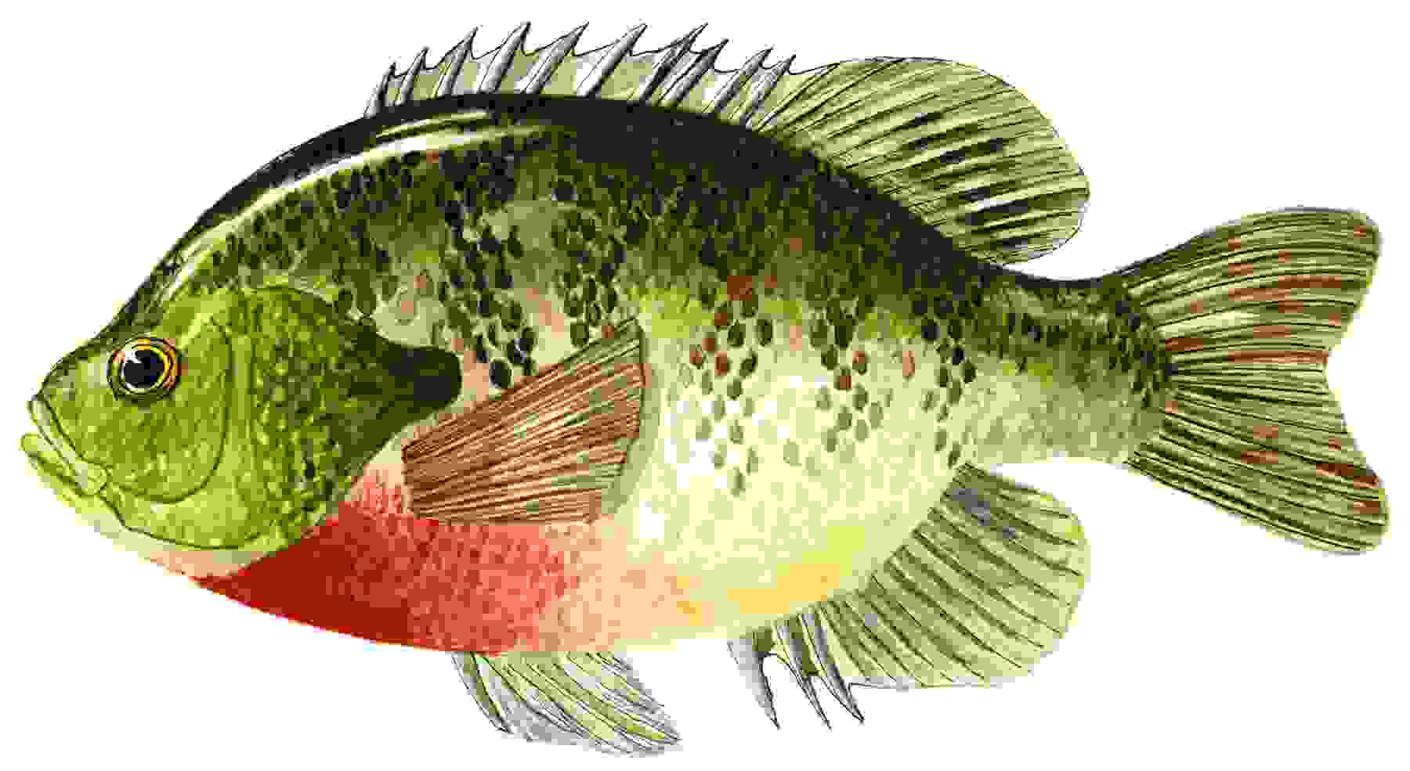
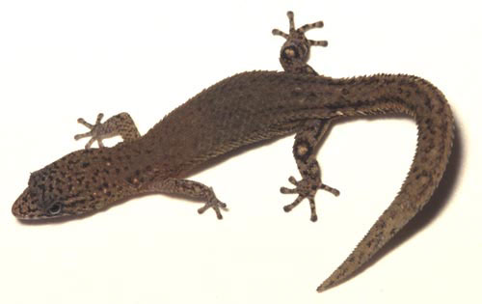
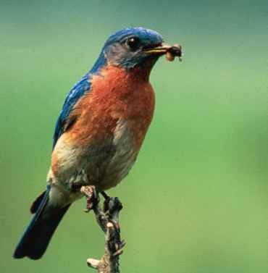
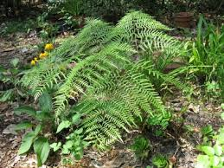
Domain Eukarya
Domain Eukarya
All cells that have nuclei and internal organelles are eukaryotic.
Eukaryotes can be uni- or multi-cellular organisms, meaning that they are composed of one or many cells, respectively

Slide 14
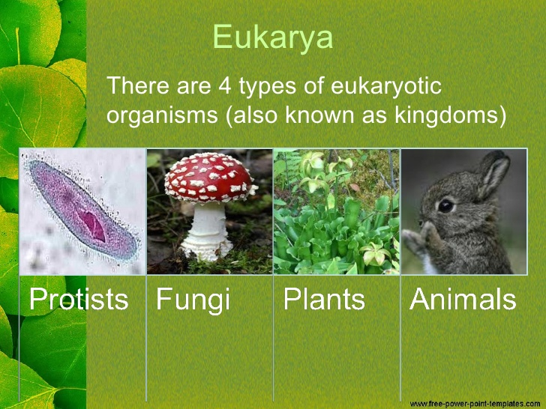
Domain Eukarya

Slide 15
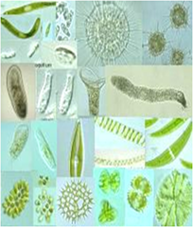
1- Kingdom Protista
Domain Eukarya
Protists
Are highly diverse;
Most of them are unicellular and microscopic , while others can be multicellular and macroscopic.

Slide 16
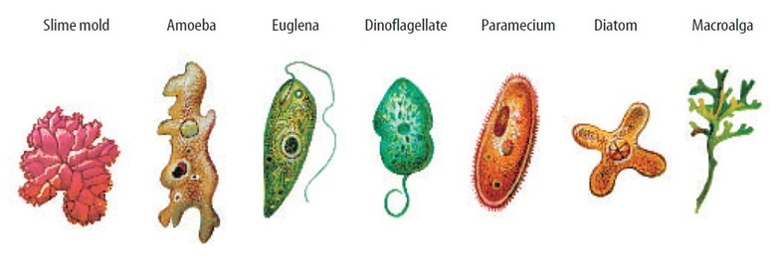
Protists can be classified according to their mode of nutrition into three groups
Domain Eukarya
Animal like protists: ingestive protists.
Fungus-like protists: absorptive protists.
Plant-like protists: photosynthetic protists.

Slide 17
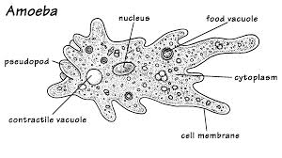
In this laboratory you will be introduced to ;
Domain Eukarya
Amoeba
It is a unicellular organism that uses pseudopodia to move and feed.

Slide 18
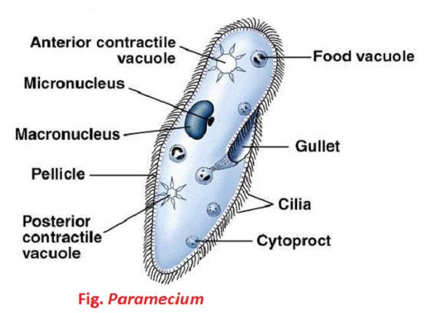
Paramecium
This protozoan uses many cilia for movement. Paramecium has one or more micronuclei and one macronucleus.
Domain Eukarya

Slide 19
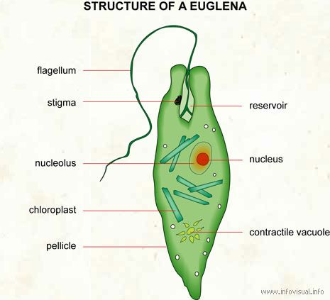
Domain Eukarya
Euglena
It is an elongated, ovoid cell with a long flagellum emerging from its end. Euglena lacks a wall and has chlorophylls a and b.

Slide 20
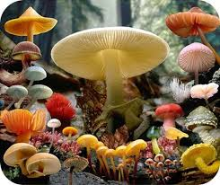
2- Kingdom Fungi:
Domain Eukarya
Fungi are eukaryotic organisms lack chlorophyll
reproduce by means of spores.
Fungi are heterotrophs and acquire their nutrients by absorption.
Fungi are primarily filamentous and multicellular.

Slide 21
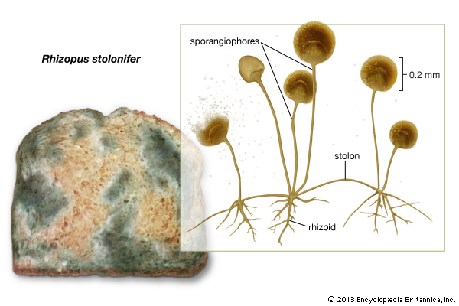
Domain Eukarya
Rhizopus nigricans is the common black bread mold.

Slide 22
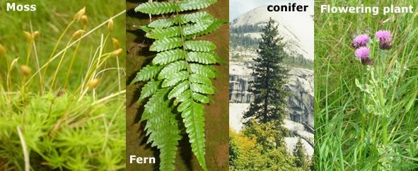
3- Kingdom Plantae:
Domain Eukarya
They are photosynthetic eukaryotes.
Plants have cells with rigid cell walls mainly composed of cellulose

Slide 23
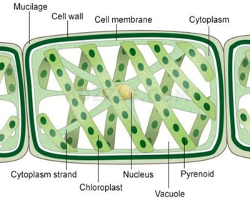
some examples of plants
Domain Eukarya
Spirogyra :
They are green filamentous algae.
Each filament is divide into cells joined end to end.
Each cell contains one or more long, green, spiral chloroplasts.
The nucleus is found near the center of the cell.

Slide 24
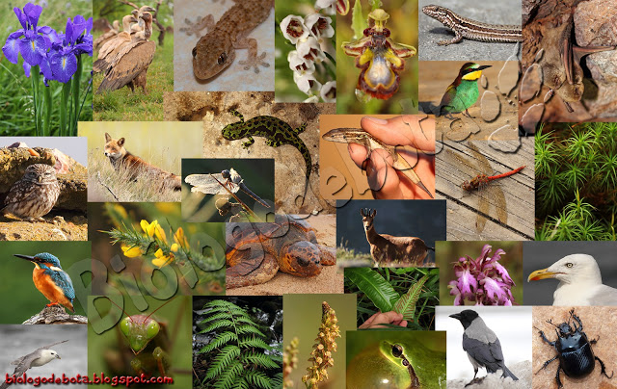
4- Kingdom Animalia:
Domain Eukarya
Animals are heterotrophs,
Intake their food by ingestion.
Their cells lack cell walls.

Slide 25
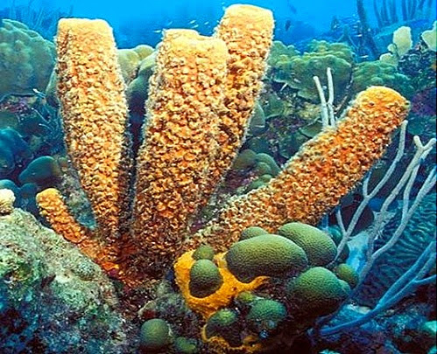
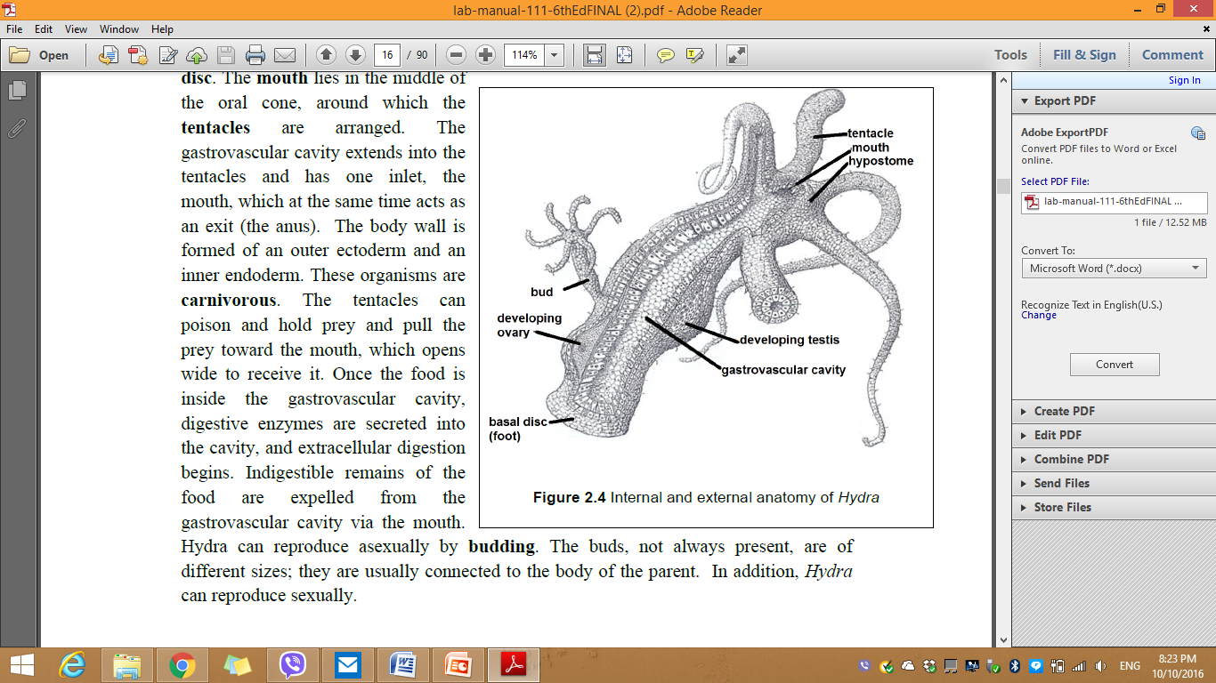
The common phyla of this kingdom
Domain Eukarya
Phylum Porifera (e.g. sponges).
b) Phylum Cnidaria (Coelenterates): primitive aquatic animals whose body is saclike body(e.g. jellyfish, sea anemones, corals and Hydra)
The gastrovascular cavity extends into the tentacles and has one inlet, The mouth, which at the same time acts as an exit (the anus).
Hydra can reproduce asexually by budding.

Slide 26
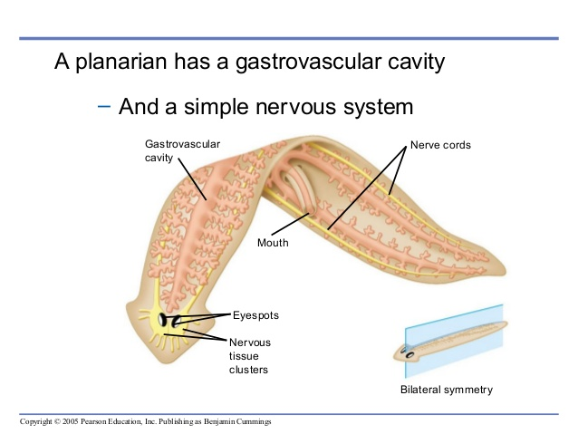
Domain Eukarya
C) Phylum Platyhelminthes (Flatworms): Flatworms include tapeworms and Planarians.
In this laboratory, you will be introduced to Planaria
The anterior , posterior , dorsal and ventral

Slide 27
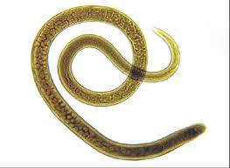
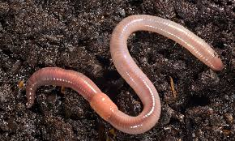
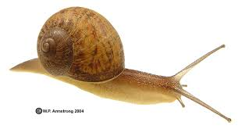
Domain Eukarya
d) Phylum Nematoda (round worms): such as Ascaris lumbricoides.
e) Phylum Annelida such as earthworms..
f) Phylum Mollusca: such as octopuses and squids

Slide 28
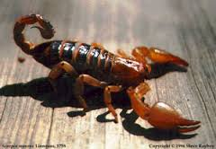
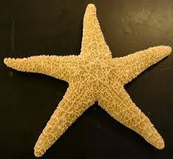
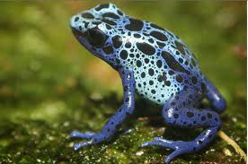
Domain Eukarya
e) Phylum Arthropoda: Arthropods include spiders, scorpions, centipedes, millipedes, crustaceans and insects.
f) Phylum Echinodermata: (e.g. sea stars, sea urchins, brittle stars, sea cucumbers).
g) Phylum Chordata: it includes a major subphylum vertebrata, which includes fish, amphibians, reptiles, birds, and mammals.

