Slide 1
Chapter 13: Enzymes
By Kamisha L. Johnson-Davis

Slide 2
General Properties and Definitions
Enzymes
Specific biologic proteins that catalyze biochemical reactions without altering equilibrium point of reaction or being consumed or changed in composition
Found in all body tissues & frequently appear in serum following cellular injury or degradation
Proteins, comprising specific amino acid sequence
Enzyme may exist in different forms (isoenzyme & isoform).
Cofactor: nonprotein molecule necessary for enzyme activity
Activator: inorganic cofactor
Coenzyme: organic cofactor

Slide 3
Enzyme Classification and Nomenclature
IUB System assigns name & code to each enzyme
1. Oxidoreductases: catalyze an oxidation–reduction reaction between two substrates
2. Transferases: catalyze transfer of a group other than hydrogen from one substrate to another
3. Hydrolases: catalyze hydrolysis of various bonds
4. Lyases: catalyze removal of groups from substrates without hydrolysis; product contains double bonds
5. Isomerases: catalyze interconversion of geometric, optical, or positional isomers
6. Ligases: catalyze joining of two substrate molecules, coupled with breaking of pyrophosphate bond in ATP

Slide 4
Enzyme Kinetics
Catalytic Mechanism of Enzymes
Activation energy: energy required to raise all molecules in 1 mole of a compound at certain temperature to transition state at peak of energy barrier
Enzymes catalyze reactions by lowering activation energy level.
Enzyme specificity
Absolute: specific to only 1 substrate
Group: specific to all substrates of a chemical group
Bond: specific to chemical bonds
Stereoisometric: specific to 1 optical isomer of a compound

Slide 5
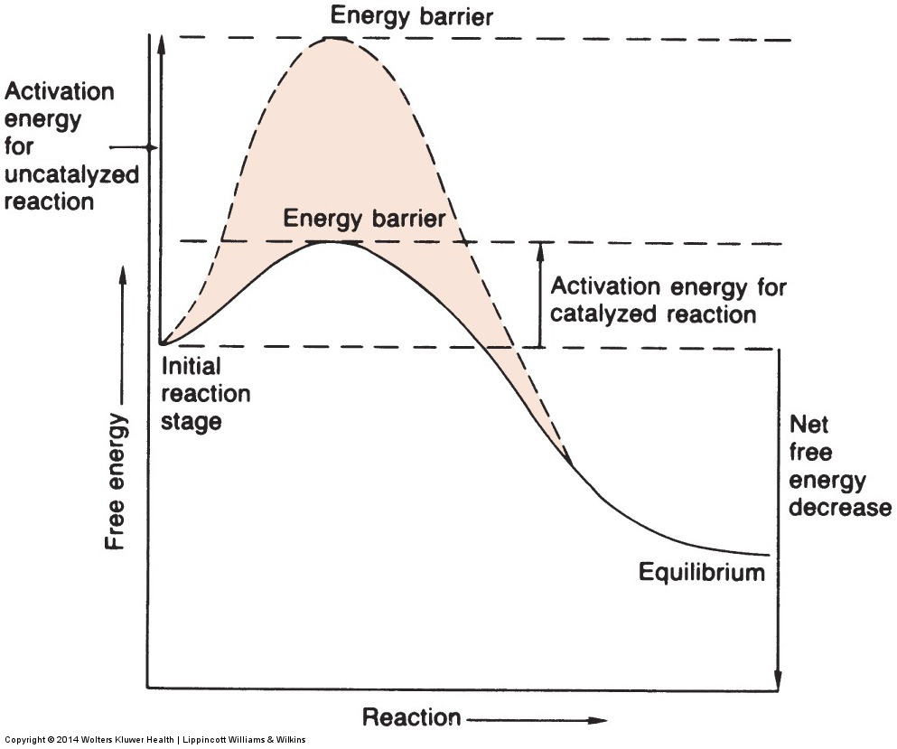
Enzyme Kinetics (cont’d)
Energy vs. progression of reaction, indicating energy barrier that substrate must surpass to react with and without enzyme catalysis

Slide 6
Enzyme Kinetics (cont’d)
Factors That Influence Enzymatic Reactions
Substrate concentration
Enzyme concentration
pH
Temperature
Cofactors
Inhibitors

Slide 7
Enzyme Kinetics (cont’d)
Measurement of Enzyme Activity
Common measurements
Increase in product concentration
Decrease in substrate concentration
Enzyme concentrations always performed in zero-order kinetics
Inhibitors must be lacking & other variables carefully controlled.
Types of measurement of enzymatic reactions: fixed-time & continuous monitoring (kinetic assay)

Slide 8
Enzyme Kinetics (cont’d)
Calculation of Enzyme Activity
International unit (IU): amount of enzyme that will catalyze reaction of 1 μmol of substrate/min under specified conditions
Enzyme concentration usually expressed in units per liter (IU/L)
The SI systems uses the katal (mol/s)> activity expressed as katal/L
1.0 IU = 17 nkatal
Measurement of Enzyme Mass
Immunoassay methodologies
Risk of overestimating active enzyme due to possible cross-reactivity with inactive enzymes
Enzymes as Reagents
Used to measure many nonenzymatic constituents in serum

Slide 9
Measurement of enzyme activity
Enzyme activity measurement is performed in zero-order kinetics, with the substrate in sufficient excess to ensure that no more than 20% of available substrate is converted to products
Coenzymes are also in excess
Coenzymes like NADH is often used, which absorbs at 340 nm while NAD⁺ does not
Coupled-enzyme assay: more than one enzyme is added excess as a reagent and multiple reactions are catalyzed

Slide 10
Enzymes of Clinical Significance

Slide 11
Creatine kinase
A dimeric enzyme (82 kDa), two subunits B and M: BB (CK-1,; brain type), MB (CK-2; hybrid type) & MM (CK-3; muscle type)
Catalyzes the following rxn:
Optimal pH for forward and reverse rxns are 9.0 and 6.7, respectively
As is true for all kinases, Mg⁺² is a cofactor
In muscle cells, it is involved in the storage of high-energy creatine phosphate. Every contraction cycle of muscle results in creatine phosphate use, with the production of ATP.

Slide 12
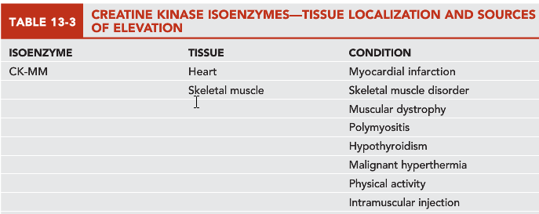
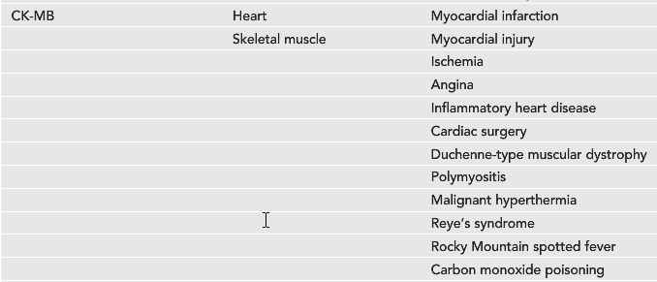
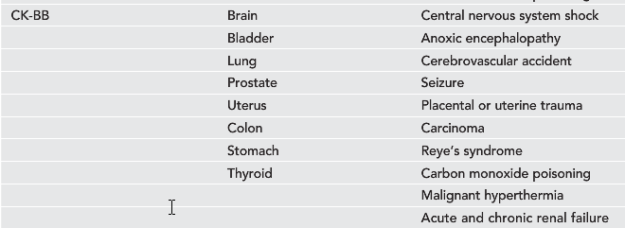

Slide 13
CK: diagnostic significance
CK levels are frequently elevated in disorders of:
Cardiac and skeletal muscle (myocardial infarction [MI], rhabdomyolysis, and muscular dystrophy).
Cerebral vascular accident, seizures, nerve degeneration, shock; hypothyroidism, malignant hyperpyrexia, Reye’s syndrome
CK level is considered a sensitive indicator of acute myocardial infarction (AMI) and muscular dystrophy, particularly the Duchenne type.
CK levels are not entirely specific indicators as CK elevation is found in various other abnormal cardiac and skeletal muscle conditions.
Levels of CK also vary with muscle mass and, therefore, may depend on gender, race, degree of physical conditioning, and age
Normal serum contains mainly CK-MM, that constitute ~94-100% of total CK
Mild to strenuous activity may contribute to elevated CK levels, as may intramuscular injections

Slide 14

CK: enzyme activity
CK is unstable in serum.
It is stabilized by addition of N-acetylcysteine, mercaptoethanol and DTT
Serum should be stored in a dark place, because CK is inactivated by light.
Hemolysis of serum samples may elevate CK activity

Slide 15
CK & MI
Demonstration of elevated levels of CK-MB, greater than or equal to 6% of total CK, is considered a good indicator for mayocardial damage, particularly AMI
Troponins (I & T) may also elevate in AMI in absence of CK-MB elevations >> more specific
Specificity of CK-MB for diagnosis of AMI can be increased if interpreted in conjunction with and LD isoenzymes and/or Troponins; or if measured sequentially over 48 hrs to show a typical rise and fall of enzyme activity

Slide 16
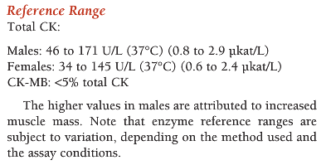
CK: reference range

Slide 17
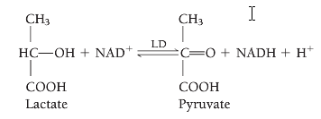
Lactate dehydrogenase (LD)
Source of error: any degree of hemolysis; instability in any temperature
Reference range: 125-220 U/L (37°C)
Tissue source:
LD is highly distributed in the body.
High levels of LD are found in heart, liver, skeletal muscles, kidney and RBCs
Less amounts of LD in lung, smooth and brain

Slide 18
LD: diagnostic significance
Increased levels are found in cardiac, hepatic, and skeletal muscle and renal diseases, as well as in several hematologic and neoplastic disorders.
The highest levels of total LD are seen in pernicious anemia and hemolytic disorders.
Intramedullary destruction of erythroblasts causes elevation as a result of the high concentration of LD in erythrocytes.
In the sera of healthy individuals, the major isoenzyme fraction is LD-2, followed by LD-1, LD-3, LD-4, and LD-5
LD flipped pattern LD1>LD2 in AMI

Slide 19
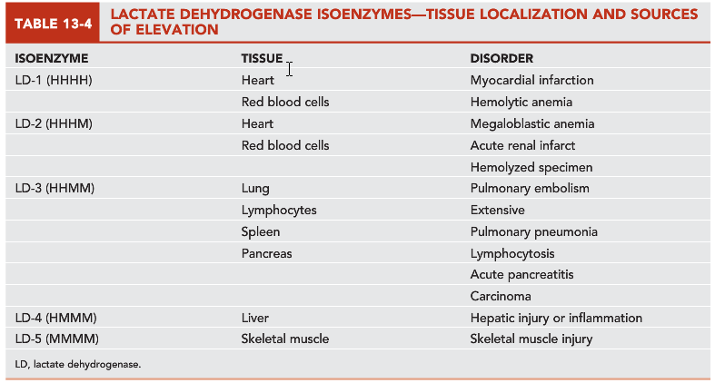

Slide 20
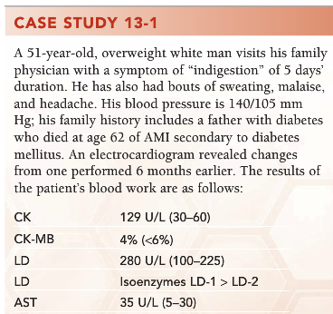
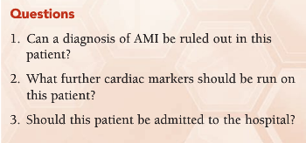

Slide 21
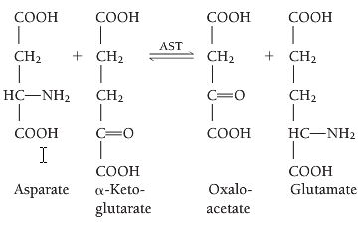
Aspartate aminotransferase (AST)
Older terminology: serum glutamic oxaloacetic transaminase (SGOT, or GOT),
Rxn catalyzed by AST; transfer of an amino group:
Pyridoxal phosphate
(PLP) functions as coenzyme

Slide 22
AST
Tissue source:
AST is widely distributed in human tissue.
The highest concentrations are found in cardiac tissue, liver, and skeletal muscle, with smaller amounts found in the kidney, pancreas, and erythrocytes

Slide 23
AST: diagnostic significance
AST is mainly used to evaluate hepatocellular disorders & skeletal muscle involvement
In AMI, AST begin to rise within 6-8 hrs, peak at 24 hrs & return to normal within 5 days
AST is not specific for AMI
AST is elevated in pulmonary embolism
Half-life is ~16 hrs
Notes:
ULN: upper limit of normal

Slide 24
AST: diagnostic significance/ cont’d
AST levels are highest in acute hepatocellular disorders
In viral hepatitis, levels may reach 100 times upper limit of normal (ULN)
In cirrhosis, AST reaches ~4X ULN
Skeletal muscle disorders & muscular dystrophy: 4-8X ULN
Notes:
ULN: upper limit of normal

Slide 25
AST: cellular location & isoenzymes
AST has 2 isoenzymes, but not routinely analyzed
Intracellular conc of AST is 7000X higher than extracellular
AST is located in cytoplasm & mitochondria,
Cytoplasmic form is the predominant form

Slide 26

Assay for AST
Karmen method:; optimum pH 7.3 – 7.8:
Sources of error:
Hemolysis dramatically increases AST
Activity stable for 3-4 days at Refrig temp.
Ref Range:
AST: 5 – 35 U/: (37C) (0.1-0.6 ukat/L)

Slide 27
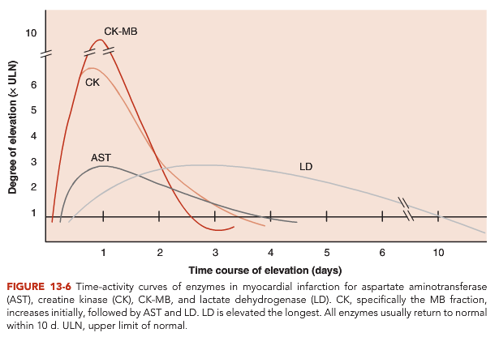

Slide 28
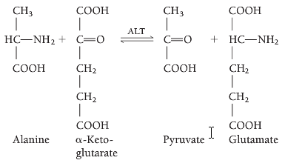
Alanine aminotransferase (ALT)
Formerly called serum glutamate-pyruvate transaminase (SGPT or GPT)
Rxn catalyzed:

Slide 29
ALT: tissue source
ALT is distributed in many tissues, with comparatively high concentrations in the liver.
It is considered the more liver-specific enzyme of the transferases.
Half life is 24 hrs
Located in cytoplasm

Slide 30
Transaminase activities in human tissues, relative to serum as unity
 | AST | ALT
Heart | 7800 | 450
Liver | 7100 | 2850
Skeletal muscles | 5000 | 300
Kidney | 4500 | 1200
Pancreas | 1400 | 130
Spleen | 700 | 80
Lungs | 500 | 45
Erythrocytes | 15 | 7
Serum | 1 | 1
Notes:
Table 21-2 page 605/ Tietz Textbook for clinical chemistry & mol diag/ 4th ed

Slide 31
ALT: diagnostic significance
ALT assays are confined mainly to evaluation of hepatic disorders.
Higher elevations are found in hepatocellular disorders than in extrahepatic or intrahepatic obstructive disorders
In acute inflammatory conditions of the liver, ALT elevations are frequently higher than those of AST and tend to remain elevated longer

Slide 32
ALT: diagnostic significance/ cont’d
Cardiac tissue contains a small amount of ALT activity, but the serum level usually remains normal in AMI unless subsequent liver damage has occurred

Slide 33

ALT assay
Optimum pH 7.3-7.8
Source of error
ALT is stable for 3-4 days at 4C
Relatively unaffected by hemolysis
Ref Ranges:
ALT: 7-45 U/L, (37C) (0.1-0.8 ukat/L)

Slide 34
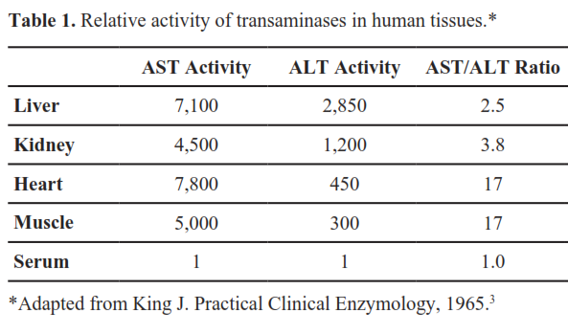
AST/ALT ratio
The AST/ALT ratio was described by Fernando De Ritis in 1957 & hence known as De Ritis ratio
Ref: Botros & Sikaris (2013) Clin Biochem Rev 34:117-130.

Slide 35
De Ritis ratio
De Ritis ratio or AST:ALT ratio is useful in differentiating between causes of liver diseases
In healthy people, ALT>AST, when AST>ALT, then a disease is likely
Ratio is less useful when liver enzymes are not elevated or multiple conditions exist
The values of the ratio are not accepted as a reference range & it is difficult to define “healthy” limits of the ratio
Notes:
Normally AST/ALT ratio is less than 1; when >1 then a disease sate is likely.

Slide 36
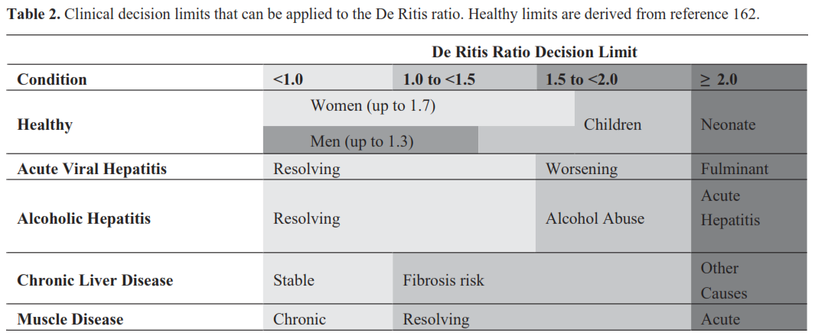
Ref: Botros & Sikaris (2013) Clin Biochem Rev 34:117-130.
Notes:
Cholestasis is defined as a decrease in bile flow due to impaired secretion by hepatocytes or to obstruction of bile flow through intra-or extrahepatic bile ducts. Therefore, the clinical definition of cholestasis is any condition in which substances normally excreted into bile are retained

Slide 37
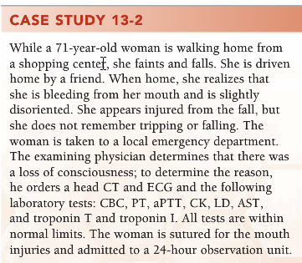
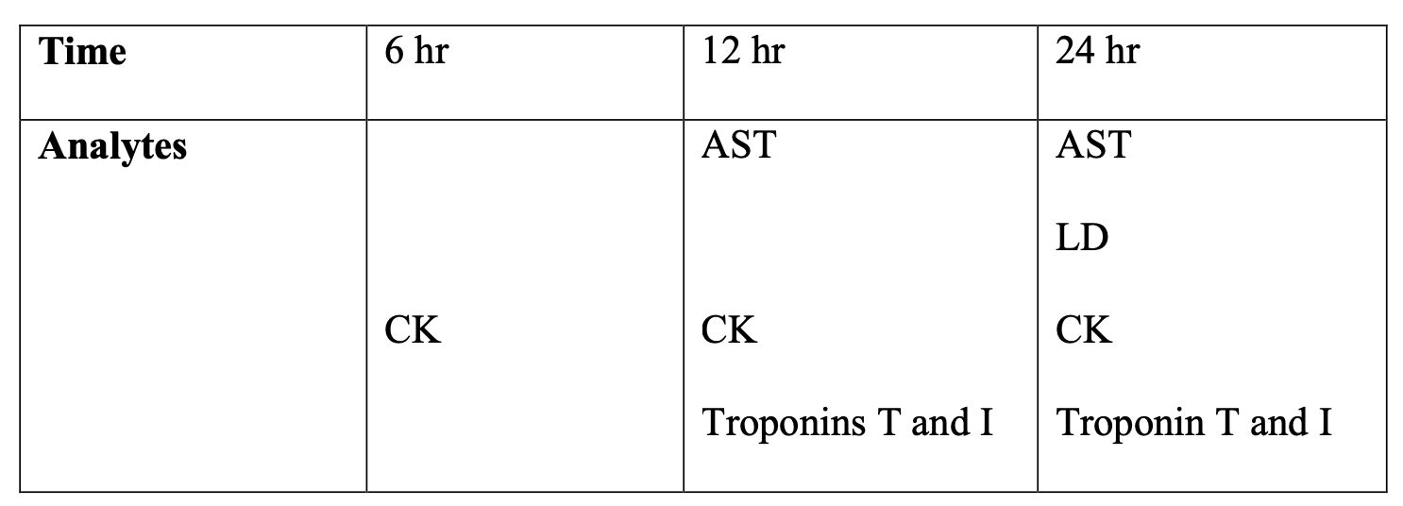
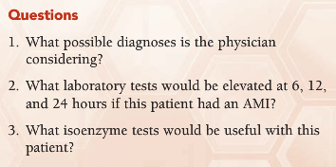
Based on the laboratory tests that were ordered, the physician is considering a diagnosis of an AMI or ischemia.
The following laboratory tests that will be elevated at the various timepoints:
The lactate dehydrogenase isoenzymes 1 and 2 (LD-1, LD-2) results would be useful for this patient. In conditions of myocardial injury the LD-1 concentration in serum will increase greater than the LD-2 concentration. This condition is known as the LD flipped pattern (LD-1 > LD2).
Notes:
This woman probably experienced a AMI.

Slide 38
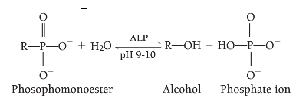
Alkaline phosphatase (ALP)
ALP belongs to a group of enzymes that catalyze the hydrolysis of various phosphomonoesters at an alkaline pH.
ALP is a nonspecific enzyme capable of reacting with many different substrates.
Specifically, ALP functions to liberate inorganic phosphate from an organic phosphate ester with the concomitant production of an alcohol

Slide 39
ALP: tissue source
ALP activity is present on cell surfaces in most human tissue.
The highest concentrations are found in the intestine, liver, bone, spleen, placenta, and kidney.
Hepatic ALP is most densely represented near the canalicular membrane of the hepatocyte. Thus, diseases that mainly affect hepatocyte secretion (e.g., obstructive diseases) will cause elevations of ALP levels.
Bile-duct obstruction and primary biliary cirrhosis (PBC) are some examples of diseases in which elevated ALP levels are often predominant over transaminase level elevations.
Notes:
serum alkaline phosphatase comprises a heterogeneous group of enzymes. Hepatic alkaline phosphatase is most densely represented near the canalicular membrane of the hepatocyte. Accordingly, diseases that predominately affect hepatocyte secretion (e.g., obstructive diseases) will be accompanied by elevations of alkaline phosphatase levels. Bile-duct obstruction, primary sclerosing cholangitis, and primary biliary cirrhosis (PBC) are some examples of diseases in which elevated alkaline phosphatase levels are often predominant over transaminase level elevations.
Primary sclerosing cholangitis (PSC) is a long-term progressive disease of the liver and gallbladder characterized by inflammation and scarring of the bile ducts which normally allow bile to drain from the gallbladder.

Slide 40
ALP: diagnostic significance
Elevations of ALP are of most diagnostic significance in the evaluation of hepatobiliary and bone disorders.
In hepatobiliary disorders, elevations are more predominant in obstructive conditions than in hepatocellular disorders;
In bone disorders, elevations are observed when there is involvement of osteoblasts.
In biliary tract obstruction, ALP levels range from 3 to 10 times the ULN.
In hepatocellular disorders, such as hepatitis and cirrhosis, show only slight increases, usually less than three times the ULN.
Due to overlapping of ALP elevations in different liver diseases, it assumes more diagnostic significance when evaluated along with other tests of hepatic function

Slide 41
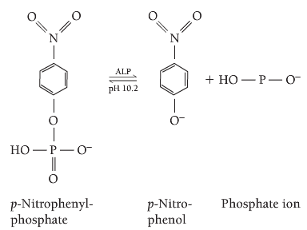
ALP assay
p-Nitrophenylphosphate (colorless) is hydrolyzed to p-nitrophenol (yellow), and the increase in absorbance at 405 nm, which is directly proportional to ALP activity, is measured.

Slide 42
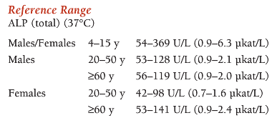
Sources of error:
Hemolysis may cause slight elevations because ALP is 6x more conc in RBCs than in serum
ALP should be assayed as soon as possible, because its activity increases 3-10% upon standing at 25 or 4C for several hrs
Values may be 25% higher following ingestion of fat meal

Slide 43
Category of liver disease by predominant serum enzyme abnormalities
Test | Liver disease category
 | Hepatocellular | Cholestatic | Infiltrative
AST, ALT higher than ALP level | Typical | -- | --
ALP higher than AST, ALT levels | -- | Typical | --
Elevation of ALP with near-normal AST, ALT levels | -- | Typical | Typical
Cholestasis: a decrease in bile flow due to impaired secretion by hepatocytes or to obstruction of bile flow through intra-or extrahepatic bile ducts
Notes:
Source: http://www.clevelandclinicmeded.com/medicalpubs/diseasemanagement/hepatology/guide-to-common-liver-tests/
serum alkaline phosphatase comprises a heterogeneous group of enzymes. Hepatic alkaline phosphatase is most densely represented near the canalicular membrane of the hepatocyte. Accordingly, diseases that predominately affect hepatocyte secretion (e.g., obstructive diseases) will be accompanied by elevations of alkaline phosphatase levels. Bile-duct obstruction, primary sclerosing cholangitis, and primary biliary cirrhosis (PBC) are some examples of diseases in which elevated alkaline phosphatase levels are often predominant over transaminase level elevations.
Infiltrative liver diseases most often result in a pattern of liver test result abnormalities similar to those of cholestatic liver disease. Differentiation often requires liver imaging studies. Liver imaging by ultrasound, computed tomography (CT) or magnetic resonance imaging (MRI) most often identify infiltration of the liver by mass lesions such as tumors. Imaging by cholangiography—endoscopic retrograde cholangiography, transhepatic cholangiography, or magnetic resonance cholangiography—identifies many bile duct lesions that cause cholestatic liver disease. Liver biopsy is often needed to confirm certain infiltrative disorders (e.g., amyloidosis) and microscopic biliary disorders such as PBC.

Slide 44

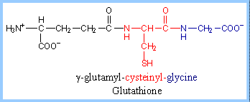
Gamma-glutamyltransferase (GGT)

Slide 45
GGT: diagnostic significance
GGT activity is found primarily in tissues of the kidney, brain, prostate, pancreas, and liver.
In the liver, GGT is located in hepatic cells and particularly in the epithelial cells lining the biliary ductules.
GGT is elevated in virtually all hepatobiliary disorders. But it’s one of the first liver enzymes to rise in blood when any of the bile ducts become obstructed, for example, by tumors or stones. This makes it one of the most sensitive of enzyme for detecting bile duct problems

Slide 46
GGT levels will be increased in patients receiving enzyme-inducing drugs such as warfarin, phenobarbital, and phenytoin.
Enzyme elevations may reach levels four times the ULN.
Heavy alcohol drinkers have GGT levels 2-3XULN
Used to monitor alcohol abstention, where levels return to normal within 2-3 weeks of alcohol abstention
Notes:
Phenobarbital and phenytoin have good antiepileptic effect, but clinically significant untoward effects occur during their long-term use. Phenobarbital may cause hyperactivity, behavioral problems, sedation, and even dementia; these effects are dose related to some extent

Slide 47
GGT levels are elevated in acute pancreatitis, diabetes and MI, but their diagnostic values in these conditions is limited
Both GGT and ALP are increased in liver diseases, but only ALP will be increased in diseases affecting bone tissue. Therefore, GGT can be used as a follow up to an elevated ALP to help determine if the high ALP result is due to liver or bone disease.
GGT activity is useful in differentiating the source of an elevated ALP level because GGT levels are normal in skeletal disorders and during pregnancy.

Slide 48
How GGT is used?
GGT test is used to determine the cause of elevated ALP. Both ALP and GGT are elevated in liver diseases, but only ALP will be elevated in bone disease.
The GGT test is sometimes used to help detect liver disease and bile duct obstructions. It is usually ordered in conjunction with ALT, AST, ALP, and bilirubin.
GGT can be used to screen for chronic alcohol abuse (it will be elevated in about 75% of chronic drinkers) and to monitor treatment for alcoholism or alcoholic hepatitis.
Notes:
In general, an increased GGT level indicates that a person's liver is being damaged but does not specifically point to a condition that may be causing the injury.
GGT levels are sometimes increased with consumption of even small amounts of alcohol. Higher levels are found more commonly in chronicheavy drinkers than in people who consume less than 2 to 3 drinks per day or who only drink heavily on occasion (binge drinkers). The GGT test may be used in evaluating someone for acute or chronic alcohol abuse.
GGT can be used to screen for chronic alcohol abuse (it will be elevated in about 75% of chronic drinkers) and to monitor for alcohol use and/or abuse in people who are receiving treatment for alcoholism or alcoholic hepatitis.

Slide 49
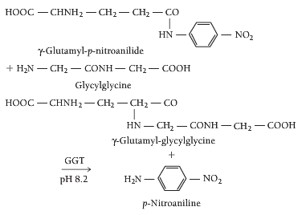
GGT assay

Slide 50
GGT: sources of error
GGT is stable for 1 week at 4C
Hemolysis does not affect GGT, because enzyme is lacking in RBCs
Ref ranges:
Male, 6-55 U/L (37C)
Female, 5-38 U/L

Slide 51
Enzymes of Clinical Significance (cont’d)
Acid Phosphatase (ACP)
Tissue source: prostate, bone, liver, spleen, kidney, erythrocytes, platelets
Diagnostic significance: prostatic carcinoma, hyperplasia of prostrate, prostatic surgery, osteoclasts, Paget’s disease, breast cancer with bone metastases, Gaucher’s disease
Assay for enzyme activity: same techniques as in alkaline phosphatase, except performed in an acid pH
Source of error: Serum should be separated from red cells as soon as blood has clotted; serum should be used immediately, frozen, or acidified.
Reference range: prostatic ACP: 0–3.5 ng/mL

Slide 52
Enzymes of Clinical Significance (cont’d)
Amylase (AMS)
Tissue source: acinar cells of pancreas & salivary glands
Diagnostic significance: acute pancreatitis, disorders causing salivary gland lesions (mumps, parotitis), intraabdominal diseases
Assay for enzyme activity: four main approaches: amyloclast, saccharogenic, chromogenic, continuous monitoring
Source of error: stable for 1 week at room temperature & 2 months at 4°C; plasma triglycerides in acute pancreatitis with hyperlipemia; administration of morphine & other opiates
Reference range: serum: 28-100 U/L; urine: 1–15 U/hour

Slide 53
Enzymes of Clinical Significance (cont’d)
Lipase (LPS)
Tissue source: primarily in pancreas; also in stomach & small intestine
Diagnostic significance: acute pancreatitis, other intraabdominal diseases (penetrating duodenal ulcers, perforated peptic ulcers, intestinal obstruction, acute cholecystitis)
Assay for enzyme activity: estimation of liberated fatty acids (triolein is substrate), turbidimetric methods, colorimetric methods
Source of error: stable in serum for 1 week at room temperature & 3 weeks at 4°C; hemolysis
Reference range: <38 U/L

Slide 54
Enzymes of Clinical Significance (cont’d)
Glucose-6-Phosphate Dehydrogenase (G-6-PD)
Tissue source: adrenal cortex, spleen, thymus, lymph nodes, lactating mammary gland, erythrocytes
Diagnostic significance: G-6-PD deficiency (an inherited sex-linked trait), which can be clinically manifested in drug-induced hemolytic anemia; myocardial infarction, megaloblastic anemias
Assay for enzyme activity: A red cell hemolysate is used to assay for deficiency of enzyme; serum is used for evaluation of enzyme elevations.
Reference range: 7.9-16.3 U/g Hgb

Slide 55
Enzymes of Clinical Significance (cont’d)
Drug Metabolizing Enzymes
Transform xenobiotics into inactive, water-soluble compounds for excretion through kidneys
Transform inactive prodrugs into active drugs, convert xenobiotics into toxic compounds, prolong elimination half-life
Catalyze addition or removal of functional groups through hydroxylation, oxidation, dealkylation, dehydrogenation, reduction, deamination, desulfuration (Phase I reactions)
Phase I reactions are often mediated by cytochrome P450 (CYP 450).

