Slide 1
Amino Acids and Peptides

Slide 2
3.4 The Structure of Proteins: Primary Structure What is it that makes one protein an enzyme, another a hormone, another a structural protein, and still another an antibody? How do they differ chemically?
The most obvious distinctions are structural, and to protein structure we now turn. Four levels of protein structure are commonly defined (Fig. 3–23). A description of all covalent bonds (mainly peptide bonds and disulfide bonds) linking amino acid residues in a polypeptide chain is its primary structure. The most important element of
primary structure is the sequence of amino acid residues.
Secondary structure refers to particularly stable arrangements of amino acid residues giving rise to recurring structural patterns. Tertiary structure describes all aspects of the three-dimensional folding of a polypeptide. When a protein has two or more polypeptide subunits, their arrangement in space is referred to as quaternary
structure.

Slide 3
Levels of Protein Structure Structurally ,proteins can be organized into four levels : 1-Primary .
2-Secondary. 3-Tertiary .
4-Quaternary.

Slide 4
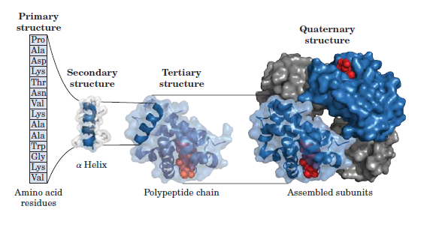

Slide 5
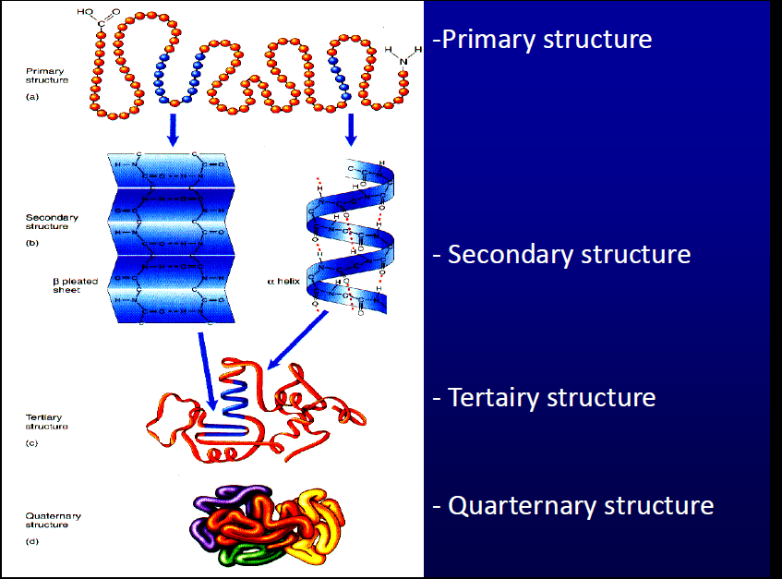

Slide 6
The differences in primary structure can be especially informative. Each protein has a distinctive number and sequence of amino acid residues. The primary structure of a protein determines how it folds up into its unique three-dimensional structure, and this in turn determines the function of the protein.
Each type of protein has a unique three-dimensional structure and this structure confers a unique function.
Each type of protein also has a unique amino acid sequence.
Intuition suggests that the amino acid sequence must play a fundamental role in determining the three-dimensional structure of the protein, and ultimately its function,
Is that correct ????????????????????????????
What do you think?

Slide 7
First, as we have already noted, proteins with different functions always have different amino acid sequences. Second, thousands of human genetic diseases have been traced to the production of defective proteins. The defect can range from a single change in the
amino acid sequence as in sickle cell anemia to deletion of a larger portion of the
polypeptide chain (as in most cases of Duchenne muscular dystrophy: a large deletion in the gene encoding the protein dystrophin leads to production of a shortened,
inactive protein). Thus we know that if the primary structure is altered, the function of the protein may also be changed. Finally, on comparing functionally similar proteins from different species, we find that these proteins often have similar amino acid sequences. An extreme case is ubiquitin, a 76-residue protein involved in regulating the degradation of other proteins. The amino acid sequence of ubiquitin is identical in
species as disparate as fruit flies and humans.
Is the amino acid sequence absolutely fixed, or invariant, for a particular protein? No; some flexibility is possible. An estimated 20% to 30% of the proteins in humans are polymorphic, having amino acid sequence variants in the human population

Slide 8
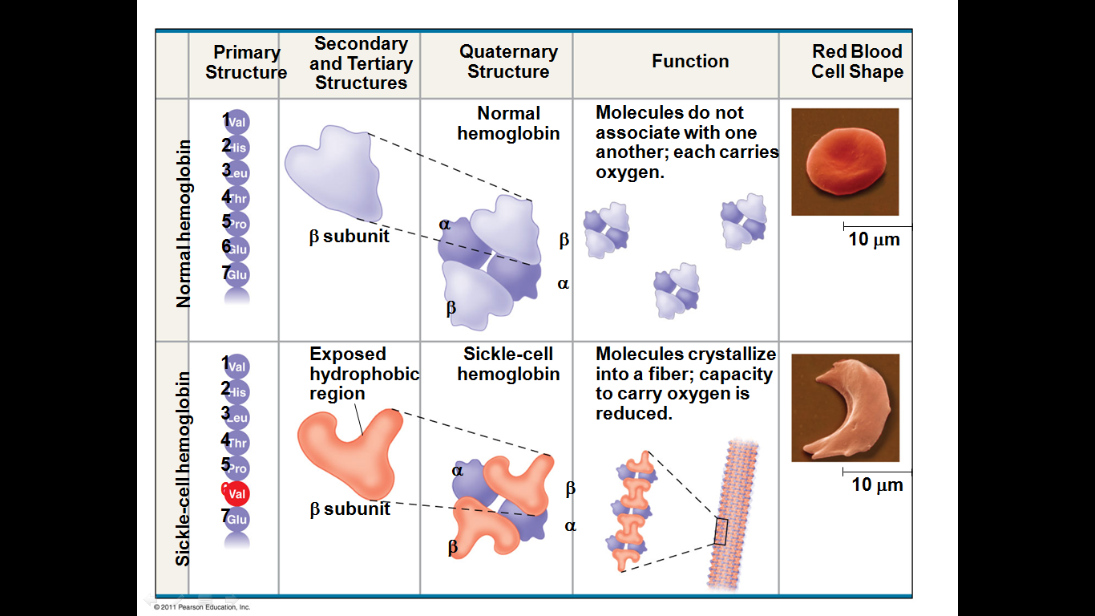

Slide 9
Furthermore, proteins that carry out a broadly similar function in distantly related species can differ greatly in overall size and amino acid sequence.
The Amino Acid Sequences of Millions of Proteins Have Been Determined
Two major discoveries in 1953 were of crucial importance in the history of biochemistry. In that year, James D. Watson and Francis Crick deduced the double-helical structure of DNA and proposed a structural basis for its precise replication . Their proposal illuminated the molecular reality behind the idea of a gene. In the same year, Frederick Sanger worked out the sequence of amino acid residues in the polypeptide chains of the hormone insulin (Fig. 3–24). a decade after these discoveries, the genetic code relating the nucleotide sequence of DNA to the amino acid sequence of protein molecules was elucidated.

Slide 10
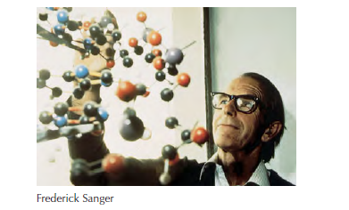

Slide 11
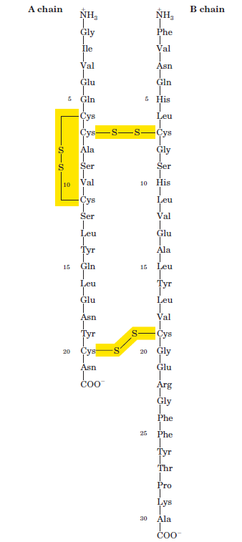


Slide 12
Short Polypeptides Are Sequenced with Automated Procedures
Various procedures are used to analyze protein primary structure. To start, biochemists have several strategies for labeling and identifying the amino-terminal amino acid residue (Fig. 3–25a). Sanger developed the reagent 1-fluoro-2,4-dinitrobenzene (FDNB) for this purpose; other available reagents are dansyl chloride and dabsyl chloride, which yield derivatives that are more easily detectable than the dinitrophenyl derivatives. After the amino-terminal residue is labeled with one of these reagents, the polypeptide is hydrolyzed (in 6 M HCl) to its constituent amino acids and the labeled amino acid is identified. Because the hydrolysis stage destroys the polypeptide, this procedure cannot be used to sequence a polypeptide beyond its amino-terminal residue. However, it can help determine the number of chemically distinct polypeptides in a protein, provided each has a different amino-terminal residue. For example, two residues—Phe and Gly—would be labeled if insulin (Fig. 3–24) were subjected to this procedure.

Slide 13
To sequence an entire polypeptide, a chemical method devised by Pehr Edman is usually employed. The Edman degradation procedure labels and removes only the amino-terminal residue from a peptide, leaving all other peptide bonds intact (Fig. 3–25b). The peptide is reacted with phenylisothiocyanate under mildly alkaline conditions, which converts the aminoterminal amino acid to a phenylthiocarbamoyl (PTC) adduct. The peptide bond next to the PTC adduct is then cleaved in a step carried out in anhydrous trifluoroacetic acid, with removal of the amino-terminal amino acid as an anilinothiazolinone derivative. The derivatized amino acid is extracted with organic solvents, converted to the more stable phenylthiohydantoin derivative by treatment with aqueous acid, and then identified. The use of sequential reactions carried out under first basic and then acidic conditions provides a means of controlling the entire process.

Slide 14
After removal and identification of the aminoterminal
residue, the new amino-terminal residue so exposed can be labeled, removed, and identified through the same series of reactions. This procedure is repeated until the entire sequence is determined. The Edman degradation is carried out in a machine, called a sequenator, that mixes reagents in the proper proportions, separates the products, identifies them, and records the results.

Slide 15
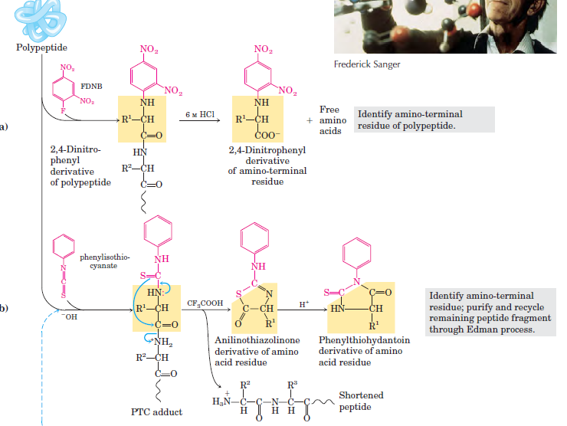

Slide 16
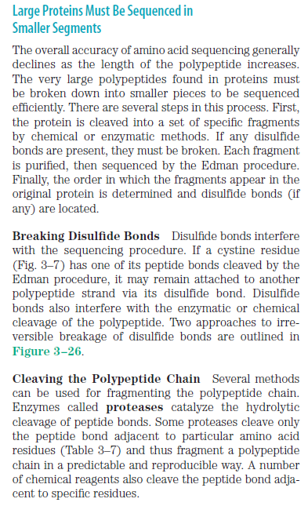

Slide 17
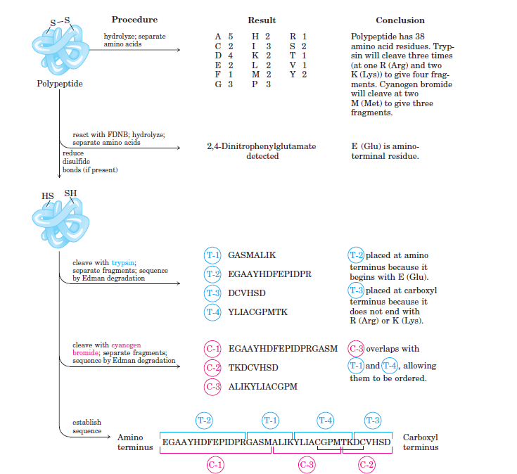

Slide 18

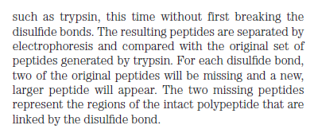

Slide 19
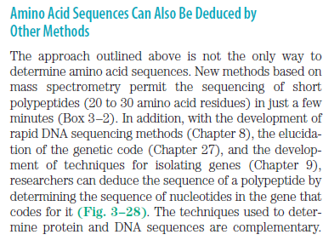
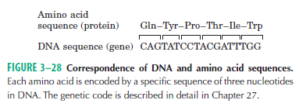

Slide 20
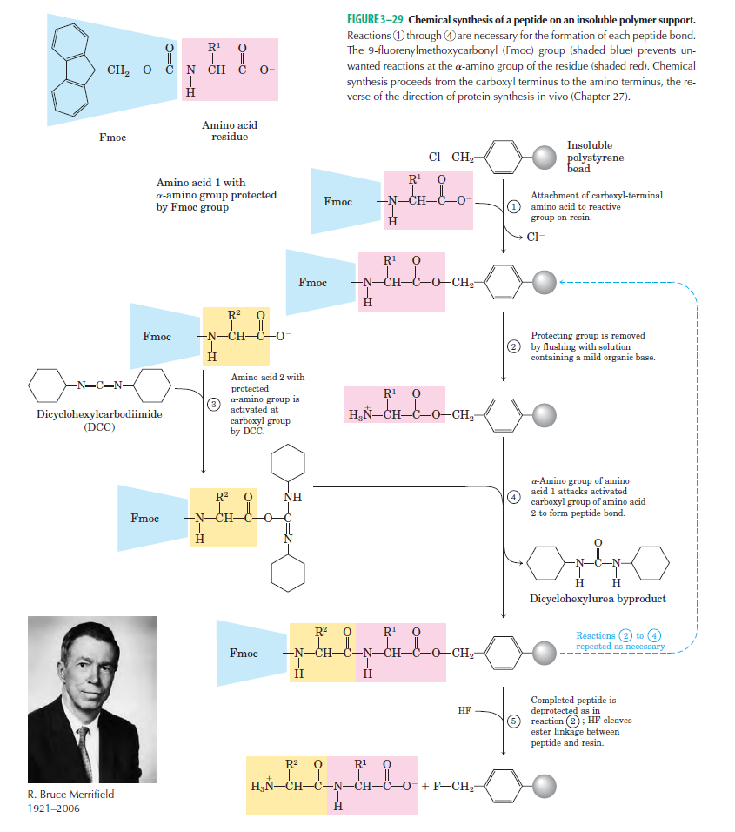

Slide 21
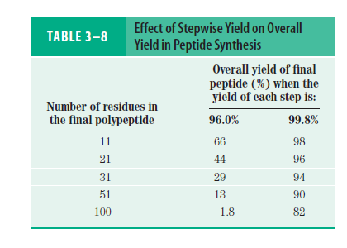

Slide 22
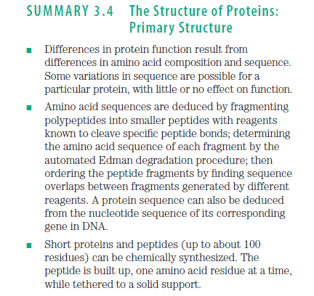

Slide 23
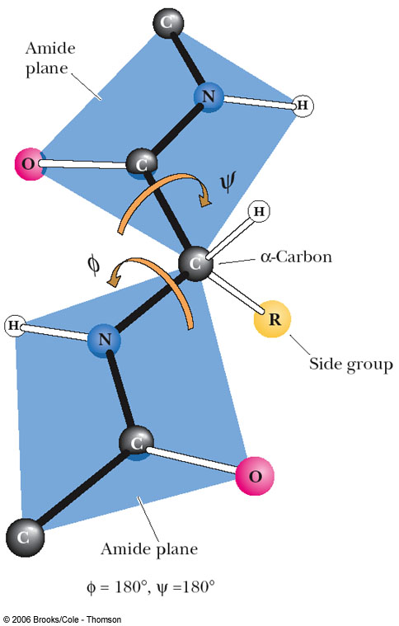
Definition of the angles that determine the conformation of a polypeptide chain:
The rigid planar peptide groups are shaded.
The angle of rotation around the Cα-N bond is designated φ (phi), and the angle of rotation around the Cα-C bond is designated Ψ (psi).
These two bonds are the ones around which there is freedom of rotation.

Slide 24
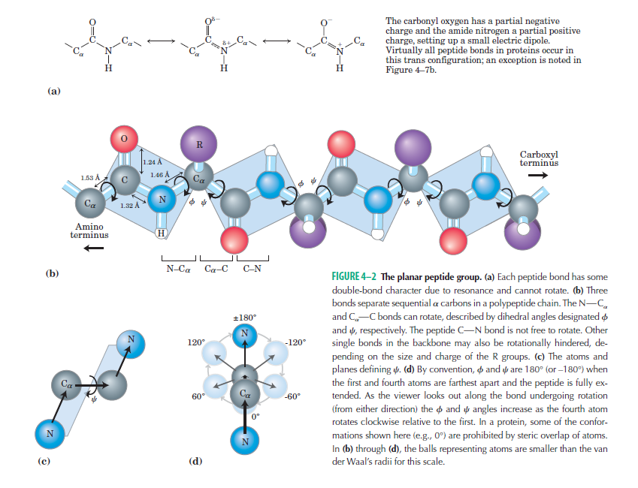

Slide 25
Primary sequence reveals important clues about a protein
• Evolution conserves amino acids that are important to protein structure and function across species. Sequence comparison of multiple “homologs” of a particular protein reveals highly conserved regions that are important for function.
• Clusters of conserved residues are called “motifs” -- motifs carry out a particular function or form a particular structure that is important for the conserved protein.

Slide 26
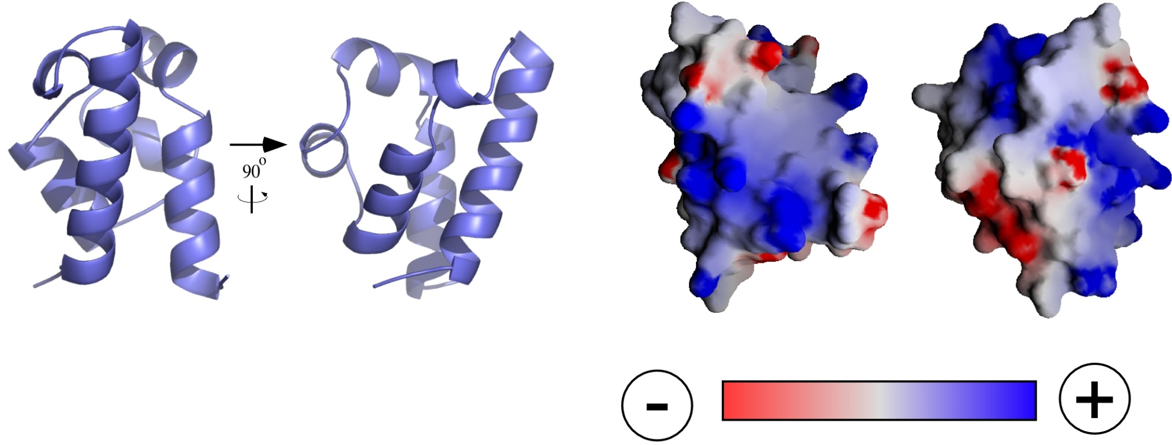
Charged and polar R-groups tend to map to protein surfaces

Slide 27
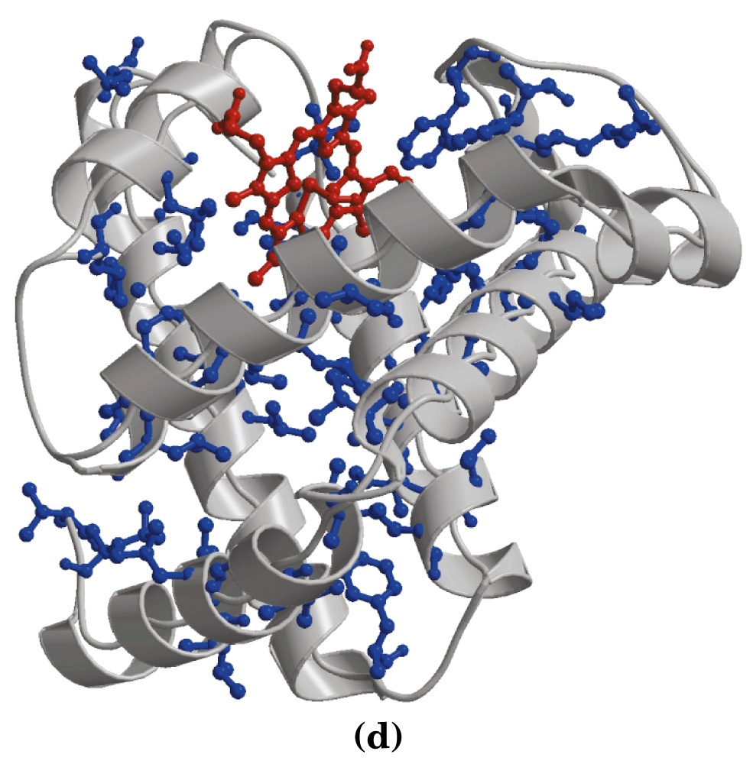
Non-polar R-groups tend to be buried in the cores of proteins
Myoglobin
Blue = non-polar
R-group
Red = Heme

Slide 28
4.2 Protein Secondary Structure
The term secondary structure refers to any chosen segment of a polypeptide chain and describes the local spatial arrangement of its main-chain atoms, without regard to the conformation of its side chains or its relationship to other segments. A regular secondary structure occurs when each dihedral angle, φ and ψ , remains the same or nearly the same throughout the segment. There are a few types of secondary structure that are particularly stable and occur widely in proteins. The most prominent are the α helix and β conformations; another common type is the β turn. Where a regular pattern is not found, the secondary structure is sometimes referred to as undefined or as a random coil. This last designation, however, does not properly describe the structure of these segments. The path of the polypeptide backbone in almost any protein is not random; rather, it is typically unchanging and highly specific to the structure and function of that particular protein. Our discussion here focuses on the regular, common structures.

Slide 29
Secondary structure of proteins
1-Secondary structure is the hydrogen-bonded arrangement in
space of the backbone, the polypeptide chain.
2-Some of the most important backbone arrangements are the
α-helix, the β-sheet, and the β-turn.
3-They can be combined in a number of ways to produce
structural motifs that occur in many proteins.
4-Domain or super-secondary structure: independent folded
portion of protein.

Slide 30
α-helix
1- Coil of the helix is clockwise or right-handed
2- There are 3.6 amino acids per turn
3- Repeat distance is 5.4Å
4- Each peptide bond is trans and planar
5- C=O of each peptide bond is hydrogen
bonded to the N-H of the fourth amino acid
away
6- C=O----H-N hydrogen bonds are parallel to
helical axis
7- All R groups point outward from helix

Slide 31
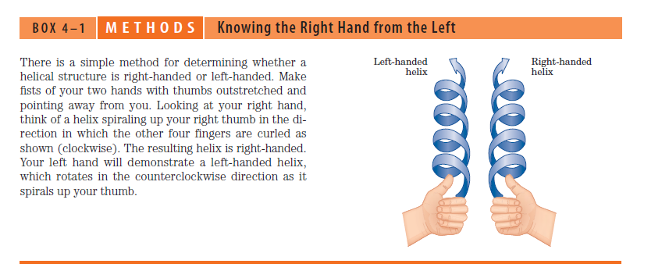

Slide 32
The α- Helix Is a Common Protein Secondary Structure
The simplest arrangement the polypeptide chain can assume, given its rigid peptide bonds (but free rotation around its other, single bonds), is a helical structure,
which Pauling and Corey called the α- helix (Fig. 4–4). In this structure the polypeptide backbone is tightly wound around an imaginary axis drawn longitudinally
through the middle of the helix, and the R groups of the amino acid residues protrude outward from the helical backbone. The repeating unit is a single turn of the helix,
which extends about 5.4 A along the long axis, slightly greater than the periodicity Astbury observed on x-ray analysis of hair keratin. The amino acid residues in the
prototypical helix have conformations with φ= - 57 and ψ=- 47, and each helical turn includes 3.6 amino acid residues. The -helical segments in proteins often
deviate slightly from these dihedral angles, and even vary somewhat within a single contiguous segment to produce subtle bends or kinks in the helical axis. In all
proteins, the helical twist of the helix is right-handed (Box 4–1). The α- helix proved to be the predominant structure in α -keratins. More generally, about one fourth
of all amino acid residues in proteins are found in α- helices, the exact fraction varying greatly from one protein to another.

Slide 33
Why does the α - helix form more readily than many other possible conformations? The answer is, in part, that an helix makes optimal use of internal hydrogen bonds.
The structure is stabilized by a hydrogen bond between the hydrogen atom attached to the electronegative nitrogen atom of a peptide linkage and the electronegative
carbonyl oxygen atom of the fourth amino acid on the amino-terminal side of that peptide bond (Fig. 4–4a). Within the α - helix, every peptide bond (except those close to each end of the helix) participates in such hydrogen bonding. Each successive turn of the helix is held to adjacent turns by three to four hydrogen bonds, conferring significant stability on the
overall structure. Further model-building experiments have shown that an α - helix can form in polypeptides consisting of either L- or D-amino acids. However, all residues must be
of one stereoisomeric series; a D-amino acid will disrupt a regular structure consisting of L-amino acids, and vice versa. In principle, naturally occurring L-amino acids can form either right- or left-handed helices, but extended left-handed helices are theoretically less stable
and have not been observed in proteins.

Slide 34
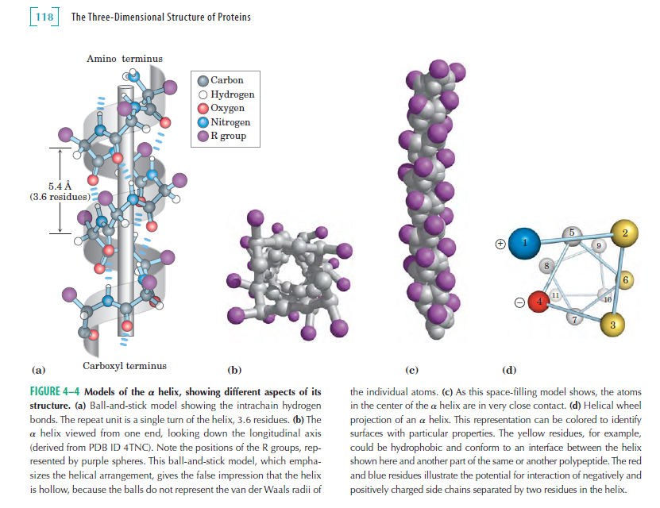

Slide 35
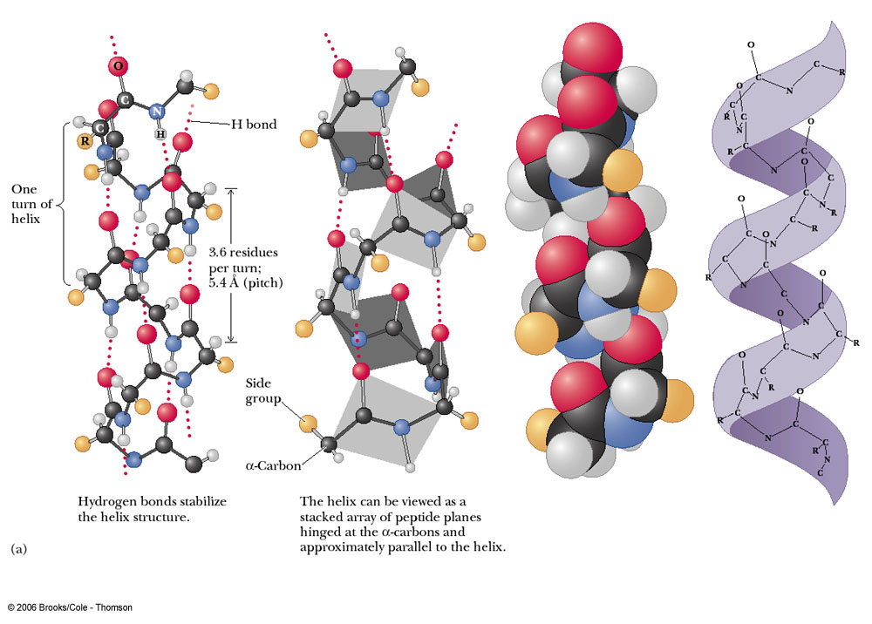
The α-helix:
. Position of hydrogen bonds
(Intrachain)
. Dimensions
. Side chain considerations

Slide 36
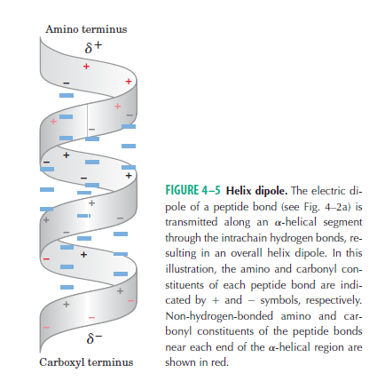

Slide 37
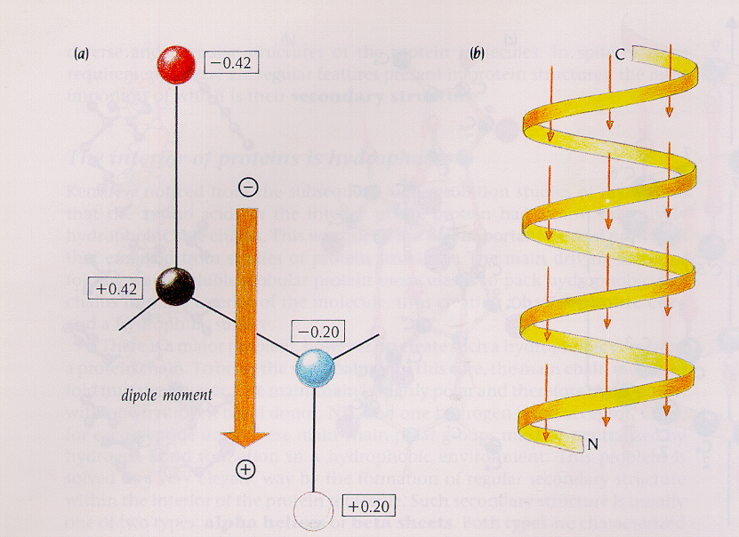

Slide 38
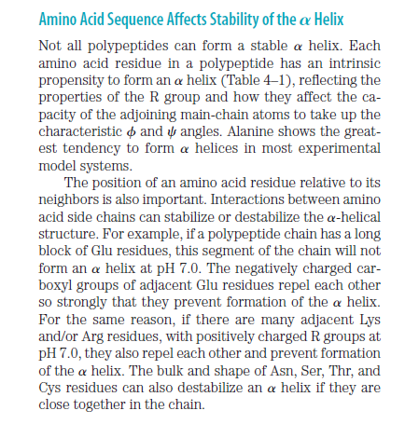

Slide 39
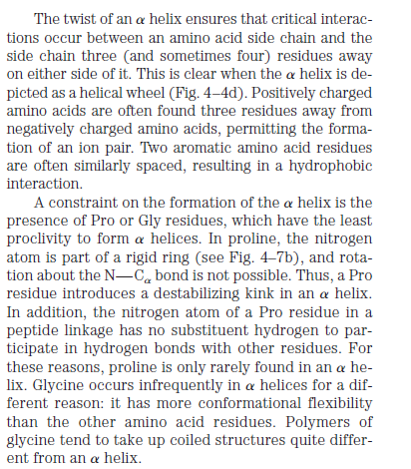

Slide 40
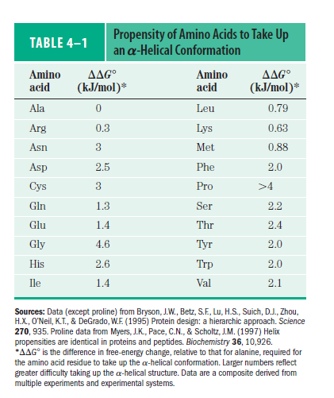

Slide 41
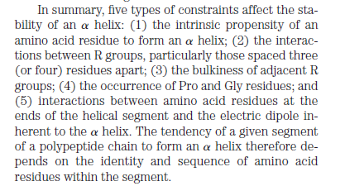

Slide 42
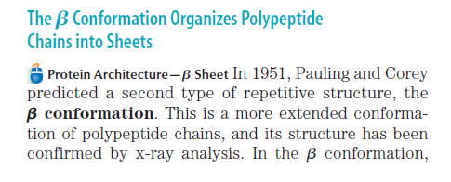
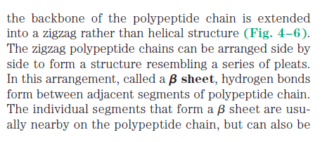

Slide 43
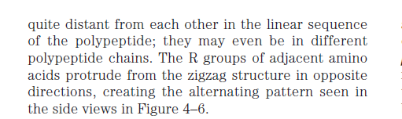
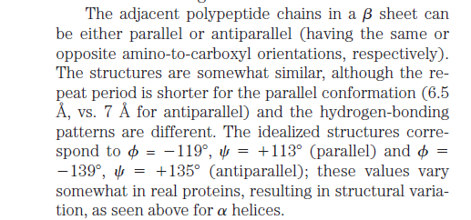

Slide 44
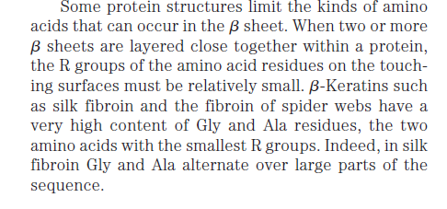

Slide 45
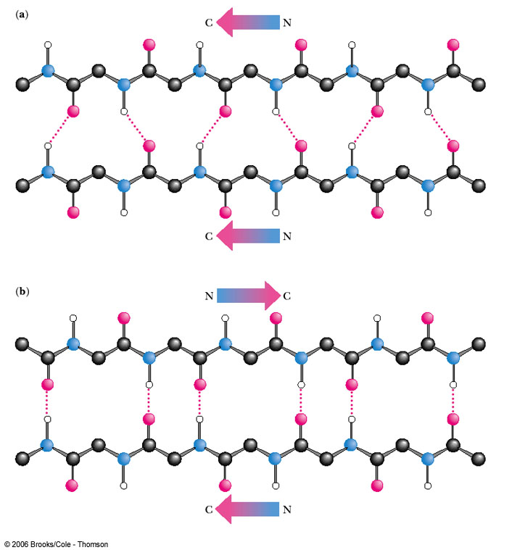

Slide 46
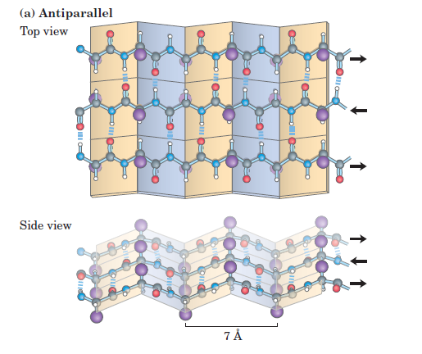

Slide 47
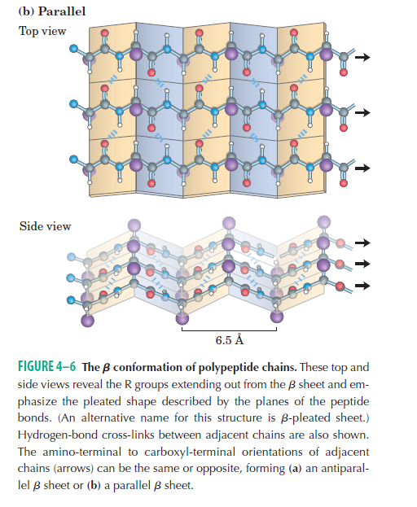

Slide 48
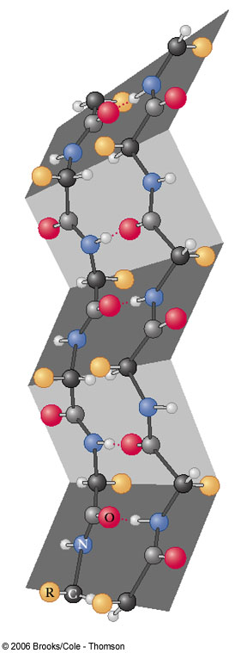
The three-dimensional form of the antiparallel β-pleated sheet arrangement. The chains do not fold back on each other but are in a fully extended conformation.

Slide 49
β-Pleated Sheet
1- Polypeptide chains lie adjacent to one another;
may be parallel or antiparallel
2- R groups alternate, first above and then below
plane
3- Each peptide bond is trans and planar
4- C=O and N-H groups of each peptide bond are
perpendicular to axis of the sheet
5- C=O---H-N hydrogen bonds are between
adjacent sheets and perpendicular to the
direction of the sheet

Slide 50
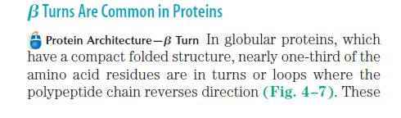
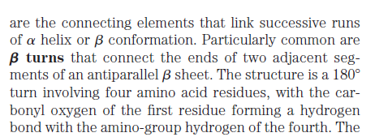

Slide 51
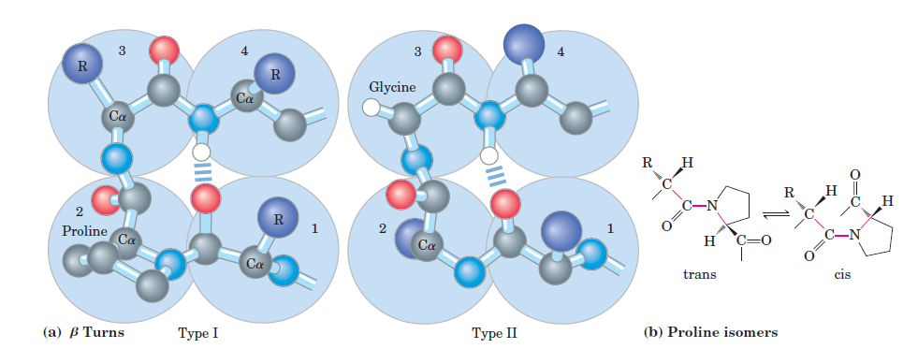
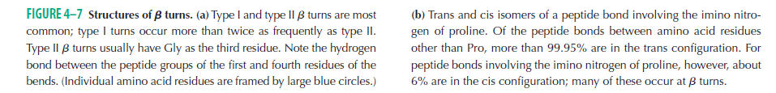

Slide 52
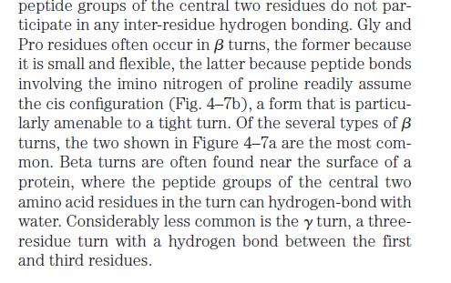

Slide 54
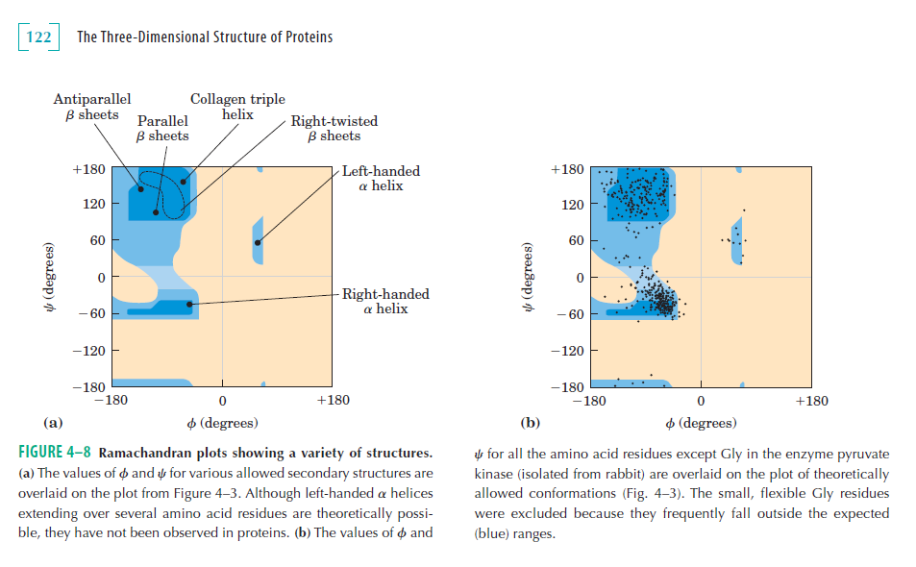

Slide 55
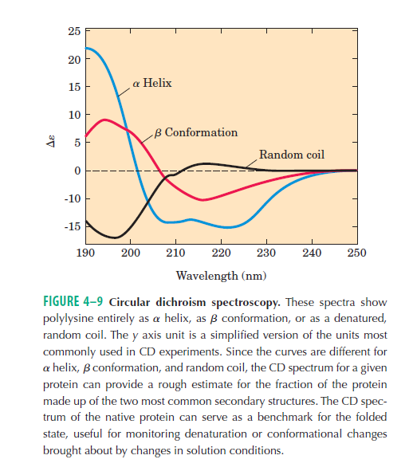

Slide 56
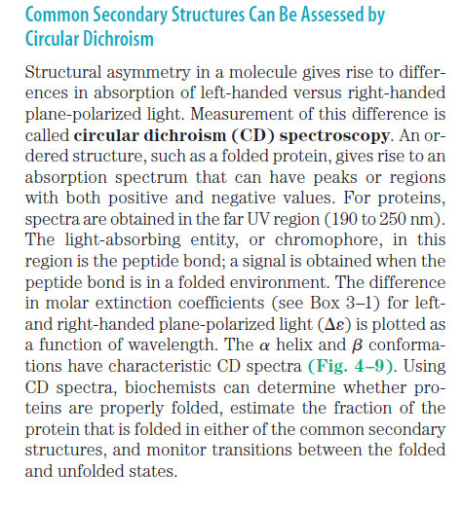

Slide 57
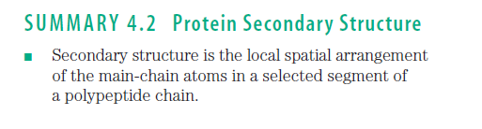
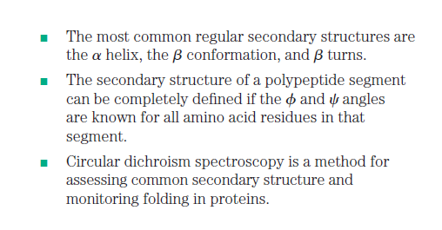

Slide 58
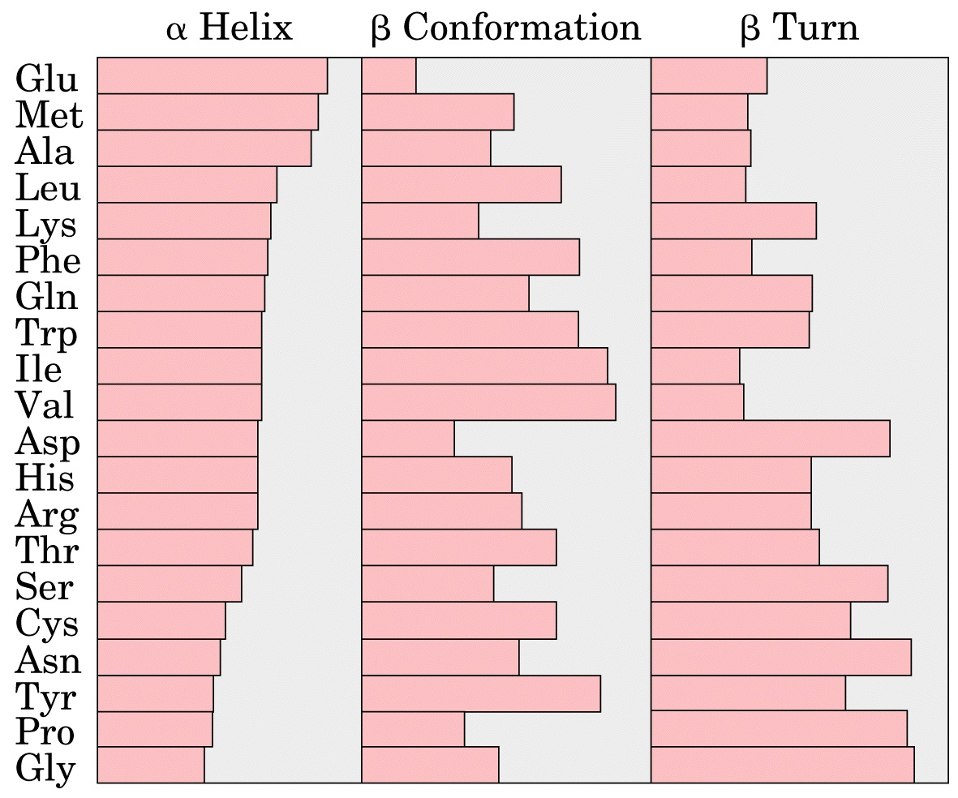
Which residues are common for α-helix, β-sheet, and β-turn elements

Slide 59
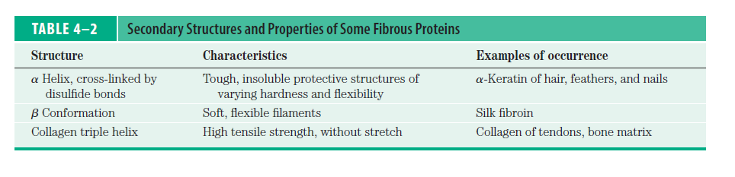

Slide 60
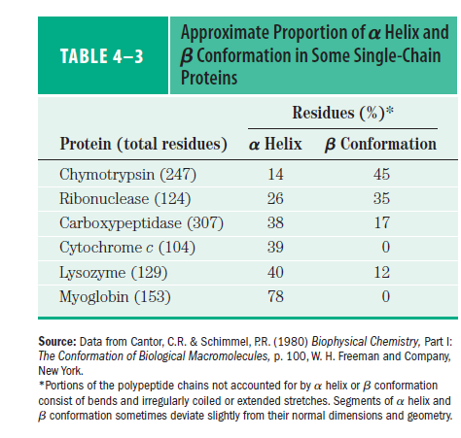

Slide 61
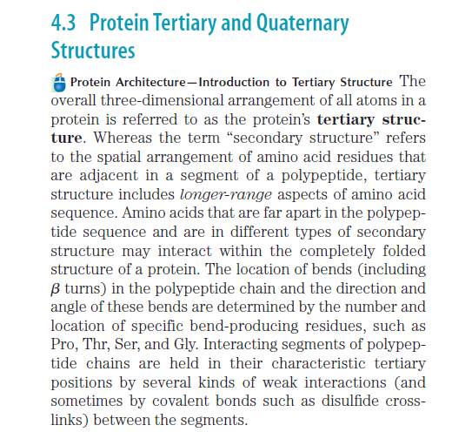

Slide 62

Forces that stabilize the tertiary structure of proteins

Slide 63

Hydrogen bond
Hydrophobic interactions and van der Waals interactions
Disulfide bridge
Ionic bond
Polypeptide backbone

Slide 64


Slide 65

(a) A ribbon model
(b) A space-filling model

Slide 66


Slide 67
Fibrous –
Polypeptides arranged in long strands or sheets
Water insoluble (lots of hydrophobic AA’s)
Strong but flexible.
Structural (keratin, collagen)
Globular –
Polypeptide chains folded into spherical or globular form
Water soluble
Contain several types of secondary structure
Diverse functions (enzymes, regulatory proteins)

Slide 68


Slide 69

A comparison of the shapes of fibrous and globular proteins:
(a) Schematic diagrams of a portion of a fibrous protein and of a globular protein.
(b) Computer-generated model of a globular protein. The color-coding in this model differs from that of models of smaller molecules. The carbons are represented by light blue spheres, and the yellow spheres represent sulfur.

Slide 70
Globular Proteins Have a Variety of Tertiary Structures
Each of these proteins has a distinct structure, adapted for its particular biological function, but together they share several important properties
with myoglobin. Each is folded compactly, and in each case the hydrophobic amino acid side chains are oriented toward the interior (away from water) and the hydrophilic side chains are on the surface. The structures are also stabilized by a multitude of hydrogen bonds and some ionic interactions.
The three-dimensional structure of a typical globular protein can be considered an
assemblage of polypeptide segments in the alpha -helical and beta -sheet conformations, linked by connecting segments. The structure can then be defined by how these segments stack on one another and how the segments that connect them are arranged.
Two important terms that describe protein structural patterns or elements in a polypeptide chain. The first term is motif, also called a supersecondary
structure or fold.

Slide 71
The first term is motif, also called a supersecondary structure or fold. A motif is simply a recognizable folding pattern involving two or more elements of secondary structure and the connection(s) between them. Although there is some confusing application of these three terms in the literature, they are generally used interchangeably. A motif can be very simple, such as two elements of secondary structure folded against each other, and represent only a small part of a protein.
An example is in (Fig. 4–17a). A motif can also be a very elaborate structure involving scores of protein segments folded together, such as the barrel (Fig. 4–17b). In some cases, a single large motif may comprise the entire protein.
We have already encountered one well-studied motif, the coiled coil of
alpha-keratin, which is also found in some other proteins. Note that a motif is not a hierarchical structural element falling between secondary and tertiary structure.
It is a folding pattern that can describe a small part of a protein or an entire polypeptide chain.

Slide 72
The second term for describing structural patterns is domain. A domain, as defined by Jane Richardson in 1981, is a part of a polypeptide chain that is independently stable or could undergo movements as a single entity with respect to the entire protein. Polypeptides with more than a few hundred amino acid residues often fold into two or more domains, sometimes with different functions. In many cases, a domain from a large protein will retain its native three-dimensional structure even when separated (for example, by proteolytic cleavage) from the remainder of the polypeptide chain. Different domains often have distinct functions, such as the binding of small molecules or interaction with other proteins. Small proteins usually have only one domain (the domain is the protein)

Slide 73


Slide 74


Slide 75

The combination of α–helix and β–sheet form the Supersecondry structure:
a- βαβ unit in which two parallel strand ob β-sheet are connected by a stretch of α-helix
b- αα unit (Helix-turn-helix) consist of two antiparallel α helices
c- β-meander in which antiparalell sheet is formed of tight reverse turns connecting stretches of the polypeptide chain.
d- Greek key in which antiparallel sheet is formed when polypeptide chain doubles back on itself.
.

Slide 76


Slide 77


Slide 78


Slide 79


Slide 80


Slide 81


Slide 82



Slide 83


Slide 84


Slide 85


Slide 86


Slide 87



Slide 88


Slide 89



Slide 90

What do we have here ?
Notes:
Figure 5.20 Exploring: Levels of Protein Structure

Slide 91


Slide 92



Slide 93


Slide 94
Linus Pauling HOW TO LIVE LONGER AND FEEL BETTER (1986) Pages 89-91
"We have come upon reasons why we require for good health so much larger amounts of vitamin C than are present in the plants we use as food... It has recently been shown by Myllyla and his colleagues that, one molecule of vitamin C is destroyed for each H (hydrogen atom) replaced by OH (during the formation of collagen)... Vitamin C, in the critical reactions that assemble collagen in the tissues, does not serve merely as a catalyst but is destroyed." Linus Pauling

Slide 95


Slide 96


Slide 97


Slide 98


Slide 99



Slide 100


Slide 101
Classes of proteins
Functional definition:
Enzymes: Accelerate biochemical reactions
Structural: Form biological structures
Transport: Carry biochemically important substances
Defense: Protect the body from foreign invaders
Structural definition:
Globular: Complex folds, irregularly shaped tertiary structures
Fibrous: Extended, simple folds -- generally structural proteins
Cellular localization definition:
Membrane: In direct physical contact with a membrane; generally water insoluble.
Soluble: Water soluble; can be anywhere in the cell.

Slide 102
Protein Function
Catalysis – enzymes
Structural – keratin
Transport – hemoglobin
Trans-membrane transport – Na+/K+ ATPases
Toxins – rattle snake venom, ricin
Contractile function – actin, myosin
Hormones – insulin
Storage Proteins – seeds and eggs
Defensive proteins – antibodies

Slide 103

Figure 5.15-a
Enzymatic proteins
Defensive proteins
Function: Selective acceleration of chemical reactions
Function: Protection against disease
Example: Digestive enzymes catalyze the hydrolysis of bonds in food molecules.
Example: Antibodies inactivate and help destroy viruses and bacteria.
Antibodies
Enzyme
Virus
Bacterium
Storage proteins
Transport proteins
Function: Storage of amino acids
Function: Transport of substances
Examples: Casein, the protein of milk, is the major source of amino acids for baby mammals. Plants have storage proteins in their seeds. Ovalbumin is the protein of egg white, used as an amino acid source for the developing embryo.
Examples: Hemoglobin, the iron-containing protein of vertebrate blood, transports oxygen from the lungs to other parts of the body. Other proteins transport molecules across cell membranes.
Transport protein
Ovalbumin
Amino acids for embryo
Cell membrane
Notes:
Figure 5.15 An overview of protein functions.

Slide 104

Figure 5.15-b
Hormonal proteins
Receptor proteins
Function: Coordination of an organism’s activities
Function: Response of cell to chemical stimuli
Example: Insulin, a hormone secreted by the pancreas, causes other tissues to take up glucose, thus regulating blood sugar concentration
Example: Receptors built into the membrane of a nerve cell detect signaling molecules released by other nerve cells.
Receptor protein
High blood sugar
Insulin secreted
Normal blood sugar
Signaling molecules
Contractile and motor proteins
Structural proteins
Function: Movement
Function: Support
Examples: Motor proteins are responsible for the undulations of cilia and flagella. Actin and myosin proteins are responsible for the contraction of muscles.
Examples: Keratin is the protein of hair, horns, feathers, and other skin appendages. Insects and spiders use silk fibers to make their cocoons and webs, respectively. Collagen and elastin proteins provide a fibrous framework in animal connective tissues.
Actin
Myosin
Collagen
Muscle tissue
100 μm
Connective tissue
60 μm
Notes:
Figure 5.15 An overview of protein functions.

Slide 105

Conformation – spatial arrangement of atoms in a protein
Native conformation – conformation of functional protein
High orders of Protein structure
A functional protein is not just a polypeptide chain, but one or more polypeptides precisely twisted, folded and coiled into a molecule of unique shape (conformation). This conformation is essential for some protein function e.g. Enables a protein to recognize and bind specifically to another molecule e.g. hormone/receptor; enzyme/substrate and antibody/antigen.

Slide 106


Slide 107
What Determines Protein Structure?
In addition to primary structure, physical and chemical conditions can affect structure
Alterations in pH, salt concentration, temperature, or other environmental factors can cause a protein to unravel
This loss of a protein’s native structure is called denaturation
A denatured protein is biologically inactive

Slide 108

Figure 5.22
De
n
a
tu
r
a
t
i
on
Normal protein
Re
n
i
on
Denatured protein
a
t
u
r
a
t
Notes:
Figure 5.22 Denaturation and renaturation of a protein.

Slide 109


Denaturation and Refolding:
Proteins can be denatured by Heat, extremes pH, and chemicals such as:
1- SDS: Disrupted Electrostatic Interaction.
2- Urea and Guanidine Hydrochloride: form H-bond with protein and disrupted the Hydrophobic interaction.
3- β-marcaptoethanol: reduce the Disulfide Bridges (-S-S- to 2 SH)
Some denatured protein can be recovered, while others are permanent.

Slide 110


Slide 111


Slide 112


Slide 113


Slide 114


Slide 115


Slide 116


Slide 117


Slide 118


Slide 119




Slide 120



Slide 121


Slide 122



Slide 123


Slide 124


Slide 125
Scientists use X-ray crystallography to determine a protein’s structure
Another method is nuclear magnetic resonance (NMR) spectroscopy, which does not require protein crystallization
Bioinformatics uses computer programs to predict protein structure from amino acid sequences

Slide 126

Diffracted X-rays
X-ray source
X-ray beam
Crystal
Digital detector
X-ray diffraction pattern
DNA
RNA polymerase II

Slide 127




Slide 128



The tertiary structure of α-Lactalbumin
X-Ray Crystallography

Slide 129


