Slide 1
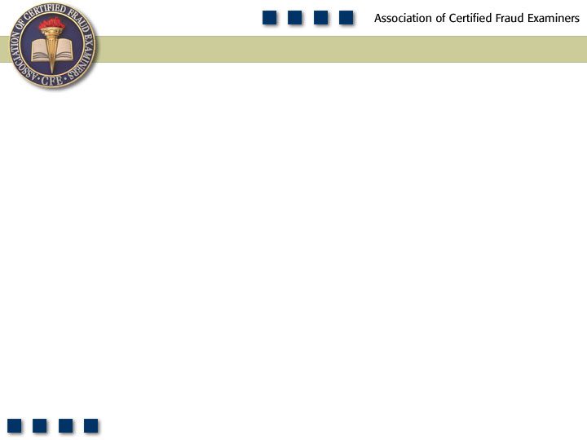
Chapter 8
Register Disbursement Schemes

Slide 2

Pop Quiz
According to the 2011 Global Fraud Survey, register disbursement schemes have a higher median loss than payroll schemes.
True or false?

Slide 3
Learning Objectives
Explain what constitutes a register disbursement scheme.
Differentiate register disbursements from skimming and cash larceny schemes.
List the two basic categories of register disbursements.
Explain how false refund schemes are committed.
Explain how false void schemes are committed.

Slide 4
Learning Objectives
Understand how register disbursement schemes cause shrinkage.
Discuss the methods by which fraudulent register disbursements are concealed.
Understand the methods identified in this chapter for preventing and detecting register disbursement schemes.
Be familiar with proactive audit tests that can be used to detect register disbursement schemes.

Slide 5
Register
Disbursements
False Voids
False Refunds

Slide 6
Frequency of Fraudulent Disbursements

Slide 7
Median Loss of Fraudulent Disbursements

Slide 8
Register Disbursement Schemes
False refunds
False voids

Slide 9
False Refunds
A refund is processed when a customer returns an item of merchandise purchased from the store
Merchandise is placed back into inventory
Purchase price is returned to the customer

Slide 10
False Refunds
Fictitious refunds
Fraudster takes cash from the register in the amount of the false return
Debit is made to the inventory system showing that the merchandise has been returned to the inventory

Slide 11
False Refunds
Overstated refunds
Fraudster overstates the amount of a legitimate refund and skims the excess money
Customer is paid the actual amount owed for the returned merchandise and the excess is kept by the fraudster

Slide 12
False Refunds
Credit card refunds
Refunds appear as credits to the customer’s credit card rather than as cash disbursements
Perpetrator does not have to physically take cash from the register
Refunded to the perpetrator’s credit card

Slide 13
False Voids
Also generate a disbursement from the register
Copy of customer’s receipt is attached to the void slip
Managers must generally approve voided sales
Rubber stamp approvals allow the fraud to succeed
Management and the employee may conspire

Slide 14
Concealing Register Disbursements
Fraudsters typically do not make any effort to conceal the shrinkage
Register disbursement schemes leave the victim organization’s books in balance
Fraudster often takes no further action

Slide 15
Concealing Register Disbursements
Small disbursements
Keep the size of the disbursements low to where management review is not required
Destroying records
Employee has conceded that management will discover the theft
Goal is to prevent management from discovering who the thief is

Slide 16
Preventing and Detecting Register Disbursement Schemes
Maintain appropriate separation of duties
Management approval should be required for all refunds and voided sales
Closely guard access to the control key or management code
Prohibit cashiers from reversing their own sales

Slide 17
Preventing and Detecting Register Disbursement Schemes
Require proper documentation for voided transactions such as the original receipt
Require cashiers to maintain a distinct login code
Periodically generate reports of all reversing transactions

Slide 18
Preventing and Detecting Register Disbursement Schemes
Look for large numbers of transactions just below the approval amount
Institute store policies encouraging customers to ask for and examine their receipts
Randomly call customers who have returned merchandise or voided sales

