Slide 1
Organic Chemistry, Fourth Edition
Janice Gorzynski Smith
University of Hawai’i
Chapter 11
Lecture Outline
Prepared by Layne A. Morsch
The University of Illinois - Springfield
Copyright © 2014 The McGraw-Hill Companies, Inc. Permission required for reproduction or display.
‹#›

Slide 2
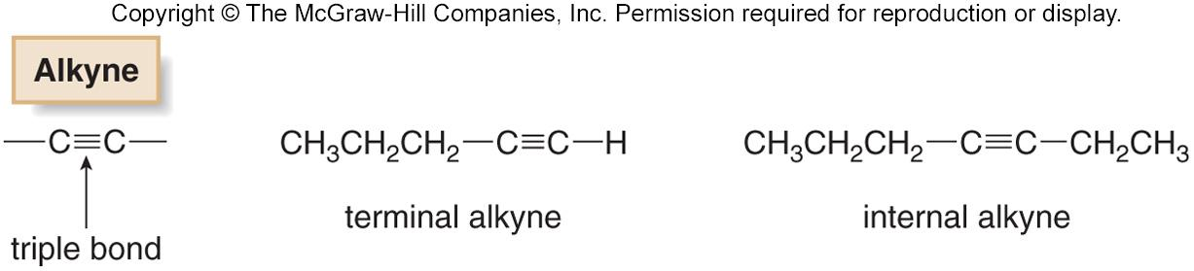
Alkyne Structure
Alkynes contain a carbon-carbon triple bond.
An alkyne has the general molecular formula C_{n}H_{2n−2}, giving it four fewer hydrogens than the maximum possible for the number of carbons present.
  The triple bond introduces two degrees of unsaturation.
Terminal alkynes have the triple bond at the end of the carbon chain so that a hydrogen atom is directly bonded to a carbon atom of the triple bond.
Internal alkynes have a carbon atom bonded to each carbon atom of the triple bond.
‹#›

Slide 3
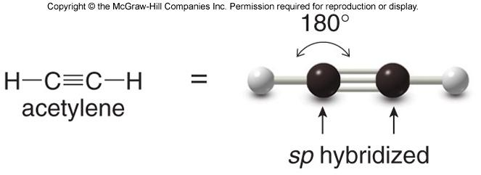
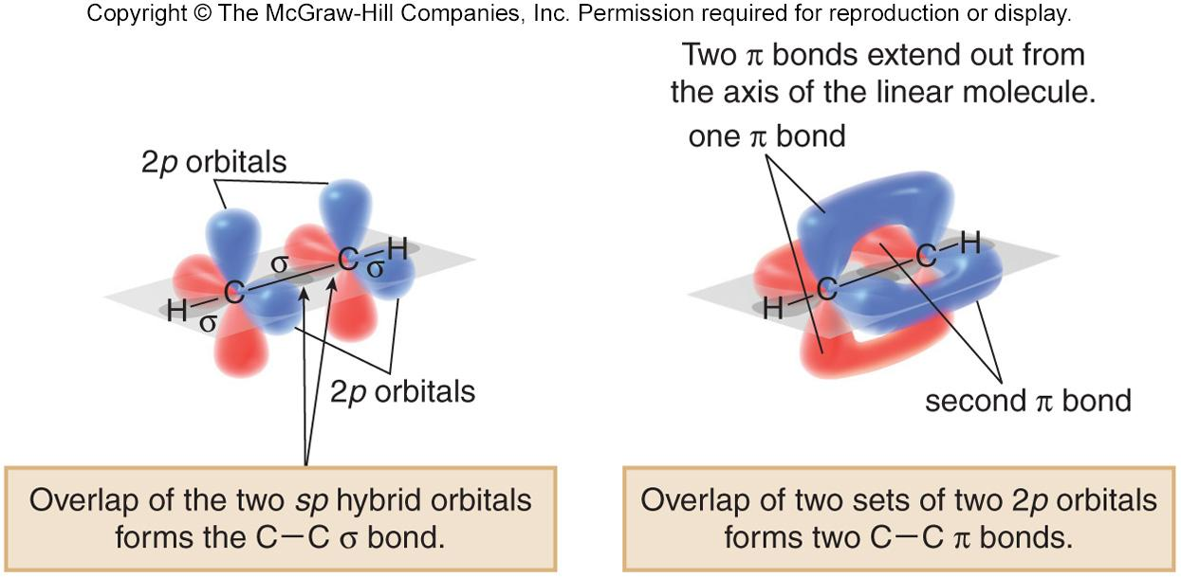
Alkyne Bonding
Recall that the triple bond consists of 2 π bonds and 1 σ bond.
Each carbon is sp hybridized with a linear geometry and bond angles of 180º.
‹#›

Slide 4
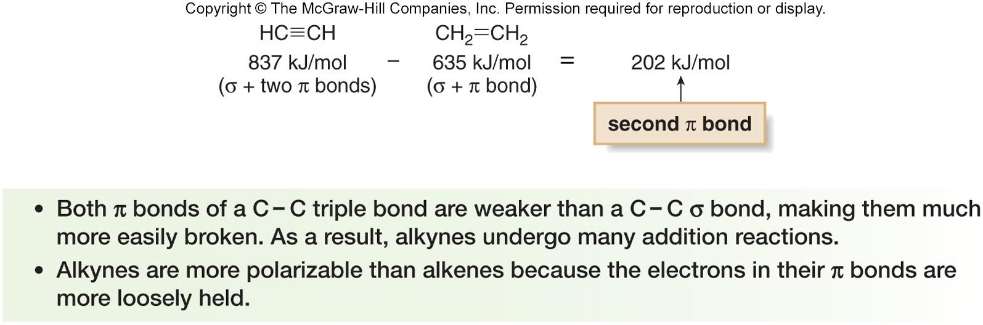
Strength of Alkyne Bonds
Bond dissociation energies of the C − C bonds in ethylene (one σ and one π bond) and acetylene (one σ and two
π bonds) can be used to estimate the strength of the
second π bond of the triple bond.
‹#›

Slide 5
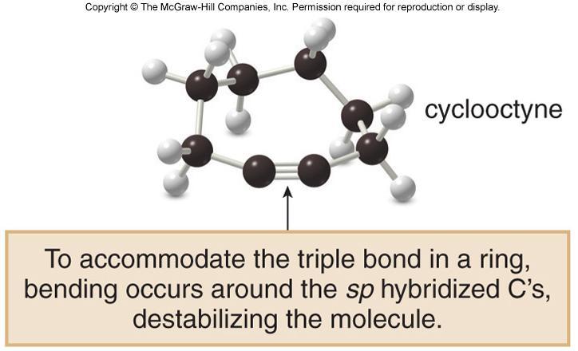
Cyclic Alkynes
Like trans cycloalkenes, cycloalkynes with small rings are unstable.
The carbon chain must be long enough to connect the two ends of the triple bond without introducing too much strain.
Cyclooctyne is the smallest isolated cycloalkyne, though it decomposes upon standing at room temperature after a short time.
‹#›

Slide 6
Naming Alkynes
Alkynes are named in the same general way that alkenes are named.
In the IUPAC system, change the –ane ending of the parent alkane name to the suffix –yne.
Choose the longest continuous chain that contains both atoms of the triple bond and number the chain to give the triple bond the lower number.
‹#›

Slide 7
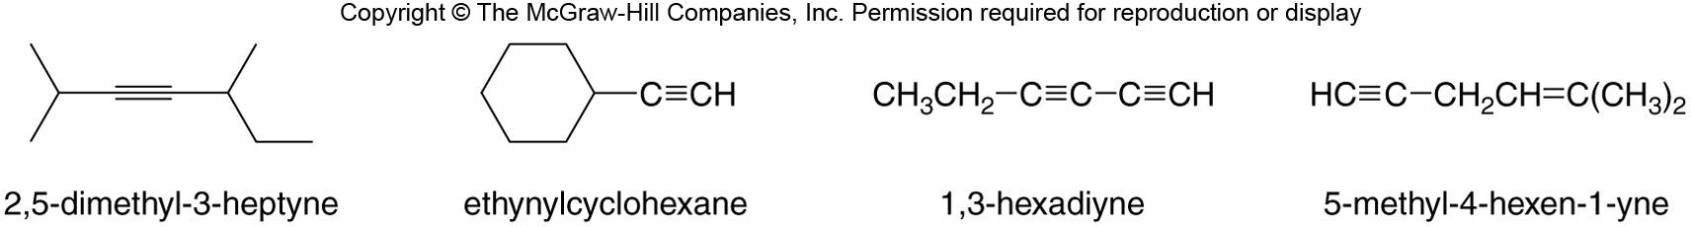
Naming Alkynes
Compounds with two triple bonds are named as diynes, those with three are named as triynes and so forth.
Compounds with both a double and triple bond are named as enynes.
The chain is numbered to give the first site of unsaturation (either C=C or C≡C) the lower number.
Figure 11.1
‹#›

Slide 8
Physical Properties of Alkynes
The physical properties of alkynes resemble those of hydrocarbons of similar shape and molecular weight.
Alkynes have low melting points and boiling points.
Melting point and boiling point increase as the number of carbons increases.
Alkynes are soluble in organic solvents and insoluble in water.
‹#›

Slide 9
Acetylene
The simplest alkyne, H−C≡C−H, named in the IUPAC system as ethyne, is more often called acetylene, its common name.
The two-carbon alkyl group derived from acetylene is called an ethynyl group.
Acetylene (H−C≡C−H) is a colorless gas that burns in oxygen to form CO₂ and H₂O.
  The combustion of acetylene releases more energy per mole of product formed than any other hydrocarbons.
  When combined with oxygen, it burns with a very hot flame and is used in welding.
‹#›

Slide 10
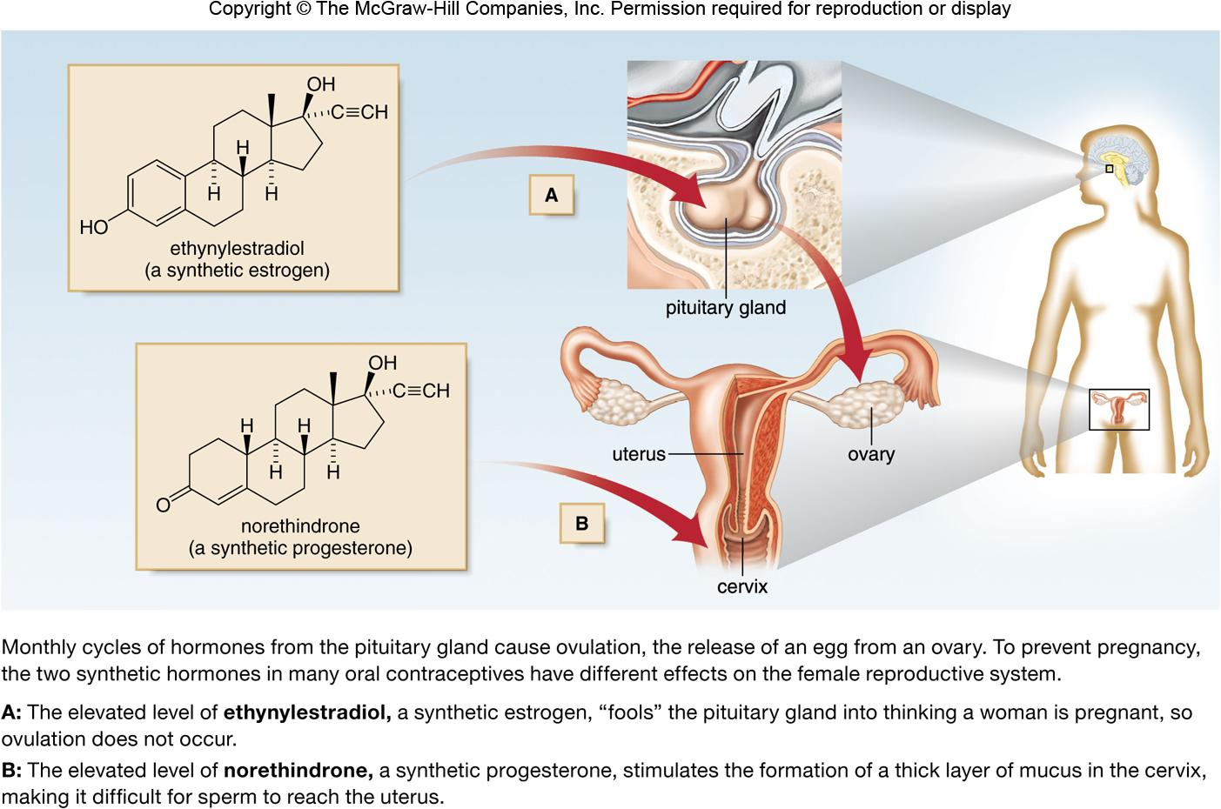
Oral Contraceptives
Figure 11.2
‹#›

Slide 11
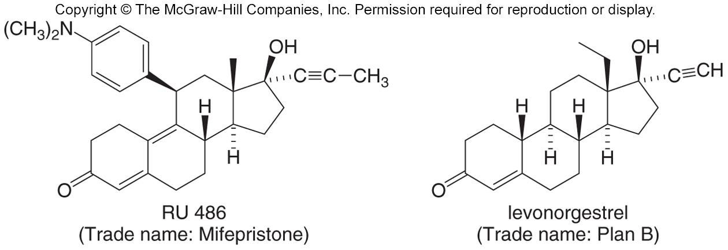
Oral Contraceptives
RU-486 and levonorgestrel are two other synthetic hormones.
RU-486 blocks the effects of progesterone, thus preventing pregnancy.
It is used to induce abortions within the first few weeks of pregnancy.
Levonorgestrel interferes with ovulation, and so it prevents pregnancy if taken within a few days of unprotected sex.
‹#›

Slide 12
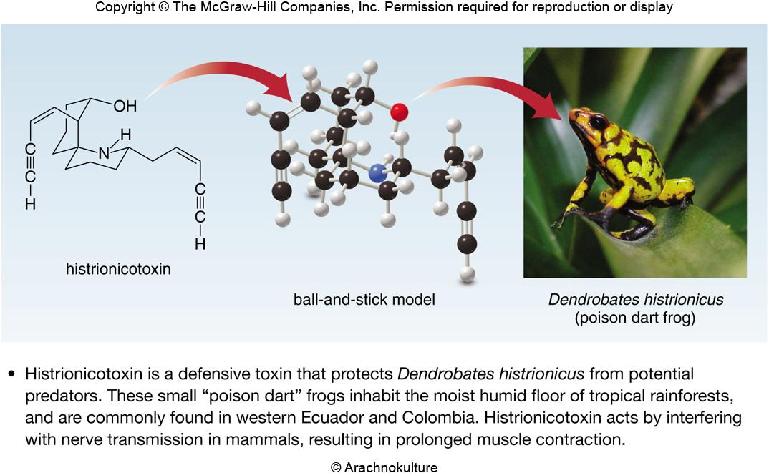
Histrionicotoxin
Figure 11.3
‹#›

Slide 13
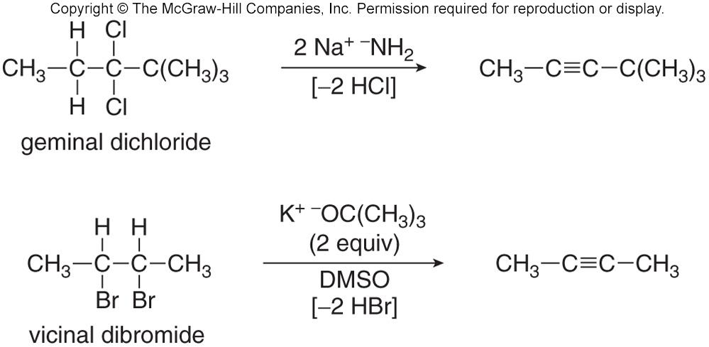
Preparation of Alkynes
Alkynes are prepared by elimination reactions.
A strong base removes two equivalents of HX from a vicinal
or geminal dihalide to yield an alkyne through two successive E2 elimination reactions.
‹#›

Slide 14
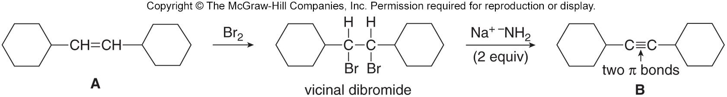
Preparation of Alkynes from Alkenes
Since vicinal dihalides are readily made from alkenes, one can convert an alkene to the corresponding alkyne in a
two-step process involving:
    Halogenation of an alkene.
    Double dehydrohalogenation of the resulting vicinal dihalide.
‹#›
‹#›

Slide 15
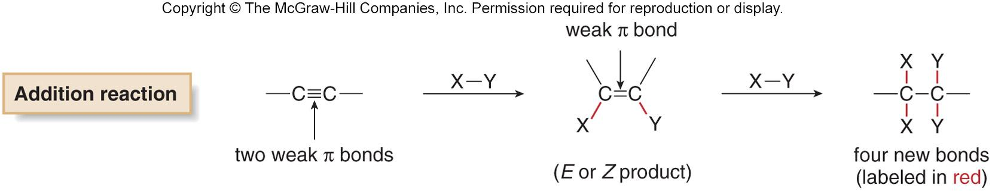
General Addition Reactions of Alkynes
Like alkenes, alkynes undergo addition reactions because they contain relatively weak π bonds.
Two sequential reactions can take place:
  addition of one equivalent of reagent forms an alkene;
  which can then add a second equivalent of reagent to yield a product having four new bonds.
‹#›

Slide 16
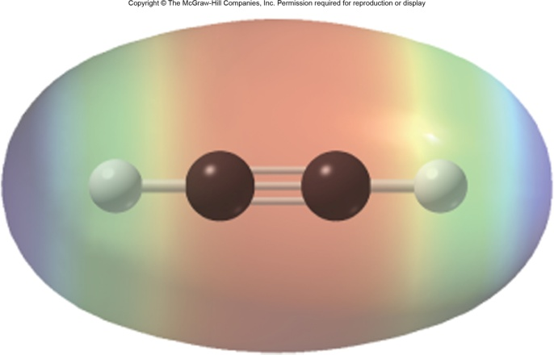
Electrostatic Potential of Acetylene
The red electron-rich region is located between the two carbon atoms forming the triple bond.
This forms a cylinder of electron density around the center of the molecule.
Figure 11.4
‹#›

Slide 17
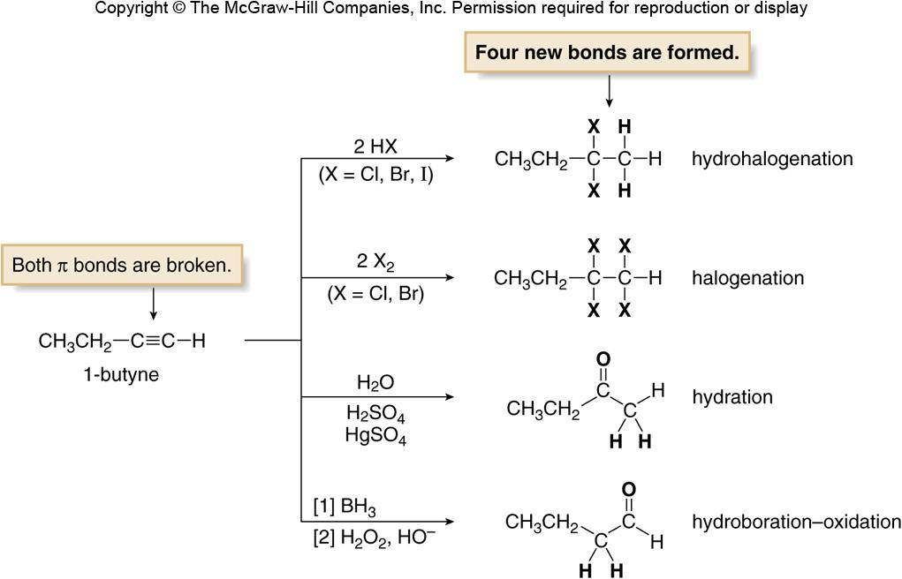
Addition Reactions of Alkynes
Figure 11.5
‹#›

Slide 18
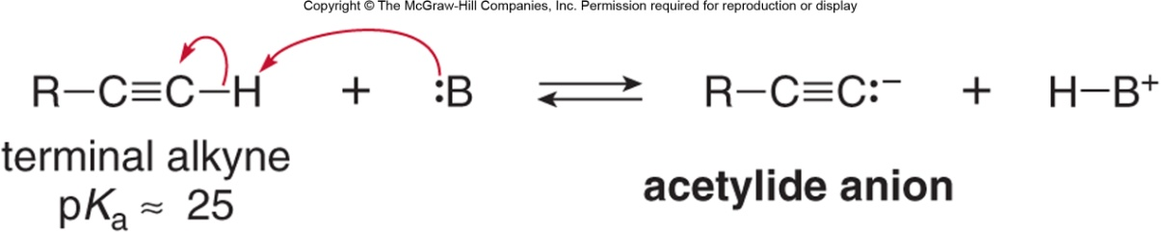
Terminal Alkynes – Reaction as an Acid
Sp hybridized C − H bonds are considerably more acidic than sp² and sp³ hybridized C − H bonds.
Therefore, terminal alkynes are readily deprotonated with strong base in a Brønsted-Lowry acid-base reaction.
The resulting ion is called the acetylide ion.
‹#›

Slide 19
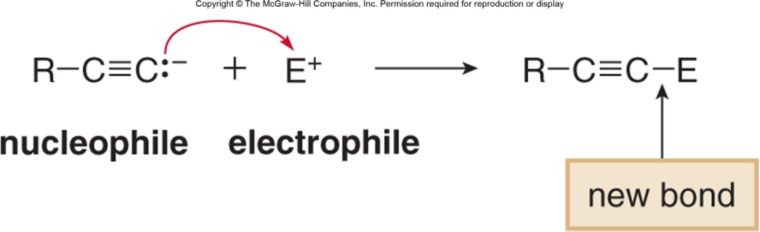
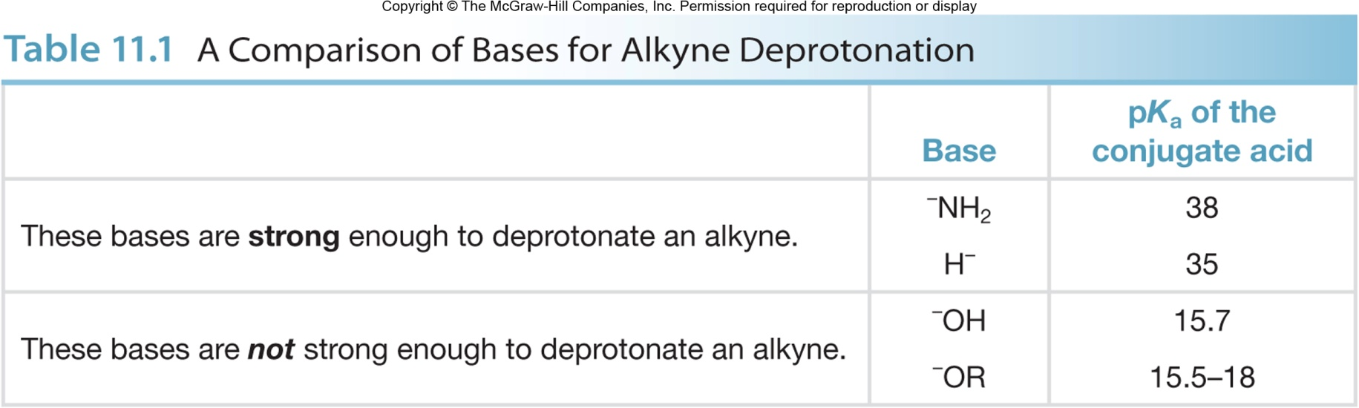
Terminal Alkynes – Reaction as an Acid
Acetylide ions formed by deprotonating terminal alkynes are strong nucleophiles.
They can react with a variety of electrophiles.
‹#›

Slide 20
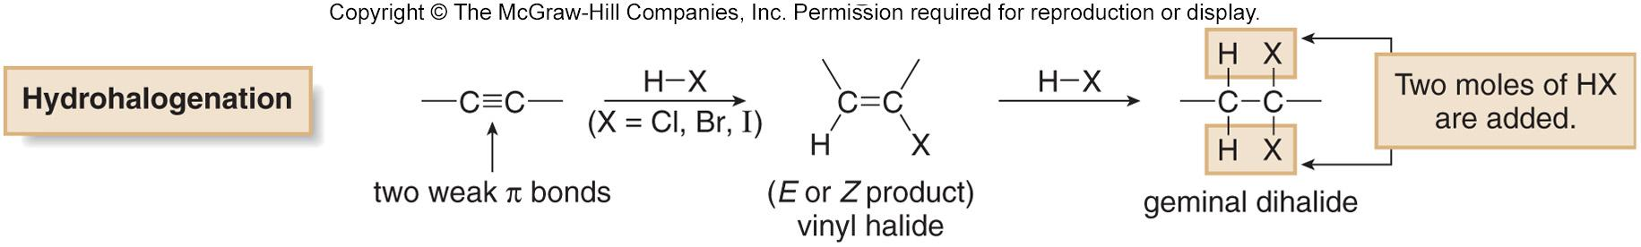
Addition of Hydrogen Halides
Alkynes undergo hydrohalogenation, the addition of hydrogen halides, HX (X = Cl, Br, I).
Two equivalents of HX are usually used: addition of one mole forms a vinyl halide, which then reacts with a second mole of HX to form a geminal dihalide.
‹#›
Notes:
‹#›

Slide 21
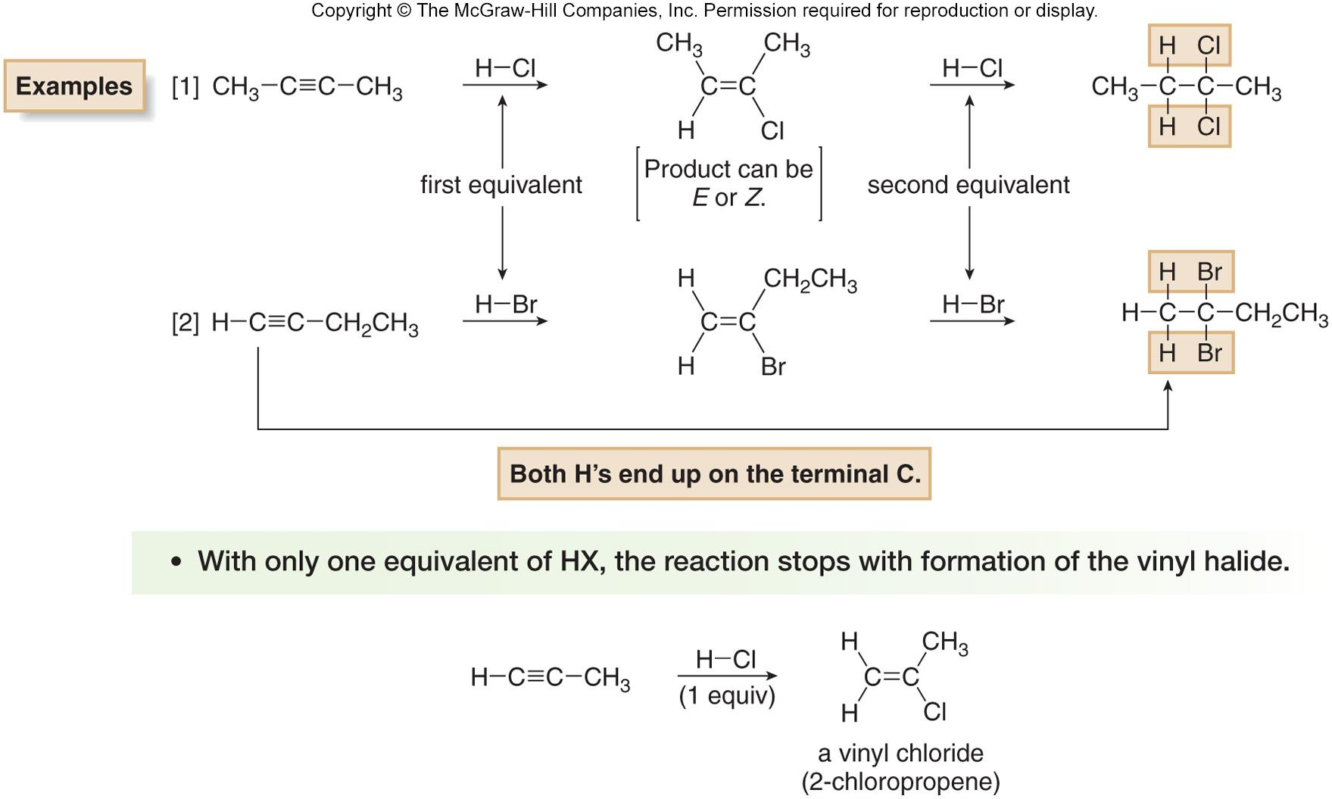
Hydrohalogenation—Markovnikov’s Rule
‹#›

Slide 22
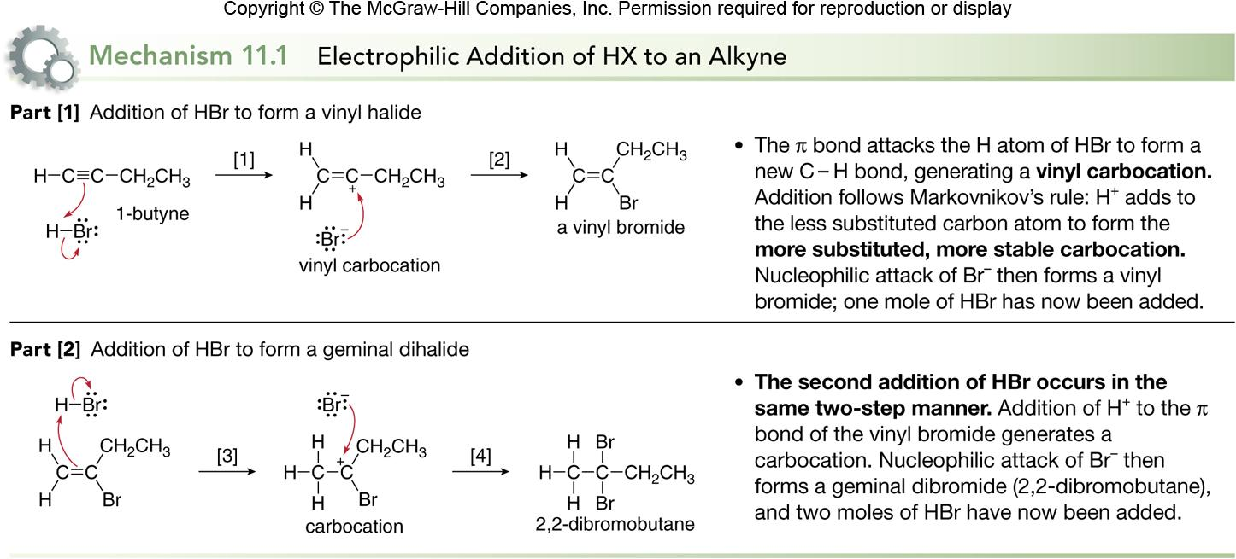
Hydrohalogenation Mechanism
‹#›

Slide 23
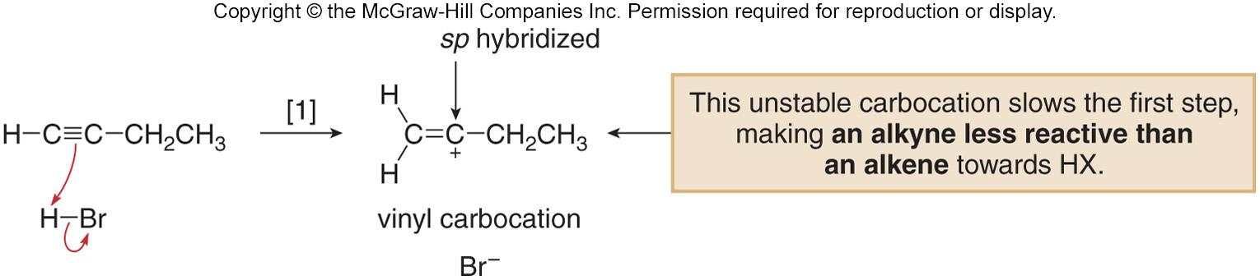
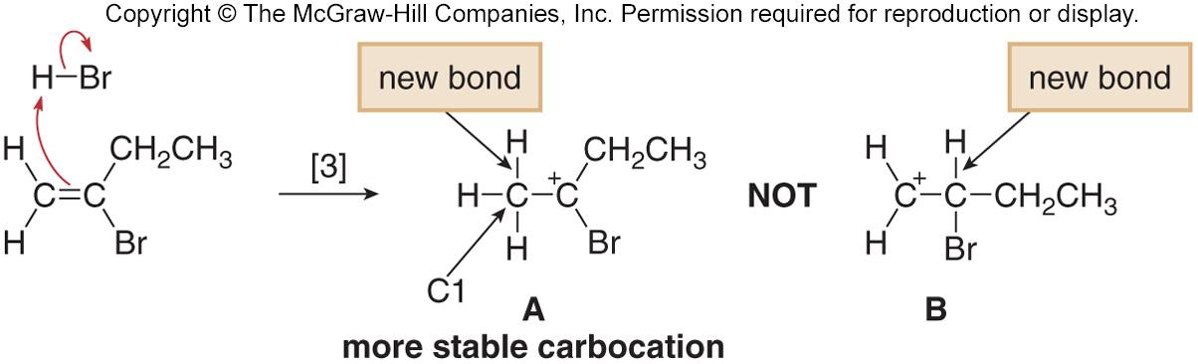
Hydrohalogenation of Alkynes vs. Alkenes
Electrophilic addition of HX to alkynes is slower than electrophilic addition of HX to alkenes, even though alkynes are more polarizable and have more loosely held π electrons than alkenes.
Markovnikov addition in step [3] places the H on the terminal carbon to form the more substituted carbocation A, rather than the less substituted carbocation B.
‹#›
Notes:
‹#›

Slide 24
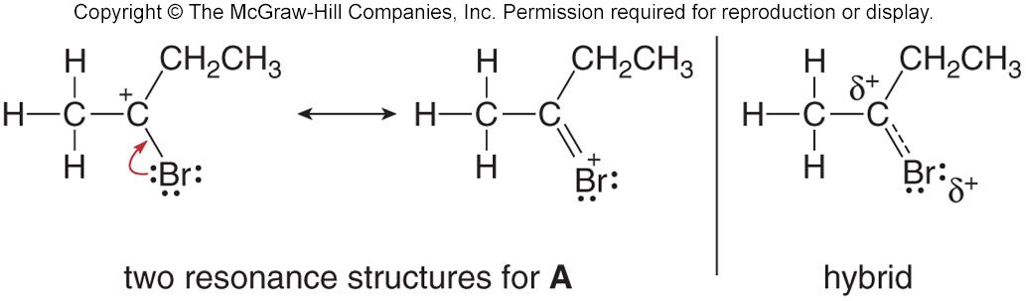
Halogen Stabilization of Carbocations
Resonance stabilizes a molecule by delocalizing charge and electron density.
Halogens stabilize an adjacent positive charge by resonance.
Carbocation A is stabilized by resonance.
‹#›

Slide 25
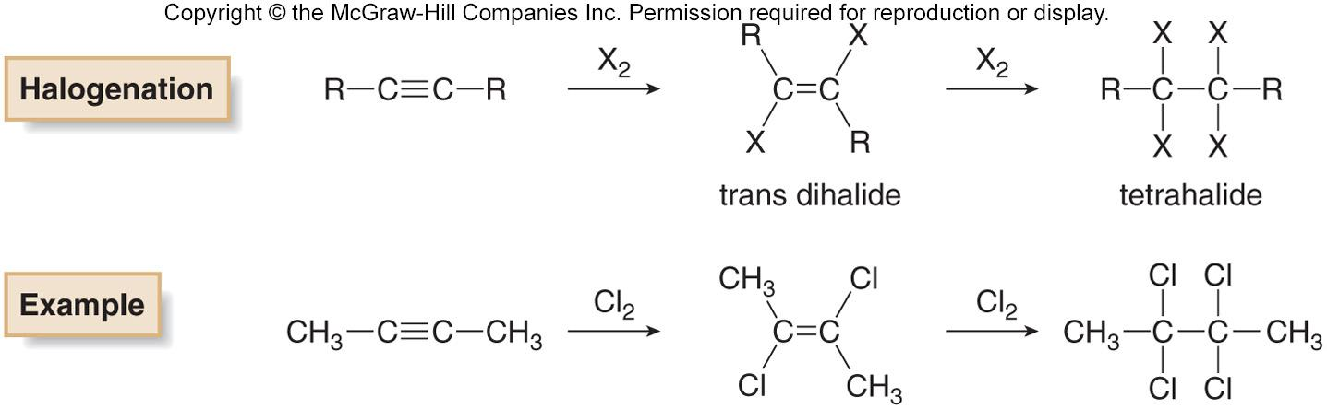
Halogenation of Alkynes
Halogens X₂ (X = Cl or Br) add to alkynes just as they do to alkenes.
Addition of one mole of X₂ forms a trans dihalide, which can then react with a second mole of X₂ to yield a tetrahalide.
‹#›

Slide 26
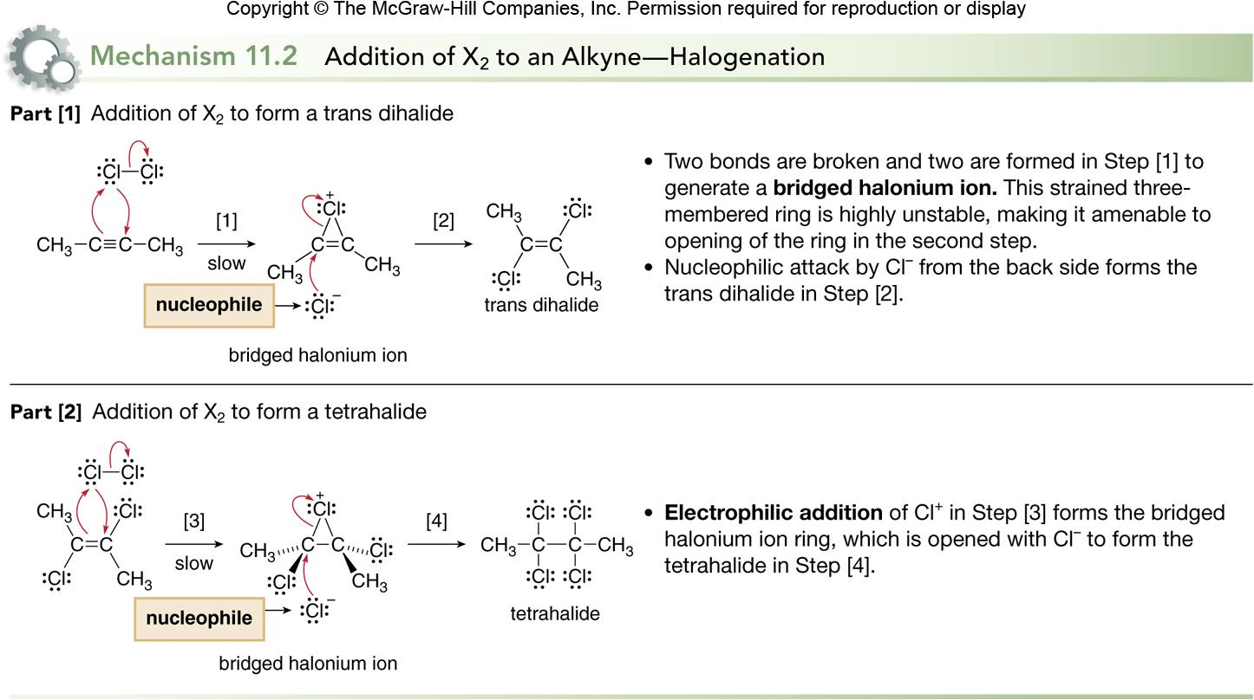
Halogenation Mechanism
‹#›

Slide 27
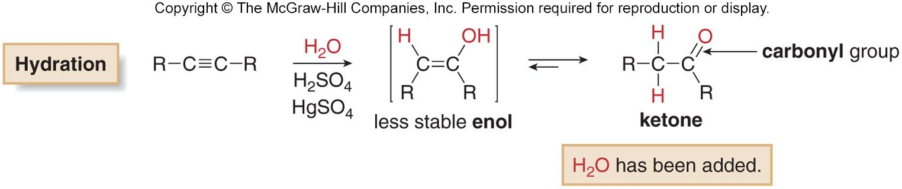
Hydration of Alkynes
In the presence of strong acid or Hg²⁺ catalyst, the elements of H₂O add to the triple bond to form an enol initially.
The enol is unstable and rearranges to a ketone.
‹#›

Slide 28
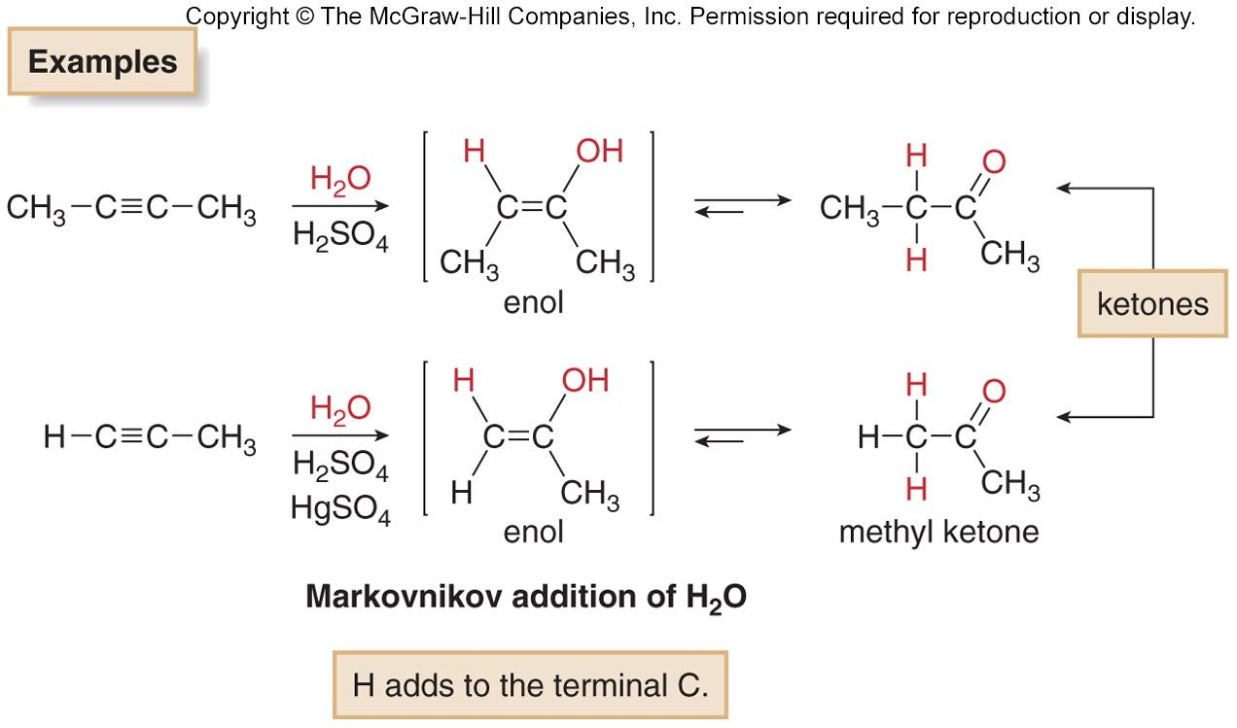
Hydration of Internal vs. Terminal Alkynes
Internal alkynes undergo hydration with concentrated acid to form ketones.
Terminal alkynes require the presence of an additional Hg²⁺ catalyst (usually HgSO₄) to yield methyl ketones by Markovnikov addition of water.
‹#›

Slide 29
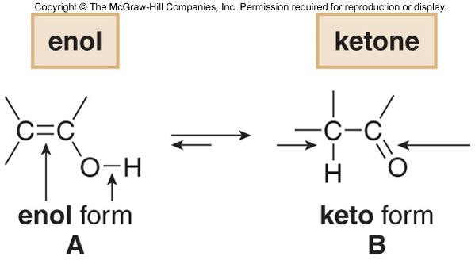
Keto-Enol Tautomerization
Tautomers are constitutional isomers that differ in the location of a double bond and a hydrogen atom.
A and B are tautomers: A is the enol form and B is the keto form of the tautomer.
An enol tautomer has an O−H group bonded to a C=C.
A keto tautomer has a C=O and an additional C−H bond.
Equilibrium favors the keto form largely because the C=O is much stronger than a C=C.
Tautomerization, the process of converting one tautomer into another, is catalyzed by both acid and base.
‹#›

Slide 30
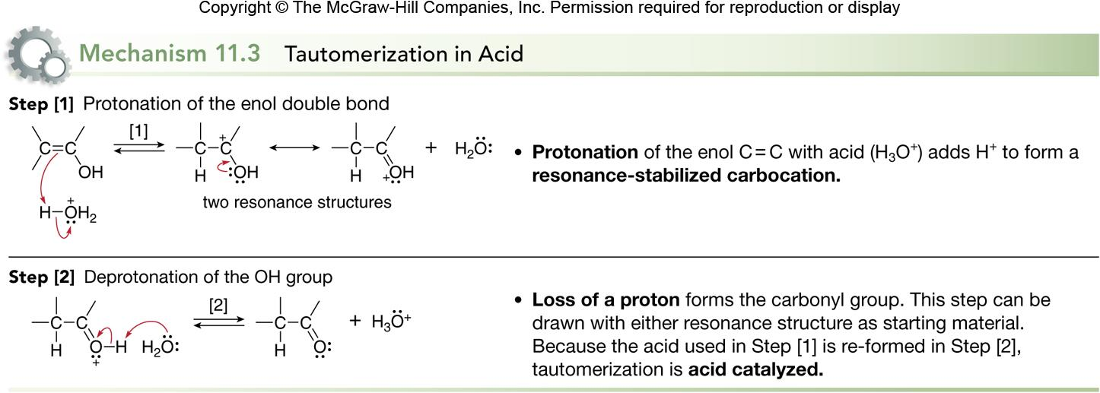
Tautomerization Mechanism
‹#›

Slide 31
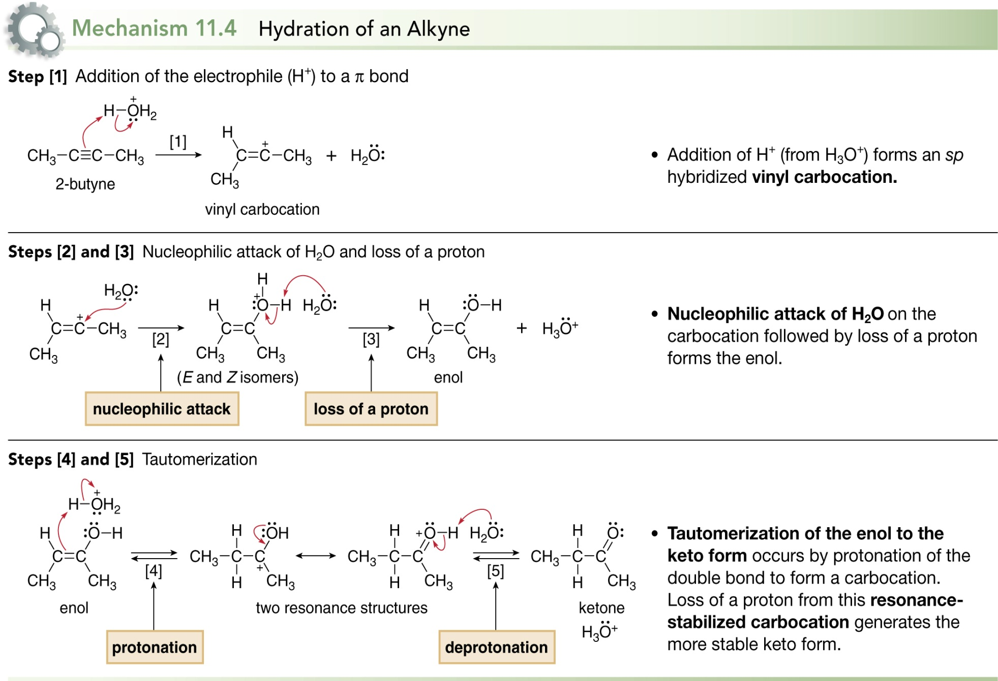
Hydration Mechanism
‹#›

Slide 32
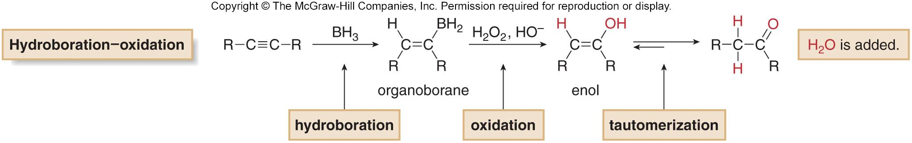
Hydroboration−Oxidation of Alkynes
Hydroboration−oxidation is a two-step reaction sequence that also converts an alkyne to a carbonyl compound.
Addition of borane forms an organoborane.
Oxidation with basic H₂O₂ forms an enol.
Tautomerization of the enol forms a carbonyl compound.
The overall result is addition of H₂O to a triple bond.
‹#›

Slide 33
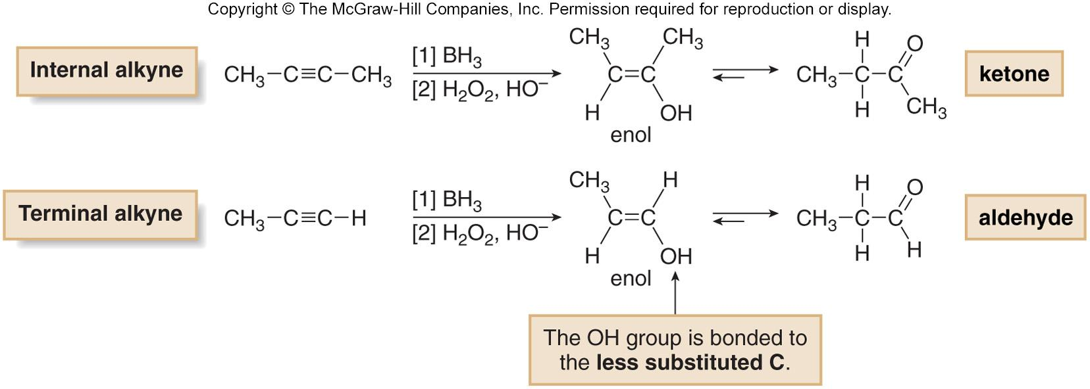
Hydroboration−Oxidation of
Internal vs. Terminal Alkynes
Hydroboration−oxidation of an internal alkyne forms a ketone, just as the acid-catalyzed hydration did.
However, hydroboration−oxidation of a terminal alkyne forms an aldehyde.
BH₂ adds to the less substituted, terminal carbon resulting in anti-Markovnikov addition of water.
‹#›

Slide 34
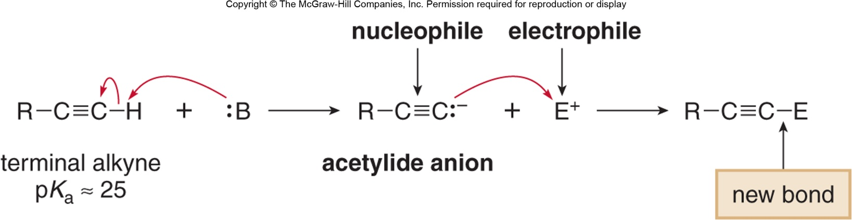
Reactions of Acetylide Ions
Terminal alkynes are readily converted to acetylide ions with strong bases such as NaNH₂ and NaH.
These anions are strong nucleophiles, capable of reacting with electrophiles such as alkyl halides and epoxides.
‹#›

Slide 35
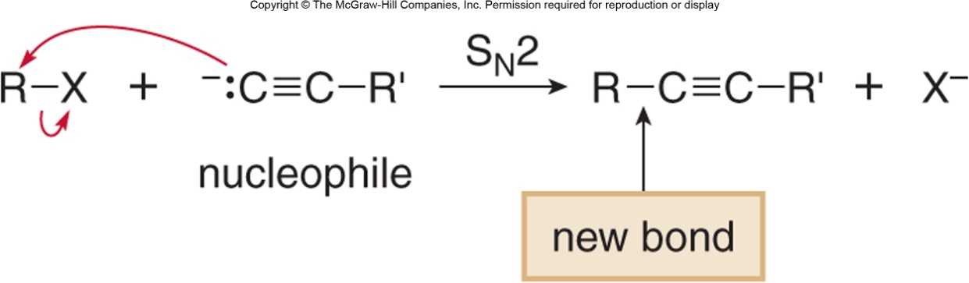
Reactions of Acetylide Ions with Alkyl Halides
Acetylide anions are strong nucleophiles and react with unhindered alkyl halides to yield products of nucleophilic substitution.
‹#›

Slide 36
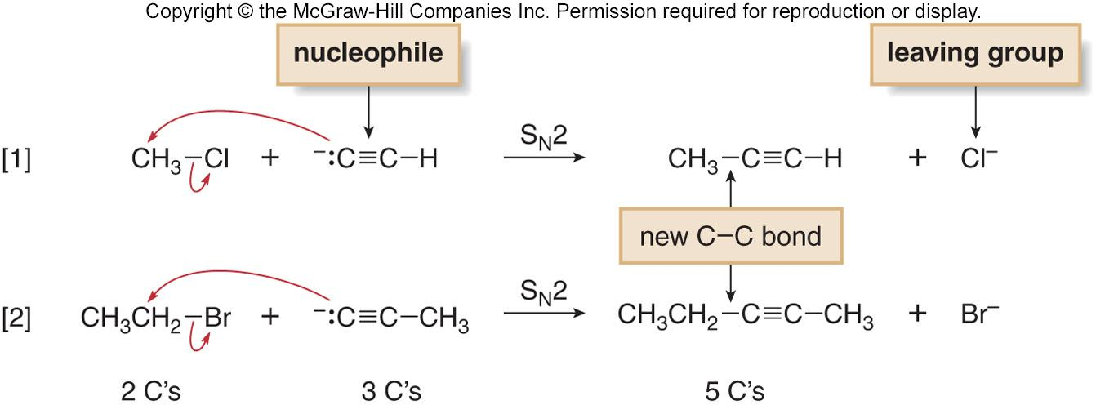
Reactions of Acetylide Ions with Alkyl Halides
The mechanism of substitution is S_{N}2, and thus the reaction is fastest with CH₃X and 1º alkyl halides.
Nucleophilic substitution with acetylide ions forms new carbon-carbon bonds.
‹#›

Slide 37
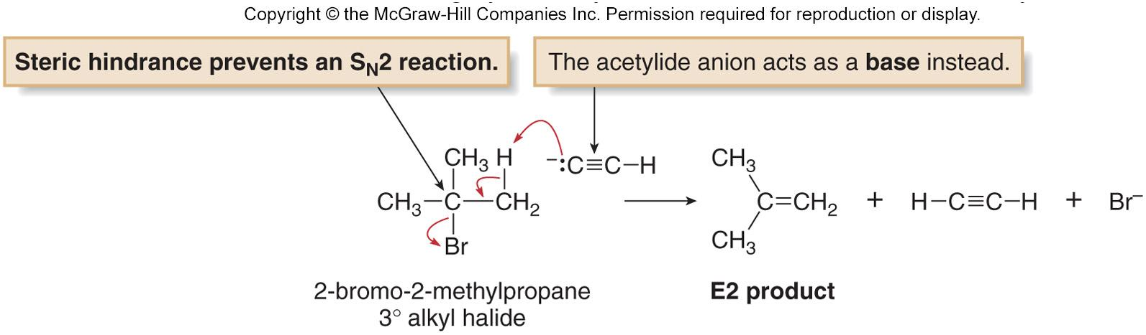
Elimination vs. Substitution with Acetylide Ions
Steric hindrance around the leaving group causes 2° and 3° alkyl halides to preferentially undergo elimination by an
E2 mechanism, as shown with 2-bromo-2-methylpropane.
Thus, nucleophilic substitution with acetylide anions forms new carbon-carbon bonds in high yield only with unhindered CH₃X and 1° alkyl halides.
‹#›

Slide 38
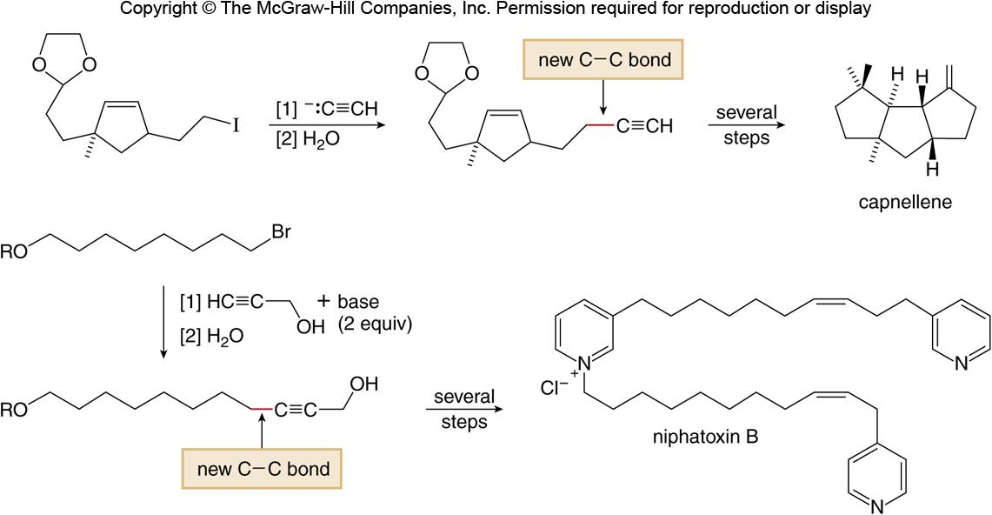
Synthesis Using Acetylide Ions
Carbon-carbon bond formation with acetylide anions is a valuable reaction used in the synthesis of numerous natural products.
Figure 11.6
‹#›

Slide 39
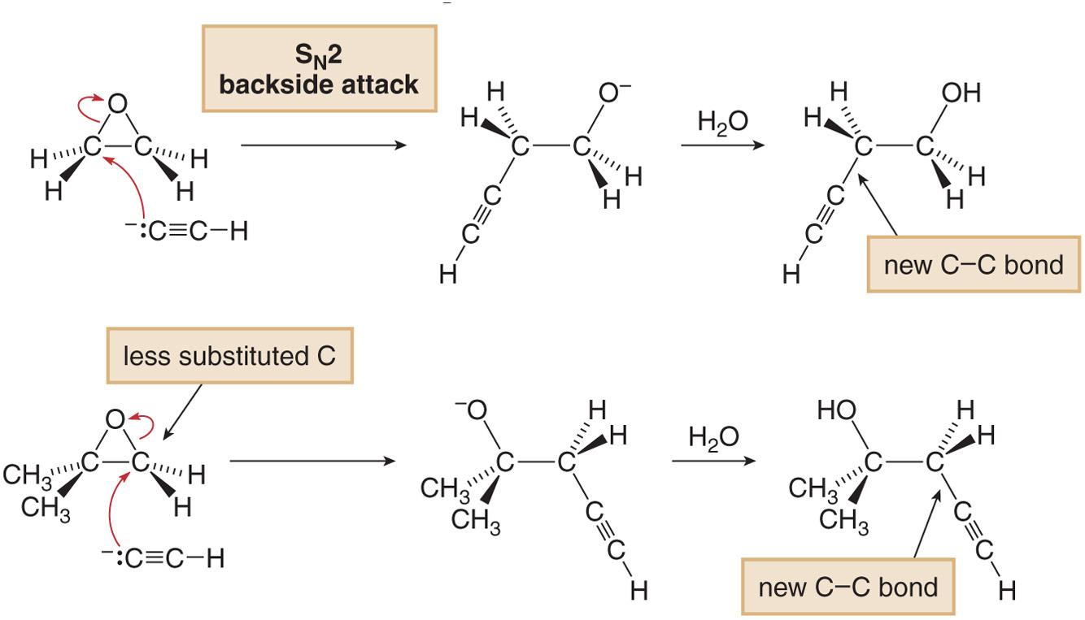
Reactions of Acetylide Ions with Epoxides
Acetylide anions are strong nucleophiles that open epoxide rings by an S_{N}2 mechanism.
Backside attack occurs at the less substituted end of the epoxide.
‹#›

Slide 40
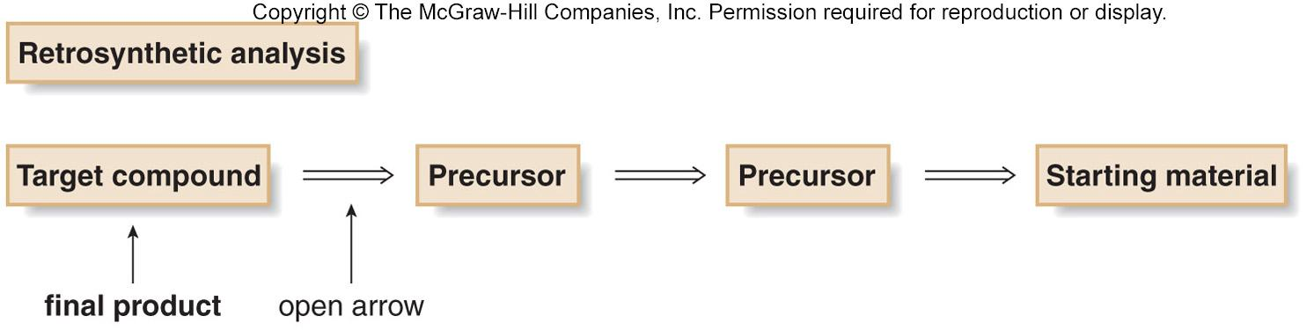
Retrosynthetic Analysis
Retrosynthetic analysis is the method of working backwards from a target compound to starting materials.
To write a synthesis working backwards, an open arrow (⇒) is used to indicate that the product is drawn on the left and the starting material on the right.
In designing a synthesis, reactions are often divided into two categories:
1. Those that form new carbon-carbon bonds.
2. Those that convert one functional group into another—that is,
functional group interconversions.
‹#›

Slide 41
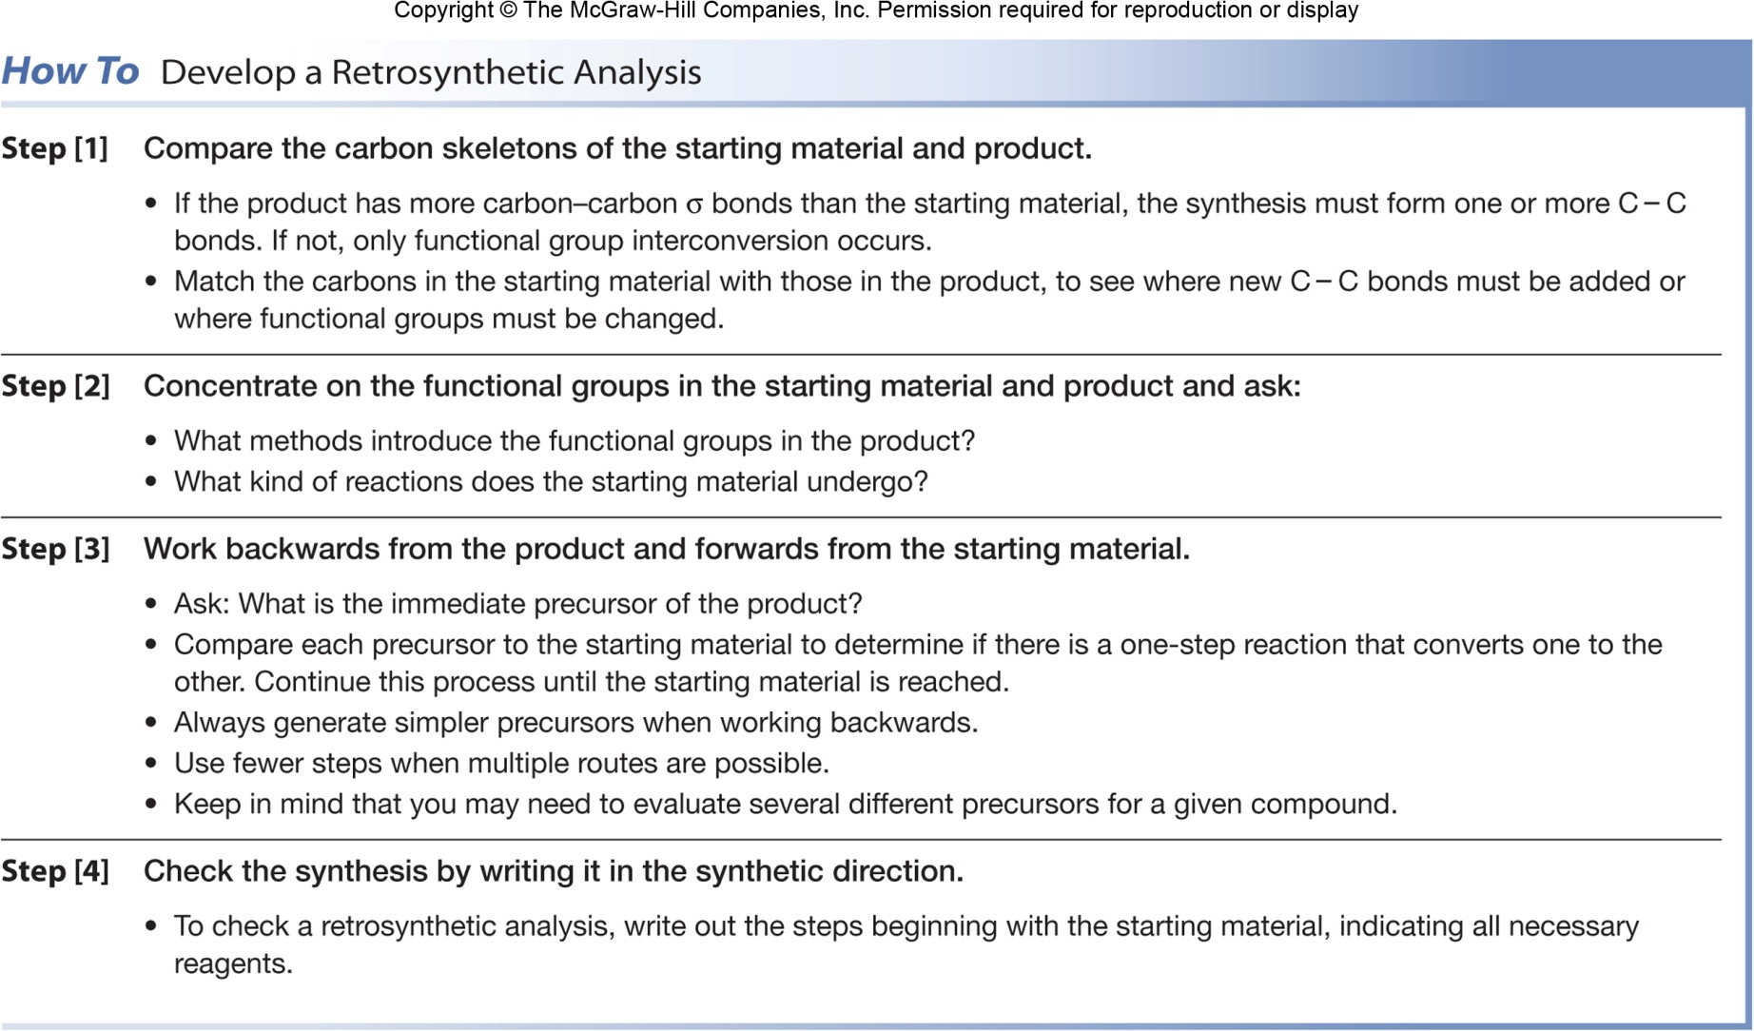
‹#›

Slide 42
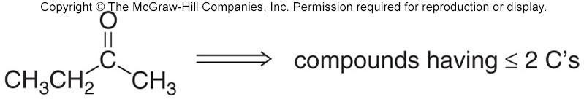
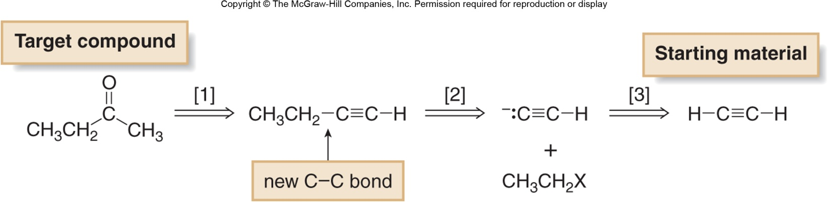
Example of a Retrosynthetic Synthesis
Devise a synthesis of the following compound from starting materials having two carbons or fewer.
Thinking backwards . . .
[1] Form the carbonyl group by hydration of a triple bond.
[2] Form a new C-C bond using an acetylide anion and a 1° alkyl halide (two 2-carbon structures are converted to a
4-carbon product).
[3] Prepare the acetylide anion from acetylene by treatment with base.
‹#›
‹#›

Slide 43
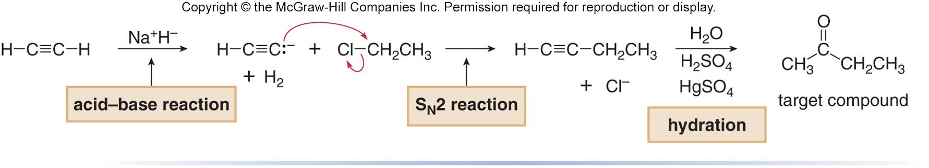
Example of a Retrosynthetic Synthesis
Three steps are needed to complete the synthesis.
  Formation of the acetylide
  S_{N}2 reaction with an alkyl halide
  Hydration of the alkyne
‹#›
‹#›

