Slide 1
SOUND WAVES
BY
A.Hammouri
M.Musallam
A.Hallaweh
Supervised by Dr. W.Karaen

Slide 2

Short history of sound waves
Sound waves created in air was first described by the greatest painter in history ,Leonardo Da Vinci around 1500 A.D .
Then the concept of sound waves developed by other people such as Galileo who demonstrated that pitch of sound depends on its frequency .
Around 1640 Marin Mersenne , a French mathematician , measured speed of sound in air .
Twenty years later, Robert Boyle established that sound can`t travel without medium .
Later the correct relationship between speed of sound in a medium and the density and compressibility of the medium was established by Isaac Newton .

Slide 3
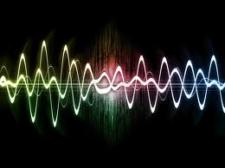
Development and applications of the theory throw the years
1490 - Leonardo da Vinci notes how the sound of air travels great distances .
1687 - Sir Isaac Newton publishes the first mathematical theory of sound.
1826 - Swiss physicist Daniel Colladon and French mathematician Charles Sturm measure the speed of sound in Lake Geneva at 1,435 meters per second--nearly five times faster than the speed of sound in air.
1877 - Lord Rayleigh publishes Theory of Sound, laying the theoretical groundwork for modern sound studies .
1919 - German scientist H. Lichte theorizes that sound waves in water will refract upward or downward on encountering slight differences in temperature, the amount of salt in the water , and pressure.
1937 - Athelstan Spilhaus builds the bathythermograph (BT) which is study of heat of water using sound.

Slide 4
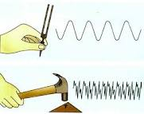
Development and applications of the theory throw the years
1954 - Between 1954-1955, the U.S. Navy activates the first-generation ocean-bottom listening devices in an array that eventually is called the Sound Surveillance System (SOSUS).
1978 - Walter Munk of the Scripps Institution of Oceanography and Carl Wunsch of the Massachusetts Institute of Technology suggest mapping ocean temperatures three-dimensionally with sound.
1992 - Scientists begin to track whales in real time with sound waves .
1993 - Using SOSUS, scientists make the first remote detection of an underwater volcanic eruption.
1996 - The Acoustic Thermometry of Ocean Climate (ATOC) experiment begins to transmit sound in the northern Pacific Ocean.

Slide 5
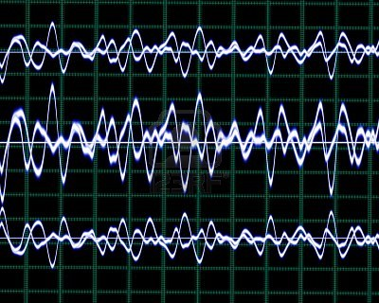
The basics of sound waves
Sound waves are a series of longitudinal or compression waves that move through air or other materials so it doesn`t travel through vacuums i.e. it needs a medium to travel in it .
Vibration of an object create sound waves .
the speed of sound depends on the mediums density, sound is about 4 times faster in liquids than solids . It`s also faster in higher temperatures than in lower ones since the density is lower which makes it easier for the waves to travel with loosing less energy to the medium’s molecules . Moreover , the substance of a medium that sound goes through is the main cause for it to slow down / get faster .

Slide 6
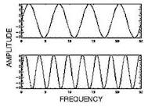

Terms used in sound waves
Length vary according to sound waves frequency . A sound having a long wavelength is heard at a low pitch (low frequency) .
On the other hand , short wave length is hears at high pitch ( high frequency ) .
wave length is the distance from one point on a wave to the corresponding point on the next wave . The number of waves per second (hertz) is the frequency of the sound. The frequency of a sound wave is also the number of vibrations per second produced by the sound source.

Slide 7
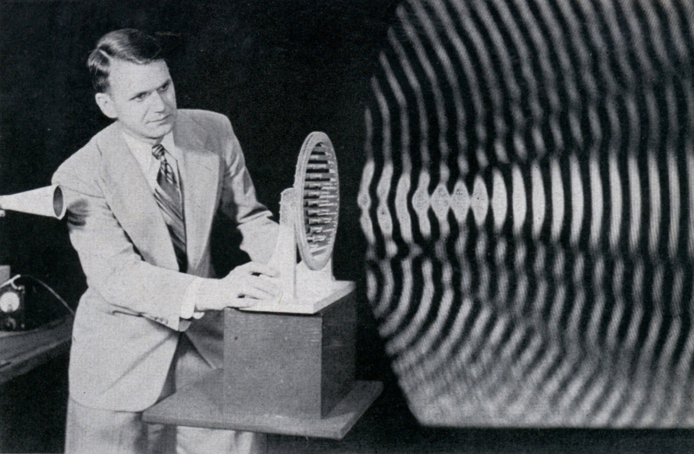
What`s sound ?
Sound `s defined a range of compression- wave frequencies to which the human ear is sensitive . Sounds that can heard by the human ears called Sonics which the hearing range extends from 20-20,000 Hz , sounds below 20Hz known as Infrasonic and ones over 20000Hz called ultrasonic . Sinusoidal plane waves is a term of description of the sound waves which characterized (as in the below equation ) by frequency , wavelength , wave number , amplitude , sound pressure , sound intensity , speed of sound and direction .
Y (x, y ) = A . sin (ωt ± κx +φ )
The wave number is related to the angular frequency by:.
where λ is the wavelength , f is the frequency , and c is the speed of propagation .

Slide 8
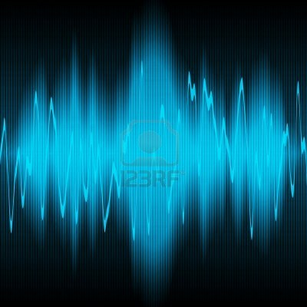
Propagation of sound
During propagation , waves can be reflected , refracted or attenuated by the medium .
Three things affect the behavior of sound propagation :
Relationship between density and pressure , the relationship affected by temperature, determines the speed of sound within the medium.
Motion of the medium itself affect the propagation
The motion of the sound wave also affected by the viscosity of the medium .

Slide 9
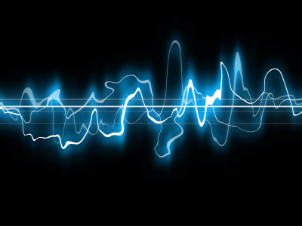
Resonance frequency
A resonant frequency is a natural frequency of vibration determined by the physical parameters of the vibrating object. Some of the implications of resonant frequencies are:
It`s easy to get an object to vibrate at its resonance frequencies , hard to get it to vibrate at other frequencies
Vibration object will oick its resonant frequencies from a complex excitation and vibrate at those frequencies

