Slide 1
Respiratory Tract Infections

Slide 2
Common Cold & Viral Influenza
Viruses are the most frequent cause of respiratory tract infections, including the common cold and infection with the influenza virus.
The common cold occurs more frequently than any other respiratory infection. The fingers are the usual source of transmission, and the most common portals of entry are the nasal mucosa and the conjunctiva of the eye.

Slide 3
Common Cold & Viral Influenza
The influenza virus causes three syndromes: an uncomplicated rhinotracheitis, a respiratory viral infection followed by a bacterial infection, and viral pneumonia.
The contagiousness of influenza results from the ability of the virus to mutate and form subtypes against which the population is unprotected.

Slide 4
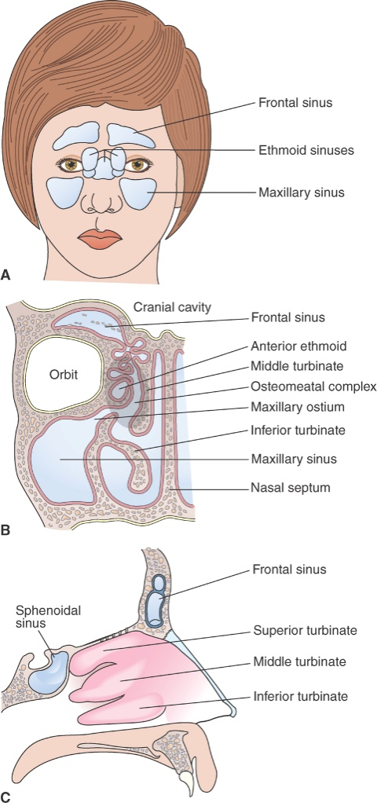
Rhinosinusitis (Sinusitis)
Infection or allergy obstructs sinus drainage.
Acute: facial pain, headache, purulent nasal discharge, decreased sense of smell, fever.
Chronic: nasal obstruction, fullness in the ears, postnasal drip, hoarseness, chronic cough, loss of taste and smell, unpleasant breath, headache.

Slide 5
Influenza
In the United States, approximately 36,000 persons die each year of influenza-related illness.
Transmission is by aerosol or direct contact.
Upper respiratory infection (rhinotracheitis):
  Like a common cold with profound malaise.
Viral pneumonia:
  Fever, tachypnea, tachycardia, cyanosis, hypotension.
Respiratory viral infection followed by a bacterial infection.

Slide 6
Penumonia
Pneumonias are respiratory disorders involving inflammation of the lung structures, such as the alveoli and bronchioles. They are caused by infectious agents such as bacteria and viruses.
They are commonly classified according to the type of organism causing the infection (typical or atypical), location of the infection (lobar pneumonia or bronchopneumonia), and setting in which it occurs (community or hospital acquired).

Slide 7
Pneumonia—Inflammation of Alveoli and Bronchioles
Typical: bacteria in the alveoli
  Lobar: affects an entire lobe of the lung.
  Bronchopneumonia: patchy distribution over more than one lobe.
Atypical
  Viral and mycoplasma infections of the alveolar septum or interstitium.

Slide 8
Tuberculosis
World’s foremost cause of death from a single infectious agent.
Causes 26% of avoidable deaths in developing countries.
Drug-resistant forms.
Mycobacterium tuberculosis:
  Aerobic.
  Protective waxy capsule.
  Can stay alive in “suspended animation” for years.

Slide 9
Initial TB Infection
Macrophages begin a cell-mediated immune response.
Takes 3 to 6 weeks to develop positive TB test.
Results in a granulomatous lesion.

Slide 10
Discussion
Someone in your class has a positive TB test.
Question:
What does this mean?
Are you at risk of infection?

Slide 11
Secondary TB
Reinfection from inhaled droplet nuclei.
Reactivation of a previously healed primary lesion.
Immediate cell-mediated response walls off infection in airways.
Bacteria damage tissues in the airways, creating cavities.
Signs of chronic pneumonia: gradual destruction of lung tissue.

Slide 12
Question
Which type of TB may be reactivated if the patient becomes immunocompromised?
  Primary
  Latent
  Miliary
  Secondary

Slide 13
Answer
D. Secondary
Rationale: Secondary TB, often referred to as reactivation or reinfection TB, may occur if patients are reexposed to TB bacilli (after a primary infection) or if they become immunocompromised (they are unable to contain the infection).

Slide 14
Lung Cancer
Cancer of the lung is a leading cause of death worldwide, with cigarette smoking being implicated in the majority of cases.
Environmental hazards, such as exposure to asbestos, increase the risk for development of lung cancer. Because the disease develops insidiously, it often is far advanced before it is diagnosed, a fact that explains the poor 5-year survival rate.

Slide 15
Lung Cancer
For purposes of staging and treatment, lung cancer is divided into nonsmall cell and small cell carcinoma.
The main reason for this is that almost all small cell lung cancers have metastasized at the time of diagnosis and are not amenable to surgical resection.

Slide 16
Lung Cancer
The manifestations of lung cancer can be attributed to the involvement of the lung and adjacent structures, the effects of local spread and metastasis, and paraneoplastic syndromes involving endocrine, neurologic, and hematologic disorders.
As with other cancers, lung cancer causes nonspecific symptoms such as anorexia and weight loss. Treatment methods for lung cancer include surgery, irradiation, and chemotherapy.

Slide 17
Manifestations of Lung Cancer
Changes in organ function (organ damage, inflammation, and failure).
Local effects of tumors (e.g., compression of nerves or veins, gastrointestinal obstruction).
Ectopic hormones secreted by tumor cells (paraneoplastic disorders).
Nonspecific signs of tissue breakdown (e.g., protein wasting, bone breakdown).

Slide 18
Respiratory distress syndrome
Respiratory distress syndrome is one of the most common causes of respiratory disease in premature infants.
In these infants, pulmonary immaturity, together with surfactant deficiency, lead to alveolar collapse.

Slide 19
Respiratory distress syndrome
Normally, both an infant’s chest wall and lungs are compliant, allowing for small changes in inspiratory pressure to inflate the lung.
In respiratory disorders that decrease lung compliance, the diaphragm must generate more negative pressure; as a result, the compliant chest wall structures are sucked inward, producing abnormal inward movements of the chest wall during inspiration called retractions.

Slide 20
Respiratory distress syndrome
Children with restrictive lung disorders, such as pulmonary edema or respiratory distress syndrome, breathe at faster rates, and their respiratory excursions are shallow.
Grunting is an audible noise emitted during expiration. An expiratory grunt is common as the child tries to raise the end-expiratory pressure to maintain airway patency and prolong the period of oxygen and carbon dioxide exchange across the alveolar–capillary membrane.

Slide 21
Respiratory distress syndrome
Because of the small size of the airway of infants and children, respiratory tract infections in these groups often are more serious. Infections that may cause only a sore throat and hoarseness in the adult may produce serious obstruction in the child.
Among the respiratory tract infections that affect small children are croup, bronchiolitis , and epiglottitis, a life-threatening supraglottic infection that may cause airway obstruction and asphyxia.

Slide 22
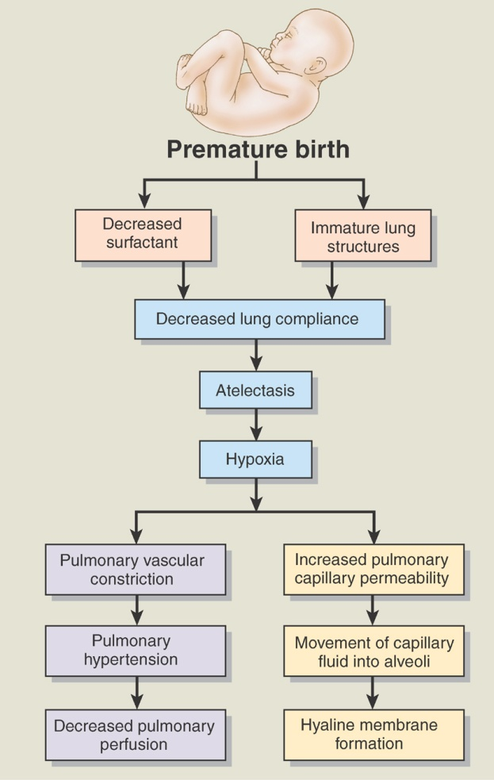
Respiratory Distress Syndrome
Lack of surfactant; infants are not strong enough to inflate their alveoli.
Protein-rich fluid leaks into the alveoli and further blocks oxygen uptake.
Treatment with mechanical ventilation may cause bronchopulmonary dysplasia and chronic respiratory insufficiency.

Slide 23
Question
True or false?
Premature infants are at greater risk of developing respiratory distress syndrome (RDS) than term infants.

Slide 24
Answer
True
Rationale: RDS occurs due to a lack of surfactant in the alveoli (the surfactant is produced by alveolar cells and keeps them inflated). Surfactant is typically produced from week 28 (gestational age) through term (40 to 42 weeks). The more premature the infant/neonate, the greater the likelihood that there will be insufficient surfactant to sustain ventilation.

Slide 25
Question
True or false?
Epiglottitis causes stridor.

Slide 26
Answer
True
Rationale: Epiglottitis affects the upper airway (inflammation causes the lumen of the upper airway to become more narrow). When the child inspires, it is difficult to pass air through the narrowed airway. This causes noisy inspiration/stridor.

