Slide 1
COMP334
PHP Basics:
Introduction to PHP
a PHP file, PHP workings, running PHP.
Basic PHP syntax
variables, operators, if...else...and switch, while, do while, and for.
Some useful PHP functions
How to work with
HTML forms, cookies, files, time and date.
How to create a basic checker for user-entered data

Slide 2
What is Server-Side Development
The basic hosting of your files is achieved through a web server.
Server-side development is much more than web hosting: it involves the use of a programming technology like PHP or ASP.NET to create scripts that dynamically generate content
Consider distinction between client side and server side…
Notes:
Apache is the most widely used web server software. Developed and maintained by Apache Software Foundation, Apache is an open source software available for free. It runs on 67% of all webservers in the world. It is fast, reliable, and secure. It can be highly customized to meet the needs of many different environments by using extensions and modules. Most WordPress hosting providers use Apache as their web server software. However, WordPress can run on other web server software as well.
What is a Web Server?
Wondering what the heck is a web server? Well a web server is like a restaurant host. When you arrive in a restaurant, the host greets you, checks your booking information and takes you to your table. Similar to the restaurant host, the web server checks for the web page you have requested and fetches it for your viewing pleasure. However, A web server is not just your host but also your server. Once it has found the web page you requested, it also serves you the web page. A web server like Apache, is also the Maitre D’ of the restaurant. It handles your communications with the website (the kitchen), handles your requests, makes sure that other staff (modules) are ready to serve you. It is also the bus boy, as it cleans the tables (memory, cache, modules) and clears them for new customers.
So basically a web server is the software that receives your request to access a web page. It runs a few security checks on your HTTP request and takes you to the web page. Depending on the page you have requested, the page may ask the server to run a few extra modules while generating the document to serve you. It then serves you the document you requested. Pretty awesome isn’t it

Slide 3
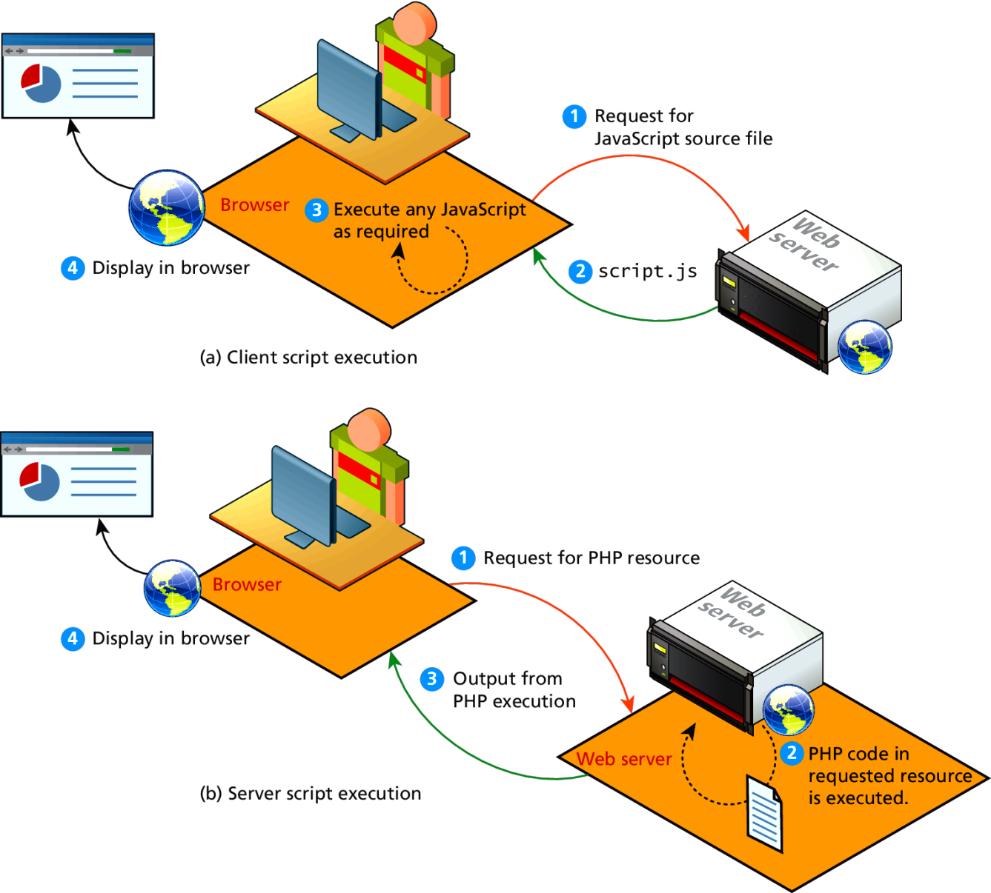
Comparing Client and Server Scripts

Slide 4
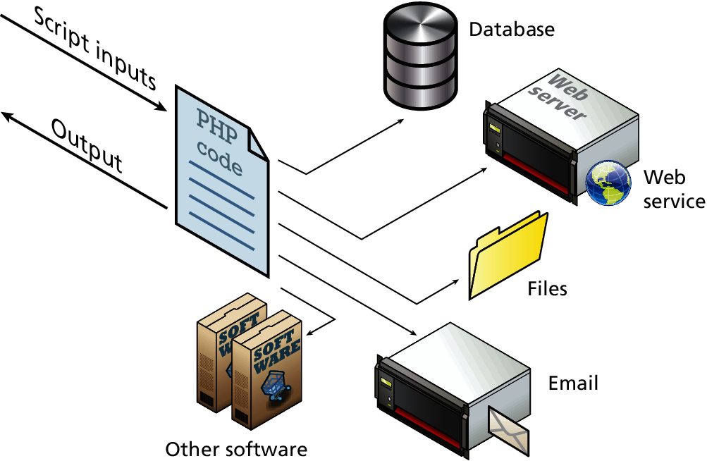
Server-Side Script Resources
So many tools in your kit
Notes:
A server-side script can access any resources made available to it by the server. These resources can be categorized as data storage resources, web services, and software applications,
, server applications can send and receive email, access user authentication services, and use network accessible storage. You could connect a web application to the regular telephone network to send texts or make calls.
web server is the software that receives your request to access a web page. It runs a few security checks on your HTTP request and takes you to the web page. Depending on the page you have requested, the page may ask the server to run a few extra modules while generating the document to serve you. It then serves you the document you requested. Pretty awesome isn’t it

Slide 5
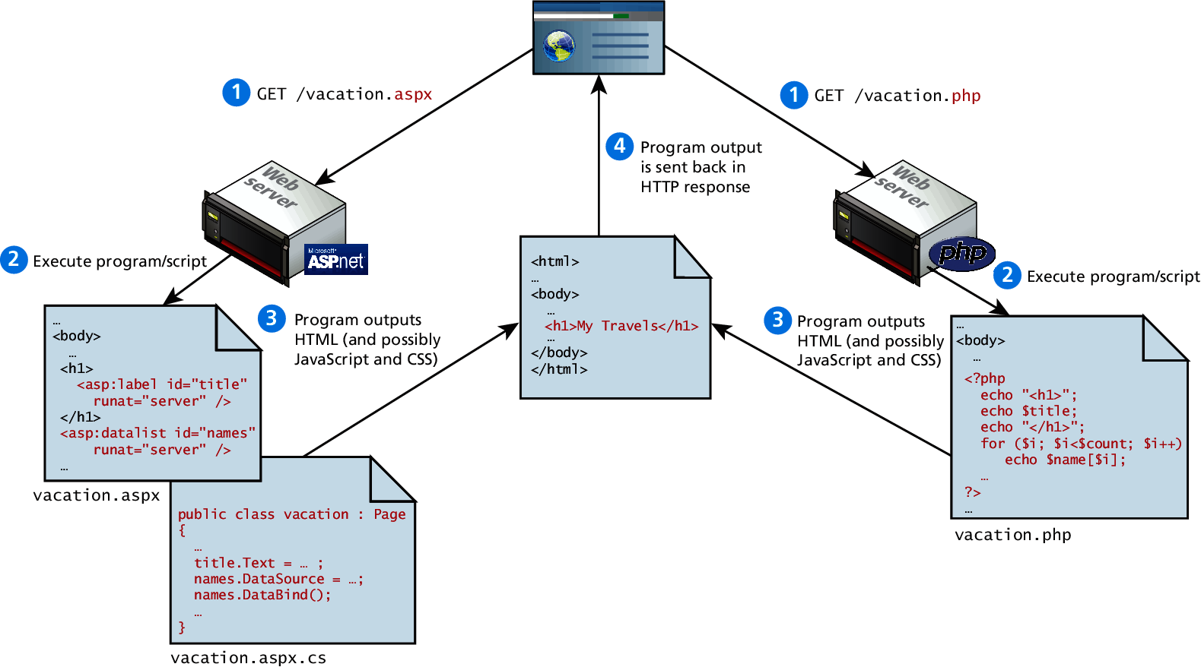
Web Development Technologies

Slide 6
Server-Side Dynamic Web Programming
CGI is one of the most common approaches to server-side programming
Universal support: (almost) Every server supports CGI programming. A great deal of ready-to-use CGI code. Most APIs (Application Programming Interfaces) also allow CGI programming.
Choice of languages: CGI is extremely general, so that programs may be written in nearly any language. Perl is by far the most popular, with the result that many people think that CGI means Perl. But C, C++, Ruby or Python are also used for CGI programming.
Drawbacks: A separate process is run every time the script is requested. A distinction is made between HTML pages and code.
Other server-side alternatives try to avoid the drawbacks
Server-Side Includes (SSI): Code is embedded in HTML pages, and evaluated on the server while the pages are being served. Add dynamically generated content to an existing HTML page, without having to serve the entire page via a CGI program.
Active Server Pages (ASP, Microsoft) : The ASP engine is integrated into the web server so it does not require an additional process. It allows programmers to mix code within HTML pages instead of writing separate programs. (Drawback(?) Must be run on a server using Microsoft server software.)
Java Servlets (Sun): As CGI scripts, they are code that creates documents. These must be compiled as classes which are dynamically loaded by the web server when they are run.
Java Server Pages (JSP): Like ASP, another technology that allows developers to embed Java in web pages.

Slide 7
PHP
developed in 1995 by Rasmus Lerdorf (member of the Apache Group)
originally designed as a tool for tracking visitors at Lerdorf's Web site
within 2 years, widely used in conjunction with the Apache server
developed into full-featured, scripting language for server-side programming
free, open-source
server plug-ins exist for various servers
now fully integrated to work with mySQL databases
PHP is similar to JavaScript, only it’s a server-side language
PHP code is embedded in HTML using tags
when a page request arrives, the server recognizes PHP content via the file extension (.php or .phtml)
the server executes the PHP code, substitutes output into the HTML page
the resulting page is then downloaded to the client
user never sees the PHP code, only the output in the page
The acronym PHP means (in a slightly recursive definition)
PHP: Hypertext Preprocessor

Slide 8
What do You Need?
Our server supports PHP
You don't need to do anything special! *
You don't need to compile anything or install any extra tools!
Create some .php files in your web directory - and the server will parse them for you.
* Slightly different rules apply when dealing with an SQL database (as will be explained when we get to that point).
Most servers support PHP
Download PHP for free here: http://www.php.net/downloads.php
Download MySQL for free here: http://www.mysql.com/downloads/index.html
Download Apache for free here: http://httpd.apache.org/download.cgi
(All of this is already present on the CS servers, so you need not do any installation yourself.)

Slide 9
Basic PHP syntax
A PHP scripting block always starts with <?php and ends with ?>. A PHP scripting block can be placed (almost) anywhere in an HTML document.
<html>
<!-- hello.php COMP334 -->
<head><title>Hello World</title></head>
<body>
<p>This is going to be ignored by the PHP interpreter.</p>
<?php echo ‘<p>While this is going to be parsed.</p>‘; ?>
<p>This will also be ignored by PHP.</p>
<?php print(‘<p>Hello and welcome to <i>my</i> page!</p>');
?>
<?php
//This is a comment
/*
This is
a comment
block
*/
?>
</body>
</html>
print and echo
for output
a semicolon (;) at the end of each statement
// for a single-line comment
/* and */ for a large comment block.
view the output page
The server executes the print and echo statements, substitutes output.

Slide 10
Scalars
All variables in PHP start with a $ sign symbol. A variable's type is determined by the
context in which that variable is used (i.e. there is no strong-typing in PHP).
<html><head></head>
<!-- scalars.php COMP334 -->
<body> <p>
<?php
$foo = true; if ($foo) echo "It is TRUE! <br /> \n";
$txt='1234'; echo "$txt <br /> \n";
$a = 1234; echo "$a <br /> \n";
$a = -123;
echo "$a <br /> \n";
$a = 1.234;
echo "$a <br /> \n";
$a = 1.2e3;
echo "$a <br /> \n";
$a = 7E-10;
echo "$a <br /> \n";
echo ’Ali once said: "I\'ll be back"', "<br /> \n";
$coffee = ‘Java';
echo "$coffee's taste is great <br /> \n";
$str = <<<EOD
Example of string
spanning multiple lines
using “heredoc” syntax.
EOD;
echo $str;
?>
</p>
</body>
</html>
Four scalar types:
boolean
true or false
integer,
float,
floating point numbers
string
single quoted
double quoted
view the output page

Slide 11
Arrays
An array in PHP is actually an ordered map. A map is a type that maps values to keys.
array() = creates arrays
<?php
$arr = array("foo" => "bar", 12 => true);
echo $arr["foo"]; // bar
echo $arr[12]; // 1
?>
key = either an integer or a string.
value = any PHP type.
if no key, the maximum of the integer indices + 1.
if an existing key, its value will be overwritten.
<?php
array(5 => 43, 32, 56, "b" => 12);
array(5 => 43, 6 => 32, 7 => 56, "b" => 12);
?>
<?php
$arr = array(5 => 1, 12 => 2);
$arr[] = 56; // the same as $arr[13] = 56;
$arr["x"] = 42; // adds a new element
unset($arr[5]); // removes the element
unset($arr); // deletes the whole array
$a = array(1 => 'one', 2 => 'two', 3 => 'three');
unset($a[2]);
$b = array_values($a);
?>
can set values in an array
unset() removes a key/value pair
array_values() makes reindexing effect (indexing numerically)
view the output page
*Find more on arrays

Slide 12
ARRAY FUNCTIONS
is_array
echo (is_array($fred)) ? "Is an array" : "Is not an array”;
Count
echo count($fred);
Sort
sort the elements of the $cars array in ascending alphabetical order:
<?php
$cars=array("Volvo","BMW","Toyota");
sort($cars);
?>
Shuffle
<?php
$my_array = array("red","green","blue","yellow","purple");
shuffle($my_array);
print_r($my_array);
?>

Slide 13
Array Function 2
Explode
<?php
$temp = explode(' ', "This is a sentence with seven words");
print_r($temp);
?>
Output
Array ( [0] => This [1] => is [2] => a[3] => sentence [4] => with [5] => seven [6] => words )
Extract
<?php
$a = "Original";
$my_array = array("a" => "Cat", "b" => "Dog", "c" => "Horse");
extract($my_array, EXTR_PREFIX_SAME, "dup");
echo "\$a = $a; \$b = $b; \$c = $c; \$dup_a = $dup_a";
?>
Out put ➔ $a = Original; $b = Dog; $c = Horse; $dup_a = Cat

Slide 14
Array Function 3
Compact
<?php
$firstname = "Peter";
$lastname = "Griffin";
$age = "41”;
$result = compact("firstname", "lastname", "age");
print_r($result);
?>
Output➔Array ( [firstname] => Peter [lastname] => Griffin [age] => 41 )
Reset

Slide 15
Constants
A constant is an identifier (name) for a simple value. A constant is case-sensitive by
default. By convention, constant identifiers are always uppercase.
<?php
// Valid constant names
define("FOO", "something");
define("FOO2", "something else");
define("FOO_BAR", "something more");
// Invalid constant names (they shouldn’t start
// with a number!)
define("2FOO", "something");
// This is valid, but should be avoided:
// PHP may one day provide a “magical” constant
// that will break your script
define("__FOO__", "something");
?>
You can access constants anywhere in your script without regard to scope.

Slide 16
Operators
Arithmetic Operators: +, -, *,/ , %, ++, --
Assignment Operators: =, +=, -=, *=, /=, %=
Comparison Operators: ==, !=, >, <, >=, <=
Logical Operators: &&, ||, !
String Operators: . and .= (for string concatenation)
Example Is the same as
x+=y x=x+y
x-=y x=x-y
x*=y x=x*y
x/=y x=x/y
x%=y x=x%y
$a = "Hello ";
$b = $a . "World!"; // now $b contains "Hello World!"
$a = "Hello ";
$a .= "World!";

Slide 17
Conditionals: if else
Can execute a set of code depending on a condition
<html><head></head>
<!-- if-cond.php COMP334 -->
<body>
<?php
$d=date("D");
if ($d=="Fri")
echo "Have a nice weekend! <br/>";
else
echo "Have a nice day! <br/>";
$x=10;
if ($x==10)
{
echo "Hello<br />";
echo "Good morning<br />";
}
?>
</body>
</html>
if (condition)
code to be executed if condition is true;
else
code to be executed if condition is false;
date() is a built-in PHP function that can be called with many different parameters to return the date (and/or local time) in various formats
In this case we get a three letter string for the day of the week.
view the output page

Slide 18
Conditionals: switch
Can select one of many sets of lines to execute
<html><head></head>
<body>
<!–- switch-cond.php COMP334 -->
<?php
$x = rand(1,5); // random integer
echo “x = $x <br/><br/>”;
switch ($x)
{
case 1:
echo "Number 1";
break;
case 2:
echo "Number 2";
break;
case 3:
echo "Number 3";
break;
default:
echo "No number between 1 and 3";
break;
}
?>
</body>
</html>
switch (expression)
{
case label1:
code to be executed if expression = label1;
break;
case label2:
code to be executed if expression = label2;
break;
default:
code to be executed
if expression is different
from both label1 and label2;
break;
}
view the output page

Slide 19
Looping: while and do-while
Can loop depending on a condition
<html><head></head>
<body>
<?php
$i=1;
while($i <= 5)
{
echo "The number is $i <br />";
$i++;
}
?>
</body>
</html>
<html><head></head>
<body>
<?php
$i=0;
do
{
$i++;
echo "The number is $i <br />";
}
while($i <= 10);
?>
</body>
</html>
view the output page
view the output page
loops through a block of code if, and as long as, a specified condition is true
loops through a block of code once, and then repeats the loop as long as a special condition is true (so will always execute at least once)

Slide 20
Looping: for and foreach
Can loop depending on a "counter"
<?php
$a_array = array(1, 2, 3, 4);
foreach ($a_array as $value)
{
$value = $value * 2;
echo “$value <br/> \n”;
}
?>
<?php
for ($i=1; $i<=5; $i++)
{
echo "Hello World!<br />";
}
?>
loops through a block of code a specified number of times
<?php
$a_array=array("a","b","c");
foreach ($a_array as $key => $value)
{
echo $key." = ".$value."\n";
}
?>
view the output page
loops through a block of code for each element in an array

Slide 21
User Defined Functions
Can define a function using syntax such as the following:
<?php
function foo($arg_1, $arg_2, /* ..., */ $arg_n)
{
echo "Example function.\n";
return $retval;
}
?>
Can also define conditional functions, functions within functions, and recursive functions.
Can return a value of any type
<?php
function square($num)
{
return $num * $num;
}
echo square(4);
?>
<?php
function small_numbers()
{
return array (0, 1, 2);
}
list ($zero, $one, $two) = small_numbers();
echo $zero, $one, $two;
?>
<?php
function takes_array($input)
{
echo "$input[0] + $input[1] = ", $input[0]+$input[1];
}
takes_array(array(1,2));
?>
view the output page

Slide 22
Variable Scope
The scope of a variable is the context within which it is defined.
<?php
$a = 1; /* limited variable scope */
function Test()
{
echo $a;
/* reference to local scope variable */
}
Test();
?>
The scope is local within functions, and hence the value of $a is undefined in the “echo” statement.
<?php
$a = 1;
$b = 2;
function Sum()
{
global $a, $b;
$b = $a + $b;
}
Sum();
echo $b;
?>
<?php
function Test()
{
static $a = 0;
echo $a;
$a++;
}
Test1();
Test1();
Test1();
?>
global
refers to its global version.
static
does not lose its value.
view the output page

Slide 23
Including Files
The include() statement includes and evaluates the specified file.
vars.php
<?php
$color = 'green';
$fruit = 'apple';
?>
test.php
<?php
echo "A $color $fruit"; // A
include 'vars.php';
echo "A $color $fruit"; // A green apple
?>
<?php
function foo()
{
global $color;
include ('vars.php‘);
echo "A $color $fruit";
}
/* vars.php is in the scope of foo() so *
* $fruit is NOT available outside of this *
* scope. $color is because we declared it *
* as global. */
foo(); // A green apple
echo "A $color $fruit"; // A green
?>
view the output page
view the output page
*The scope of variables in “included” files depends on where the “include” file is added!
You can use the include_once, require, and require_once statements in similar ways.

Slide 24
PHP Information
The phpinfo() function is used to output PHP information about the version installed on the server, parameters selected when installed, etc.
INFO_GENERAL The configuration line,
php.ini location,
build date,
Web Server,
System and more
INFO_CREDITS PHP 4 credits
INFO_CONFIGURATION Local and master values
for php directives
INFO_MODULES Loaded modules
INFO_ENVIRONMENT Environment variable
information
INFO_VARIABLES All predefined variables
from EGPCS
INFO_LICENSE PHP license information
INFO_ALL Shows all of the above (default)
<html><head></head>
<!– info.php COMP334
<body>
<?php
// Show all PHP information
phpinfo();
?>
<?php
// Show only the general information
phpinfo(INFO_GENERAL);
?>
</body>
</html>
view the output page

Slide 25
Server Variables
The $_SERVER array variable is a reserved variable that contains all server information.
<html><head></head>
<body>
<?php
echo "Referer: " . $_SERVER["HTTP_REFERER"] . "<br />";
echo "Browser: " . $_SERVER["HTTP_USER_AGENT"] . "<br />";
echo "User's IP address: " . $_SERVER["REMOTE_ADDR"];
?>
</body>
</html>
view the output page
The $_SERVER is a super global variable, i.e. it's available in all scopes of a PHP script.

Slide 26
File Open
The fopen("file_name","mode") function is used to open files in PHP.
r Read only. r+ Read/Write.
w Write only. w+ Read/Write.
a Append. a+ Read/Append.
x Create and open for write only. x+ Create and open for read/write.
<?php
$fh=fopen("welcome.txt","r");
?>
For w, and a, if no file exists, it tries to create it (use with caution, i.e. check that this is the case, otherwise you’ll overwrite an existing file).
For x if a file exists, it returns an error.
<?php
if
( !($fh=fopen("welcome.txt","r")) )
exit("Unable to open file!");
?>
If the fopen() function is unable to open the specified file, it returns 0 (false).

Slide 27
File Workings
fclose() closes a file.
feof() determines if the end is true.
fgetc() reads a single character
fgets() reads a line of data
fwrite(), fputs () writes a string with and without \n
file() reads entire file into an array
<?php
$myFile = "welcome.txt";
if (!($fh=fopen($myFile,'r')))
exit("Unable to open file.");
while (!feof($fh))
{
$x=fgetc($fh);
echo $x;
}
fclose($fh);
?>
<?php
$myFile = "welcome.txt";
$fh = fopen($myFile, 'r');
$theData = fgets($fh);
fclose($fh);
echo $theData;
?>
view the output page
view the output page
<?php
$myFile = "testFile.txt";
$fh = fopen($myFile, 'a') or die("can't open file");
$stringData = "New Stuff 1\n";
fwrite($fh, $stringData);
$stringData = "New Stuff 2\n";
fwrite($fh, $stringData);
fclose($fh);
?>
<?php
$lines = file('welcome.txt');
foreach ($lines as $l_num => $line)
{
echo "Line #{$l_num}:“ .$line.”<br/>”;
}
?>
view the output page
view the output page

Slide 28
Form Handling
Any form element is automatically available via one of the built-in PHP variables (provided the element has a “name” defined with it).
<html>
<-- form.html COMP334 -->
<body>
<form action="welcome.php" method="POST">
Enter your name: <input type="text" name="name" /> <br/>
Enter your age: <input type="text" name="age" /> <br/>
<input type="submit" /> <input type="reset" />
</form>
</body>
</html>
<html>
<!–- welcome.php COMP 334 -->
<body>
Welcome <?php echo $_POST["name"].”.”; ?><br />
You are <?php echo $_POST["age"]; ?> years old!
</body>
</html>
$_POST
contains all POST data.
$_GET
contains all GET data.
view the output page

Slide 29
Cookie Workings
setcookie(name,value,expire,path,domain) creates cookies.
<?php
setcookie("uname", $_POST["name"], time()+36000);
?>
<html>
<body>
<p>
Dear <?php echo $_POST["name"] ?>, a cookie was set on this
page! The cookie will be active when the client has sent the
cookie back to the server.
</p>
</body>
</html>
NOTE:
setcookie() must appear
BEFORE <html> (or any output) as it’s part of the header information sent with the page.
view the output page
<html>
<body>
<?php
if ( isset($_COOKIE["uname"]) )
echo "Welcome " . $_COOKIE["uname"] . "!<br />";
else
echo "You are not logged in!<br />";
?>
</body>
</html>
$_COOKIE
contains all COOKIE data.
isset()
finds out if a cookie is set
view the output page
use the cookie name as a variable

Slide 30
Getting Time and Date
date() and time () formats a time or a date.
<?php
//Prints something like: Monday
echo date("l");
//Like: Monday 15th of January 2003 05:51:38 AM
echo date("l jS \of F Y h:i:s A");
//Like: Monday the 15th
echo date("l \\t\h\e jS");
?>
date() returns a string formatted according to the specified format.
view the output page
<?php
$nextWeek = time() + (7 * 24 * 60 * 60);
// 7 days; 24 hours; 60 mins; 60secs
echo 'Now: '. date('Y-m-d') ."\n";
echo 'Next Week: '. date('Y-m-d', $nextWeek) ."\n";
?>
time() returns current Unix timestamp
view the output page
*Here is more on date/time formats: http://uk.php.net/manual/en/function.date.php

Slide 31
Required Fields in User-Entered Data
A multipurpose script which asks users for some basic contact information and then checks to
see that the required fields have been entered.
<html>
<!-- form_checker.php COMP334 -->
<head>
<title>PHP Form example</title>
</head>
<body>
<?php
/*declare some functions*/
Print Function
function print_form($f_name, $l_name, $email, $os)
{
?>
<form action="form_checker.php" method=“POST">
First Name: <input type="text" name="f_name" value="<?php echo $f_name?>“ /> <br/>
Last Name <b>*</b>:<input type="text" name="l_name" value="<?php echo $l_name?>“ /> <br/>
Email Address <b>*</b>:<input type="text" name="email" value="<?php echo $email?>“ /> <br/>
Operating System: <input type="text" name="os" value="<?php echo $os?>“ /> <br/><br/>
<input type="submit" name="submit" value="Submit“ /> <input type=“reset“ />
</form>
<?php
} //** end of “print_from” function

Slide 32
Check and Confirm Functions
function check_form($f_name, $l_name, $email, $os)
{
if (!$l_name||!$email){
echo "<h3>You are missing some required fields!</h3>";
print_form($f_name, $l_name, $email, $os);
}
else{
confirm_form($f_name, $l_name, $email, $os);
}
} //** end of “check_form” function
function confirm_form($f_name, $l_name, $email, $os)
{
?>
<h2>Thanks! Below is the information you have sent to us.</h2>
<h3>Contact Info</h3>
<?php
echo "Name: $f_name $l_name <br/>";
echo "Email: $email <br/>";
echo "OS: $os";
} //** end of “confirm_form” function

Slide 33
Main Program
/*Main Program*/
if (!$_POST["submit"])
{
?>
<h3>Please enter your information</h3>
<p>Fields with a "<b>*</b>" are required.</p>
<?php
print_form("","","","");
}
else{
check_form($_POST["f_name"],$_POST["l_name"],$_POST["email"],$_POST["os"]);
}
?>
</body>
</html>
view the output page

Slide 34
Learning Outcomes
In the last lectures you have learned
What is PHP and what are some of its workings.
Basic PHP syntax
variables, operators, if...else...and switch, while, do while, and for.
Some useful PHP functions
How to work with
HTML forms, cookies, files, time and date.
How to create a basic checker for user-entered data.

