Slide 1

DIABETES Mellitus

Slide 2
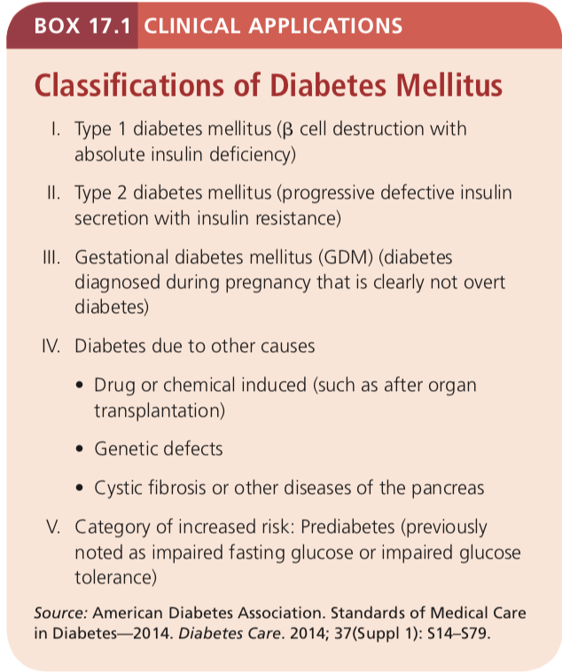
Introduction
Diabetes
The silent disease
The damaging effects of high blood glucose can take decades to develop
Diabetes mellitus is not a single disease but a diverse group of disorders that differ in origin and severity
All forms of diabetes mellitus share one common characteristic: hyperglycemia

Slide 3
Diabetes Mellitus
Metabolic disorders characterized by elevated blood glucose concentrations and disordered insulin metabolism.
Inability to produce sufficient insulin or use insulin effectively
(Defects in insulin production, insulin action, or both)

Slide 4
Under normal conditions
Post food intake, the pancreas increases insulin secretion
Insulin enables muscle and adipose cells to take up newly absorbed glucose from the blood
Insulin is also secreted between meals in smaller amounts to restrain glucagon
Remember glucagon works by increasing glucose in blood
Glucagon promotes gluconeogenesis and glycogenolysis ( both aim to increase blood sugar levels)

Slide 5
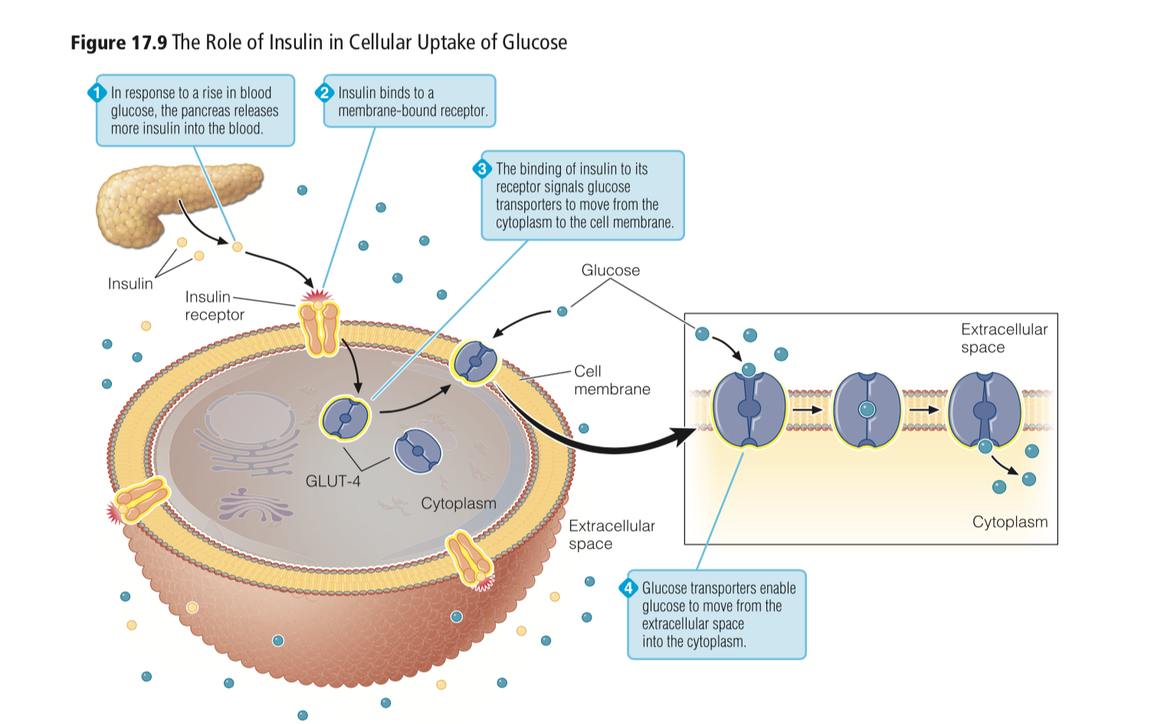

Slide 6
In Diabetes
In diabetes, insulin secretion may be inadequate
Or cells develop insulin insensitivity
  cells normally responsive to insulin may be resistant to its effects
  Or both
Result:
Defective glucose uptake and utilization in muscle and adipose cells
Unrestrained gluconeogenesis in the liver
Hyperglycemia: a marked elevation in blood glucose levels that can ultimately cause damage to blood vessels, nerves, and tissues

Slide 7
Other actions of Insulin
Additionally Insulin promotes
Triglyceride storage in adipose tissue
Protein synthesis in muscle
Impaired insulin action can lead to?
Notes:
increased fatty acid and triglyceride levels in the blood and muscle wasting.

Slide 8
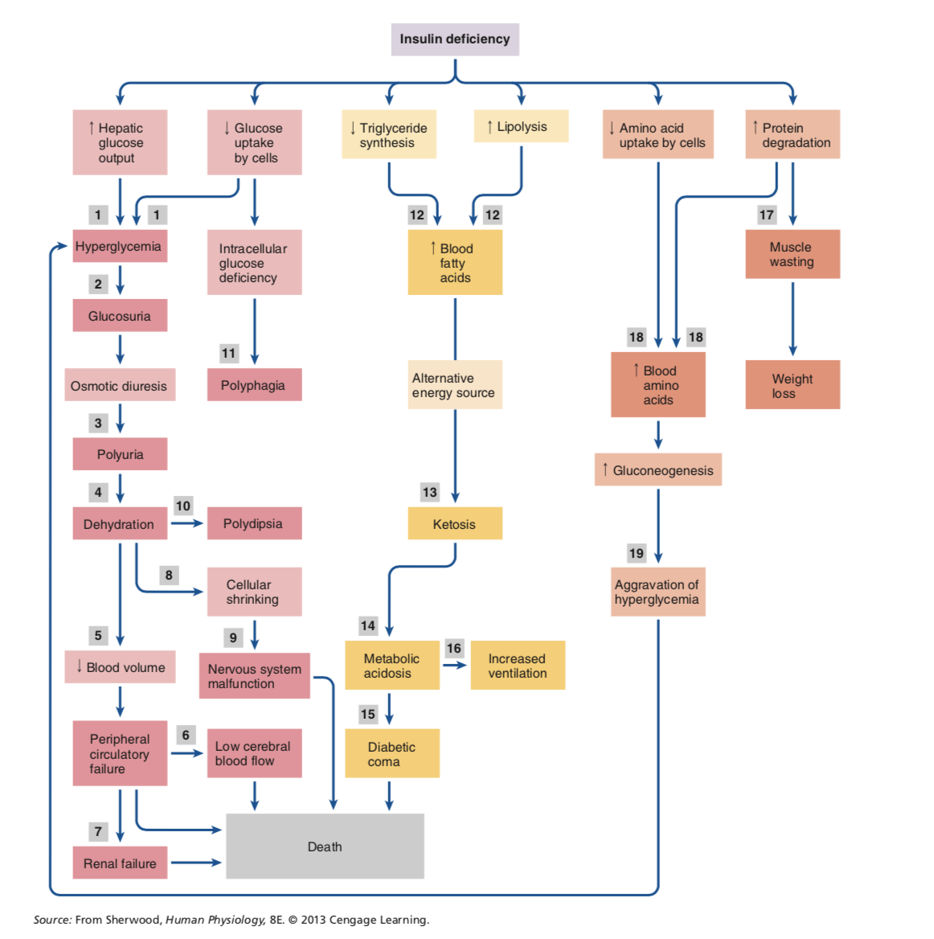
Notes:
As the insulin deficiency persists, production of additional hormones (catecholamines, cortisol, glucagon, and growth hormone) increases, leading to lipolysis

Slide 9
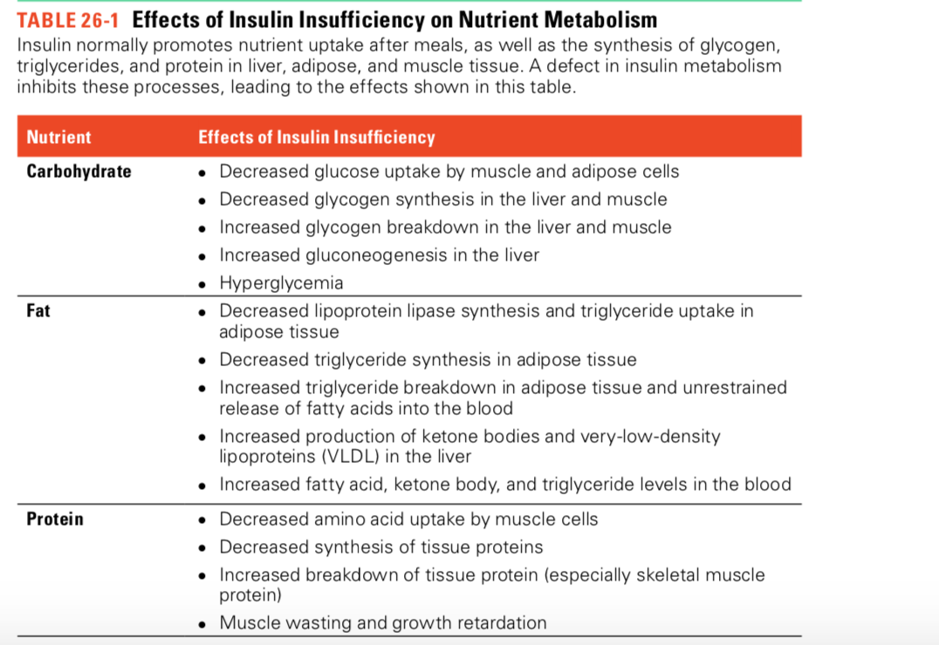

Slide 10
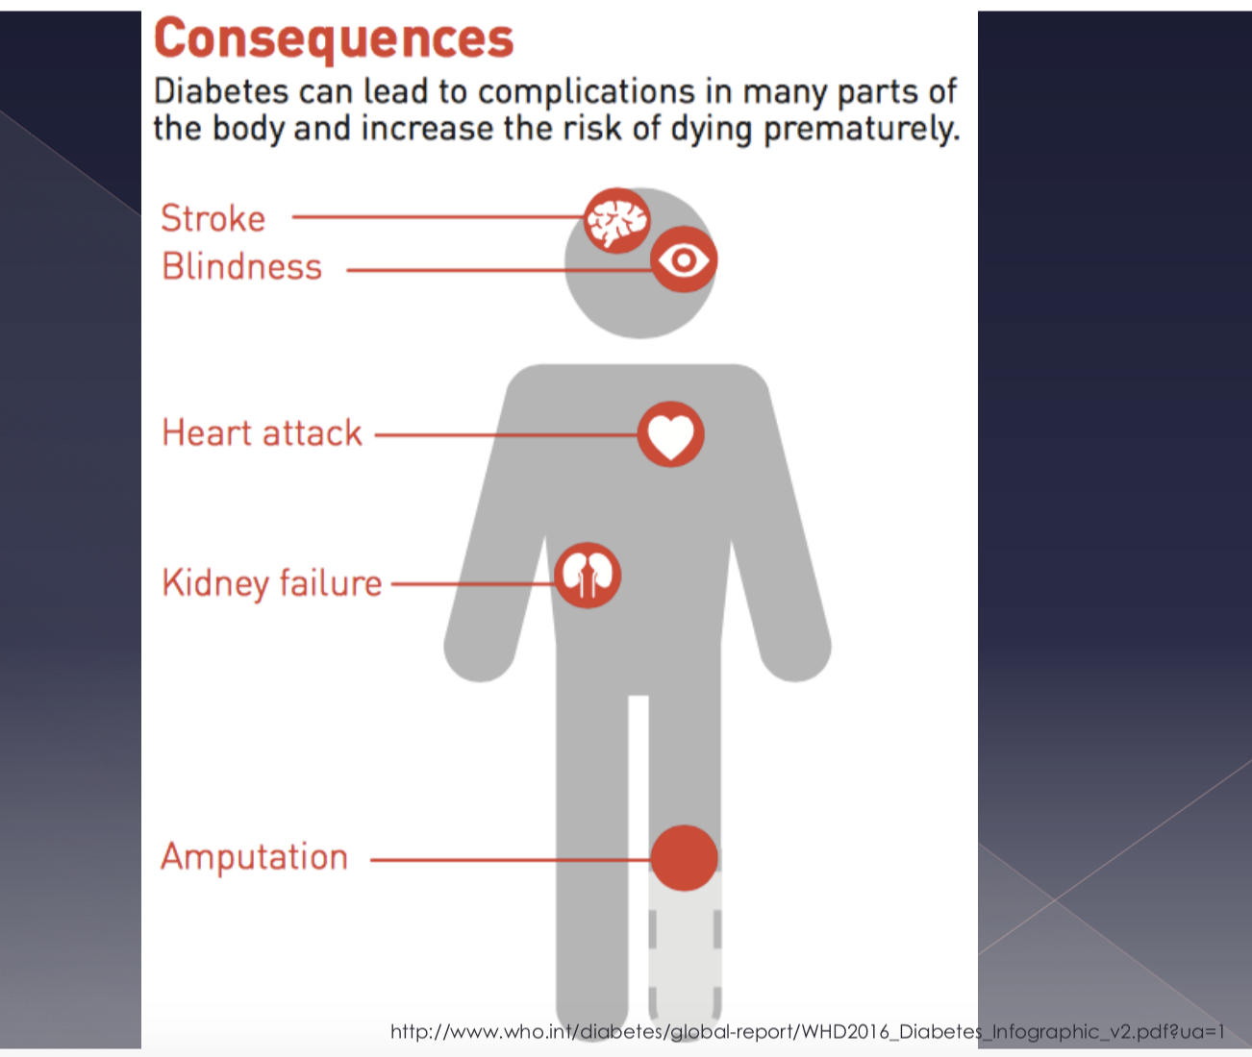
Consequences of Diabetes

Slide 11
Symptoms of Diabetes Mellitus
When the plasma glucose concentration > 200 milligrams per deciliter (mg/dL) it exceeds the Renal threshold
Renal threshold: The concentration of a substance dissolved in the blood above which the kidneys begin to remove it into the urine
Glycosuria (The presence of glucose in the urine) draws additional water from the blood, increasing the amount of urine produced
As total body water decreases, potassium, sodium, magnesium, and phosphorus are also lost. Serum levels of these ions may be normal due to decreased fluid volume

Slide 12
Polyuria excessive urine production
Dehydration
Polydipsia excessive thirst
Weight loss and excessive hunger (polyphagia) as a result of the nutrient depletion that occurs when insulin is deficient
Blurred vision
Increased infections are common in individuals with diabetes
  Due to weakened immune responses and impaired circulation
Fatigue
Hypovolemia-→ increased hct and hgb levels and WBC may be present

Slide 13
Diagnosis of Diabetes Mellitus
Plasma glucose levels can be measured under
Fasting conditions
Non-fasting conditions
oral glucose tolerance test

Slide 14
Fasting Glucose Levels
Measured after a fast of at least 8 hours
Random/Non fasting Glucose Levels
Measured at random times during the day
Diagnosis criteria: >=126 mg/dL
Diagnosis criteria: >=200 mg/dL and classic symptoms are present

Slide 15
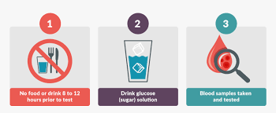
Oral Glucose Tolerance Test
An individual ingests 75-gram glucose load
Plasma glucose is measured at one or more time intervals following glucose ingestion
Diagnosis criteria: plasma glucose >= 200 mg/dL after 2 hours

Slide 16
Glycated Hemoglobin
The HbA1c level is 6.5 percent or higher
Hemoglobin carries oxygen BUT can also attach to sugar in the blood, forming a substance called glycated hemoglobin
Reflect hemoglobin’s exposure to glucose
An indirect assessment of blood glucose levels
Red blood cells have a life span of 120 days, A1c can measure the average glucose concentration for the previous 2–3 month

Slide 17
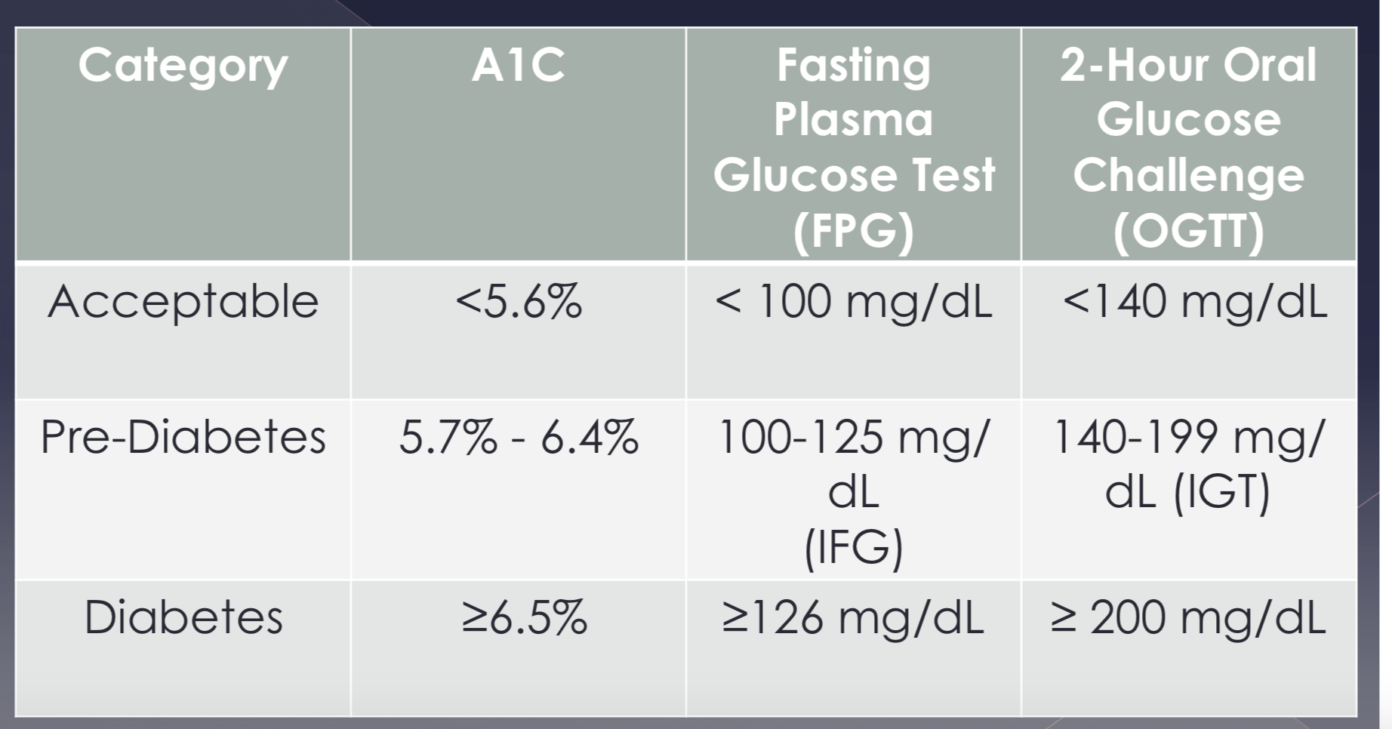
Prediabetes
Prediabetes is used when an individual’s blood glucose levels are above normal but not high enough to be classified as diabetes
Hb

Slide 18
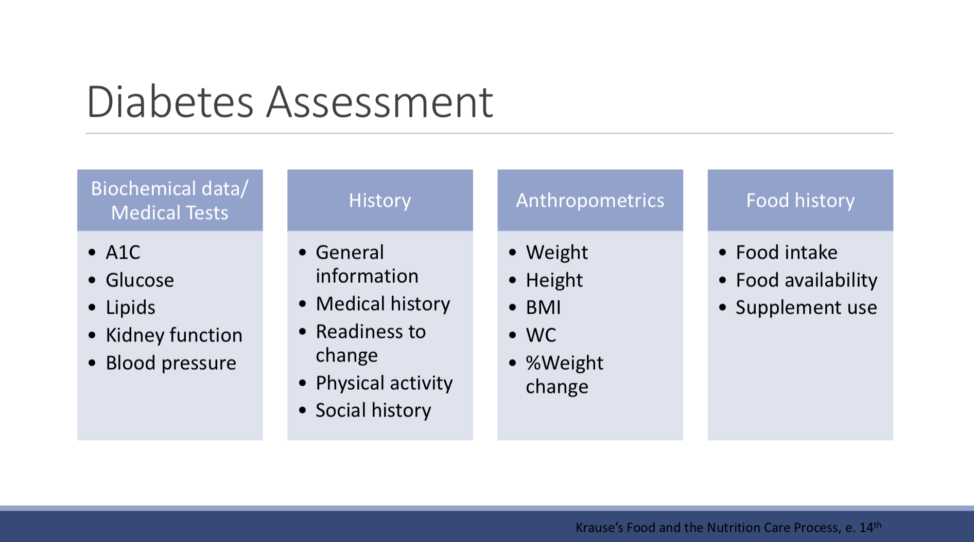

Slide 19
Goals for Nutrition treatment
A1c <7%
BP < 140/80 mg/Hg
Cholesterol:
› LDL-Chol <100 mg/dL
› TG < 150 mg/dL
› HDL-Chol > 40 mg/dL men; >50 mg/dL women
NTP/Evert, et. al. (2014). Nutrition Therapy Recommendations for the management of adults with diabetes. Diabetes Care. 37:S120-142

Slide 20
Goals with Nutrition treatment
Achieve healthy body weight
Delay/prevent complications of DM
Individual nutrition needs:
  Personal & cultural preference
  Health literacy
  Access to healthful food choices
  Willingness & ability to make behavioral changes › Barriers to change
  Maintain pleasure of eating
Provide practical tools for day-to-day
Meal planning
NTP/Evert, et. al. (2014). Nutrition Therapy Recommendations for the management of adults with diabetes. Diabetes Care. 37:S120-142

Slide 21
Types of Diabetes Mellitus
Type 1 Diabetes
caused by autoimmune destruction of the pancreatic beta cells
Beta cells which produce and secrete insulin-> Insulin insufficiency
Usually, by the time symptoms develop, the damage to the beta cells has progressed so far and insulin must be supplied exogenously
Type 1 diabetes typically develops during childhood or adolescence BUT may occur at any age
Autoantibodies testing

Slide 22
Signs and symptoms of DM1
Hyperglycemia
Polyuria
Polydipsia
weight loss
fatigue
ketoacidosis

Slide 23
Diabetic ketoacidosis (DKA) MAY occur before type 1 diagnosis is made
DKA occurs when blood glucose is dangerously high and the body can't get nutrients into the cells because of the absence of insulin
The body breaks down muscle and fat for energy
Leading to an accumulation of ketones in the blood and urine
Symptoms of DKA
A fruity odor on the breath,
heavy, taxed breathing and vomiting
If left untreated, DKA can result in unconsciousness, and even death.
American Diabetes Association
https://www.diabetes.org/diabetes/type-1/symptoms

Slide 24
Type II Diabetes
Most prevalent form of diabetes caused by
Insulin resistance: the reduced sensitivity to insulin in muscle, adipose, and liver cells
The pancreas increases insulin secretion to compensate hyperinsulinemia
The high demand can eventually exhaust pancreatic cells and lead to impaired production of insulin
2. Insulin deficiency: the lack of sufficient insulin to manage glucose effectively

Slide 25
Causes of type 2 Diabetes
The precise causes of type 2 diabetes are unknown BUT risk increases with Obesity (especially abdominal obesity)
Aging
Physical inactivity
Obesity itself can directly cause some degree of insulin resistance
Genetic factors strongly influence risk
  type 2 diabetes is more prevalent in certain ethnic groups

Slide 26
Type 2 Diabetes in Children and adolescents
Children and teenagers who are overweight or obese or have a family history of diabetes are at increased risk of developing type 2 Diabetes

Slide 27
Obesity and Insulin resistance
Remember from last lecture
Enlarged adipose cells have a reduced capacity to store triglyceride -> release of fatty acids into the bloodstream, resulting in an abnormal accumulation of triglycerides in the muscle and liver->alter cellular responses to insulin that lead to insulin resistance
obesity causes adipose cells to alter the hormones and proteins they release into the blood
Adiponectin
Resistin
Enlarged adipose cells activate local macrophages (immune cells), which secrete a number of cytokines ----> state of inflammation
Notes:
ADIPONECTIN adipocyte hormone that promotes insulin sensitivity and glucose tolerance
Resistin, which promotes insulin resistance

Slide 28
Prevention of Type 2 Diabetes Mellitus
Importance of intensive lifestyle changes in preventing or slowing the development of Type 2 Diabetes for individuals at risk
The first step in treatment for T2DM is weight loss and increased physical activity.
The next step of treatment includes the initiation of pharmacological agents, including insulin + medical nutrition therapy
Goal: Avoiding hyperglycemia and slowing development of complications within an acceptable level of treatment side effects.

Slide 29
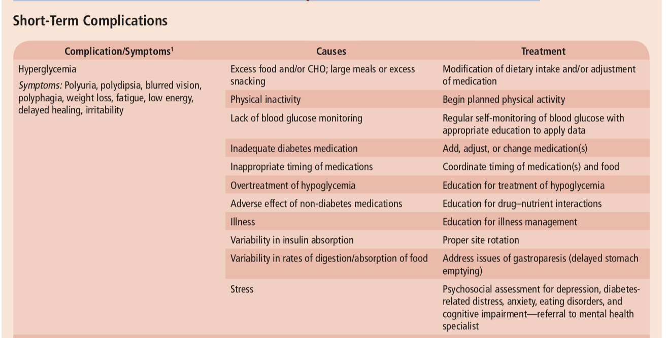
Risk Factors for and Treatment of Complications of Diabetes Mellitus

Slide 30
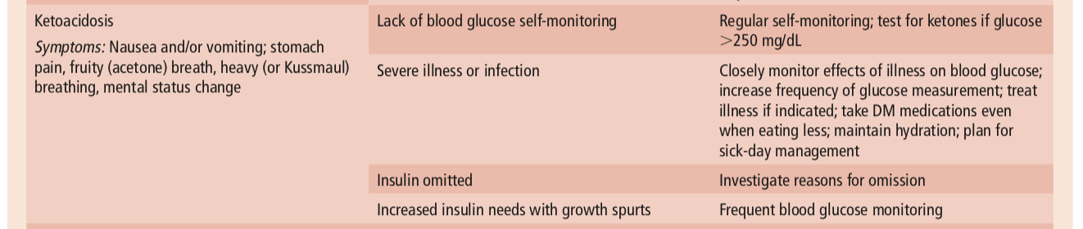
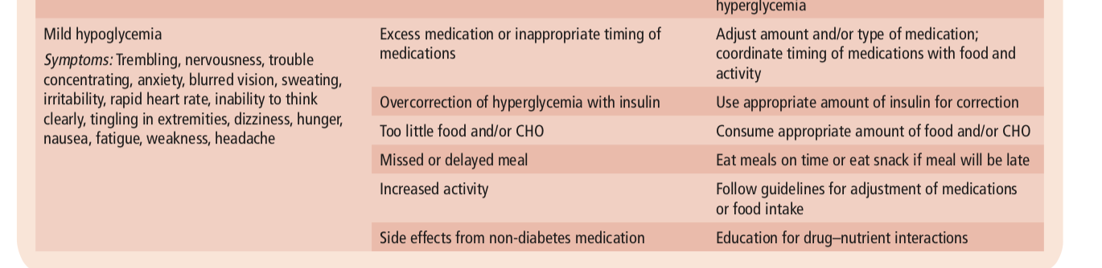
Causes
Treatment

Slide 31

Gestational Diabetes
Glucose intolerance with initial onset during pregnancy
Gestational diabetes is a type of diabetes that is first seen in a pregnant women who did not have diabetes before pregnancy
Risk:
  Age 25 or older
  Obesity BMI >30
  Complications in previous pregnancies
  Prediabetes or symptoms of diabetes
  Family history of diabetes

Slide 32
Gestational Diabetes
Women should be routinely tested for gestational diabetes between 24 and 28 weeks of gestation
In high risk women, screening should begin prior to pregnancy or soon after conception (screening should occur at 6–12 weeks)
Weight loss is not recommended during pregnancy
Obese/overweight women with gestational diabetes could benefit from a modest reduction (about 30%) of calorie intake to slow weight gain
Limiting the carbohydrate intake to less than 45 percent of total energy intake may aid in blood glucose control

Slide 33
During the second or third trimesters of pregnancy, metabolic alterations → maternal and fetal demands for energy and nutrients. Changes in both insulin secretion and glucose, amino acid, and lipid metabolism
Insulin resistance
Inability of the beta cells to meet increased insulin needs during pregnancy→ hyper glycemia
most women with GDM have normal glucose tolerance after delivery
But they are at a greater risk of
  Developing type 2 diabetes later in life,
  Children developing obesity and type 2 diabetes as they enter adulthood
  Uncontrolled diabetes is linked with increased incidences of miscarriage, birth defects, and fetal deaths

Slide 34
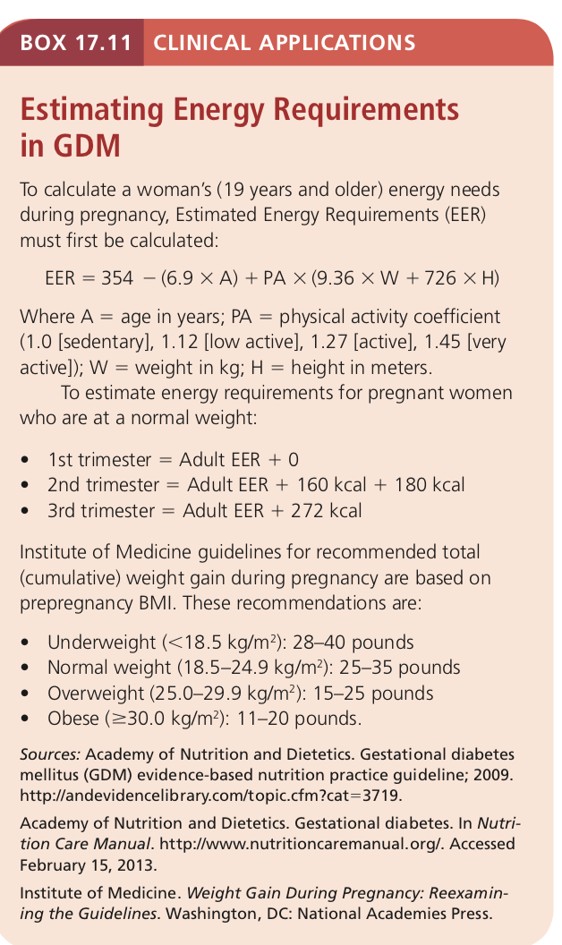

Slide 35
Guidelines for Diabetes Prevention
Weight Management
Weight loss of about 7 percent of body weight for overweight and obese individuals
Healthy eating behaviors should be encouraged to prevent additional weight gain
Dietary modifications
Increased intake of whole grains, nuts, fruits, and vegetables
limit intake of sugar-sweetened beverages
Reduce intake of fat of obese or overweight

Slide 36
Active lifestyle
At least 150 minutes of moderate physical activity
(30 minutes of activity on 5 days of the week)
Regular monitoring
Individuals at risk should be monitored each year

Slide 37
Treatment of diabetic ketoacidosis
Ketone bodies (acidic) can reach dangerously high levels in the bloodstream (ketoacidosis) and spill into the urine (ketonuria)
Additionally, patients may exhibit hyperglycemia, polyuria
lowering blood volume and blood pressure and depleting electrolyte
Insulin therapy to correct the hyperglycemia
Intravenous fluid and electrolyte replacement
Bicarbonate therapy to treat acidosis

Slide 38
Treatment of Diabetes Mellitus
Managing blood glucose levels
Goal :Good glycemic control
Meal planning
Proper timing of medications
Physical exercise

Slide 39
Treatment goals
Main Goal: maintain blood glucose levels within a desirable range to prevent or reduce the risk of complications
Other Goals:
Maintaining healthy blood lipid concentrations
Controlling blood pressure
Weight Management

Slide 40
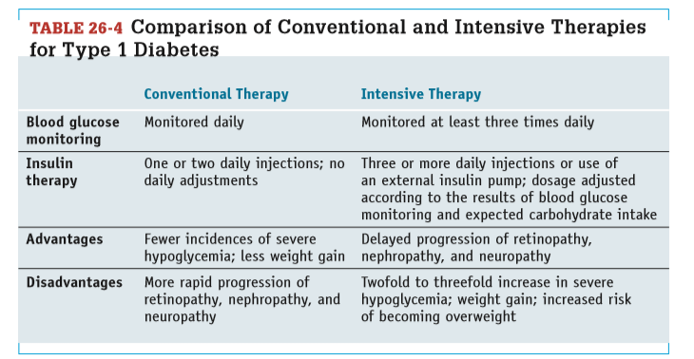

Slide 41

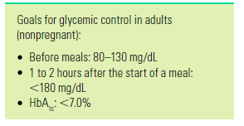
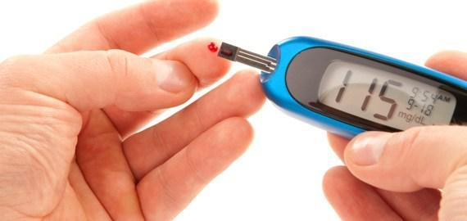
Evaluating Diabetes Treatment
Good glycemic control requires frequent testing of blood glucose levels using a glucose meter, referred to as self-monitoring of blood glucose
A drop of blood from a finger prick is applied to a chemically treated paper strip, which is then analyzed for glucose

Slide 42
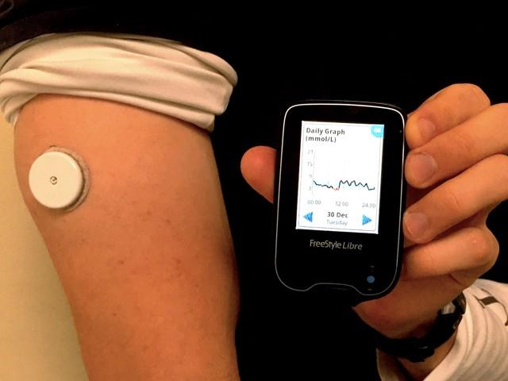
Glucose testing provides valuable feedback
  Food intake
  Medications
  Physical activity
  Preventing hypoglycemia
Continuous glucose monitoring system
measures tissue glucose levels every few minutes using a tiny sensor placed under the skin
Usually patients with type 1 diabetes

Slide 43
Long-term Glycemic Control
HbA1C
  The percentage of HbA in the hemoglobin reflects glycemic control over
the preceding 2 to 3 months
Fructosamine testing (glycated albumin test)
  Determines the non enzymatic glycation of serum proteins (primarily albumin) which have a shorter half-life than hemoglobin
  Used to evaluate recent adjustments in diabetes treatment or glycemic control during pregnancy

Slide 44
Evaluating Diabetes Treatment
Glycemic control
Blood pressure
Monitor lipid profile– evaluate need for statin therapy, plant sterol, reduce sat fat, trans fat, smoking
Albuminuria (urinary protein can determine whether nephropathy has developed)
Monitor Long-term Complications
  Physical examination: retinopathy, neuropathy, foot problems Optimize glycemic control
    Daily foot care, walking, stretching etc.
Ketone Testing
  Blood ketone levels
  Urine ketone levels

