Slide 1
Krebs Cycle
TCA cycle
Citric acid cycle

Slide 2
TCA Cycle
Acetyl-CoA donates its acetyl group to the four-carbon compound oxaloacetate to form the six-carbon citrate. Citrate is then transformed into isocitrate, also a six-carbon molecule
dehydrogenated with loss of CO2 to yield the five-carbon compound Alpha-ketoglutarate
alpha-Ketoglutarate undergoes loss of a second molecule of CO2 and ultimately yields the four-carbon compound succinate.
Succinate is then enzymatically converted in three steps into the four-carbon oxaloacetate—which is then ready to react with another molecule of acetyl-CoA.
Notes:
In each turn of the cycle, one acetyl group (two carbons) enters as acetyl-CoA and two molecules of CO2 leave

Slide 3
The tricarboxylic acid (TCA) cycle
Krebs cycle
The citric acid cycle
The enzymes of the TCA cycle are located in the mitochondrial matrix
Fuel Molecules lose electrons, get oxidized and donate those electrons to energy carriers producing NADH and FADH2
Main function of the TCA cycle is to release high-energy electrons that power the synthesis of ATP via oxidative phosphorylation

Slide 4
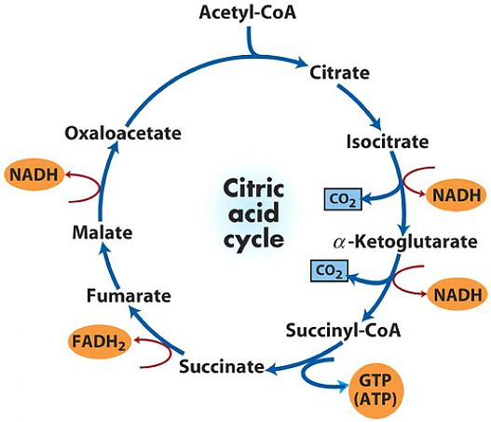

Slide 5
Acetyl-CoA adds two carbons to oxaloacetate to start the cycle.
Isomerization takes place by removing H2O and then adding it back.
A CO2 is lost and a NADH is produced
Another CO2 is lost and another NADH is produced.
A substrate-level phosphorylation.
FAD+ is reduced to form FADH2
another NADH is produced

Slide 6
Each turn of the cycle forms
1 GTP
3 NADH molecules
1 FADH2 molecule
Note: oxygen is not required until later
Oxygen is required to recycle
  NADH→ NAD+
  FADH2→ FAD
  (Thus generating ATP)
Cofactors must be recycled to be reused in the Krebs Cycle

Slide 7
The role of the citric acid cycle not confined to the oxidation of acetate only
The citric acid cycle is a “hub of intermediary metabolism”
Four- and five-carbon end products of many catabolic processes feed into the cycle and serve as fuels.
Oxaloacetate and alpha ketoglutarate are produced from aspartate and glutamate
Under some metabolic circumstances, drawn out of the cycle to serve as precursors of the amino acids aspartate and glutamate by simple transamination reactions
Oxaloacetate is converted to glucose in gluconeogenesis
Succinyl- CoA is a central intermediate in the synthesis of the porphyrin ring of heme groups, which serve as oxygen carriers (in hemoglobin and myoglobin)

Slide 8
As intermediates of the citric acid cycle are removed to serve as biosynthetic precursors, they are replenished by anaplerotic reactions
The most important anaplerotic reaction in mammalian liver and kidney is the reversible carboxylation of pyruvate by CO2 to form oxaloacetate
Pyruvate carboxylase is a regulatory enzyme and is virtually inactive in the absence of acetyl-CoA,
Notes:
Anaplerosis is the act of replenishing TCA cycle intermediates

Slide 9
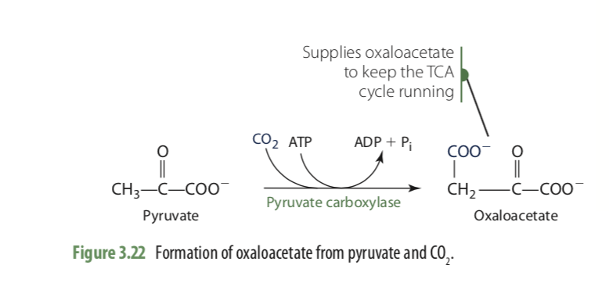
To keep the TCA cycle functioning, oxaloacetate—and other TCA cycle intermediates that can lead to oxaloacetate— must be replenished in the cycle.
Oxaloacetate, fumarate, succinyl-CoA, and a-ketoglutarate can all be formed from certain amino acids
We need an ample supply of oxaloacetate from pyruvate (three carbons) + CO2 which is catalyzed by pyruvate carboxylase
High levels of acetyl CoA activate pyruvate Carboxylase
Requires Biotin

Slide 10
Regulation of the Citric Acid Cycle
No hormonal regulation
Allosteric regulation only ( molecules in cell bind to enzymes part of the TCA cycle, not on active site on a different allosteric site , causing enzyme to undergo a conformational change, either making enzyme work better or be inhibited)
Substrate availability
Example
  Low concentration of acetyl CoA will slow down citric acid cycle
  Citrate being shuttled out of citric acid cycle for FA synthesis→ Slow down cycle
  In starvation state, amino acids break down and enter critic acid cycle as alpha ketoglutarate or oxaloacetate→ more substrate→ speeding cycle

Slide 11
Allosteric regulation
The PDH complex ( Pyruvate→ acetyl CoA)
  Inhibited by fatty acids and acetyl-CoA and when the cell’s [ATP]/[ADP] and [NADH]/[NAD+] ratios are high
  Regulatory protein enzymes- The PDH complex is inhibited by reversible phosphorylation of E1 complex ( protein kinase and protein phosphatase)
The Citric Acid Cycle Is Regulated at Its Three Exergonic Steps
  Citrate synthase
  Isocitrate dehydrogenase
  alpha-ketoglutarate dehydrogenase

Slide 12
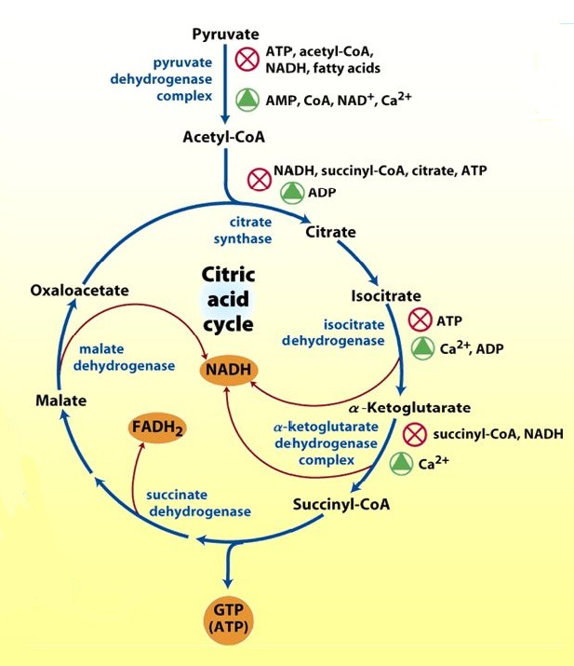
Fumarate
Succinate
Notes:
Ca+2, the signal for contraction and for a concomitant increase in demand for ATP, activates both isocitrate dehydrogenase and alpha-ketoglutarate dehydrogenase, as well as the PDH complex

Slide 13
Formation of ATP
Acts as the main energy currency and must be continually synthesized from the energy provided by macronutrients
  Some ATP are synthesized by direct phosphorylation involving high-energy phosphate donors, referred to as substrate-level phosphorylation
  Two reactions in glycolysis
  one reaction in the TCA cycle produce GTP
The production of ATP in mitochondria by oxidative phosphorylation
(Electron transport chain)
Oxidative phosphorylation is the process of making ATP by using the proton gradient generated by the ETC.

Slide 14
The production of ATP in mitochondria by oxidative phosphorylation begins with the oxidation of fuel molecules by the TCA cycle and the release of electrons and protons.
Electrons obtained from nutrients and metabolic intermediates are transferred to NAD⁺ and FAD
AH₂ + NAD⁺→ A+ NADH + H⁺
BH₂ + FAD→ B +FADH₂
The electrons and protons are captured by NADH and FADH2 and delivered to the inner mitochondrial membrane.
TCA CYCLE AND GLYCOLYSIS

Slide 15
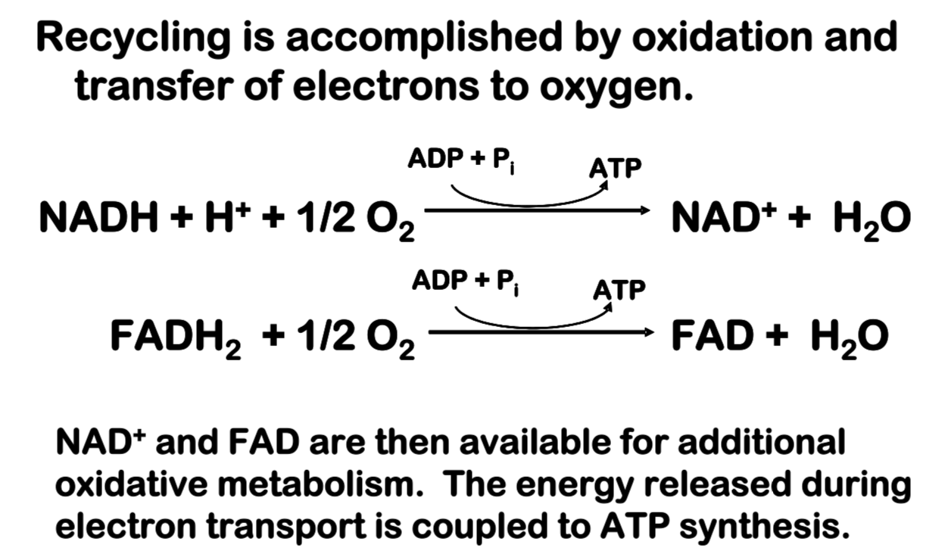
NAD⁺ and FAD must be recycled

Slide 16
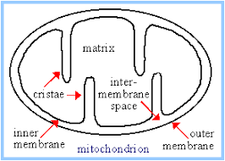
The electrons and protons are captured by NADH and FADH2 and delivered to the inner mitochondrial membrane.
Location of mitochondrial complexes
• Inner mitochondrial membrane:
  Electron transport chain: oxidizes reduced coenzymes
  ATP synthase: machinery to synthesize ATP

Slide 17
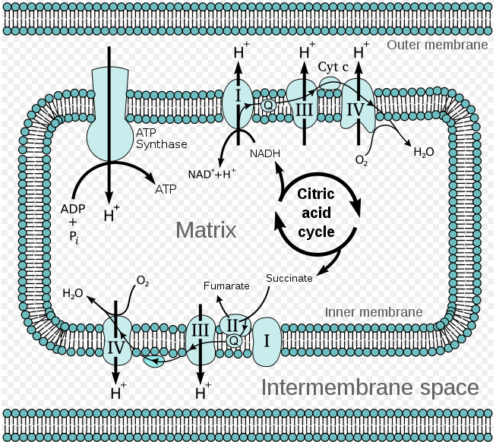

Slide 18
The flow of electrons from NADH or FADH₂ to O₂ through protein complexes located in the mitochondrial inner membrane leads to the pumping of protons out of the mitochondrial matrix. The resulting uneven distribution of protons generates a pH gradient and a transmembrane electrical potential that creates a proton-motive force
ATP is synthesized when protons flow back to the mitochondrial matrix through an enzyme complex (ATP synthase) . Thus, the oxidation of fuels and the phosphorylation of ADP are coupled by a proton gradient across the inner mitochondrial membrane
https://www.ncbi.nlm.nih.gov/books/NBK21208/

Slide 19
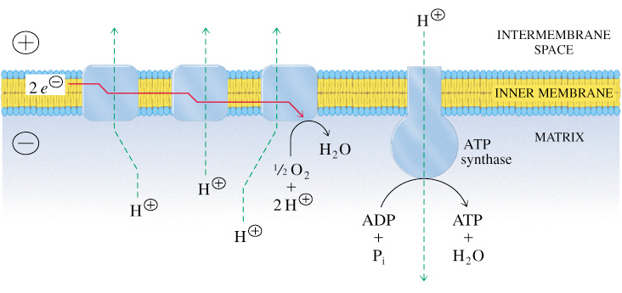
The steps are coupled. Electrons do not flow to oxygen unless ATP is needed
Each NADH produces 2.5 ATP
Each FADH₂ produces 1.5 ATP

Slide 20
Four protein complexes in the Inner membrane make up the ETC
Complexes I, II, III, IV
Work together in succession to catalyze redox reactions
Integral membrane proteins with prosthetic groups to move electrons
Electrons move through the complexes in order
  Electrons from NADH enter at Complex I
  Electrons from FADH2 enter at Complex II
In each reaction, an electron donor is oxidized and an electron acceptor is reduced
Compounds differ from one another in how readily they will be oxidized or reduced

Slide 21
Electrons flow downhill – spontaneously moving from molecules that are strong electron DONORS to strong electron ACCEPTORS = move from high energy state to low energy state
Flow of electrons is spontaneous and thermodynamically favorable because the next carrier has greater affinity for electrons than the previous
NADH is a strong electron donor: because its electrons are held in a high-energy linkage, the free-energy change for passing its electrons to many other molecules is favorable
NADH is a good molecule for donating electrons to the respiratory chain, while O₂ is a good electron acceptor
Notes:
pairs of compounds that have the most negative redox potentials have the weakest affinity for electrons and therefore contain carriers with the strongest tendency to donate electrons. Conversely, those pairs that have the most positive redox potentials have the strongest affinity for electrons and therefore contain carriers with the strongest tendency to accept electrons

Slide 22
Co-factors in Electron Transport
Protein components use metal- containing prosthetic groups or flavins to carry electrons
Metal-containing groups such as iron-sulfur clusters, copper ions, hemes

Slide 23
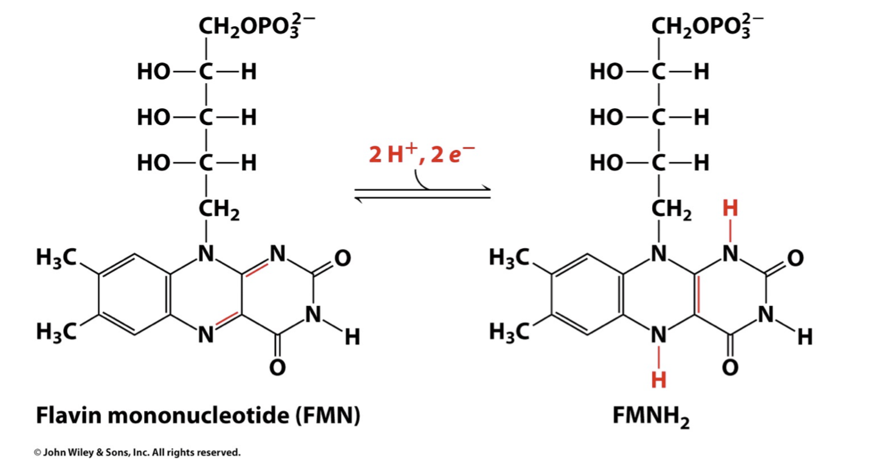
Co-factors in Electron Transport
Flavins:
(Complex I) FMN – FMNH2
(Complex II) FAD - FADH2

Slide 24
Co-factors in Electron Transport
Ubiquinone (Q) (Mobile electron carrier)
Also called coenzyme Q
A membrane-soluble compound
Long hydrophobic tail keeps Q anchored in the mitochondrial inner membrane
lipid soluble molecule that diffuses within the lipid bilayer, and shuttles electrons from Complexes I and II and pass them to III
Not a part of any complex

Slide 25
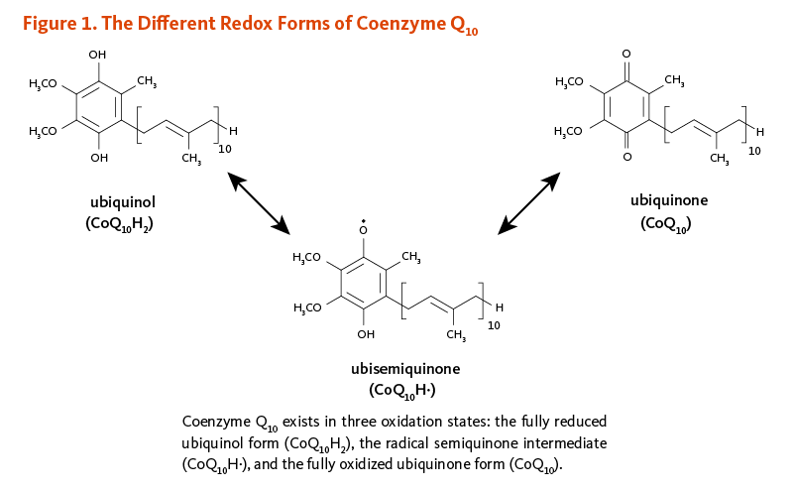
Q
QH2
https://lpi.oregonstate.edu/book/export/html/352

Slide 26
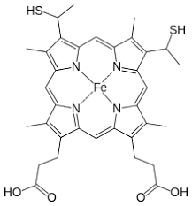
Co-factors in Electron Transport
Cytochrome c
A peripheral membrane protein associated with the outer face of the membrane, transports electrons from III to IV
Not a part of any complex
Shuttles electrons and protons from Complex III to Complex IV

Slide 27
MIDTERM
Thursday/ NOV 18

Slide 28
Complex I
Complex I includes a flavoprotein (contains FMN – related to FAD) and proteins with Fe-S centers (iron-sulfur clusters)
Electrons flow from NADH to Flavin mononucleotide (FMN)
Electrons then flow to a prosthetic group on an iron sulfur cluster
Iron cycles between 3+ and 2+ states
Reduction of Q to QH2 requires 2 e-
About 4 H+ translocated per 2 e- transferred ( pumped from matrix→ intermembrane space)

Slide 29
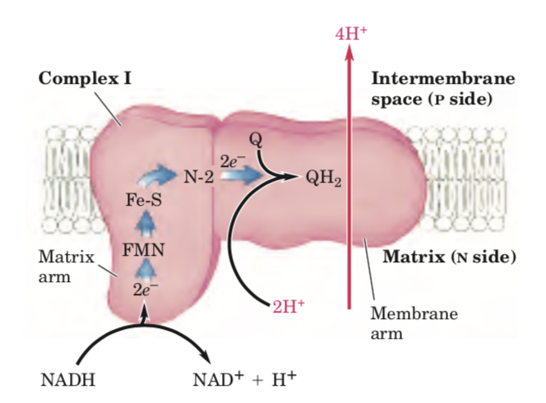
Complex 1
NADH dehydrogenase, is a very large, L-shaped structure that functions to accept high energy electrons from NADH molecules.
NADH binds to the vertical component of complex (within the matrix)
NADH gives off two electrons onto an acceptor molecule called flavin mononucleotide (FMN)
the FMN also uptakes two hydrogen ions (one from the matrix and one from the NADH molecule) to form the fully reduced FMNH2.

Slide 30
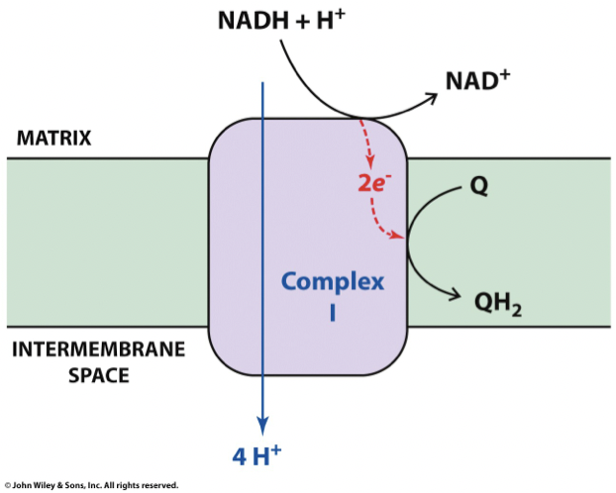
The electrons then move through a series of iron-sulfur clusters (Iron cycles between +2 and +3
end up being transferred onto ubiquinone.(Q)
Q uptakes two protons from the matrix to form ubiquinol (QH2)

Slide 31
The transfer of electrons to CoQ occurs one electron at a time.
The Q molecule is lipid soluble and freely moves through the hydrophobic core of the membrane. Once it is reduced, (QH₂), ubiquinone delivers its electrons to the next complex in the electron transport chain.

Slide 32
Complex II
Contains succinate dehydrogenase, a component of the TCA cycle
Complex II contains a FAD protein and Fe-S centers
succinate is converted to fumarate in the TCA cycle, FAD is reduced to FADH2.
FADH2 (produced in kreb cycle ) remains bound to complex
Complex II can oxidize the FADH2 back into FAD and move the free electrons through a series of iron-sulfur clusters and onto ubiquinone, thereby forming ubiquinol (The FADH2 is oxidized by electron transfer through the Fe-S centers to reduce Q to QH2)

Slide 33
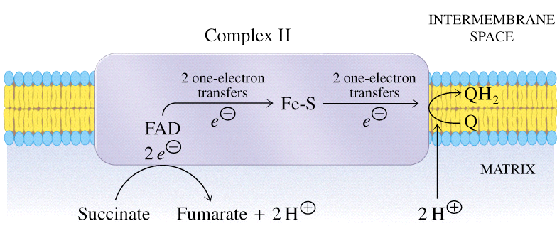
Complex II does NOT contribute to proton gradient, but supplies electrons from succinate.
Less ATP generated from FADH2 compared to NADH

Slide 34
Electron transfer and proton flow in Complex III
Electron transfer from Ubiquionol (QH2) to chytochrome c
The electrons derived from both NADH and FADH2 are passed from QH2 to cytochrome c through the reactions of Complex III
Complex III contains two different cytochromes and a Rieske center that contains the 2Fe-2S center group
  Cytochrome b ( two heme groups)
  Cytochrome c (single heme group, carries one electron)
  Rieske center that contains the 2Fe-2S center group

Slide 35
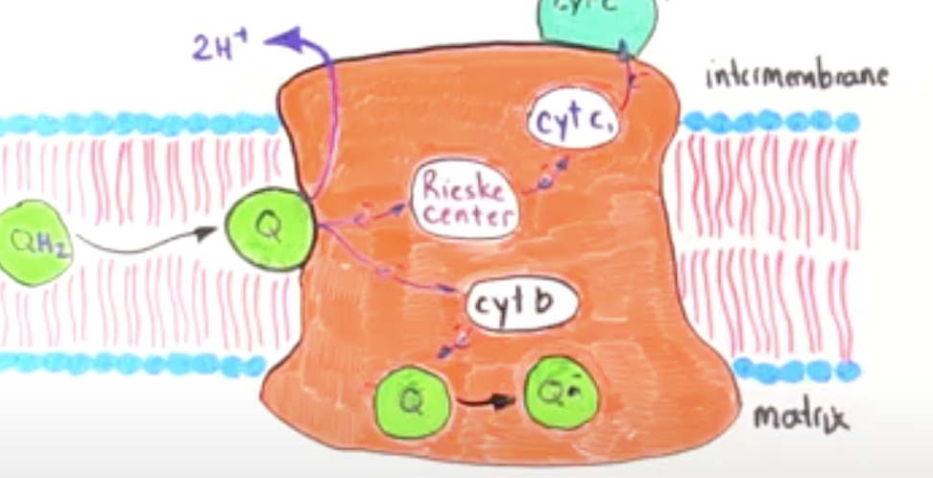
Complex III
CYT C
The process by which the electrons are transferred from the ubiquinol to cytochrome c is known as the Q cycle → Two half cycles
In the first half of the cycle, one electron flows to cytochrome c. A second electron flows to cytochrome b where it transfers to a Q molecule, creating an unstable semiquinone ion.
Q
QH2
Q
Q Radical

Slide 36
One of these electrons moves onto the Rieske center, then onto cytochrome c1 and finally onto cytochrome c. Note that cytochrome c, unlike ubiquinone, can only carry a single electron at any given time.
The other electron that comes from QH2 follows a different pathway and moves through the heme groups of cytochrome b and onto ubiquinone to form a partially reduced species called a semiquinone radical ion. The two protons that were originally attached to ubiquinol are transferred into the intermembrane space.
In the second half-cycle of the Q cycle, another ubiquinol (QH2) attaches onto complex III. Upon binding, the two protons are moved into the intermembrane space and the two electrons follow the same pathways as before The fourth electron flows to cytochrome b where it joins the semiquinone( Q radical) to form QH2

Slide 37
Complex III
In the second half-cycle of the Q cycle, another ubiquinol attaches onto complex III. Upon binding, the two protons are moved into the intermembrane space and the two electrons follow the same pathways as before
Summary
A single Q cycle
oxidation of 2 QH2
Reduces two cytochrome c molecules
forms a single ubiquinol molecule
pumps four protons into the intermembrane space
So Oxidation of 2 QH2 is accompanied by the translocation of 4 H+ across the inner mitochondrial membrane

Slide 38
Complex IV
Accepts electrons from cytochrome c
Contains 2 cytochromes (a and a3) and proteins with copper centers that provide multiple centers for oxidation-reduction
Cytochromes a and a3 are the only species capable of direct transfer of electrons to oxygen
two heme groups (one in each of the cytochromes a and a₃

Slide 39
oxygen molecule held very tightly between the iron and copper ions until the oxygen is completely reduced
Catalyzes reduction of oxygen to form water.
The metal ions cycle between their oxidized (Fe+3, Cu+2) and reduced (Fe+2, Cu+)
Moves H+ into the intermembrane space and contributes to the proton gradient

Slide 40
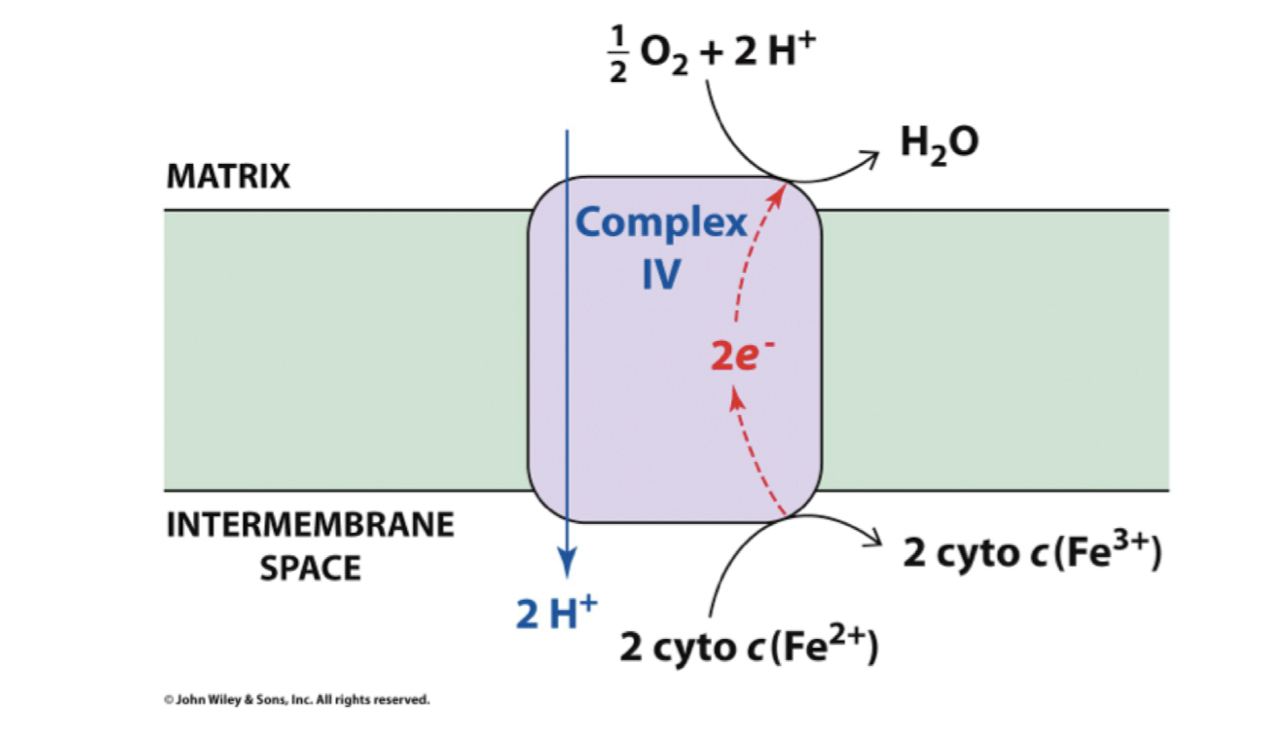
Complex IV
O2 + 4 e- + 4H+ 2 H2O

Slide 41
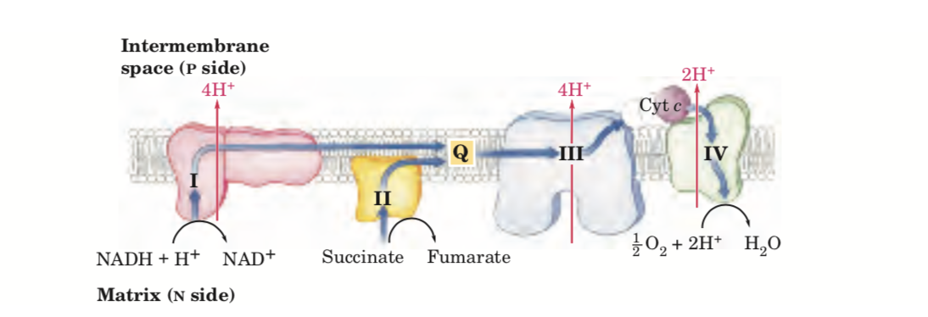
Oxidative phosphorylation. Electrons from NADH and FADH2 travel along the electron transport chain
a total of 10 protons are translocated from the matrix to the intermembrane space.

Slide 42
ATP Synthesis
How is a concentration gradient of protons transformed into ATP?
Complex I, Complex III and Complex IV pump protons across the inner mitochondrial membrane
Pumping uses the energy liberated from the oxidation of NADH and FADH2
Pumping generates a membrane potential because it generates an electrochemical gradient
  Negative inside, positive outside
  Alkaline inside, acidic outside

Slide 43
ATP Synthesis
The Chemiosmotic Hypothesis
A proton concentration gradient serves as the energy reservoir for driving ATP formation
Protonmotive force (Δp) is the energy of the proton concentration gradient
Protons that are translocated into the intermembrane space by electron transport, flow back into the matrix via ATP synthase
H+ flow forms a circuit (similar to an electrical circuit)
The transmembrane protein, ATP synthase, catalyzes the phosphorylation of ADP in a reaction driven by movement of H+ across the inner membrane into the matrix
As protons move back into the matrix through ATP Synthase, the energy stored in the electrochemical proton gradient is used to make ATP
Notes:
The electrochemical energy built through the difference in proton concentration and separation of charge across inner mitochondrial membrane translates to the proton motive force (PMF).

Slide 44
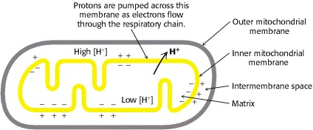
In chemiosmotic theory transmembrane ATP synthases are very important. They convert energy of spontaneous flow of protons through them into chemical energy of ATP bonds.
The proton gradient is COUPLED with ATP synthesis
Biochemistry. 5th edition.Berg JM, Tymoczko JL, Stryer L.
New York: W H Freeman; 2002.

Slide 45
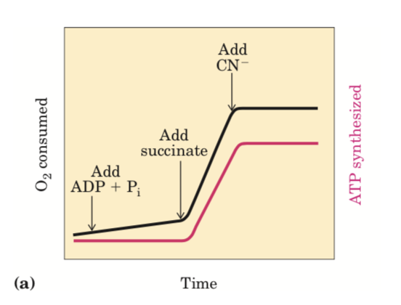
In experiments to demonstrate coupling, mitochondria are suspended in a buffered medium and an O2 electrode monitors O2 consumption (Oxygen disappearance from closed vessel)
At intervals, samples are removed and assayed for the presence of ATP.
Addition of ADP and Pi alone results in little or no increase in either respiration (O2 consumption; black) or ATP synthesis (red). When succinate is added, respiration begins immediately and ATP is synthesized. Addition of cyanide (CN⁻ ) , which blocks electron transfer between cytochrome oxidase and O2, inhibits both respiration and ATP synthesis.

Slide 46
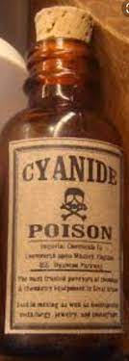
Cyanide is a naturally occurring chemical, found in many plants, that has been used in conventional warfare
Cyanide poisons the mitochondrial electron transport chain within cells and renders the body unable to derive energy (adenosine triphosphate—ATP) from oxygen. Specifically, it binds to the a3 portion (complex IV) of cytochrome oxidase and prevents cells from using oxygen, causing rapid death
Notes:
Gradient ? ETC?

Slide 47
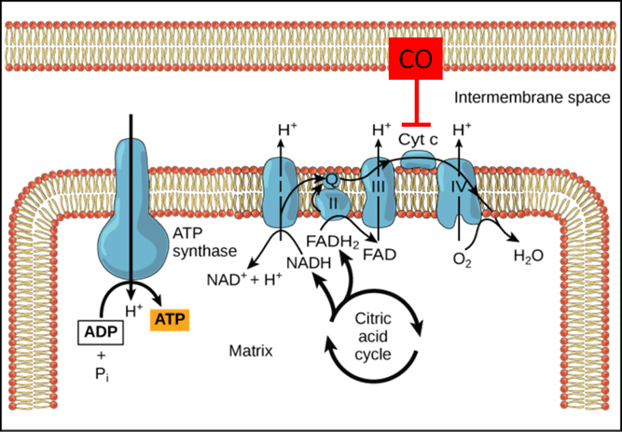
Carbon Monoxide works similarly to
Cyanide
Carbon monoxide binds to and inhibits cytochrome c oxidase (complex IV)
https://blogs.brown.edu/emergency-medicine-residency/winter-is-coming-think-co-toxicity/

Slide 48
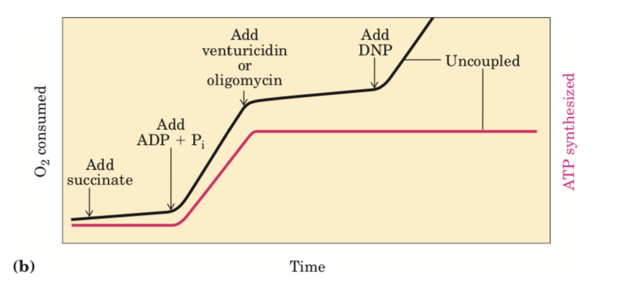
Experiments demonstrate that the reverse is true as well!
inhibition of ATP synthesis blocks electron transfer in intact mitochondria (providing O2 and oxidizable substrates, but no ADP) no ATP synthesis can occur and electron transfer to O2 does not proceed
venturicidin or oligomycin, inhibitors of ATP synthase, blocks both ATP synthesis and respiration
Dinitrophenol (DNP) is an uncoupler, allowing respiration to continue without ATP synthesis.

Slide 49
What would happen to the energy stored in the proton gradient if it weren't used to synthesize ATP or do other cellular work?
The proton-motive force builds up

Slide 50
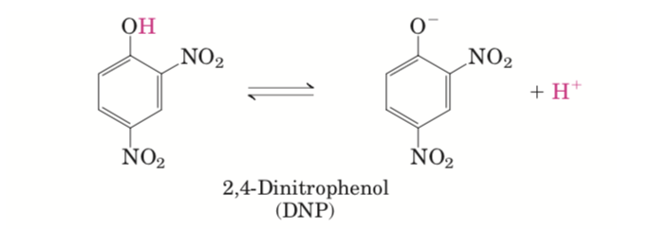
Uncoupling agents: molecules that disrupts oxidative phosphorylation in by dissociating the reactions of ATP synthesis from the electron transport chain
Mitochondria still capable of catalyzing electron transfer from succinate or NADH to O₂
O2 consumed but no ATP generated
DNP has dissociable proton/ hydrophobic molecule. Diffuse readily across mitochondrial membranes. After entering the matrix in the protonated form, they can release a proton

Slide 51
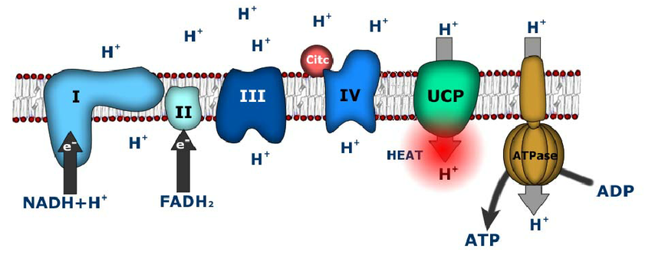
Mitochondrial transporters present in the inner membrane of mitochondria
Allow proton-leak : they act as proton channels to redirect protons back into the matrix and away from ATP synthase
dissipation of oxidation energy as heat
Implicated in thermogenesis
Valle, Adamo & Oliver, Jordi & Roca, Pilar. (2010). Role of Uncoupling Proteins in Cancer. Cancers. 2. 567-591. 10.3390/cancers2020567.

Slide 52
Uncoupling Protein-1 (UCP₁)
Uncoupling proteins found in mammalian brown adipose tissue (BAT)
“Brown fat” dark color due to high levels of mitochondria which contain thermogenin ( uncoupling protein)- produce heat- non shivering thermogenesis
In humans and other large mammals, BAT disappears after infancy

Slide 53
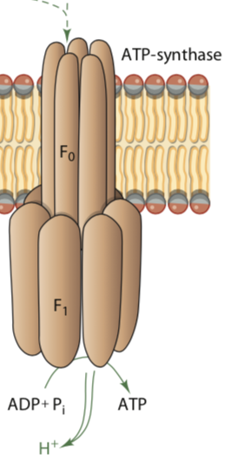
ATP Synthase
H⁺
Knob like Projections into the matrix side
Two units
F₁ Contains the catalytic site for ATP synthesis
F₀ transmembrane channel for H⁺
Proton flow back into the matrix through (F₀) component of the ATP synthase while F₁ catalyzes the synthesis of ATP
MATRIX
Notes:
F0 is anchored in the membrane and F1 sticks out of the membrane into the mitochondrial matrix.

Slide 54
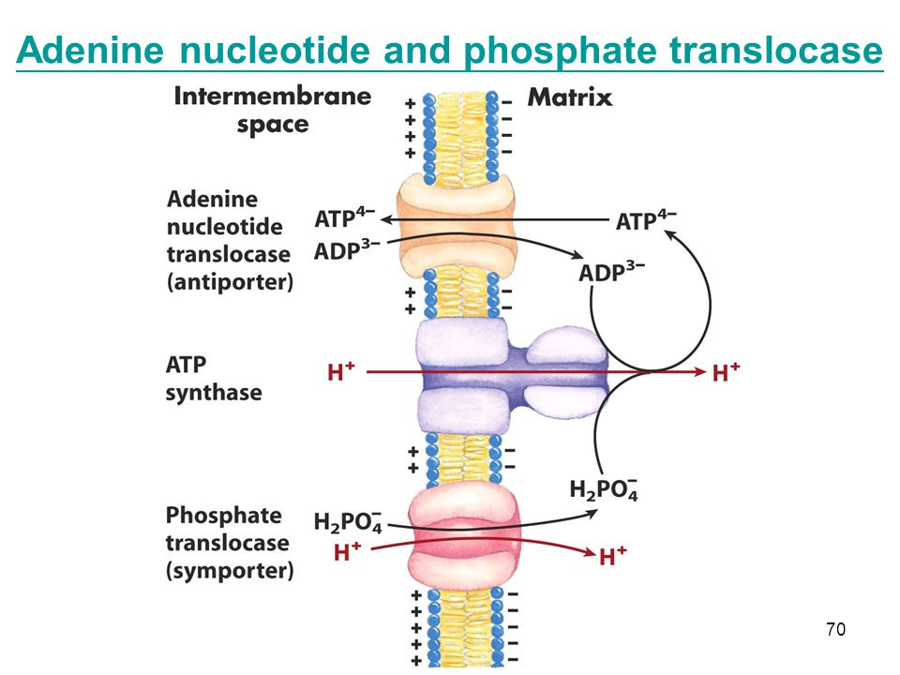
ATP is synthesized in mitochondria but must be moved to the cytosol to supply energy for the cell. The enzyme ATP-ADP translocase shuttles ATP out of the mitochondria and ADP in.
ATP must be transported to the cytosol, and ADP and Pi must enter the matrix
ADP/ATP carrier exchanges mitochondrial ATP4- for cytosolic ADP3-
The exchange causes a net loss of -1 in the matrix (draws some energy from the H+ gradient)
A similar translocase moves ATP and ADP between IMS and Cytosol
Notes:
ATP Synthesized in matrix, has to be used by other parts of the cell--> translocate into cytosol

Slide 55
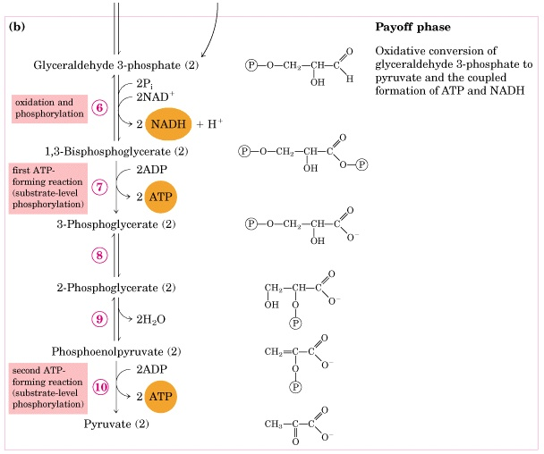
Recall that the glycolytic pathway generates NADH in the cytosol in the oxidation of glyceraldehyde 3-phosphate
NAD⁺ must be regenerated for glycolysis to continue.
Under anaerobic conditions, NADH in the cytosol is used in the lactate dehydrogenase reduction of pyruvate to lactate, thereby becoming reoxidized to NAD+ without involving oxygen

Slide 56
NADH cannot simply pass into mitochondria for oxidation by the respiratory chain, because the inner mitochondrial membrane is impermeable to NADH and NAD⁺
How is cytosolic NADH reoxidized under aerobic conditions?

Slide 57
Electrons from NADH,rather than NADH itself, are carried across the mitochondrial membrane
Glycerol 3-phosphate shuttle
specific to certain tissues. The glycerol-3-phosphate shuttle functions in the brain and skeletal muscle
NADH in the cytosol transfers its electrons to dihydroxyacetone phosphate, forming glycerol-3-phosphate that freely diffuses across the outer mitochondrial membrane.
Electrons of glycerol-3-phosphate are then transferred to FAD that is associated with a membrane-bound isoform of glycerol- 3-phosphate dehydrogenase located in the inner mitochondrial membrane

Slide 58
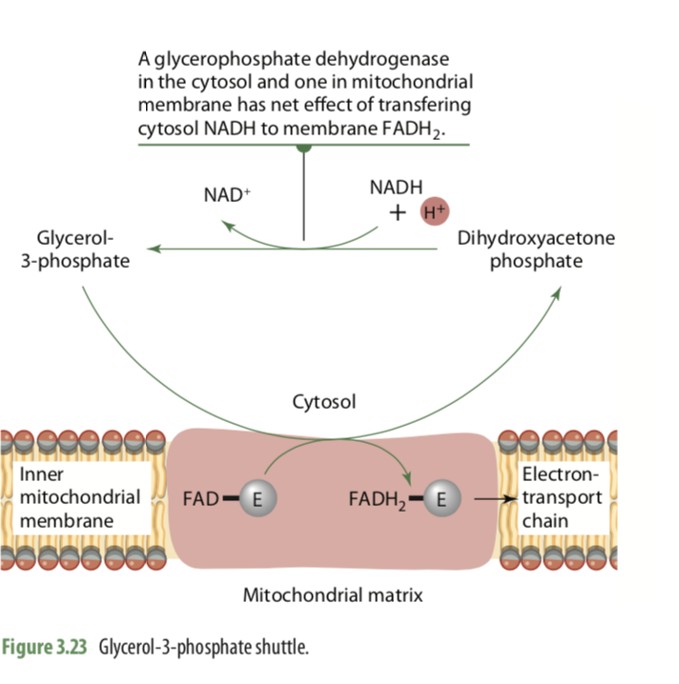
Cytosol glycerol- 3-phosphate dehydrogenase
Mitochondrial- 3-phosphate dehydrogenase
The first step in this shuttle is the transfer of a pair of electrons from NADH to dihydroxyacetone phosphate, a glycolytic intermediate, to form glycerol 3-phosphate This process occurs in the cytoplasm

Slide 59
Once G3P moves into the intermembrane space, it is then oxidized back into DHAP by the action of a membrane-bound enzyme called the mitochondrial glycerol 3-phosphate dehydrogenase
An FAD molecule bound to this enzyme accepts the two high energy electrons and the two H+ ions to form FADH2. The FADH2 then gives up the two protons and electrons to a ubiquinone molecule to form ubiquinol. Ubiquinol then moves along the inner mitochondrial membrane to transfer the electrons onto complex III. Since this shuttle bypasses complex I, NADH molecules transported onto the ETC in this manner only produce a net result of 1.5 ATP molecules per NADH.

Slide 60
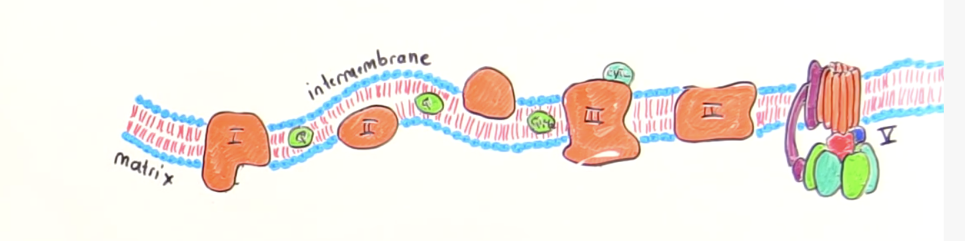
glycerol- 3-phosphate dehydrogenase
IV
NADH molecules transported onto the ETC through the glycerol 3 phosphate shuttle produce 1.5 ATP molecules per NADH
Because bypassing complex 1

Slide 61
Malate–Aspartate Shuttle System
In heart and Liver

Slide 62
The most active shuttle compound, malate, is freely permeable to the inner mitochondrial membrane. Oxaloacetate from the cytosol is reduced by the NADH to form malate and NAD1. The malate is oxidized by the enzyme malate dehydrogenase to oxaloacetate in the matrix of mitochondria, producing NADH that enters the electron transport chain and generates 2.5 moles of ATP per mole of NADH

