Slide 1
Replay or Do over

Slide 2



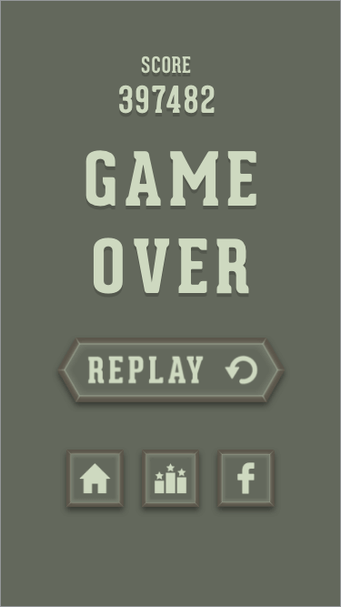





Replay or Do Over
Definition : it is an option that gives the player
the permission to fail .
Replay encourages exploration, curiosity, and discovery based learning and gives a sense of freedom to test hypotheses, and to remember which approaches were successful and which ones failed.
e.g : like running out into the open to see where the enemies are hiding .

Slide 3



Players enjoy failures or at least use them to progress .
Player expect to fail and look forward to the lessons learned during the failure process .
The necessity to approach the game differently adds to and expands the playability of the game. And gives the player the opportunity to explore multiple options for success.
Many games provide an option to level down or provide some hints to overcome failures because a player will quit the game , if he or she cannot overcome a failure .
Note : it is a dissatisfying experience to win a game without failure and failing several times instills the feeling of accomplishment and makes the act of winning more pleasurable.

Slide 4
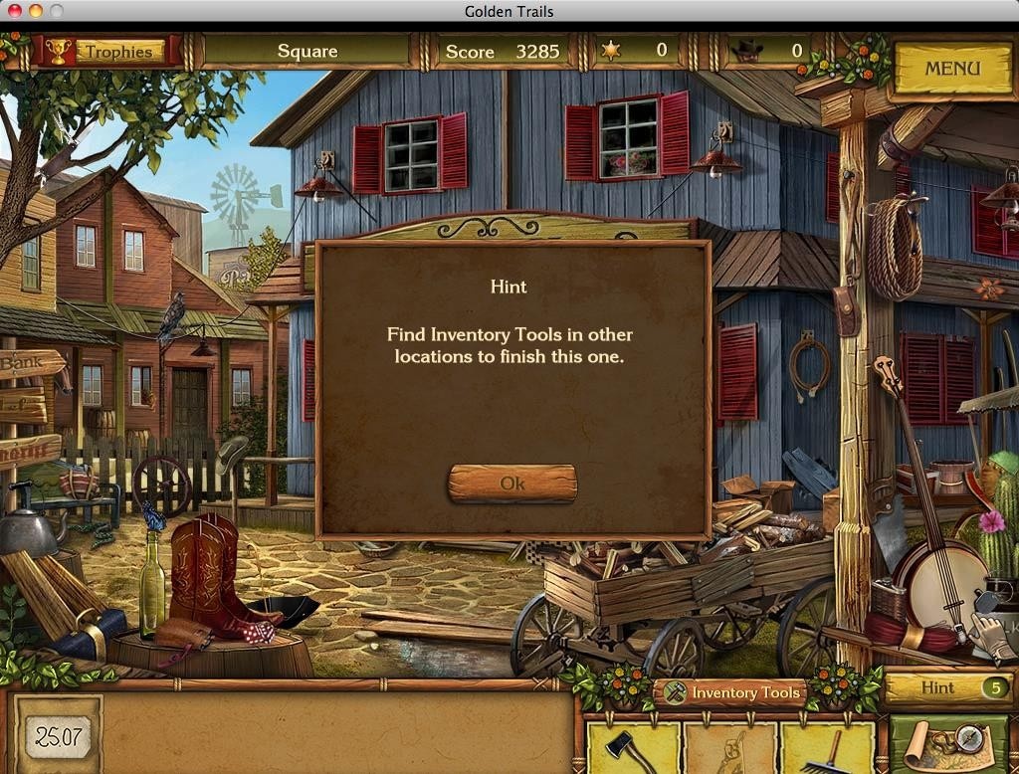

Slide 5
Aesthetics

Slide 6
Definition
Aesthetics is simply defined as the art and the beauty of the game.
Aesthetics and realism are not related; Some real-life elements may not be too appealing as they are in games.
Better graphics can greatly improve the experience of the game.

Slide 7
What to Know About Aesthetics
Aesthetics is not only graphics; graphics is a part of aesthetics
Aesthetics is more of the game’s style rather in visual techniques.

Slide 8
Interest curve

Slide 9
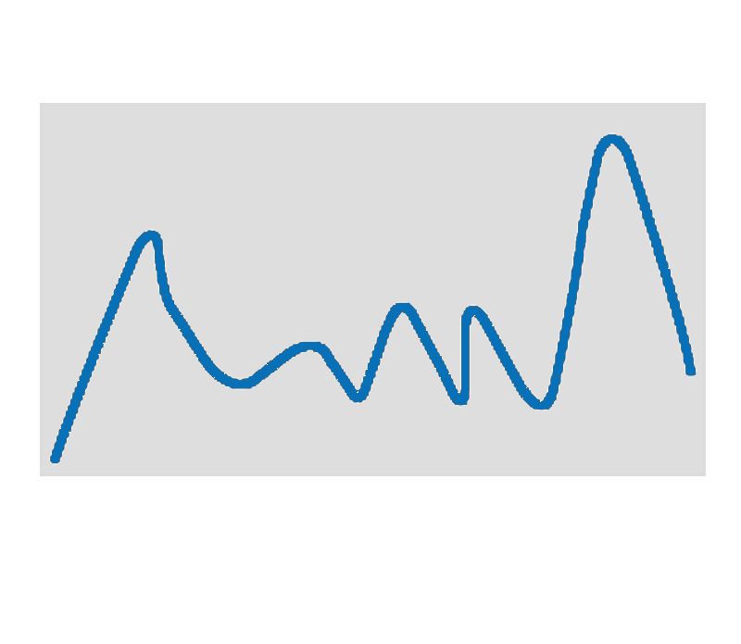




Interest Level
Time
The flow and sequence of events that occur over time to maintain a player's engagement with the game.

Slide 10

















“Grabbing the learner and Getting him Excited”
Interesting case study.
A mystery.
A series of questions.

Slide 11
Story Telling

Slide 12
Definition: is the art of using language , vocalization, and/or physical movement and gesture to reveal the element and images of a story to a specific, live audience..
Story telling and games
Helps developing skills which can be useful in the real life and work environments
Provides relevance and meaning to the experience
Makes games more interesting
Is a form of teaching and giving lessons in a exciting environment

Slide 13
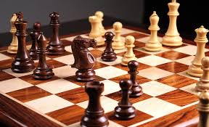

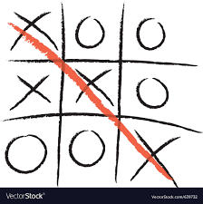
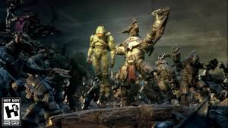
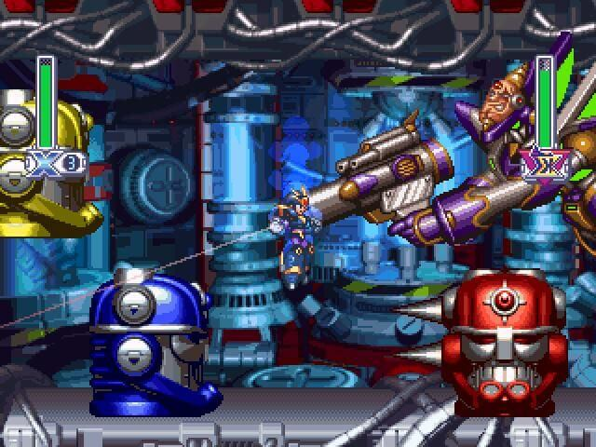
Basic Story structure
Examples of games without storytelling..
Examples of games with storytelling..
Characters
Plot
Tension
Resolution

Slide 14
Playing Levels

Slide 15
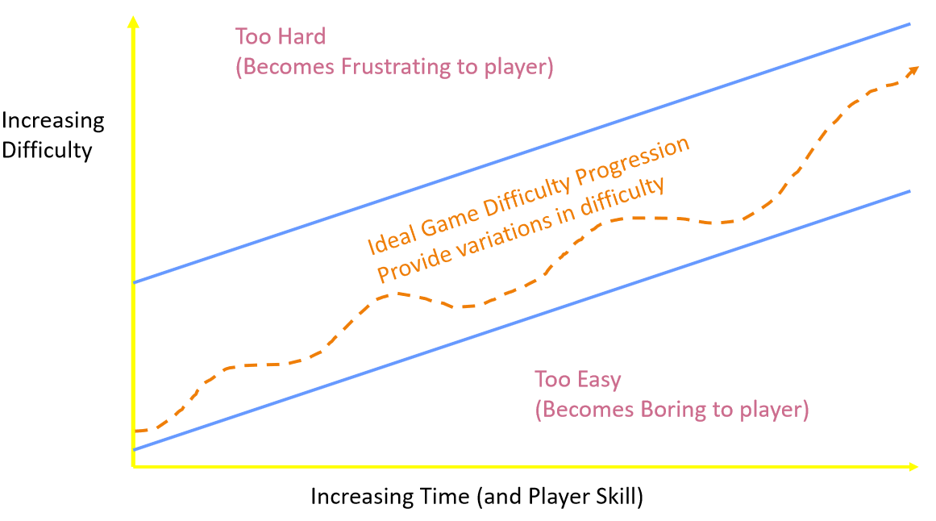

Slide 16
The game difficulty progression provides variation in difficulty to make it funny . The player gain experience in the game and can solve the difficulties, using what he had learned from the previous levels.
Game levels vary from level to level according to the following:
1. The Novice Player: Just needs to try to figure out how the game works and who need simple challenges and basic help while playing the game and a slower time than those with experience.
2. Experienced Player: Create a very difficult level with the fastest villains, challenge more puzzles, and less time to defeat levels.
* There are three different game play levels: 1. Easy 2. Intermediate 3. Hard level
Catching the attention of wide audience.
Designing three levels makes it more accessible to learners and many encourage them to
replay the game.
The third level , which is aimed at the middle level of difficulty . The three levels also increase the replay ability of the games; Once someone defeats the game at the easy level, he may challenge himself with the hardest level

Slide 17
*Human education How to deal with games is through levels to acquire skills and rules gradually and show you how to play
* Creating a test or " free play " mode would not give learners any guide but playing independently which is a difficult stage , yet it gives them a chance to apply what they learn immediately to the task and this would be similar to realty in classroom
* Providing different entry levels based on knowledge it will allow to make experience different difficulty levels and a way to make the game accessible to a broad audience.
*feedback - practice level :Learning in games is given by guidance and feedback, such as arrows, hints, instructions, highlights, and advice, in order to help the user to achieve the goal.

Slide 18
Games Levels

Slide 19
Mission based levels serve several purposes within the design of game :
One of purposes is to keep the game space manageable .
In the beginning the game will be of several levels starting at an easy level and then the difficulty begins.
The player learns several skills and helps him to progress in levels.

Slide 20
The presence of a suspense element to motivate the player to move from level to level.
Progress in levels is small achievable goals and leads to the player's desire to reach the highest level.

