Slide 1

MANAGERIAL ECONOMICS
14th Edition
By
Mark Hirschey and Eric Bentzen

Slide 2
Demand Estimation
Chapter 5

Slide 3
Chapter 5
OVERVIEW
Interview and Experimental Methods
Simple Demand Curve Estimation
Simple Market Demand Curve Estimation
Identification Problem
Regression Analysis
Measuring Regression Model Significance
Measures of Individual Variable Significance

Slide 4
Chapter 5
KEY CONCEPTS
market demand curve
simultaneous relation
identification problem
consumer interview
market experiments
regression analysis
deterministic relation
statistical relation
time series
cross section
scatter diagram
linear model
multiplicative model
simple regression model
multiple regression model
standard error of the estimate (SEE)
correlation coefficient
coefficient of determination
degrees of freedom
corrected coefficient of determination
F statistic
t statistic
two-tail t tests
one‑tail t tests

Slide 5
Introduction
How does P&G succeed in businesses where others routinely fail? Quite simply, P&G is marketing juggernaut طاغوت.
Although P&G's vigilant cost cutting is legendary, its marketing expertise is without peer. Nobody does a better job at finding out what consumers want.
At P&G, demand estimation is the lynchpin of its enormously successful 'getting close to the customer' operating philosophy.

Slide 6
Interview Method
Consumer Interviews
  Unfortunately, consumers are often unable or unwilling to provide accurate answers to hypothetical questions.
  However, interviews can solicit useful information when market data is scarce.
  For example, an interviewer might ask questions about several competing goods and learn that most customers are unaware of existing price differentials. This is an indication that demand may not be highly sensitive to price changes, so a producer should not attempt to increase the quantity sold by reducing prices.
  You have to be careful as consumer opinions can differ from behavior.

Slide 7
Experimental Method
Market Experiments
Controlled experiments can generate useful insight.
Firms study one or more markets with specific prices, packaging, or advertising, and then vary controllable factors over time or between markets.
For example, British Petroleum may have determined that uncontrollable consumer characteristics are similar in London and Paris.
British Petroleum could raise the relative price of fuel in Paris, and then compare fuel sales in the two markets.
With several markets, the firm might also be able to use census or survey data to determine how demographic characteristics such as income, family size, educational level, and ethnic background affect demand.
Experiments can be expensive, have low levels of confidence, might not be good for long run decisions, possibility of uncontrolled variables to create biases in the results

Slide 8
Experimental Method
Experiments can be expensive, low sample size problems may make inference from sample to population tenuous.
They may have low levels of confidence, might not be good for long run decisions, possibility of uncontrolled variables to create biases in the results. For example:
  A local strike, layoffs by a major employer,
  or a severe snowstorm can ruin a market experiment. Likewise,
  a change in a competing product's promotion, price, or packaging can distort the results.
There is also the danger that the customers lost during the experiment as a result of price manipulations may not be regained when the experiment ends.

Slide 9
Simple Demand Curve Estimation
Simple Linear Demand Curves
  The best estimation method balances marginal costs and marginal benefits.
  Simple linear relations are often useful for demand estimation.
Using Simple Linear Demand Curves
  Straight-line relations can give useful approximations.
Example: Suppose Manchester United in the Premier League offered £20 off the £200 regular price of reserved seats, and sales spurted from 32000 to 40000 seats per game. Estimate the demand function! We can estimate the simple linear inverse demand equation and then the demand equation.
P = a + bQ b = ΔP/ΔQ = (180-200) / (40000 – 32000) = -0.0025
To calculate a (a – 200)/ (0 -32000) = -0.0025 a = 280
P = 280 – 0.0025Q and Q = 112,000 – 400P

Slide 10
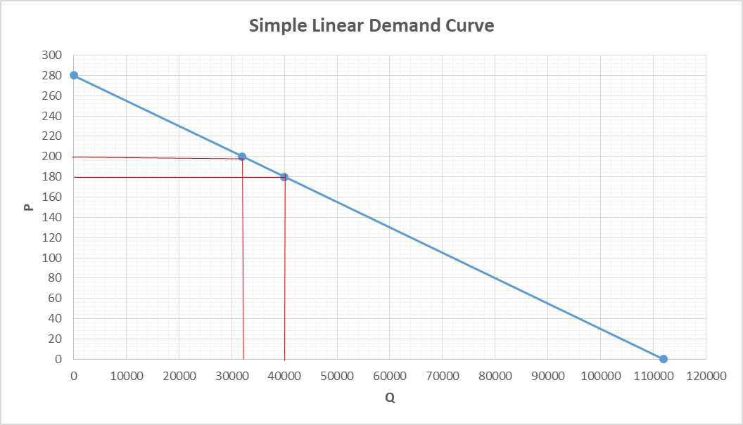
P = 280 – 0.0025Q
Q = 112,000 – 400P
b = (180 -200) / (40000 -32000) = – 0.0025
(a – 200) / (0 – 32000) = -0.0025
a = 280

Slide 11
How Useful the Simple Linear Demand Equation?
TR = PxQ = (280 – 0.0025Q)Q = 280Q – 0.0025Q².
Find MR and set it = 0. dTR/dQ = 280 – 0.005Q = 0
Solving for Q yields Q = 56,000 tickets and
P = 280 – 0.0025 (56000) = £ 140/ticket.
TR = 140 x 56000 = £ 7,840,000.
This is a ticket-revenue-maximizing level of output because total ticket revenue is decreasing for output beyond Q > 7,840,000, or d²TR/dQ² = -0.005 < 0. If total costs are fixed, this revenue-maximizing price will also result in maximum profits.
In the sports world, it is worth mentioning that even promotionally priced tickets can result in high profits if the added customers are big buyers of high profit margin parking services, and high margin concessions like soda pop, beer, candy, and hot dogs. In such instances, revenue per unit must include direct and indirect receipts.

Slide 12
Simple Market Demand Curve Estimation
Market Demand Curve
  Shows total quantity customers are willing to buy at various prices under current market conditions.
Graphing the Market Demand Curve
  Market demand is the horizontal sum of individual demand quantities, Q₁ + Q₂ = Q₁₊₂.
  Add quantities, not prices!

Slide 13
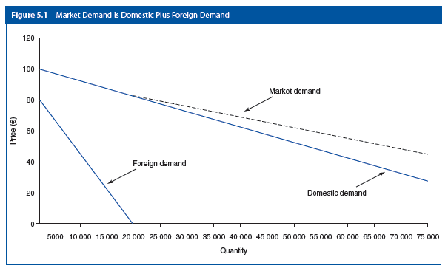
Bayer AG
P_{D} = €100 — €0.001Q_{D} (Domestic demand) Demand)
So Q_{D} = 100,000 – 1000P
Q_{T} = Q_{D} + Q_{F}
Q_{T} = = 120000-1250P
P = 96 – 0.0008Q_{T}
P_{F} = €80- €0.004Q_{F}
Q_{F} = 20,000 – 250P
(Foreign demand) )

Slide 14
Evaluating Market Demand
For prices above €80, the demand curve for domestic customers is the market demand curve.
For prices below €80, market demand will originate from both domestic and foreign customers,
and market demand is simply the sum of the quantity demanded by both customer groups.

Slide 15
Evaluating Market Demand
If TC = €1200000 + €24Q (Total Cost)
We can set MR = MC and find the profit maximizing P & Q.
Since P = 96 – 0.0008Q_{T} , then MR = 96 – 0.0016Q
MC = dTC/dQ = 24. Therefore, 96 – 0.0016Q = 24.
Solving for Q yields Q = 45,000 units and P = €60
The profit equation of Bayer AG is
π = €96Q - €0.0008Q² - (€1200000 + €24Q) =
Therefore, profit of Bayer AG π = TR – TC = €420 000.
This is profit maximum because d²π/dQ² = -0.0016 < 0.

Slide 16
Identification Problem
Firms sometimes face problems in estimating demand relations because of the interplay between demand and supply conditions.
Changing Nature of Demand Relations
  Demand curve estimation is sometimes relatively simple, especially in the case of stable short-run demand relations.
  Demand relations are dynamic. The unpredictable nature of the overall economy is another factor that makes demand estimation difficult.
  When the income elasticity of demand is high, demand tends to vary more than the corresponding changes in economic activity.
  Demand for many goods and services also tends to be sensitive to changes in competitor prices, competitor advertising, interest rates, and the weather.
Interplay of Demand and Supply
  Economic conditions affect demand and supply.
Shifts in Demand and Supply
Curve shifts can be estimated. If the demand curve has not shifted but the supply curve has shifted, price-quantity data can be used to estimate demand relations.
Simultaneous Relations
  Quantity and price are jointly determined.

Slide 17
Identification Problem
To estimate demand curve, all non-price determinants of demand are held constant (only supply determinants change).
Changes in price and quantity will trace the demand curve.
However, due to the dynamic nature of demand (e.g. unexpected changes in of demand), ceteris paribus assumption is often violated, causing demand curve to shift.
When demand curve or supply and demand curves shift simultaneously, we cannot identify if changes in price and quantity are movements along a demand curve or movements between equilibrium points.
Identification Problem

Slide 18
Identification Problem

Slide 19
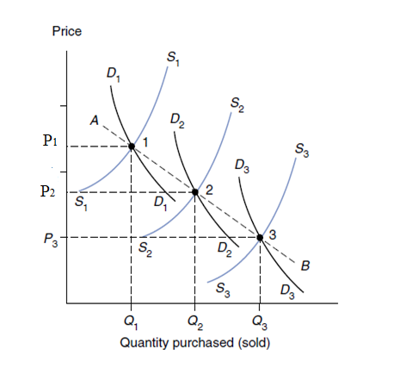
Identification Problem
Can the line AB be interpreted as a demand curve?
Price-quantity data may not plot out a demand curve. In this figure, nonprice variables in the supply and demand functions have changed between each data point.
Shifts in demand and supply curves must be distinguished from movements along individual supply and demand curves.
The problem of estimating any given economic relation in the presence of important simultaneous relations is known as the identification problem.

Slide 20
Regression Analysis
What Is a Statistical Relation?
A statistical relation exists when averages are related. the exact relation between two economic variables is not known with certainty and must be estimated.
  A deterministic relation is an association between variables that is known with certainty, and it is true by definition. Example: TR is a deterministic relation.
Specifying the Regression Model
  Dependent variable Y is caused by X.
  X variables are independently determined from Y.
  The data we collect is either time series or cross sectional.
Least Squares Method
  Minimize sum of squared residuals.

Slide 21
Assumptions of Regression Analysis
The error term (e) (or vertical deviation) is:
  normally distributed.
  Has zero expected value or mean, and
  Has constant variance in each time period and for all values of X, and that
  Its value in one time period is unrelated to its value in any other period.
These assumptions are required to
  obtain unbiased estimates of the slope coefficient and
  be able to utilize probability theory to test for the reliability of the estimates.

Slide 22
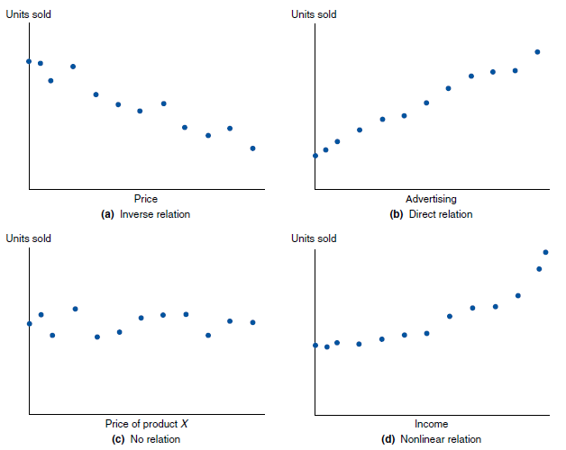
A scatter diagram is a plot of data where the dependent variable is plotted on the vertical axis (Y-axis), and the independent variable is plotted on the horizontal axis (X-axis).
Scatter plot diagrams can give an instinctive 'feel' for the data. However, the choice of which variable to call 'dependent' or 'independent' is often haphazard. Scatter diagrams illustrate correlation between variables; however, they do not establish causality. To warrant the inference of cause and effect, the correlation between two series of data must be interpreted in the light of experience or economic theory.

Slide 23
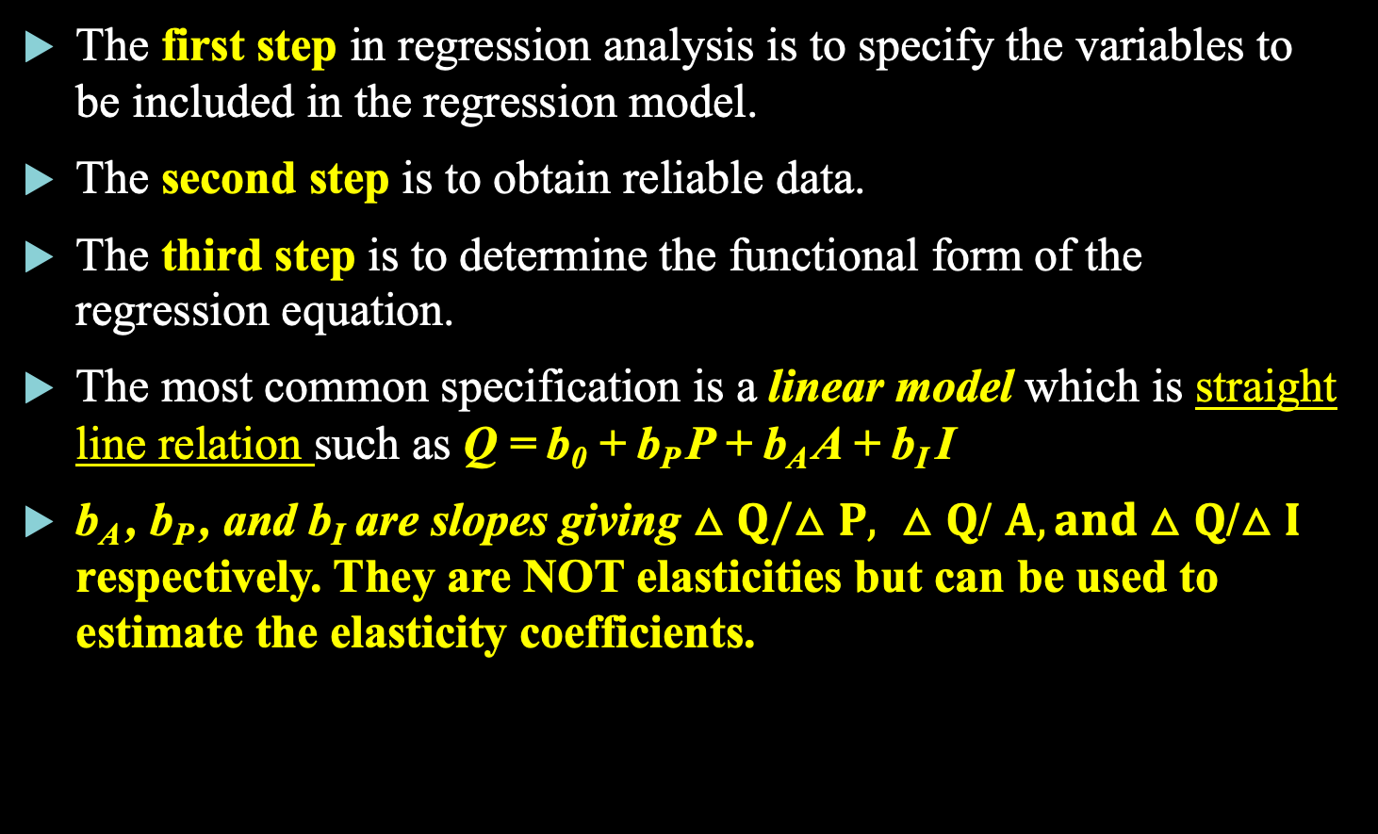
Specification of the Regression Model to be Estimated
The first step in regression analysis is to specify the variables to be included in the regression model.
The second step is to obtain reliable data.
The third step is to determine the functional form of the regression equation.
The most common specification is a linear model which is straight line relation such as Q = b₀ + b_{P} P + b_{A} A + b_{I} I
b_{A} , b_{P} , and b_{I} are slopes giving $△Q/△P, △Q$/ $A, and△Q$/$△I$ respectively. They are NOT elasticities but can be used to estimate the elasticity coefficients.

Slide 24
The Non-Linear Demand Function
A second specification of the demand equation is a non-linear one whereby there is an interaction between the variables affecting demand. Demand curve in this case is not astright line.
Example: Q = b₀ P^{b1} A^{b2} I^{b3}
This form must be transformed into double log (or natural logariothmic) function to be estimated. It becomes:
log Q = log b₀ + b₁ log P + b₂ log A + b₃ log I
b₁, b₂ and b₃ are constant price elasticity of demand, advertisment expedniture elasticity and income elasticity of demand, respectively.

Slide 25
Specification of the Regression Model to be estimated
The fourth step is to estimate the function by running the regression.
This can be done using a software like SPSS, Eviews, or Excel.
We are going to use Excel for our purposes in this course.
The fifth and last step is to test the results of the regression.

Slide 26
Unit Sales_{t} = Y_{t} = b₀ + b_{x}X_{t} + u_{t}

Slide 27
The Error (or residual) Term: u_{t}
It is the vertical deviation of the actual or observed value from the estimated value of the dependent variable from the regression line in period t.
Reasons for such an error:
  Numerous explanatory variables with only slight or irregular effect on Y are not included in the model equation.
  Possible errors in the measurement of Y.
  Random human behavior leads to different results (for example different purchases) under identical conditions.

Slide 28
Regression Line
It is the line that best fits the data points.
It is so because the sum of the Σu²_{t} is minimum.
Remember to square the errors before adding them up in order to avoid the cancellation of errors of equal size but opposite signs.
Squaring the errors also penalizes larger errors relatively more than smaller ones.

Slide 29
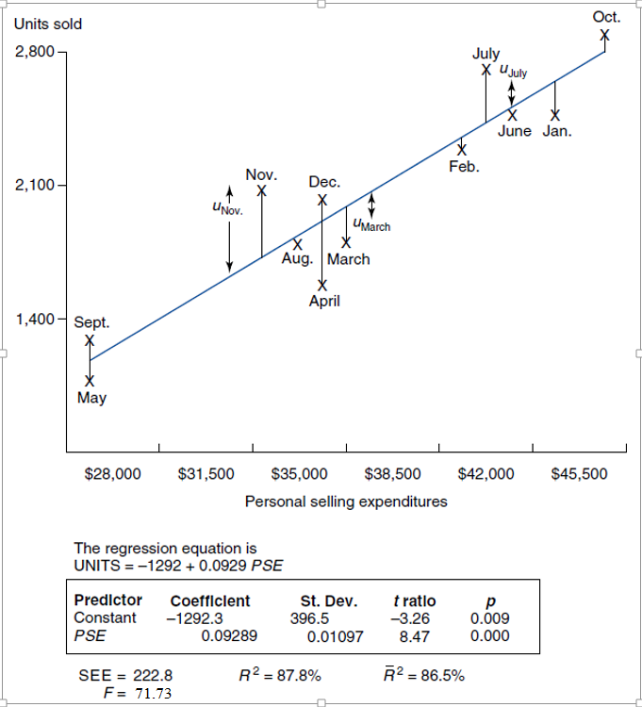

Slide 30
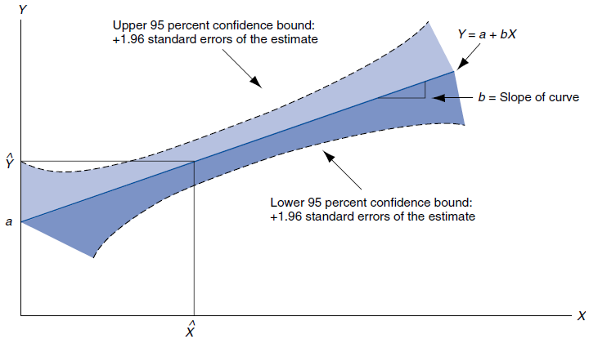
Measuring Regression Model Significance
Standard Error of the Estimate (SEE) reflects degree of scatter about the regression line.

Slide 31
Goodness of Fit
Correlation shows degree of concurrence, r.
  r = 1 means perfect correlation.
  r = 0 means no correlation.
Coefficient of determination, R².
  R² = 100% means perfect fit.
  R² = 0% means no relation.
Corrected coefficient of determination
  Adjusts R² downward for small samples and multiple independent variables.

Slide 32
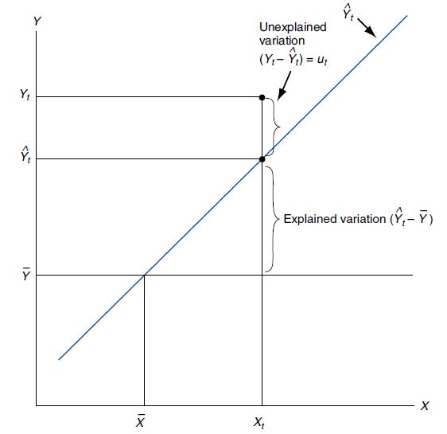


Slide 33
The Coefficient of Determination, R²
In our example, R² = 0.877 and adjusted R² = 0.865

Slide 34
Assumptions of Multiple Regression Model
In addition to the assumptions made for simple regressions analysis we have another two assumptions:
(1) the number of independent variables in the regression be smaller than the number of observations, and
(2) there is no perfect linear correlation among the independent variables.

Slide 35
Analysis of Variance & F statistic:
Tells if R² is statistically significant.
R² is the coefficient of determination; k is the number of coefficients to be estimated; and n is the number of observations.
The F distribution is skewed to the right but tends toward normality as degrees of freedom become very large.

Slide 36
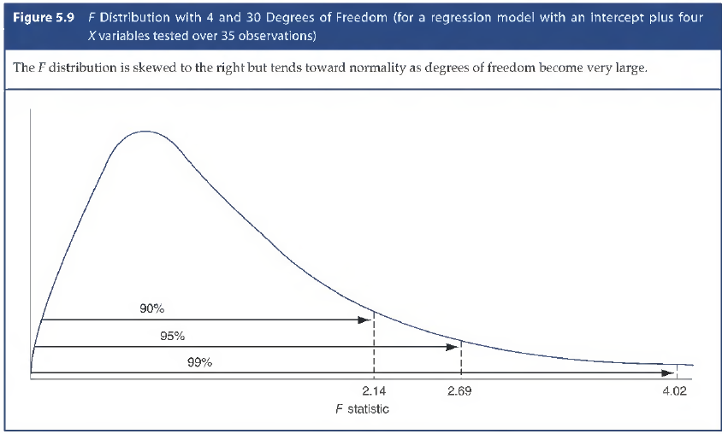

Slide 37
Judging Variable Significance
t statistics compare sample characteristics to the standard deviation of that characteristic.
t = estimated coefficient/standard deviation (or error) of the estimated coefficient.
  t > 2 implies a strong effect of X on Y (95% confidence).
  t > 3 implies a very strong effect of X on Y (99% confidence).
Two-tail t Tests
  Tests of effect.
One-Tail t Tests
  Tests of magnitude or direction.
© 2016 Cengage Learning

Slide 38
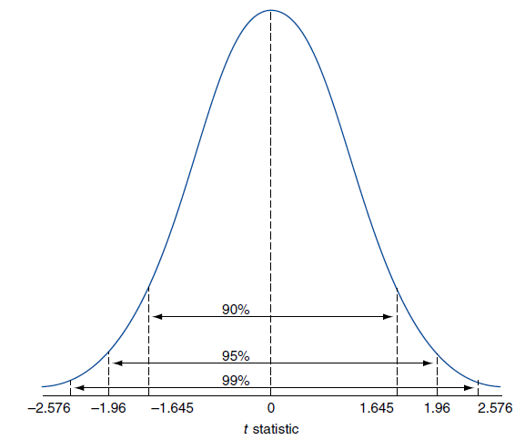

Slide 39
Summary of the Evaluation of Regression Estimation
The Coefficient of Determination (R²): How well does the regression line fit the data?
The F-Test: Does the estimated equation have sufficient explanatory power?
The t-Test: Is each of the independent variables statistically significant?
The P-Value: How accurate individual coefficients are? Is it a matter of chance?

Slide 40
Problems in Regression Analysis
Identification Problem and omitted variables
Multicollinearity: Two or more explanatory variables are highly correlated.
Heteroscedasticity: Variance of error term is not independent of the X variable.
Autocorrelation: Consecutive error terms are correlated.

Slide 41
Omitted Variables & Identification Problem
Omitted Variables: When regression results are inconsistent with economic theory, the omission of important variables could be the cause.
Identification Problem: Coefficients are biased. For example: There is simultaneity between the supply and demand equations.
Symptom: Independent variables are known to be part of a system of equations.
Solution: Use as many independent variables as possible.

Slide 42
Multicollinearity
Multicollinearity: Two or more explanatory variables are highly correlated. Example expenditure on quality control and advertising expenditure can be so if the firm keeps the level of the first as a % of the second.
Result in exaggerated SE and low t values for both variables.
Can be overcome by (1) extending the sample size,
(2) using a priori information like b₂ = 2b₁ from previous studies,
(3) transforming the functional relationship, and or
(4) dropping one of the highly collinear variables.

Slide 43
Multicollinearity
EXAMPLE: Q =Eggs
Q = a + b P_{d} + c P_{g}
where P_{d} is for a dozen
and P_{g} is for a gross.
Symptoms: Coefficients are UNBIASED, large standard errors and therefore, t-values are small, and R² is high.
Solutions:
  Drop a variable.
  Do nothing if forecasting

Slide 44
Heteroscedasticity
It is that the variance of error term is not independent of the X variable, i. e. error term may rise or fall with the size of an independent variable.
Common for cross-sectional data.
This result in biased SE and incorrect statistical tests.
Symptoms:
  different variances for different sub-samples
  scatter of error terms shows increasing or decreasing dispersion
Solution:
  Transform data, e.g., logs
  Take averages of each sub-sample: weighted least squares.

Slide 45
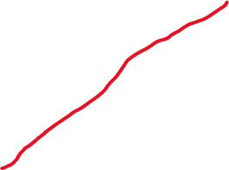

The Error term rises with X

Slide 46
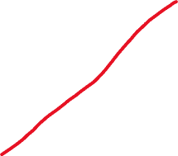

The Error term falls with X

Slide 47
Autocorrelation or Serial Correlation
Common for time-series data.
Positive autocorrelation: the error term is positively correlated with itself.
Negative autocorrelation: the error term is negatively correlated with itself. This is less common than positive autocorrelation.
Check for this problem using the Durbin-Watson statistic.
Results in SE biased downward, t values are exaggerated. Significance tests will be unreliable.
Solution: include time as an additional explanatory variable; or include an important missing variable; re-estimate the regression in nonlinear form; or take first differences of data: Δ Q = a + b• Δ P

Slide 48

Positive Autocorrelation is present if the DW < 2, and the test is inconclusive, and we cannot rule it out if d_{l} < calculated d < d_{u}

Slide 49
Negative Autocorrelation is Rare and the DW statistic would be around 4.

Slide 50

Durbin-Watson Statistic:
Test for Autocorrelation
The value of d ranges between 0 & 4.
If d = 2, autocorrelation is absent.
If d_{l} < calculated d < d_{u} , the test is inconclusive, and we cannot rule out the existence of autocorrelation.

