Slide 1

The cpa profession
Chapter 2

Slide 2
Chapter 2 Learning Objectives
2-1 Describe the nature of CPA firms and what they do.
2-2 Describe the structure of CPA firms.
2-3 Understand the role of the Public Company Accounting Oversight Board and
the effects of the Sarbanes-Oxley Act on the CPA profession.
2-4 Summarize the role of the Securities Exchange Commission in accounting and
auditing.
2-5 Describe the key functions performed by the AICPA.
2-6 Understand the role of international auditing standards and their relation to
U.S. auditing standards.
2-7 Use U.S. auditing standards as a basis for further study.
2-8 Identify quality control standards and practices within the accounting
profession.

Slide 3
OBJECTIVE 2-1
Describe the nature of CPA firms and what they do.

Slide 5
Activities of Cpa Firms
CPA firms provide audit services as well as other attestation and assurance services.
CPA firms also provide accounting and bookkeeping services, tax services, and management consulting and risk advisory services.
Although the Sarbanes-Oxley Act and the SEC restrict auditors from providing many consulting services to public company audit clients, audit firms are not restricted from providing consulting to private companies and public companies that are not audit clients.

Slide 6
OBJECTIVE 2-2
Describe the structure of CPA firms.

Slide 7
Organizational structure
CPA firms vary in nature and range of services, which affects the structure of the firms. Three main factors that affect the structure of all firms are:
The need for independence from clients
The importance of a structure to encourage competence
The increased litigation risk faced by auditors

Slide 8
Six organizational structures are available to CPA firms
Proprietorship
General Partnership
General Corporation
Professional Corporation
Limited Liability Companies
Limited Liability Partnership
Notes:
LLPs are structured and taxed like a partnership, but provide liability protection from the acts of their partners. Partners are liable only for their own negligent acts or of those they supervise. All of the Big Four firms and many smaller firms operate as LLPs.

Slide 9
Organizational Hierarchy of typical Cpa firm

Slide 10
OBJECTIVE 2-3
Understand the role of the Public Company Oversight Board and the effects of the Sarbanes-Oxley Act on the CPA profession.

Slide 11
Sarbanes-oxley act and public company accounting oversight board
Sarbanes-Oxley Act—Established the Public Company Accounting Oversight Board (PCAOB).
PCAOB—Provides oversight for auditors of public companies including:
Establishing auditing, attestation, and quality control standards for public company audits.
Performing inspections of audit engagements and quality controls.

Slide 12
OBJECTIVE 2-4
Summarize the role of the Securities Exchange Commission in accounting and auditing.

Slide 13
Securities and exchange commission
The Securities Exchange Commission (SEC)—A federal government agency that assists in providing investors with reliable information upon which to make investing decisions.
The Securities Act of 1933—Requires most companies planning to issue new securities to the public to submit a registration statement to the SEC for approval.

Slide 14
Securities exchange commission (cont.)
The Securities Exchange Act of 1934—Provides additional protection for investors by requiring public companies to file detailed annual reports with the commission.
The Securities Acts of 1933 and 1934—Require financial statements and the opinion of an independent public accountant as part of the registration statement and subsequent reports.

Slide 15
Securities exchange commission (cont.)
Several reports required by the SEC are of interest to auditors:
Form S-1—“S” forms must be completed prior to issuing new securities to the public
Form 8-K—report significant events of interest to investors
Form 10-K—annual report with detailed financial information, including audited financial statements
Form 10-Q—quarterly report containing certain financial information and auditor reviews of financial statements
Notes:
Form 8-K reports changes in auditors and other significant events. Form 10-K includes a lot of nonfinancial information as well. Form 10-Q is intended to be an update to the annual 10-K.

Slide 16
OBJECTIVE 2-5
Describe the key functions performed by the AICPA.

Slide 17
American institute of certified public accountants
CPAs are licensed by the state in which they practice, but significant influence is exerted by their professional organization, the American Institute of Certified Public Accountants (AICPA).
Membership in the AICPA is restricted to CPAs. Membership is voluntary, so not all CPAs are members, but it is the largest professional association for CPAs in the United States.

Slide 18
American institute of certified public accountants
The AICPA sets standards and rules that all members and other practicing CPAs must follow in four major areas:
Auditing standards
Compilation and review standards
Other attestation standards
Code of Professional Conduct

Slide 19
American institute of certified public accountants
Establishing Standards and Rules
The Auditing Standards Board (ASB) of the AICPA issues auditing standards, called Statements on Auditing Standards (SASs), which apply to all audit engagements not covered by PCAOB standards
The Accounting and Review Services Committee issues Statements on Standards for Accounting and Review Services (SSARS) that apply to preparation, compilation, and review services
Statements on Standards for Attestation Engagements apply to assurance on nonfinancial information. Attestation Standards are studied in Chapter 25
The AICPA Professional Ethics Executive Committee sets rules of conduct that CPAs are required to meet. The Code of Professional Conduct is the subject of Chapter 4

Slide 20
American institute of certified public accountants
Other AICPA Functions
The AICPA writes and grades the CPA Exam.
The AICPA supports its own research staff and provides grants to others for research.
The AICPA publishes the Journal of Accountancy, industry audit guides, and periodic updates to the Codification of Statements on Auditing Standards and the Code of Professional Conduct.

Slide 21
OBJECTIVE 2-6
Understand the role of international auditing standards and their relation to U.S. auditing standards.

Slide 22
international and u.s. auditing standards
International Standards on Auditing (ISAs) are issued by the International Auditing and Assurance Standards Board (IAASB) of the International Federation of Accountants (IFAC).
IFAC is a worldwide organization for the accountancy profession.
IAASB works to improve uniformity of auditing practices throughout the world.

Slide 23
international and u.s. auditing standards (cont.)
ISAs do not override a country’s regulations governing audit practices.
Most countries, including the United States, base their auditing standards on ISAs, modified as appropriate for each country’s regulatory environment.
The Auditing Standards Board in the United States has revised its audit standards to converge with international standards.

Slide 24
AICPA auditing standards
Auditing standards for private companies and other entities in the United States are established by the Auditing Standards Board (ASB) of the AICPA.
These standards are called Statements of Auditing Standards (SASs). The AICPA standards are also referred to as generally accepted auditing standards (GAAS).
Prior to passage of the Sarbanes-Oxley Act, the ASB established auditing standards for private and public companies. Now the PCAOB has responsibility for auditing standards for public companies and brokers and dealers registered with the SEC.

Slide 25
PCAOB Standards
Initially, the PCAOB adopted existing auditing standards established by the ASB as interim standards.
The PCAOB considers international standards when developing new standards.
PCAOB standards apply only to the audits of U.S. public companies and brokers and dealers registered with the SEC.
Figure 2-1 shows the relationships among international auditing standards, AICPA auditing standards, and PCAOB auditing standards.

Slide 27
OBJECTIVE 2-7
Use U.S. standards as a basis for further study.

Slide 28
organization of u.s. auditing standards
The ASB issued a Preface to the Codification of Auditing Standards containing the “Principles Underlying an Audit in Accordance with Generally Accepted Auditing Standards” (the principles).
The principles provide a framework for the two objectives of conducting an audit of financial statements:
Obtain reasonable assurance about whether the financial statements as a whole are free from material misstatement, whether due to fraud or error; and
Report on the financial statements, and communicate as required by GAAS, in accordance with the auditor’s findings.

Slide 29
Organization of u.s. auditing standards (cont.)
The principles are not requirements and do not carry authority, but they provide structure for the Codification. The structure is organized around the following principles:
Purpose of an audit (Purpose)
Personal responsibilities of the auditor (Responsibilities)
Auditor actions in performing the audit (Performance)
Reporting (Reporting)
These principles are summarized in Figure 2-2.

Slide 31
Organization of u.s. auditing standards (cont.)
Purpose: The purpose of an audit is to provide financial statement users with an opinion issued by the auditor on whether the financial statements are presented fairly, in all material respects, in accordance with applicable financial reporting framework.
Responsibilities: The auditor’s responsibilities stress the importance of the qualities that the auditor should possess:
Appropriate competence and capabilities
Comply with relevant ethical requirements
Maintain professional skepticism and exercise professional judgment

Slide 32
Organization of u.s. auditing standards (cont.)
Performance: To obtain reasonable assurance that the financial statements are presented fairly, the auditor fulfills several performance responsibilities:
Adequate planning and supervision
Determine and apply materiality levels
Assess risks of material misstatement
Sufficient appropriate evidence
Reporting: The auditor is responsible for expressing an opinion in the form of a written report about whether the financial statements are expressed fairly, in all material respects, in accordance with the applicable financial reporting framework.
The audit report is the final step in the auditing process.

Slide 33
Organization of u.s. auditing standards (cont.)
Principles versus Auditing Standards
The principles underlying auditing standards are general.
The standards (SASs issued by the AICPA and ASs issued by the PCAOB) provide specific guidance.
Classification of Auditing Standards
SASs issued by the AICPA have two classification numbers: an SAS number identifying the order in which it was issued and an AU-C number indicating its location in the Codification of Auditing Standards.
Auditing Standards issued by the PCAOB are also numbered consecutively as issued. The PCAOB recently reorganized their standards by topic.

Slide 34
Organization of u.s. auditing standards (cont.)
Standards of Performance
Although auditing standards provide authoritative guidance for members of the profession, the amount of guidance is limited.
The AICPA principles and auditing standards are minimum standards of performance. If standards seem impractical in a certain situation, the auditor may use an alternative course of action, though the burden of justifying a departure from the standards falls on the auditor.
When auditors want more specific guidelines, they must use less authoritative sources. Materials published by the AICPA, including industry audit guides, provide assistance on specific questions.

Slide 35
OBJECTIVE 2-8
Identify quality control standards and practices within the accounting profession.

Slide 36
quality control
For a CPA firm, quality control includes the methods used to ensure that the firm meets its professional responsibilities to clients.
Elements of Quality Control: Each firm should document quality control policies and procedures. The quality control system should address the six elements detailed in Table 2-3.
Notes:
Quality control within a CPA firm includes all of the policies and procedures put in place by management to ensure that the work provided by the firm is of the highest quality. It is similar to a system of internal controls implemented by any company.

Slide 38
Quality Control (cont.)
Peer Review
Public accounting firms must enroll in an AICPA-approved practice-monitoring program, also known as peer review, which is administered by the state CPA societies.
Firms required to be registered with the PCAOB must be reviewed by the AICPA National Peer Review Committee to review the non-SEC portion of the firms practice that is not inspected by the PCAOB.

Slide 39
Quality Control (cont.)
Audit Practice and Quality Centers
The AICPA has established audit practice and quality centers to improve audit practice quality.
The Center for Audit Quality (CAQ) is a public policy organization affiliated with the AICPA serving investors, public company auditors, and the capital markets.
The Private Companies Practice Section (PCPS) provides practice management information to firms of all sizes.
Figure 2-3 summarizes the relationships among auditing standards, quality control, the audit practice and quality centers, and peer review in ensuring audit quality.

Slide 40
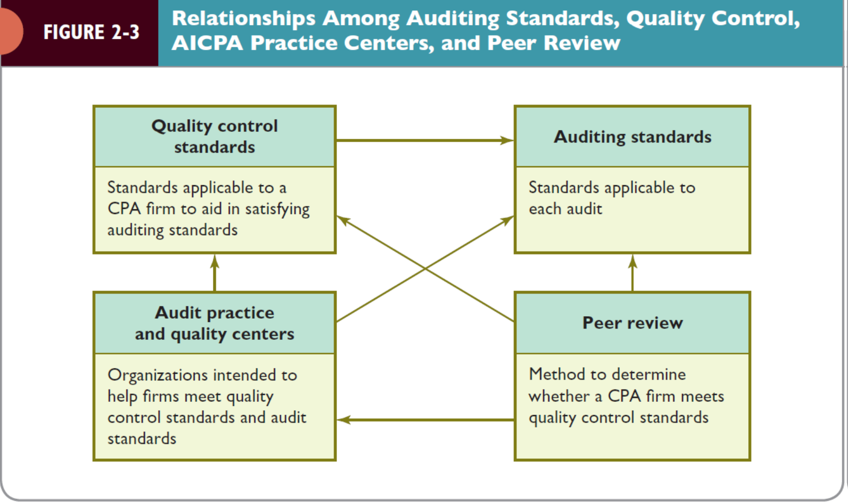

Slide 41
Chapter 2 summary
This chapter discussed the nature of the CPA profession and the need for CPAs to conduct themselves at a high level, which is detailed in Figure 2-4 below.

Slide 42
