Slide 1
infancy: let the language achievements begin

Slide 2
What major Language-DeveLOpment milestones Occur In Infancy?
What do we mean by milestones ?

Slide 3
What major Language-DeveLOpment milestones Occur In Infancy?
Infant Speech Perception
Awareness of Actions and Intentions
Category Formation
Early Vocalizations

Slide 4
Infant speech perception
Infants’ speech perception ability: their ability to devote attention to the prosodic and phonetic regularities of speech—develops tremendously.
in the first year as infants move from detecting larger patterns, such as rhythm, to detecting smaller patterns, such as combinations of specific sounds.

Slide 5
Infant speech perception
Attention to Prosodic Regularities
Attention to Phonetic Regularities
Categorical Perception of Speech

Slide 6
Attention to Prosodic Regularities
Prosodic characteristics
frequency, or pitch, of sounds.
The duration, or length, of sounds.
Intensity, or loudness, of sounds.
Stress is the prominence placed on certain syllables of multisyllabic words.
Intonation is the prominence placed on certain syllables, but it also applies to entire phrases and sentences.

Slide 7
Attention to Prosodic Regularities
Stress is the prominence placed on certain syllables of multisyllabic words.
Intonation is the prominence placed on certain syllables, but it also applies to entire phrases and sentences.
You are happy. (low Intonation declarative)
Are you happy ? (high Intonation interrogative)

Slide 8
Attention to Prosodic Regularities
By age 9 months, infants learning English prefer to listen to words containing strong–weak stress patterns (jusczyk, cutler, & redanz, 1993).
How does this help infants begin to isolate words in continuous speech?
infants who notice the common stress patterns in their native language learn over time where likely word boundaries occur in running speech.

Slide 9
Attention to Phonetic Regularities
The phonetic details of speech include phonemes, or speech sounds, and combinations of phonemes.
According to stager and Werker (1997), infants (8months old) devote much attention to the phonetic details of speech, whereas older children ( 14 months) concentrate their efforts on word learning at the expense of fine phonetic details

Slide 10
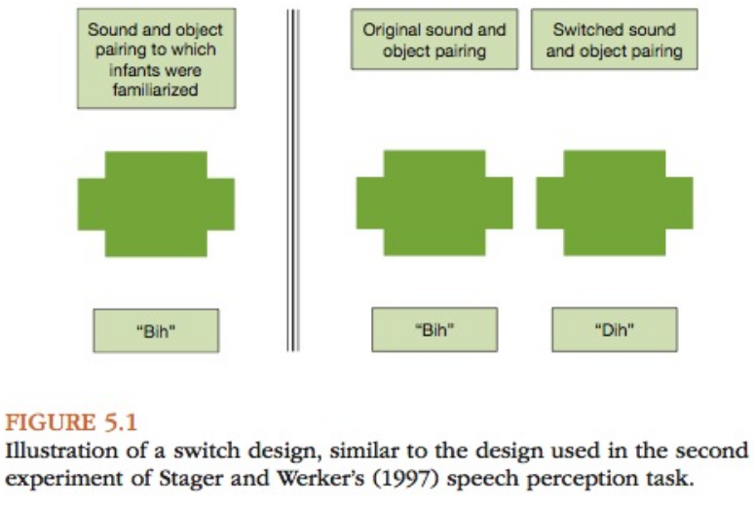
Attention to Phonetic Regularities

Slide 11
Detection of Nonnative Phonetic Differences.
up to about 6 months of age, infants learning English can distinguish between two different sounds in the Hindi language that would both sound like “da” to older English-speaking children and adults.
the process by which infants start to focus more on perceptual differences that are relevant to them (in their native language) is called perceptual narrowing*.
* is not limited to speech sounds (face and musical rhythm perceptions)

Slide 12
Detection of Phonotactic Regularities.
As infants hear their native language more and more, they also develop the ability to recognize permissible combinations of phonemes in their language, or phonotactic regularities.
Infants’ ability to differentiate between permissible and impermissible sound sequences in their native language is present by about age 9 months (jusczyk, Luce, & charles-Luce, 1994).
Some research suggests phonotactic regularities may play a role in later-developing skills, such as word learning. HOW?
Infants’ ability to detect phonotactic regularities in their native language helps them segment words from continuous speech. As children seem to learn words with common phonotactic sequences more rapidly than words with rare phonotactic sequences

Slide 13
Categorical Perception of Speech
We categorize input in ways that highlight differences in meaning. This develops gradually:
infants categorize incoming sounds into speech and nonspeech sounds.
then infants learn to categorize speech sounds according to the particular features of the sounds
( voice/voiceless).
without special training, people cannot distinguish between allophones of the same phoneme. allophones of a phoneme are measurably different from one another (such as in the amount of aspiration they contain, e.g.: /b/, /p/), but they do not signal a difference in meaning between two words, as phonemes do.
One mechanism humans use to distinguish between sounds in different categories Voice onset time: is the interval between the release of a stop consonant (e.g., p, b, t, d) and the onset of vocal cord vibrations.

Slide 14
awareness of actions and Intentions
By age 4 months, infants can distinguish between purposeful and accidental actions, and they appear to focus on the intentions underlying actions rather than the physical details of the actions.
Woodward (1998) experiment: details are in the book.

Slide 15
category Formation
The ability to form categories, or to group items and events according to the perceptual and conceptual features they share, is crucial for language development.

Slide 16
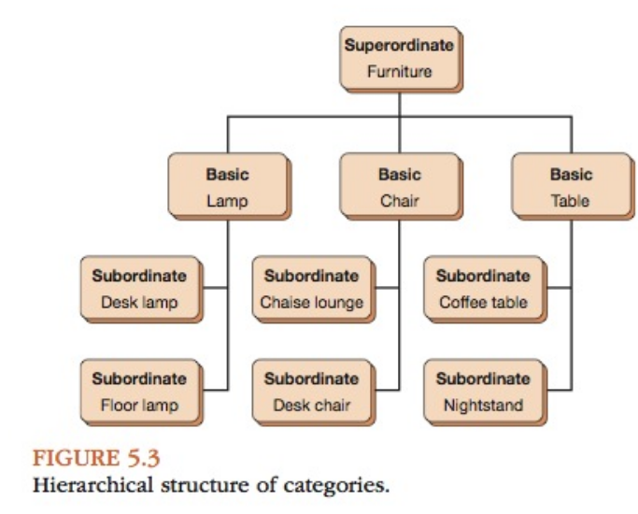
Hierarchical Structure of Categories
General concept, latest acquired in preschool.
First word
Most specific, basic and subordinate almost acquired in the same time.

Slide 17
Basic Categories at Each Hierarchical Level
Infants form perceptual categories on the basis of similar-appearing features, use to recognize and identify objects around them.
including color, shape, texture, size, and so forth.
Conceptual categorization requires infants to know what an object does. Infants learn that balls roll, dogs bark, and air- planes fly.

Slide 18
early vocalizations
Stage model: which means they describe infants’ vocalizations as following an
observable and sequential pattern.
One such stage model is the stark assessment of early vocal Development-revised SAEVD-R:
Reflexive (0–2 months): the first sounds infants produce are called reflexive sounds, which include sounds of discomfort and distress (crying, fussing) and vegetative sounds such as burping, coughing, and sneezing.
Control of phonation (1–4 months): cooing and going, “raspberries,” trills, and clicks, vowel-like sounds, consonant-like sounds (far back in the oral cavity “goooo”), combine vowel-like segments with a consonant-like segment “aaam”, isolated consonant sounds such as nasalized.

Slide 19
early vocalizations
Expansion (3–8 months): isolated vowel (vowel glides “eeeey”).experiment loudness and pitch of their voices, squeals. Marginal babbling, (consonant-like and vowel-like sounds with prolonged transitions between them).
Basic canonical syllables (5–10 months): single consonant-vowel (c-v) syllables, Reduplicated babbling (consists c-v pairs “ma ma ma”), non-reduplicated babbling (variegated babbling) nonrepeating c-v combinations “da ma goo ga’’, nasal and stop sounds, whispered vocalizations, c-v combinations followed by isolated consonant (“ba—g”) and disyllables consist of two c-v syllables separated by an audible gap (ba—ba).
Advanced forms (9–18 months): Diphthongs(combinations of two vowel sounds within the same syllable ’’boy’’. complex syllable forms, (single-syllable types v–c (“am”) and c–c–v (“stee”), complex disyllables v–c–v (“abu”), and multisyllabic strings with and without varied stress intonation patterns (“odago”). Jargon type of babbling containing at least two syllables and at least two different consonants and vowels and varied stress and intonation patterns.

Slide 20
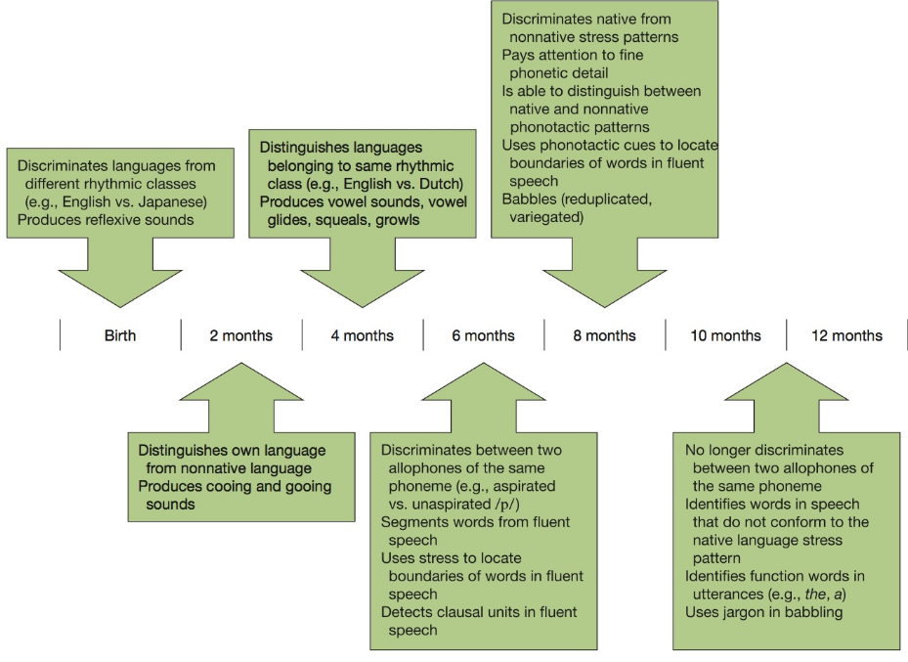
Developmental timeline : Phonology

