Slide 1
Terminology and classical Cryptology
By
Hafez Barghouthi

Slide 2
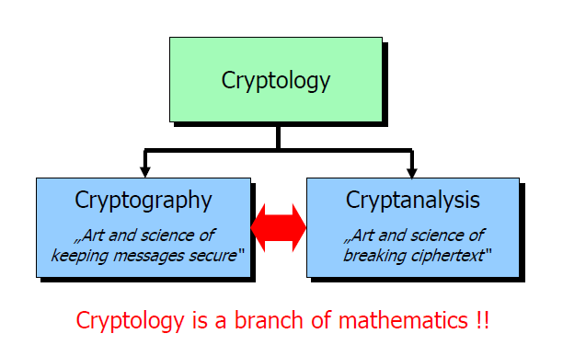
What is Cryptology?

Slide 3
Terminology
The art and science of keeping messages secure is cryptography, and it is
practiced by cryptographers.
Cryptanalysts are practitioners of cryptanalysis, the art and science of breaking cipher text.
The branch of mathematics encompassing both cryptography and cryptanalysis is cryptology an its practitioners are cryptologists.
Modern cryptologists are generally trained in theoretical mathematics
(they have to be ☺).
Source: Bruce Schneier, „Applied Cryptography“, Second Edition, p. 1,John Wiley & Sons, 1996

Slide 4
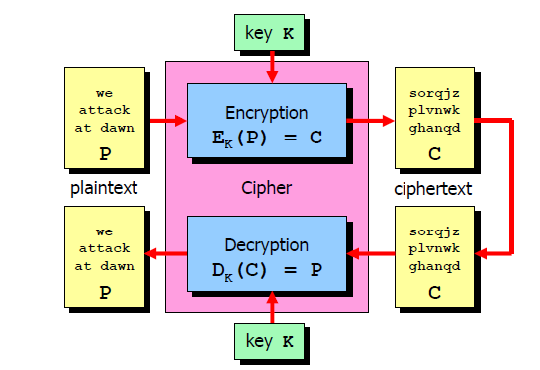
Terminology-2

Slide 5
Terminology-3
A message is plaintext (sometimes called cleartext). The process of disguising a message in such a way as to hide its substance is called encryption.
An encrypted message is ciphertext. The process of turning ciphertext back into plaintext is called decryption.
A cryptographic algorithm, also called a cipher, is the mathematical function used for encryption and decryption.
The security of a modern cryptographic algorithm is based on a secret key.
This key might be any one of a large number of values. The range of possible
key values is called the keyspace.
Both encryption and decryption operations are dependent on the key K and this is denoted by the K subscript in the functions EK(P) = C and DK(C) = P.

Slide 6
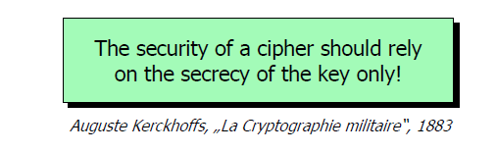
Fundamental Assumptions

Slide 7
Fundamental Assumptions-2
Attacker knows every detail of the crypto-graphical algorithm
Attacker has an encryption / decryption equipment
(HW machine or SW implementation)
•Attacker has access to an arbitrary number of plaintext /ciphertext pairs generated with the same (unknown) key.
Strong cipher: Best attack should be brute force key search!

Slide 8
Types of Attacks (cryptanalysis)
Ciphertext-Only Attack
• Attacker knows cipher text of several messages encrypted with the
same key and/or several keys.
• Recover the plaintext of as many messages as possible or even better
deduce the key (or keys).
Known-Plaintext Attack
• Known cipher text / plaintext pair of several messages.
• Deduce the key or an algorithm to decrypt further messages.
Chosen-Plaintext Attack
• Attacker can choose the plaintext that gets encrypted thereby
potentially getting more information about the key
Adaptive Chosen-Plaintext Attack
• Attacker can choose a series of plaintexts, basing the choice on the
result of previous encryption → differential cryptanalysis!

Slide 9
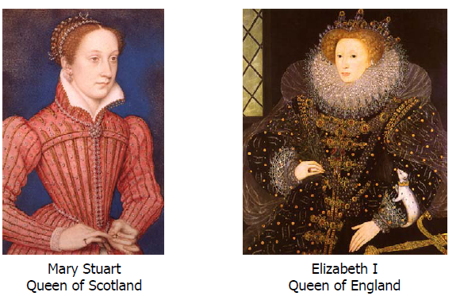
History evidence
Codes have decided the fates of empires throughout recorded history
• Mary Stuart, Queen of Scotland was put to death by her cousin Queen Elizabeth
of England, for the high crime of treason after spymaster Sir Francis Walsingham
cracked the secret code she used to communicate with her conspirators.
Source: Simon Singh, „The Code Book“, Doubleday, 1999
Cryptanalysis is not just for fun ☺.

Slide 10
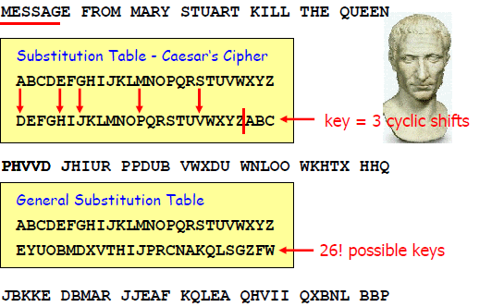
Caesar Monoalphabetic Substitution Cipher

Slide 11
Monoalphabetic Substitution
(old and weak but not bad)
Each character in an alphabet is replaced by another character in the same alphabet or sometimes even by a symbol of a different alphabet.
26! Different keys it seem to be secure.
Each occurrence of a specific plaintext character is always mapped to the same cipher text character.
Weak against count statistics of natural language plaintexts.
Not bad coz great Idea
Substitution using S-Boxes
• In modern ciphers a fixed number of plaintext bits are grouped together and are substituted by a different bit combination according to a fixed lookup table.
• A software or hardware module which implements this substitution operation is called an S-Box.

Slide 12
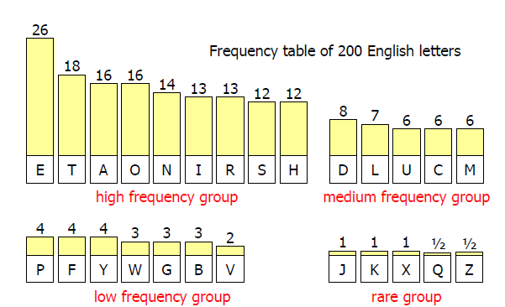
Redundancy of Natural Language Texts

Slide 13
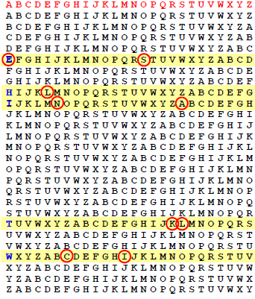
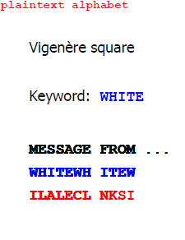
Vigenère Polyalphabetic Substitution Cipher

Slide 14
Poly alphabetic substitution
Effectively smears the characteristic statistics of natural language text.
For a long time was thought to be unbreakable.
Problem of long period using the key.
A frequency analysis can be effected on each individual alphabet.

Slide 15
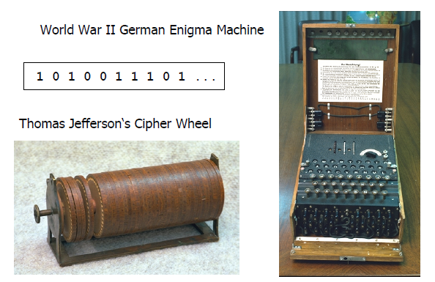
How to construct a Secure Cipher?

Slide 16
Thomas Jefferson‘s Cipher Wheel
Protect communications from England and France to the U.S
Device consisted of an iron spindle and a screw used to keep 36 distinct wooden wheels fixed in place.
On each of the numbered wheels the 26 letters of the alphabet were engraved on the circumference in arbitrary order, so that no two cylinder had the same order.
In order to encrypt a plain text, the letters were arranged on a single line by aligning the individual wheels accordingly.
The cipher text could then be read off by selecting any other line of the cylinder.

Slide 17
The German Enigma
The Enigma was an electromechanical rotor machine implementing a poly alphabetic substitution cipher.
It was used by the German Wehrmacht and Kriegsmarine to encrypt most of its communications.
Due to several weaknesses both in the implementation and the usage of the machine, the cipher could be broken by the British.

Slide 18
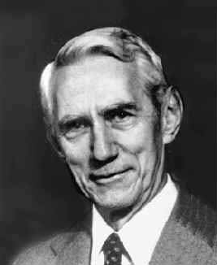
Claude Shannon 1916 - 2001
The Father of Information Theory
• Model of a secrecy system.
• Definition of perfect secrecy.
• Basic principles of „confusion“ and
„diffusion“.
Basic Principles of „Confusion“ and „Diffusion“
Shannon was the first to formulate these two principles explicitly,
„confusion“ standing for substitution operations and
„diffusion“ standing for transposition or permutation operations.
These two principles are still actively used in modern ciphers.

Slide 19
confusion
Caesar and Vigenère cipher.
S-Box in modern cipher.

Slide 20
Transposition Cipher
In a classical transposition cipher the plaintext is written on a piece of paper in horizontal rows of c characters each.
The ciphertext is read out vertically column after column
The columns could be chosen in any order.
In modern ciphers a fixed number of bits are written in linear order into a buffer and are read out in a permuted order controlled by a fixed lookup table.
A software or hardware module which implements this permutation operation is called a P-Box.

Slide 21
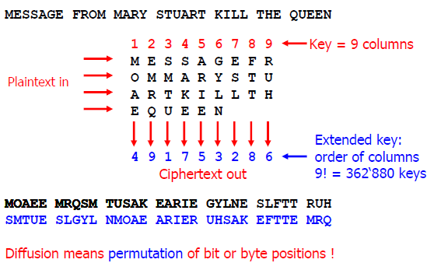
Transposition Cipher-1

Slide 22
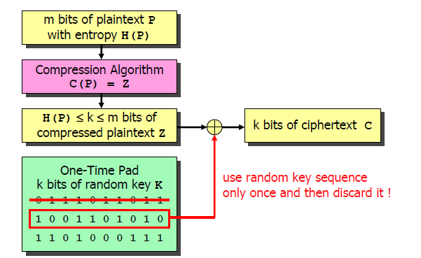
Perfect secrecy

Slide 23
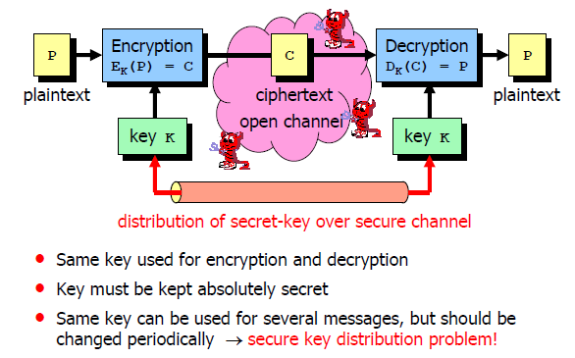
Shannon‘s Model of a Secrecy System

