Slide 1
Fluid Mechanics I
Chapter 2
Fluid Statics
Dr. Afif Akel Hasan
Mechanical & Mechatronics Engineering

Slide 2
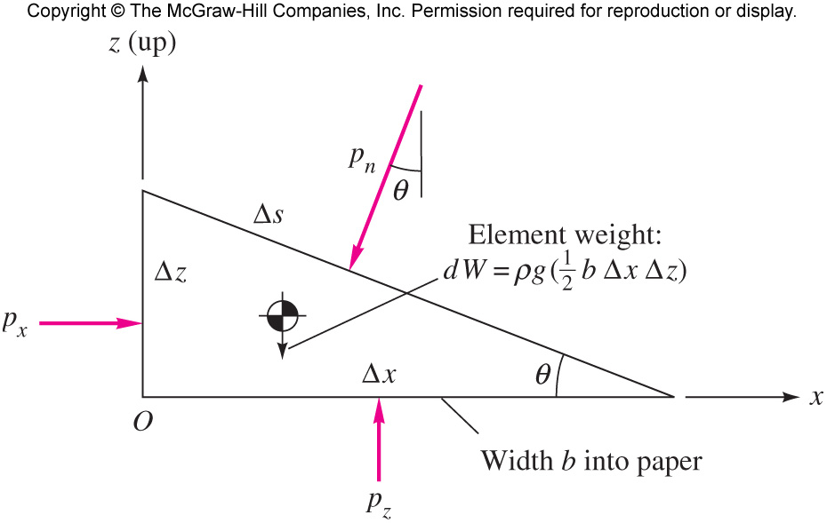
Pressure at a point
It can be shown that at any point in a fluid the pressure is the same in all directions .
P_{x} = P_{y} = P_{z}

Slide 3
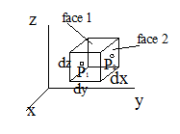
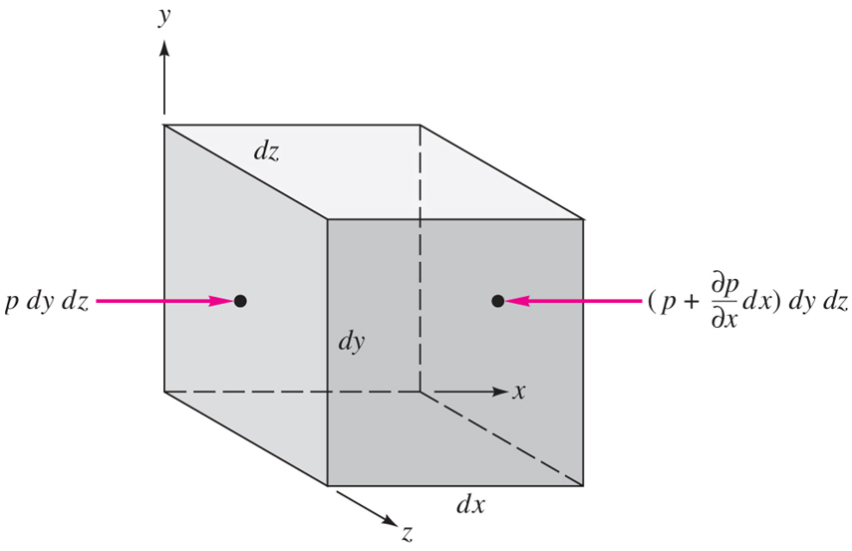
Pressure force on fluid element
Pressure variation in static fluid ( incompressible fluid);
consider volume element dx dy dz
pressure at center of face 1 (left side y – direction ) is P1 then the pressure at opposite face 2 ( right side y – direction )
P2 = P1 + (dp/dy ) *dy or P1-P2 = -(dp/dy) dy
Pressure force in y – direction
dF_{y} = P₁ dx dz – P₂ dx dz = (P1-P2) dx dz
= - (dp /dy ) dx dz dy
similarly for x – direction and z- direction
dF_{x} = -( dp/dx) dx dy dz
dF_{z} = -( dp/dz) dx dy dz

Slide 4
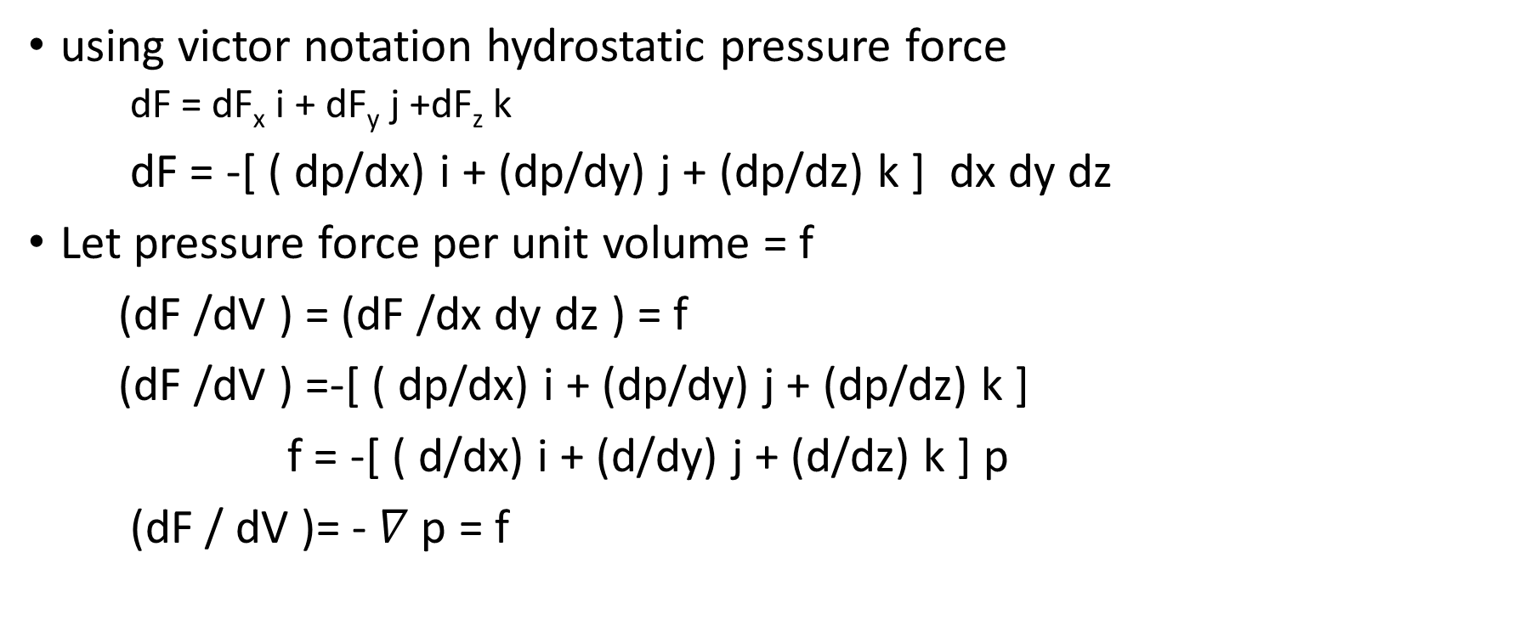
Pressure force on fluid element
using victor notation hydrostatic pressure force
  dF = dF_{x} i + dF_{y} j +dF_{z} k
dF = -[ ( dp/dx) i + (dp/dy) j + (dp/dz) k ] dx dy dz
Let pressure force per unit volume = f
(dF /dV ) = (dF /dx dy dz ) = f
(dF /dV ) =-[ ( dp/dx) i + (dp/dy) j + (dp/dz) k ]
f = -[ ( d/dx) i + (d/dy) j + (d/dz) k ] p
(dF / dV )= - $∇$p = f

Slide 5
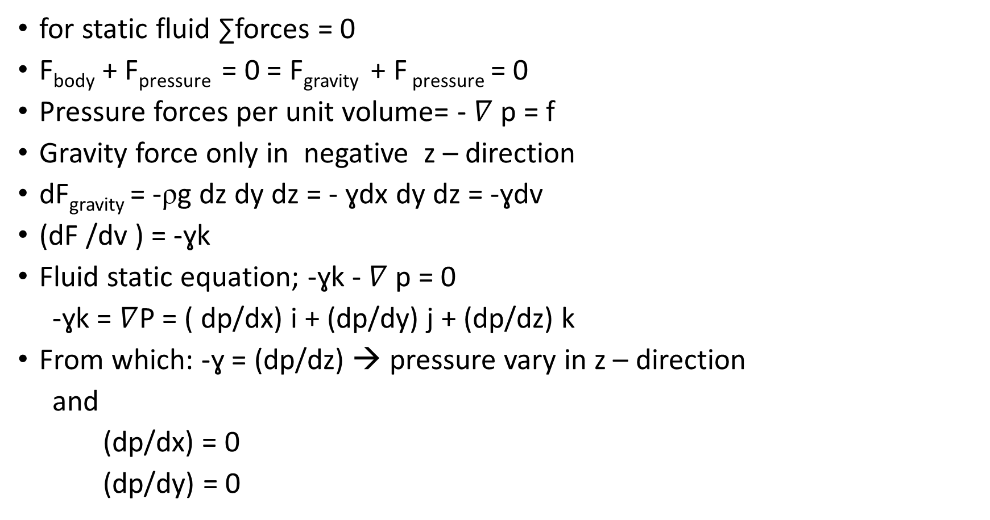
Fluid static
for static fluid ∑forces = 0
F_{body} + F_{pressure} = 0 = F_{gravity} + F _{pressure} = 0
Pressure forces per unit volume= - $∇$p = f
Gravity force only in negative z – direction
dF_{gravity} = -ρg dz dy dz = - ɣdx dy dz = -ɣdv
(dF /dv ) = -ɣk
Fluid static equation; -ɣk - $∇$ p = 0
-ɣk = $∇$P = ( dp/dx) i + (dp/dy) j + (dp/dz) k
From which: -ɣ = (dp/dz) → pressure vary in z – direction
and
(dp/dx) = 0
(dp/dy) = 0
Pascal’s law : two points at same level have same pressure

Slide 6
Pressure variation
Pressure in a continuously distributed uniform static fluid varies only with vertical distance and is independent of the shape of the container.
The pressure is the same at all points on a given horizontal plane in the fluid.
The pressure increases with depth in the fluid.

Slide 7
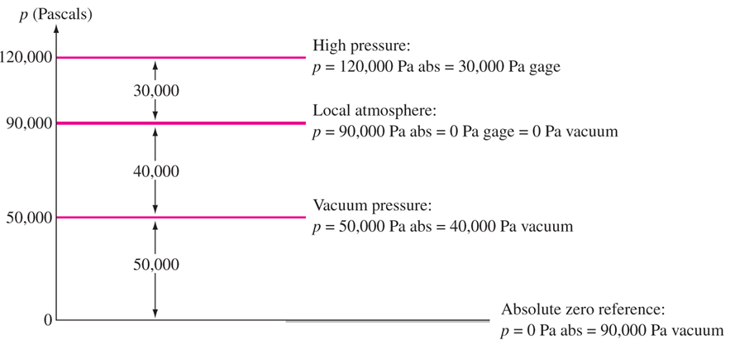
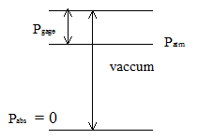
Pressure scale
Absolute pressure at complete vacuum
P_{gauge} = P _{absolute} - P_{atmosphere}
Or
P_{abs} = P_{atm} + P_{gauge}
P_{atm} = 760 mm Hg
= 101.325kPa
= 14.7 psi
Bourdon gauge : measures gauge pressure
Barometer : measure atmospheric pressure

Slide 8
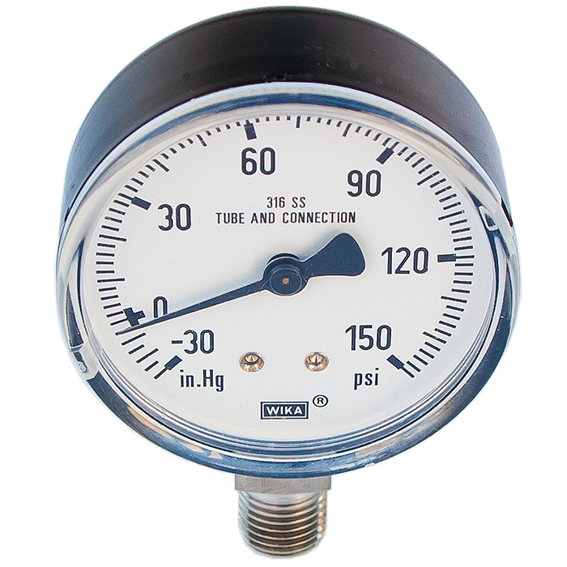
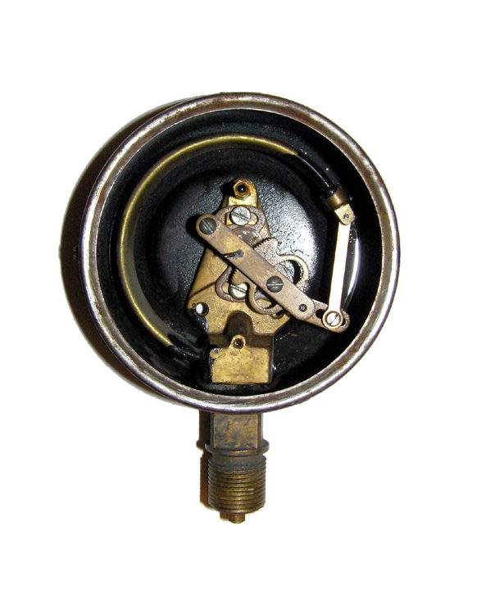
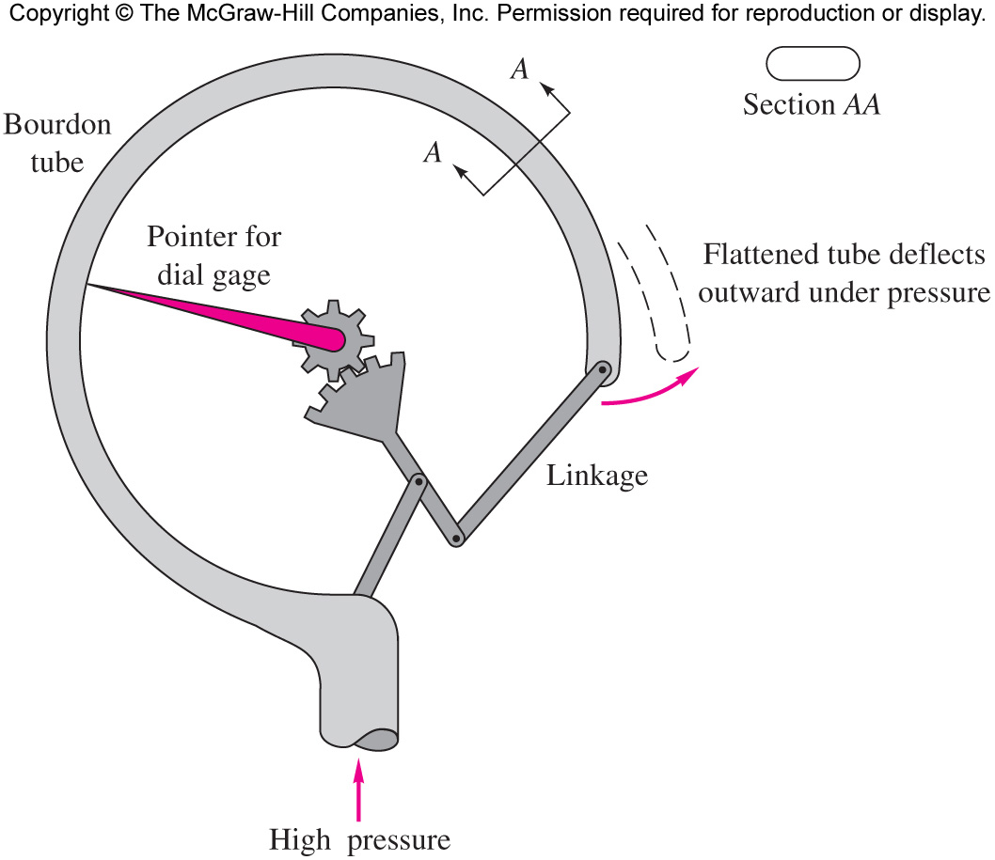
Bourdon gauge

Slide 9
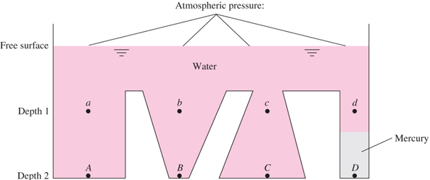
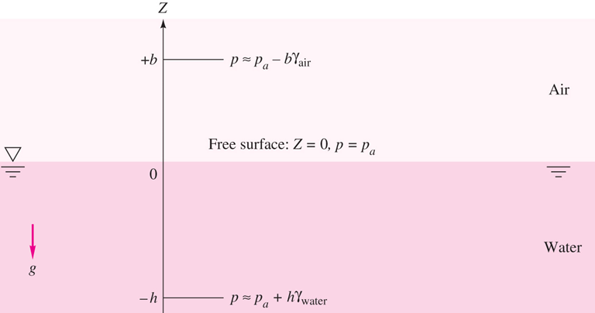
Incompressible fluid
Hydrostatic pressure distribution
( dp/dz ) = -ɣ = -ρg
P₂ –P₁ = - ɣ (z₂-z₁ )
P₂ = P₁ + ɣ (z₁-z₂)
P₂ = P₁ + ɣh
If P₁ = P_{atm}
Then P₂ = P_{atm} + ɣh
P _{down} = P_{up} +ɤ h

Slide 10
EXAMPLE 2.1
Newfound Lake, a freshwater lake near Bristol, New Hampshire, has a maximum depth of 60 m, and the mean atmospheric pressure is 91 kPa. Estimate the absolute pressure in kPa at this maximum depth.

Slide 11

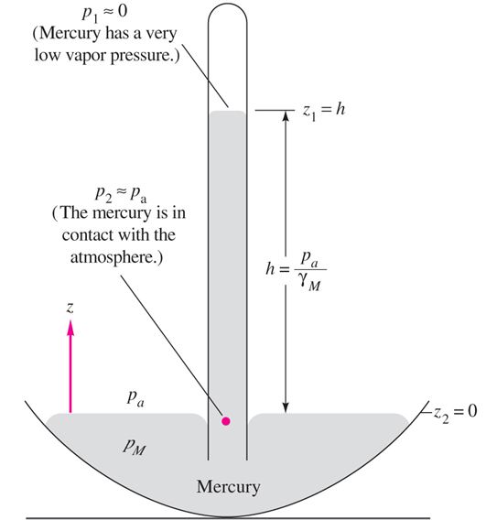
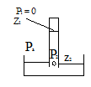
Barometer
Barometer is simplest application of the hydrostatic formula.
P₂ - P₁ = -ρg( z₂- z₁ )
Mercury barometer is a tube filled with mercury and inverted in mercury reservoir.
P₂ = P₁+ ρg( z2- z1 ) = P1 + ρg h
At z₁ top of mercury P₁ = 0 since Hg has low vapor pressure P₂ = P_{a} at the same level
P₂ = P_{a} = ρ_{Hg} g h ➔ h = P_{a}/ ρ_{Hg} g
e.g P_{a} = 101350 Pa ɤ_{Hg} = 133100N/m³
then h = 0.761 m = 761 mm
mercury is used because it is the heaviest liquid
h _{H2O} = 101350/ɣ_{H2O} = (101350/9790) m H₂O

Slide 12
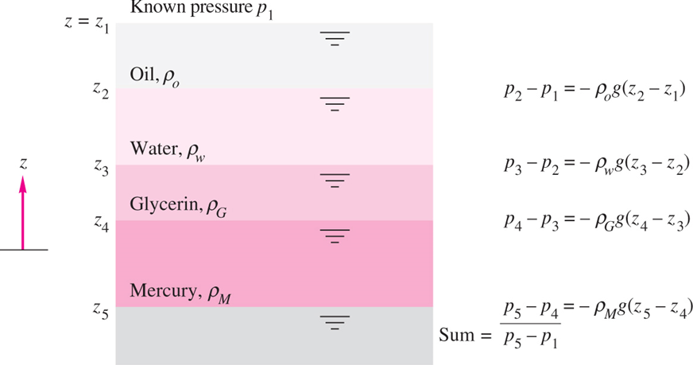
Multi layer liquids

Slide 13
EXAMPLE 2.8 modified
A tank is filled with layered liquids; 8 ft of oil, 6 ft of water, and 4 ft of mercury. Compute pressure at middle of each layer.

Slide 14
Pressure variation in compressible fluid
For Isothermal gas; temperature is constant or is not function of z
Assume ideal gas P = ρRT ➔ ρ = (P/RT )
But
dp/dz =- ρ g= (P/RT )g
dp/p =- (g/RT)dz
Integrating from z₀ where P₀ and T₀ to Z where P
ln ( P/P₀) = - g (z-z₀ ) /RT
P=P₀ exp [- g (z-z₀ ) /RT₀]

Slide 15
Non – isothermal gas
Assume temperature variation with elevation
T = T₀ -βZ
ρ = P /RT = P /R(T₀ - β Z)
T = T₀ when z = 0
dp /dz = - ρg = - P g/ R(T₀ - β Z), Integrating, let u=R(T₀ - β Z), du = -R β dz

Slide 16
EXAMPLE 2.2
If sea-level pressure is 101,350 Pa, compute the standard pressure at an altitude of 5000 m, using (a) the exact formula and (b) an isothermal assumption at a standard sea-level temperature of 15°C. Is the isothermal approximation adequate?
(a) exact formula

Slide 17
EXAMPLE 2.2
(b) isothermal approximation

Slide 18
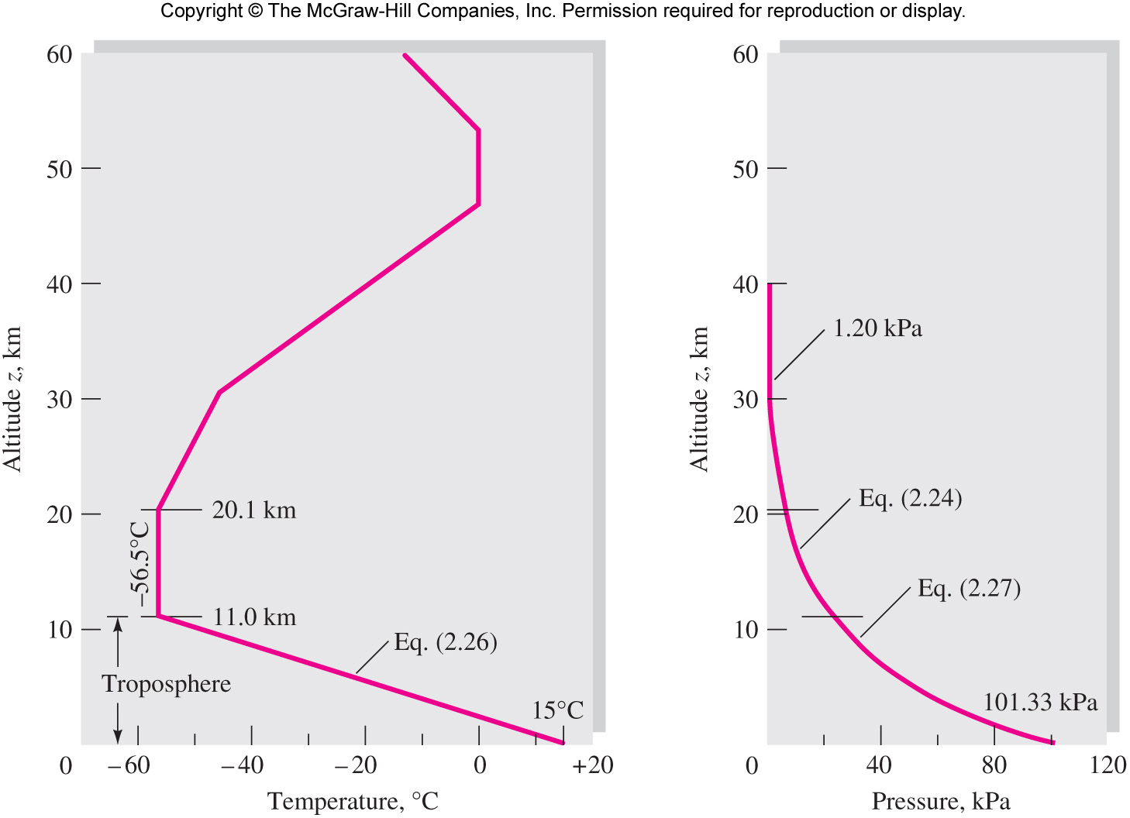
Atmosphere temperature & pressure

Slide 19
Table A.6 Properties
of the
Standard
Atmosphere

Slide 20
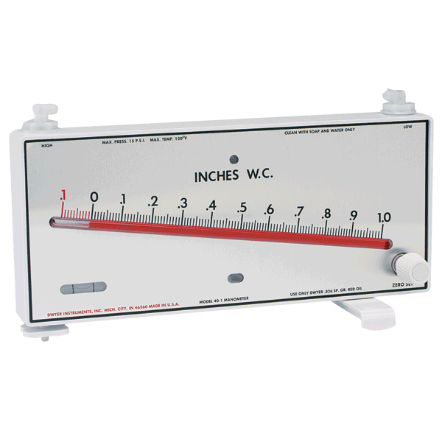
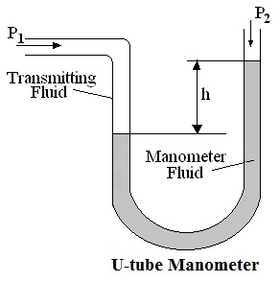
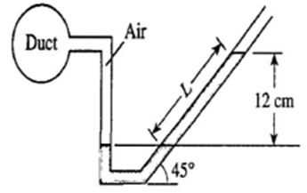
Manometer
Based on Pascal law two points at the same level of continuous fluid have same pressure .

Slide 21
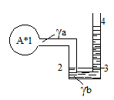
Manometer
Based on Pascal law two points at the same level of continuous fluid have same pressure
P₂ = P₃ at the same level .
P₂ = P_{A} + ϒ_{a 1}h₂
And P₃ = P₄ +ϒ_{b 3}h₄
P_{A} + ϒ _{a 1}h₂ = P₄ + ϒ _{b 3}h₄
P_{A} = - ϒ _{a 1}h₂ + P₄ + ϒ _{b 3}h₄
P_{A} = P_{atm} + ϒ _{b 3}h₄ - ϒ _{a 1}h₂

Slide 22
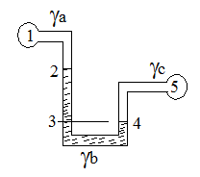
Manometers
Example 2 Find P₁ = ?
P₃ = P₄
But P₃ = P₁ + ϒ_{b 2}h₃ + ϒ _{a 1}h₂
And P₄ = P₅ + ϒ _{c 4}h₅
P₁ + ϒ _{b 2}h₃ + ϒ _{a 1}h₂ = P₅ + ϒ _{c 4}h₅
P₁ = - ϒ _{b 2}h₃ - ϒ _{a 1}h₂ + P₅ + ϒ _{c 4}h₅

Slide 23
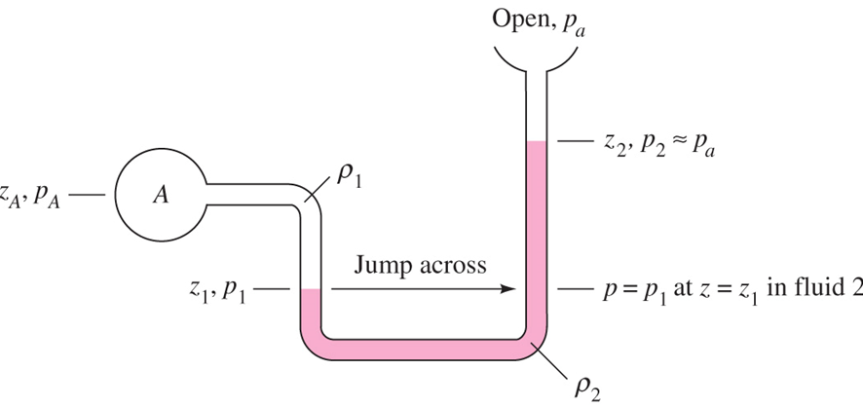
Manometer Problems
Systematic approach .
  Start at one end and write pressure there .
  Add to this , the change in the same units from one meniscus to the next one plus if next meniscus is lower and minus if it is higher
  Continue until the end of the gauge and equate the expression to the pressure at that point .

Slide 24
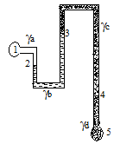
Example
Example 3 Find P₁- P₅ = ?
P₁ + ϒ_{a 1}h₂ - ϒ _{b 2}h₃ + ϒ _{c 3}h₄ + ϒ _{d 4}h₅= P5
P₁ – P₅ = - ϒ _{a 1}h₂ + ϒ _{b 2}h₃ - ϒ _{c 3}h₄ - ϒ _{d 4}h₅
Example 4 Re work e.g 2
P₁ + ϒ _{a 1}h₂ +ϒ_{b 2}h₃ + - ϒ _{c 4}h₅ = P₅
P₁ - P₅ = - ϒ _{b 2}h₃ - ϒ _{a 1}h₂ + ϒ _{c 4}h₅

Slide 25
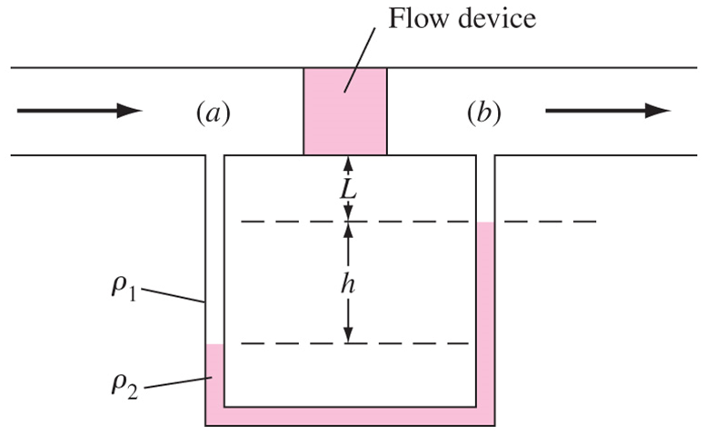
Examples
Example 2.3 p. 74
Derive formula for pressure difference P_{a}- P_{b}

Slide 26
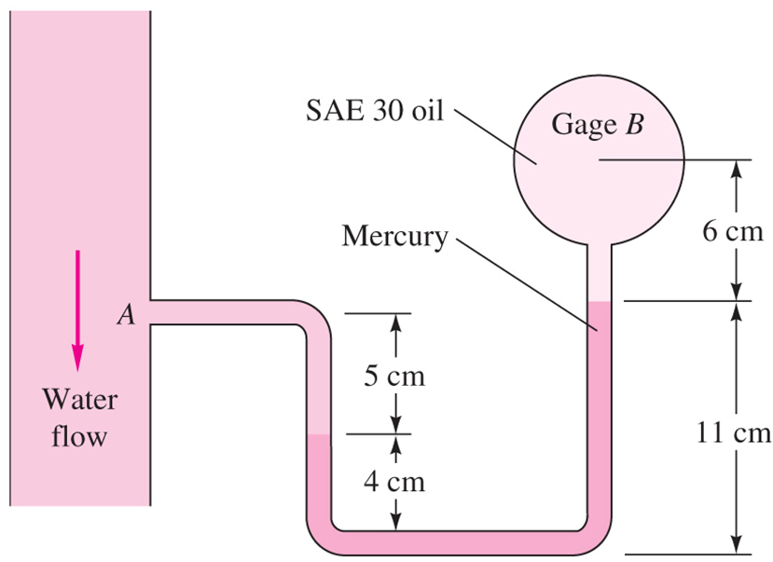
Example 2.4 p.76
Pressure at B is 87 kPag estimate pressure at A?

Slide 27
Force on plane areas
The distributed pressure forces may be replaced by a resultant force ,F_{R} its line of action is called pressure center .
Task to calculate resultant force magnitude and direction.
Derive formula for horizontal surfaces
Derive formula for inclined surfaces.

Slide 28
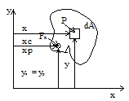
Horizontal surfaces
df =PdA but P is constant
F = ∫df= ∫ PdA= PA
Direction normal to the surface and toward the surface .
Pressure center :
To find center of pressure (Xp, Yp) moment of distributed pressure forces equals moment of F_{R}
For Xp take moment about the y – axis

Slide 30
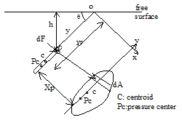
Inclined surface
Consider area element dA
dF= PdA
but P = ϒh then dF =ϒhdA
but h = y sinθ then dF=ϒ y sinθdA

Slide 31
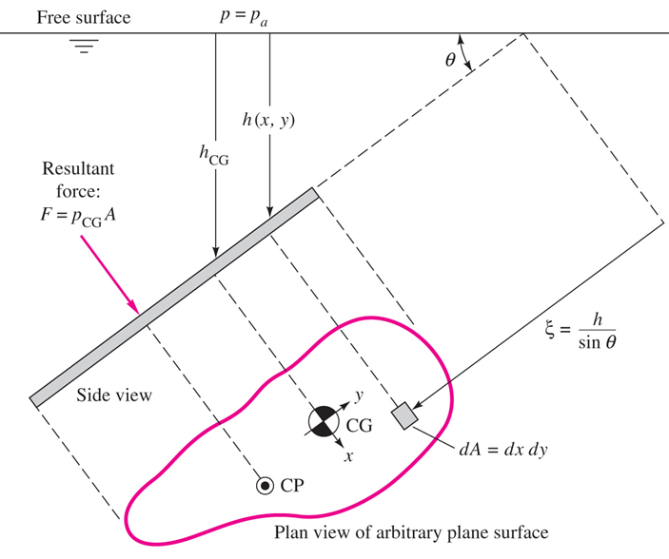
Inclined surface
F_{R} = ϒhc A = P_{c} A
Resultant hydrostatic pressure force is pressure at the centroid multiplied by area of surface.

Slide 32
Center of pressure
Distributed pressure moment about O equals F_{R} moment about O:

Slide 35


Slide 36
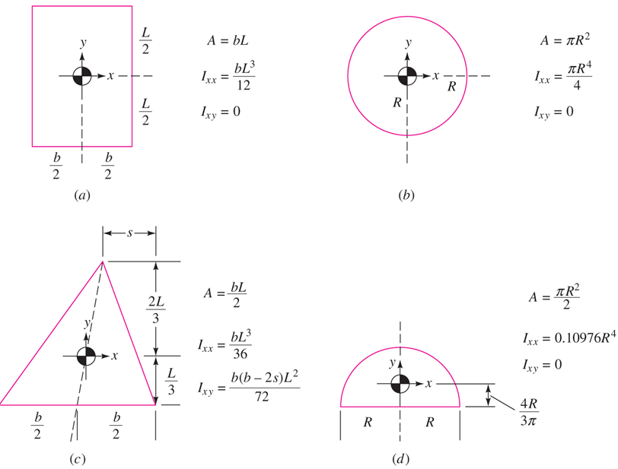

Slide 37


Book notation
Resultant force; $F=$P_{CG} A where P_{CG} is the pressure at centroid
Center of pressure
Ixx is the area moment of inertia of the plate area about its centroidal x axis
Y _{CP} is below the centroid or
Ycp = Yc -Yp
where Ixy is the product of inertia of the plate
X _{CP} is below the centroid or
Xcp = Xc -Xp

Slide 38
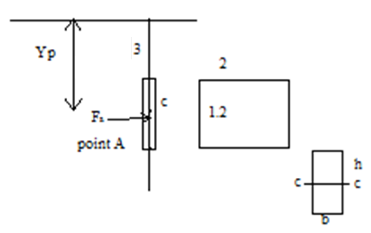
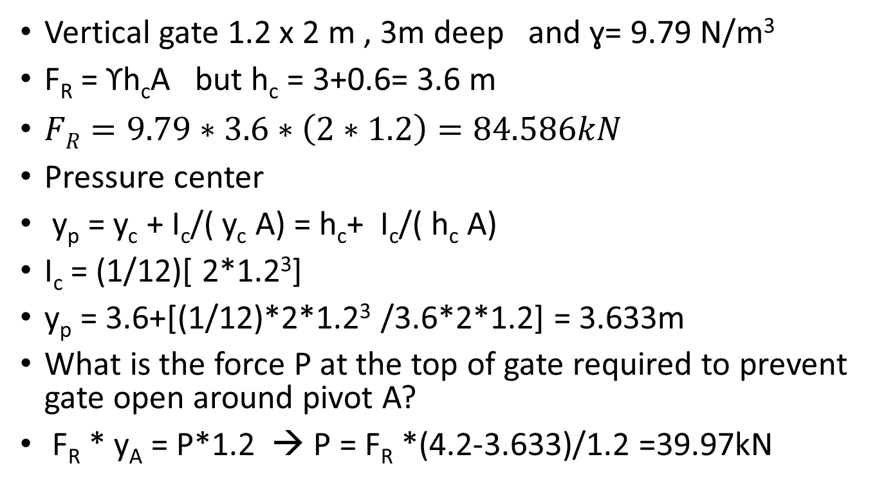
Example vertical rectangular gate
Vertical gate 1.2 x 2 m , 3m deep and ɣ= 9.79 N/m³
F_{R} = ϒh_{c}A but h_{c} = 3+0.6= 3.6 m
$FR=9.79∗3.6∗\left(2∗1.2\right)=84.586kN$
Pressure center
y_{p} = y_{c} + I_{c}/( y_{c} A) = h_{c}+ I_{c}/( h_{c} A)
I_{c} = (1/12)[ 2*1.2³]
y_{p} = 3.6+[(1/12)*2*1.2³ /3.6*2*1.2] = 3.633m
What is the force P at the top of gate required to prevent gate open around pivot A?
F_{R} * y_{A} = P*1.2 → P = F_{R} *(4.2-3.633)/1.2 =39.97kN

Slide 39
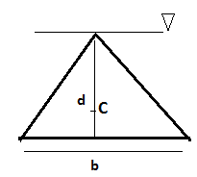
Example vertical triangular gate
Vertical equal sides triangle , with head at free surface
F_{R} =P_{c}A= γh_{c}A
Centroid (2/3) from top h_{c} = (2/3)d
F_{R} = γ(2/3)d*A
A= (bd/2)
So F_{R} = γ(2/3) d (bd/2) = (γ/3)bd²
y_{p} = h_{p} = y_{c} +[(I_{c})_{xx}/y_{c}A] = h_{c} +I_{c}/h_{c}A
y_{p} = (2/3)d + [bd³ /36]/(2/3)d(bd/2)= 3d/4

Slide 40
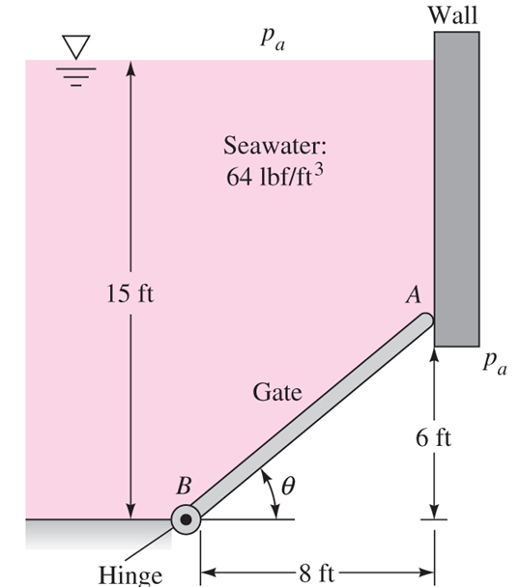
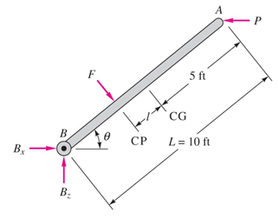
Example 2.5 p. 80
A 5 ft wide gate hinged at B and rest against smooth surface at A. Compute (a) the force on the gate due to seawater pressure. (b) the horizontal force P exerted by the wall at A, and (c ) the reactions at the hinge B?

Slide 41

Example 2.5 p. 80

Slide 43

Effect of Atmospheric Pressure
In the previous discussions of submerged surface pressure is taken from free surface P = ϒ h actually pressure on surface is P_{atm} + ϒh
Then force
F_{R} = ∫( P_{atm} +ϒh) dA = AP_{atm} +∫ ϒh dA
F_{R} = P_{atm} A + P_{c} A = ( P_{atm} +P_{c} ) A
however atmospheric pressure acts on the other side of the surface
as (P_{atm} A ) and the thus it will cancel the atmospheric pressure force on the first side .

Slide 44
Effect of Atmospheric Pressure
Now if net force on surface (on both side ) is required then no need to add ( P_{atm} A ).
If force on only submerged side is required then , should add ( P_{atm}A)
If pressure above liquid is different from atmospheric then should add effect of P₀ A
F_{R inside} = ( P₀ +P_{c} ) A
F_{R net} = F_{inside} – F _{outside} = P₀A + P_{c}A –P_{atm}A
F_{R net} = P₀A –P_{atm}A +P_{c}A = P_{gauge}A +P_{c} A

Slide 45
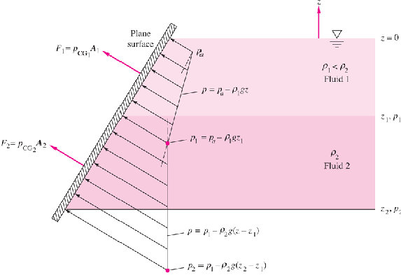
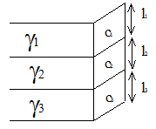

Multi layer fluids
Multi layer fluids :
F= F₁ + F₂ +F₃
F = P_{c1} A₁ + P_{c2} A₂ + P_{c3} A₃
Pc1 = ϒ1L1/2
Pc2 = ϒ1L1+ ϒ2 L2/2
Pc3 = ϒ1L1+ ϒ2 L2+ ϒ3L3/2
For center of pressure see eq.
$Xcpi=−γ\sin{θ Ixyi/}$ $PCGiAi=−γ\sin{θ Ixyi/}$F_{Ri}
$Ycpi=$ $−γ\sin{θ Ixxi/}$ $PCGiAi=−γ\sin{θ Ixxi/}$F_{Ri}

Slide 46
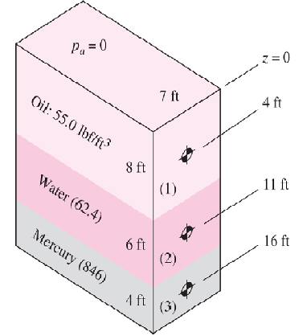
Multi layer fluids
See e.g 2.10 p. 88.
A tank 18 feet deep and 7 feet wide is layered with 8 ft of oil, 6 ft of water, and 4 ft of mercury. Compute the total hydrostatic force and the resultant center of pressure of the fluid on the right- hand side of the tank?

Slide 48
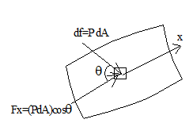
Force on Curve Surface
For case of curved surface
  horizontal and vertical force components
  component are computed F_{H} and F_{V}
Horizontal component
dF = PdA
dF_{x} = dF (cosθ )
dF_{x} = PdA (cosθ )
but (dA (cosθ ) is the projection of dA on to a plane normal to x- direction . Then
where A_{x} projection of area into plane normal to “x” in zy plane

Slide 49
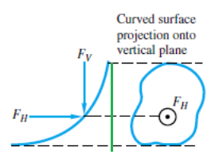
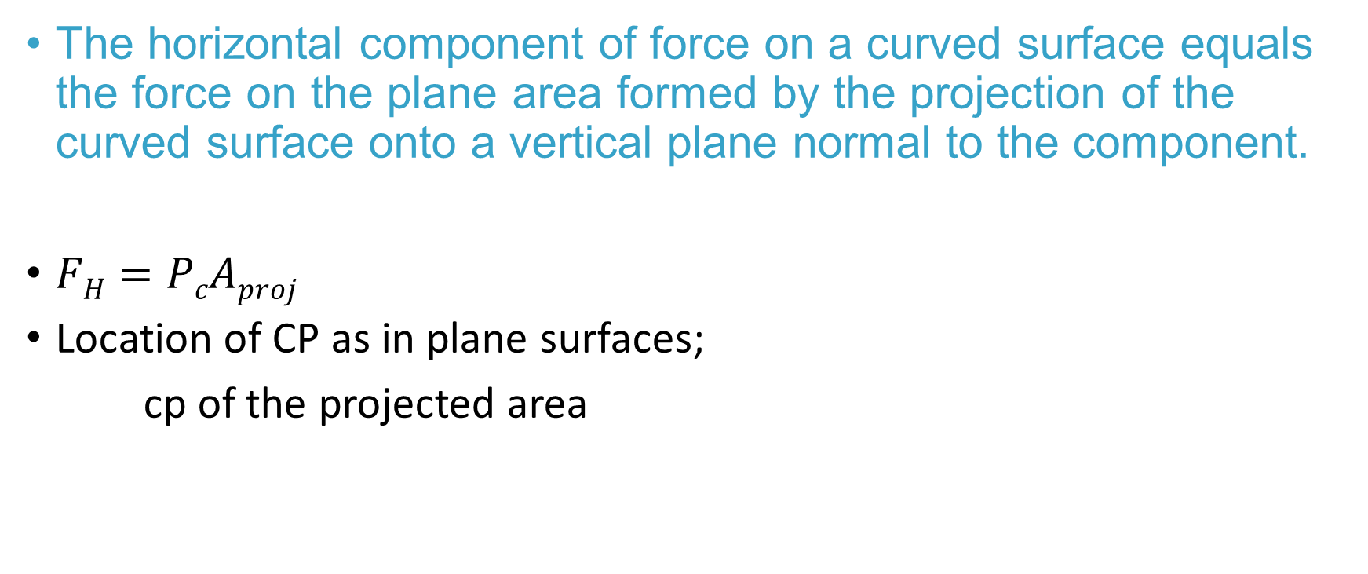
Horizontal component, F_{H}
The horizontal component of force on a curved surface equals the force on the plane area formed by the projection of the curved surface onto a vertical plane normal to the component.
$FH=PcAproj$
Location of CP as in plane surfaces;
cp of the projected area

Slide 50
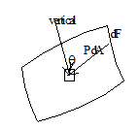
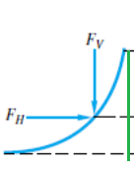
Vertical component
Vertical component F_{v}
dF_{v} = (PdA) (cosθ ) = PdA (cos θ )
dF_{v} = ϒh (dA cos θ ) = ϒ (h dA cos θ )
dF_{v} = ϒ dV integrating
F_{V} = ∫ ϒ dV = ϒ V
V is the volume of liquid above surface .
Vertical component equals weight of fluid above surface.
Fluid might be imaginary above surface ,it should extend to free surface with same ϒ.
Line of action of F_{v} passes through centroid of real or imaginary volume above surface .
See e.g 2.9 p. 87

Slide 51
Vertical component
The vertical component of pressure force on a curved surface equals in magnitude and direction the weight of the entire column of fluid, both liquid and atmosphere, above the curved surface

Slide 52
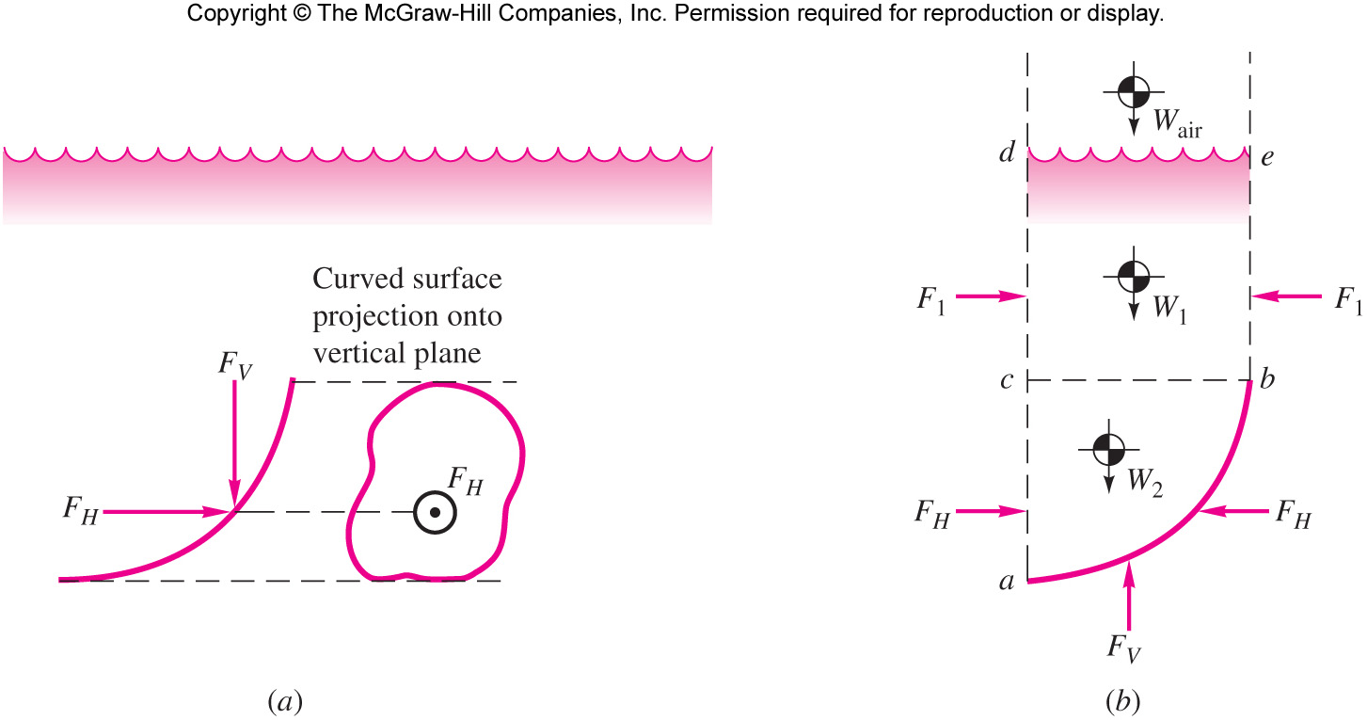

Curved surfaces
Resultant, F_{R}
$FR=\sqrt{FH2+FV2}$
Direction:
$\tan^{−1}{∅=FV/}FH$
$∅:$Angle with horizontal

Slide 53
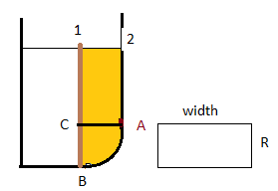
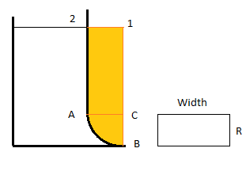
Vertical component
Example
Find horizontal and vertical force components on cylindrical gate AB
a) actual liquid above gate?
b) imaginary liquid above the gate?

Slide 54
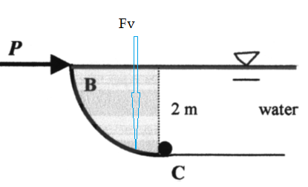
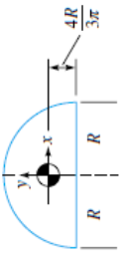
Example ( problem 2.86)
2.86 The quarter circle gate BC in Fig. P2.86 is hinged at C. Find the horizontal force P required to hold the gate stationary. The width b into the paper is 3 m.
F_{H}: acts 2/3 of the way down or 1.333 m down from the surface (0.667 m up from C).
F_{V} acts down at (4R/3π) = 0.849 m to the left of C.

Slide 55

Tensile stress in a Pipe
Consider unit length of a pipe with pressure P
Pressure forces equal to tensile force .
Take half a ring of pipe then
F_{H} = T­₁ +T₂
Assuming pressure center at center of pipe then
T₁ = T₂ =T and F_{H} =2T
But F_{H} = P_{c} A_{H}
P_{c} = P and A_{H} = 2r(1) = 2r
F_{H} = P 2r = 2Pr = 2T
T= Pr
But tensile stress σ = (T/e)
where “e” is thickness of pipe
Then e σ = Pr
P = (σ e/r)

Slide 56

Buoyant Forces
Completely submerged body .
dF_{b} = dF_{l} –dF_{u}
= P_{l} dA – P_{u} dA
= ϒ z_{l} dA – ϒz_{u} dA
dF _{B} = = ϒ(z_{l} – z_{u} )dA = ϒ dV_{body}
* buoyant force equals weight of displaced fluid “ Archimedes Principle “
Center of buoyancy : It can be shown that
X_{B} = (1/F_{B} ) ∫ ϒ x (z_{l} – z_{u} )dA = (ϒ /F_{B} )∫ x dV = (1/V) ∫ x dV
Which is the centroid of volume ( submerged )

Slide 57

Buoyant Forces
Body at interface of two immiscible fluids it can be shown
F_{B} = ϒ_{a}V_{a} +ϒ_{b}V_{b}
Weight of fluids being displaced by the body
See e.g 2.11 p.91

Slide 58


Floating bodies
Weight = buoyancy
Neglect buoyance due to air

Slide 59

Example
Vertical forces on half cylinder with radius R?
F _{buoyancy} = F_{L}-F_{U} = weight of displaced liquid
Volume of cylinder multiplied by liquid specific weight.

Slide 60

Buoyant Forces
weight in fluid 1 F_{B1} + F₁ = w
ϒ₁v+F₁ = w
weight in fluid 2 F_{B2} + F₂ = w
  = ϒ ₂ V +F₂ = w
then V = (F₁-F₂ )/ (ϒ₂- ϒ ₁ ) ; and
w = (F₁ ϒ ₂ - F₂ ϒ ₁)/ (ϒ ₂ - ϒ ₁ )
also
ρ = (w/g )/v = (F₁ ϒ ₂ - F₂ ϒ ₁)/ g(F₁-F₂ )
S.G = (w/v ) / ϒ _{H2o}

Slide 61
EXAMPLE 2.9
A block of concrete weighs 100 lbf in air and “weighs’’ only 60 lbf when immersed in fresh water (62.4 lbf/ft3). What is the average specific weight of the block?
A free-body diagram of the submerged block (see Fig. E2.9) shows a balance between the apparent weight ( in water), the buoyant force, and the actual weight
Solving gives the volume of the block as 40/62.4 = 0.641 ft3

Slide 62




Stability of Floating Bodies
Vertical stability ; floating between two fluids If displaced upward then F_{B} becomes (ϒ v_{sub} ) become smaller than w, and it go back to stable position.
if displaced down ward F_{B} = (ϒ v_{sub} ) become greater than weight and body moves upward and restore to stable position .
Rotational stability
  stable : any rotation sets a restoring couple e.g when gravity center below buoyancy center . case 1
  unstable : any angular displacement set up a couple that tends to increase stability . case 2
  Neutral stable : angular rotation does not set up any couple .
  This is the case when buoyancy and gravity center act at the same point . e.g. sphere.

Slide 63



Rotational stability of floating bodies
Note : gravity center G
Buoyancy center B
New buoyancy center of rotation body B`.
Measure of stability is GM
  GM ≥ 0 stable .
  GM < 0 unstable
But GM= BM –BG
BG = L₂ – L₁
Find L₁ from w = F_{B} = ϒ_{F} v = ϒ_{F} A(2 L₁₋₂)
L1 = (w /2 ϒ_{F} A)

Slide 64


Rotational stability of floating bodies
It can be shown that BM = (ϒ_{F} /W _{body} )Iyy = (I yy /Vsub )
Where Iyy = ∫ x² dA about rotational, axis y-y .
Restoring couple C = ϒ_{F} ∂θ Iyy
Or C = wMG( sinθ)
See e.g 2.12 p. 94

Slide 65
Fig. 2.18 Calculation of the metacenter M of the floating body shown in (a). Tilt the body a small angle . Either (b) B moves far out (point M above G denotes stability); or (c) B moves slightly (point M below G denotes instability)
If point M is above G, that is, if the metacentric height MG is positive, a restoring moment is present and the original position is stable. If M is below G (negative MG, the body is unstable and will overturn if disturbed. Stability increases with increasing MG.

Slide 66


Example 2.12
A barge has a uniform rectangular cross section of width 2L and vertical draft of height H. Determine the metacentric height for a small tilt angle and the range of ratio L/H for which the barge is statistically stable, if G is exactly at the water line.

Slide 67




Fluid Rigid body motion
Linear acceleration
Rotational acceleration
General acceleration equation
General fluid equation
$$a=\frac{dVo}{dt}+Ωx\left(Ωxro\right)+\frac{dΩ}{dt}xro$$
$∇p=ρG=ρ(g−a)$

Slide 68

General acceleration equation
General form of fluid equation
$$∇p=ρG+μ∇2V$$
Neglecting viscous forces it becomes
$∇p=ρG$ where G is the general acceleration vector
G = g-a where g gravity acceleration , a linear acceleration.
Then constant or fixed pressure surface ( isobars) are normal or perpendicular to the G direction.
Special case if a =0 only gravity acceleration then constant pressure surfaces are normal to vertical or Z direction

Slide 69




General form of rigid body acceleration
$a=\frac{dVo}{dt}+Ωx\left(Ωxro\right)+\frac{dΩ}{dt}xro$
Where $Vo$ velocity at center of rotation point O for an arbitrary point P with position vector $ro$ and angular velocity $Ω$.
  First term is translation acceleration
  2nd term is centripetal acceleration whose direction from point P perpendicular toward the axis of rotation.
  3rd term is the linear acceleration due to change in $Ω$
P
$$Ω$$
$$ro$$
O
$$Vo$$

Slide 70




Uniform linear acceleration
Equation becomes;
Referring to figure determine g-a using parallelogram.
Surface of constant pressure is perpendicular to the G direction. Make an angle $θ$ with original free surface (horizontal).
From figure $\tan{θ=\frac{ax}{g+az}}$ or
$$θ=\tan^{−1}{\frac{ax}{g+az}}$$
Also $\frac{dP}{ds}=ρG=ρ(g−a)$
where dP/ds is the gradient in the s –direction which is normal to new free surface.
$∇p=ρG=ρ(g−a)$
$$G=\sqrt{ax2+(g+az)2}$$

Slide 71



Example 2.12 p. 96
Drag racer rests her coffee cup on horizontal tray while she accelerates at 7 m/s² (horizontally). The mug is 10 cm deep and 6 cm in diameter and contains coffee 7 cm deep at rest.
Determine whether it will spill the coffee?
Calculate the gage pressure in the corner at point A if density of coffee is 1010 kg/m³.?
$$θ=\tan^{−1}{\frac{ax}{g+az}}$$

Slide 72


Angular acceleration
Consider rotation of the fluid about z –axis without translation.
In figure fluid rotates with $Ω$ , the position vector
$ro=irr$ and
angular vector $Ω$=k $Ω$
The centripetal acceleration
$Ωx\left(Ωxro\right)$= - r$Ω2ir$
The pressure equation
$$∇p=ρG=ρ\left(g−a\right)$$
$=ρ(−gk+$ r$Ω2ir$ )
From which $\frac{∂p}{∂r}=ρ\text{r}Ω2$ and $\frac{∂p}{∂z}=−γ$
Solution gives P(r,z)

Slide 73

Angular acceleration
Integrating 1st. equation holding z constant gives $\frac{∂p}{∂r}=ρ\text{r}Ω2$
$P=\frac{1}{2}ρr2$ $Ω2$+f(z)
Differentiating this equation with respect to z gives; $\frac{∂P}{dz}=\acute{f(z)}$
But ; $\frac{∂P}{dz}=$-$γ$ and $\frac{∂P}{dz}$= $f′(z)$ , by integrating
$f\left(z\right)=−γz+c$
Hence $P=\frac{1}{2}ρr2$ $Ω2$+f(z)=$\frac{1}{2}ρr2$ $Ω2$ -$γz+c$
from origin or P(r=0, z=0) = P₀ then c= P₀ and
$P=\frac{1}{2}ρr2 Ω2\text{ −}γz+P0$
Or for a fixed pressure P1
$z=\frac{P0−P1}{γ}+r2 Ω2/2g$ which is a parabola concaved upward

Slide 74



New free surface
Rise at tip and drop at center
For rotation of cylinder a bout its axis
Volume of paraboloid =$\frac{π}{2}R2h=$ Volume of liquid= base* height = $πR2H$ from which H=h/2 is drop of center which also rise of tip.
h is z when r =R from equation h=z(r=R) for free surface P1 =P0 then
$h=\frac{P0−P0}{γ}+\frac{R2 Ω2}{2g}=\frac{R2 Ω2}{2g}$
$z=\frac{P0−P1}{γ}+r2 Ω2/2g$

Slide 75


Example 2.13 rotating cup
Coffee cup of previous example is placed on a turntable and rotated about its central axis until rigid body mode. Find the angular velocity that will cause the coffee to just reach the tip, the gage pressure at point A for this condition.
$\frac{h}{2}=\frac{R2 Ω2}{4g}=\frac{0.032 Ω2}{4∗9.81}$= 0.03
Then $Ω2$ = 1308 and $Ω$ = 36.2 rad/s = 345 rpm

Slide 76

Example 2.13 rotating cup
To compute the pressure, it is convenient to put the origin of coordinates r and z at the bottom of the free-surface depression, as shown in Fig. E2.13.
The gage pressure here is P0= 0, and point A is at (r, z)= (3 cm, -4 cm). Equation (2.63) can then be evaluated
$$P−P0=\frac{1}{2}ρr2 Ω2\text{ −}γz$$

Slide 77
END OF CHAPTER 2

