Slide 1
Chapter 15
Batters and Dough

Slide 2
Batters and Dough
Batters and dough are also called flour mixtures.
Batters and dough make a large variety of baked goods.
Wheat is the principle grain used to make flour here in Palestine and many other countries of the world.

Slide 3
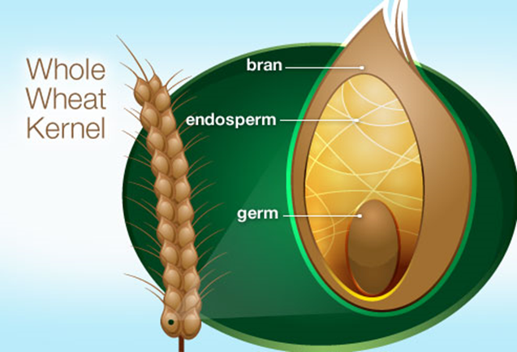

Slide 4
Milling of wheat
Milling of wheat means separating the: Endosperm ( ̴83% of the kernel)( it is mainly starch)
from:
  Germ ( ̴2.5% of the kernel) (embryo or sprouting section of the seed) (contains fat which decreases the storage life)
  Bran ( ̴14.5% of the kernel) ( it is cellulose + other nutrients like some B complex vitamins and some protein),
Then
  Grinding the endosperm into a fine flour.
Milled flour usually contains (65-70)% starch + (8-13)% protein + other nutrients.

Slide 5
Aged Flour
Is flour that was stored for several weeks or months
  Produces better breads (higher volume and finer texture) because during aging flour becomes lighter in color [bleached].
How?
Carotenoid pigments get oxidized
Portions of the glutenin and gliadin proteins in the flour get oxidized:
  And this allows for better bonds between them when they form the gluten.

Slide 6
Bleaching of Flour
Can be either natural due to storage
or
Through the use of approved chemicals.

Slide 7
Types of flour on the market
Whole wheat flour (also called graham flour)
All-purpose flour : (usually made from a blend of different kinds of wheat)
Bread flour : (made from hard wheat) which contains more protein than soft wheat.
Pastry flour: (made from soft wheat)

Slide 8
Types of flour on the market Cont’d.
Cake flour: ( made from soft wheat)
Instant flour [instant blending flour] [quick mixing flour]
Self-rising flour: usually contains leavening agent + salt (typically 1 ½ tsp B.P. + ½ tsp salt/ cup)
Gluten flour: made of wheat flour mixed with dried extracted gluten
  Gluten flour contains about 41% protein compared to 8-13% in most wheat flours.
  Gluten gives the dough its elasticity, helping it rise and keep its shape

Slide 9
Instant Flour
Is low-protein flour that
Has been "pre-gelatanized" so that it:
  Can dissolve quickly and smoothly in liquids regardless of temperature
Does not pack
Does not need sifting
It is usually used to thicken gravies, sauces, and soups

Slide 10
Gluten Extraction
Gluten is extracted from flour by:
Kneading the flour
Agglomerating the gluten into an elastic network [a dough]
Then washing out the starch.

Slide 11
Other Flours
Rye, barley, buckwheat, triticale (is a hybrid of wheat and rye) amaranth, corn, rice, potato, soybeans.
  These flours need to be mixed with wheat flour because they either contain very little gluten or do not contain gluten
  These flours alone do not make high quality baked products.

Slide 12
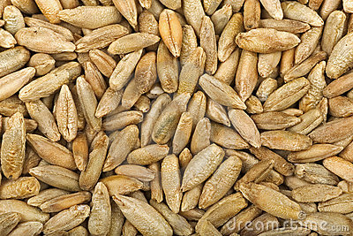
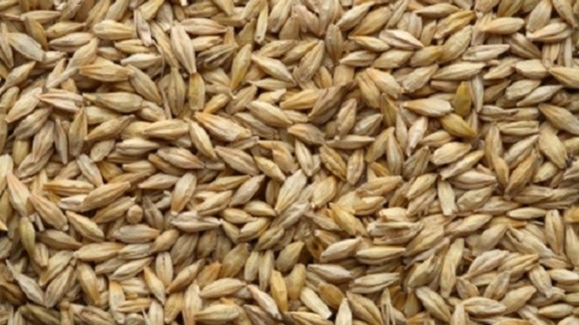
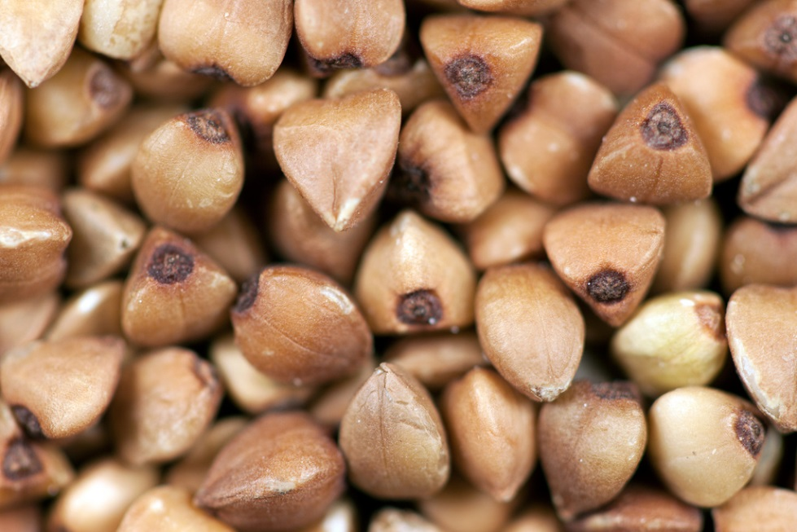
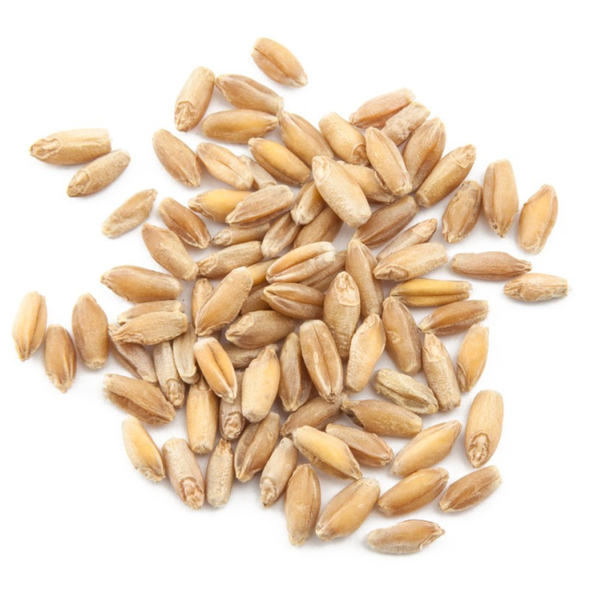
Rye
Barley
Triticale (is a hybrid of wheat and rye)
Buckwheat

Slide 13
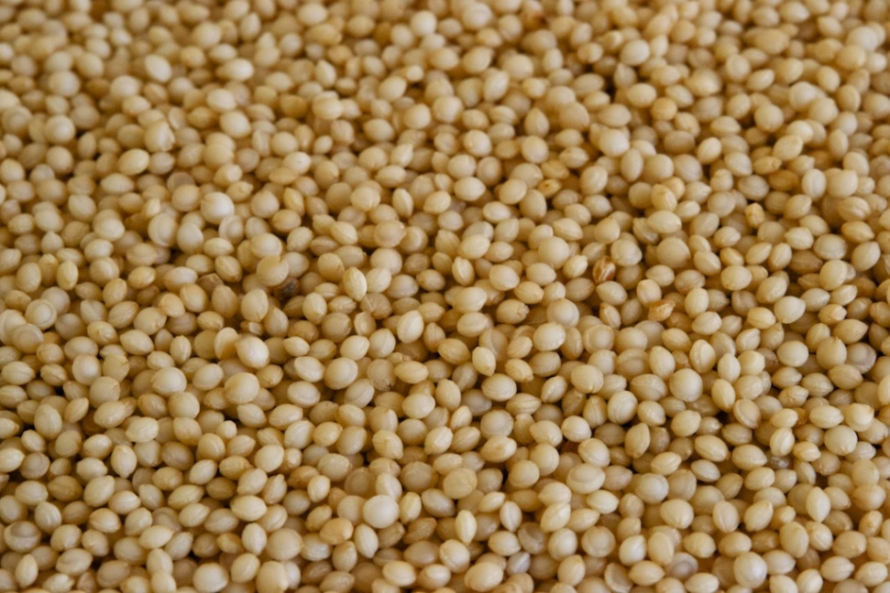
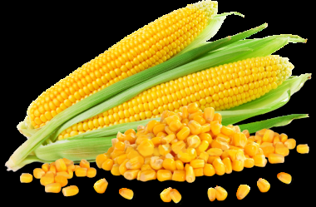
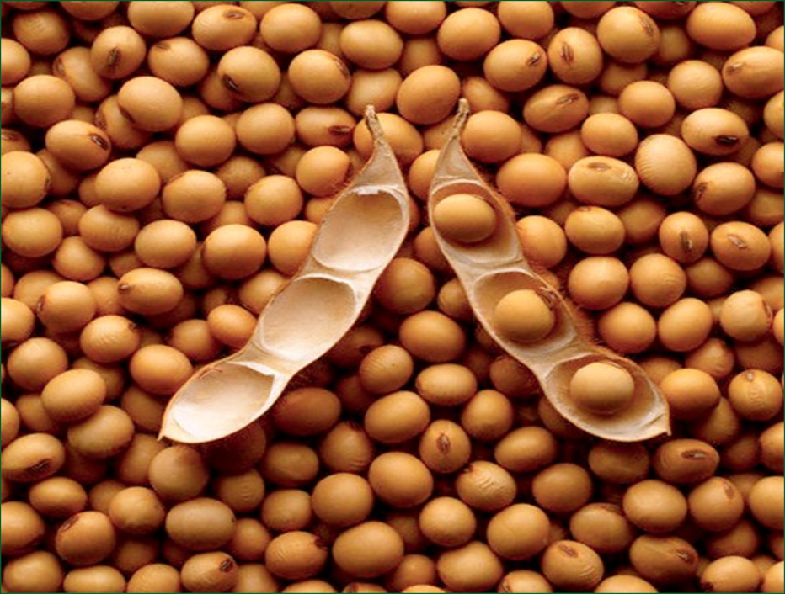
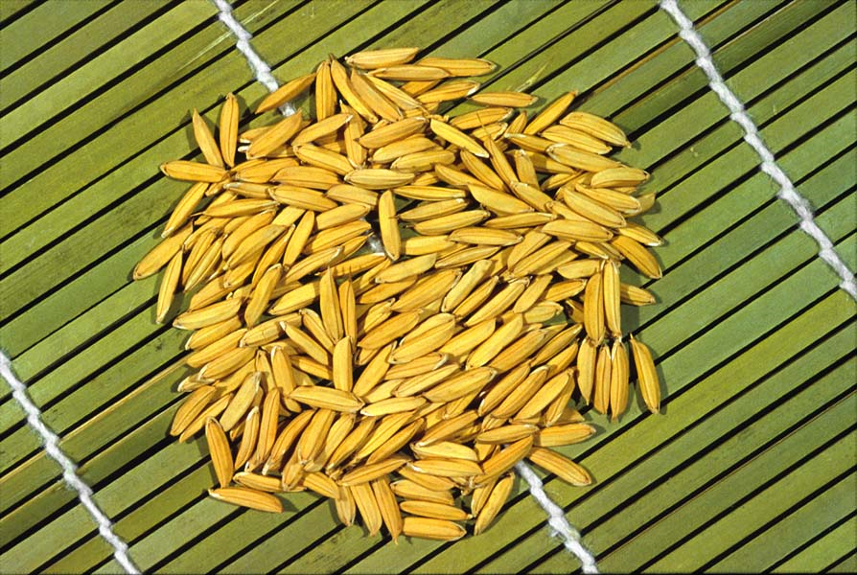
Corn
Amaranth
Rice
Soybeans

Slide 14
Gluten Formation
Gluten is a blend of both glutenin and gliadin proteins.
When flour is hydrated [mixed with water] glutenin and gliadin bond together
  Glutenin fraction provides elasticity to the dough
  Gliadin provides stickiness, cohesiveness and fluidity

Slide 15
Leavening
Leavening: means to make the product light and porous.
Leavening gases: There are 3 major leavening gases
  Air
  Steam
  CO2
CO2: can be produced in flour mixtures:
  Either by biological processes (yeast during fermentation) or
  By a chemical reaction (when B.P. or B.S. are used).

Slide 16
Agents that produce a chemical reaction include:
Double acting B.P.: home used B.P. acts twice:
  At room temperature when ingredients are moistened
  When the mixture is heated during baking.

Slide 17
Agents that produce a chemical reaction include:
Baking soda:
  Can be used instead of B.P. but should be used with an acid to work.
    Acid with baking soda produce CO2.
  Use ¼ tsp B.S.+ 5/8 tsp cream of tartar (potassium acid tartrate [acid salt]) or ½ tsp vinegar or ½ tsp lemon juice in place of 1 tsp B.P.

Slide 18
Ratio of B.S. to Acidic Liquid
The usual is: ½ tsp B. S / 1 c of acidic liquid such as:
  Buttermilk
  Thinned Yogurt
  Orange juice
Or use
  Less of the acidic liquid such as lemon juice or vinegar or cream of tartar [acidic salt] such as: ¼ tsp B.S.+ ½ tsp lemon juice,
Or use
  Less B.S. should be used with less sour ingredients such as:
    Honey and
    Brown sugar.
Too much B. S. gives an off flavor which is not agreeable.

Slide 19
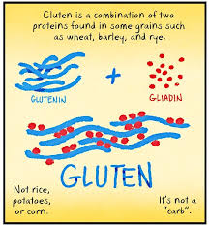
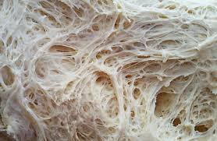
Other ingredients used in flour mixtures
Fat
Is used to tenderize the product.
It shortens the strands of gluten.
When substituting (oil or shortening) for (butter or margarine) in a recipe,
  The amount should be adjusted because the amount of fat is not the same.
    1 c butter = 1 c margarine = 7/8 c (shortening or lard)
    1 c shortening = 1 c butter or margarine + 2 Tbsp + 2 tsp
Plastic fats: when creamed with sugar, they trap air bubbles, this makes good quality product.
Plasticity makes the fat prone to molding and shaping when worked with.

Slide 20
Other ingredients used in flour mixtures
Liquids
Hydrate the starch and gluten
Dissolve dry ingredients such as sugar, salt, B.P., etc.; also
Gelatinize the starch (thicken) in flour during heating

Slide 21
Other ingredients used in flour mixtures
Eggs
Incorporate air into the batter
Add flavor
Enhance the color
Help in forming emulsions (Lecithin is the emulsifier in egg yolks), and
Increase the rigidity of the flour mixture due to the coagulation of egg protein.

Slide 22
Other ingredients used in flour mixtures
Sugar
Sweetens
Helps in browning (Caramelization & Maillard Reaction)
Provides food for the yeast
Tenderizes
Increases the volume of the product.

Slide 23
Types of batters & dough
Types of batters
  Thin or pour batter:(pancakes, cakes)
  Drop batter: (muffins, cream puffs).
Types of dough:
  Soft
  Stiff
  Dough is thick enough to be handled or kneaded.

Slide 24
Proportions of liquid to flour
Classification of Batters and Dough (ratios):
TYPE | LIQUID | FLOUR
Pour batter | 1 | 1
Drop batter | 1 | 2
Soft dough | 1 | 3
Stiff dough | 1 | 4

Slide 25
Objectives of mixing dough & batter
Distribution of ingredients evenly
Minimizing loss of the leavening power of the leavening agent
Optimum blending
Optimum gluten development.

Slide 26
Mixing methods
3 basic methods
Muffin method
Pastry method
Conventional method

Slide 27
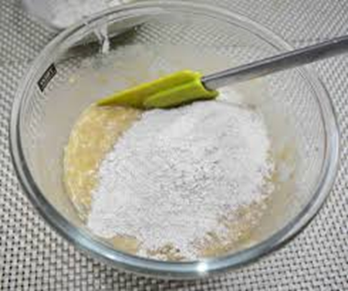
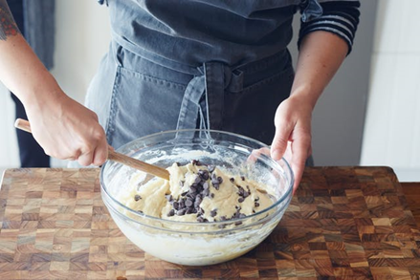
Muffin Mixing Method
Mix dry ingredients in a separate bowl.
Fold dry ingredients into egg, milk, and oil mixture, just until moistened; batter should be lumpy.

Slide 28
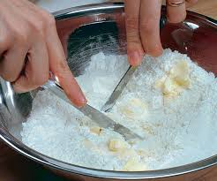
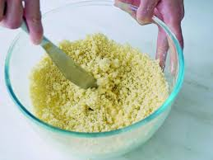
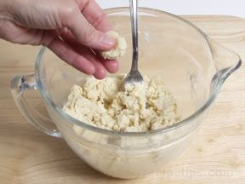
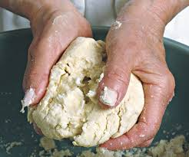
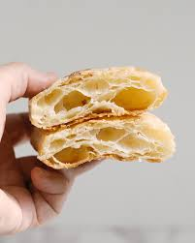
Pastry Mixing Method
Mix flour and salt in a mixing bowl
Cut shortening into flour mixture until particles are the size of a pea.
Sprinkle with water, 1 Tbsp. at a time until all flour is moistened and pastry almost leaves side of bowl.
Gather pastry into a ball.

Slide 29
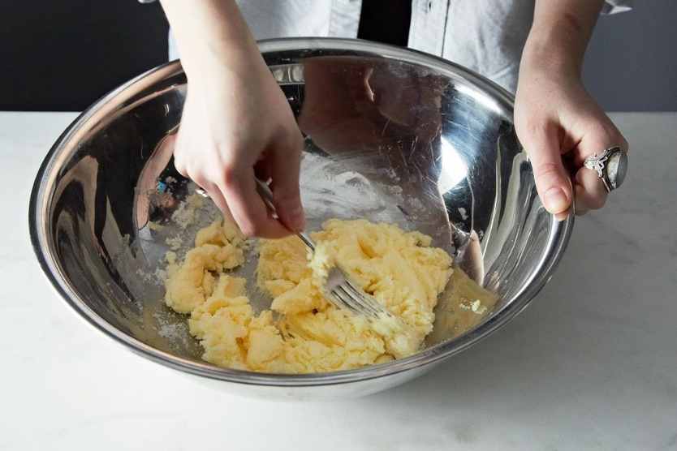
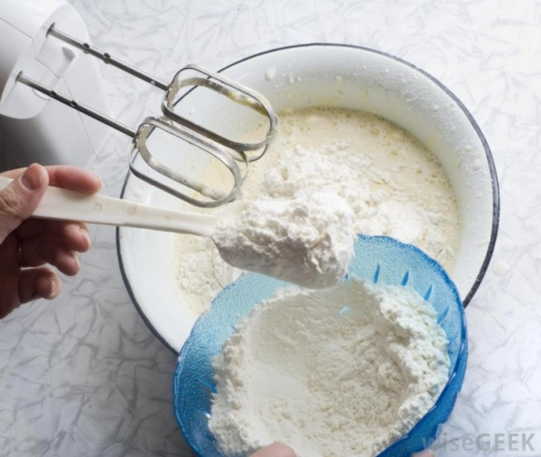
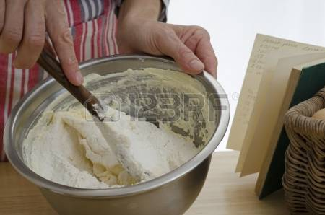
Conventional Mixing Method
Add shortening to sugar and mix well.
Add beaten eggs and vanilla,
Sift, 3 times, all dry ingredients in a separate bowl and mix well.
Add 1/3 of the dry ingredients to the (sugar, shortening, vanilla and egg) mixture and beat well;
Add ½ the liquids and beat.
Add the second 1/3 of the dry ingredients and beat;
Add the rest of the liquids and beat.
Add the last 1/3 of the dry ingredients and beat well.

Slide 30
Adjustments for baking at high altitude
Leavening agent:
  The amount of BP should be ↓decreased by 1/8 tsp when the height is 2000 meters above sea level.
Baking temperature:
  ↑increase by 15-25⁰ F (9-14⁰ C ): Since leavening and evaporation proceed more quickly, the idea is to use a higher temperature to “set” the structure of baked goods before they over expand and dry out.
Why?
↓ Atmospheric pressure at high altitudes which leads to:
  Leavening power ↑ increases
  Faster ↑ Expansion of leavening gases
  Increased ↑ Evaporation because boiling point ↓
Our altitude is not high enough to call for major changes.

Slide 31
Dry flour mixtures
e.g. Dry (Cake Mixes), (Pie Mixes), (Cookie Mixes), etc.
Contain besides the flour:
  Leavening agent – Sugar – Salt – Fat
  Sometimes in the dry form – Non-fat dry milk – Dried eggs – Flavoring ingredients such as cocoa, ginger, dried molasses, dried extracts etc. –
  Also many additives like emulsifiers, modified starch, caseinate (milk protein) gums, cellulose, whipping aids.
Dry flour mixtures have a long shelf life because of the many additives that are used.

