Slide 1
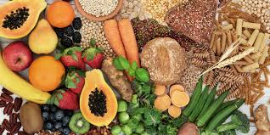
Carbohydrates

Slide 2
Chemical Formula
Carbohydrates are stored energy.
C_{n}(H₂O)
Carbohydrates are the most important source of food energy in the world, the major staples being cereals, such as rice, wheat, maize, barley, rye, oats etc.
Provide between 40-80% of energy needs, depending on culture’s food habits

Slide 3
Chemistry of Carbohydrates (cho)
Made up of Carbon, Hydrogen, and Oxygen
Simple carbohydrates
Monosaccharides ( 1 sugar)
Disaccharides (2 sugars)
Trisaccharide ( 3 sugar)
Oligosaccharides (3-10 sugars)
Complex carbohydrates
Polysaccharides

Slide 4
Classification of Carbohydrates
CHO classified in different ways depending on chemistry
Simple Carbohydrates = “sugars”
1-3 saccharides
mono (1), di (2), tri (3)
Complex Carbohydrates = Starch
Polysaccharides
Complex Carbohydrates = Fiber
different chemical bonds than starches

Slide 5
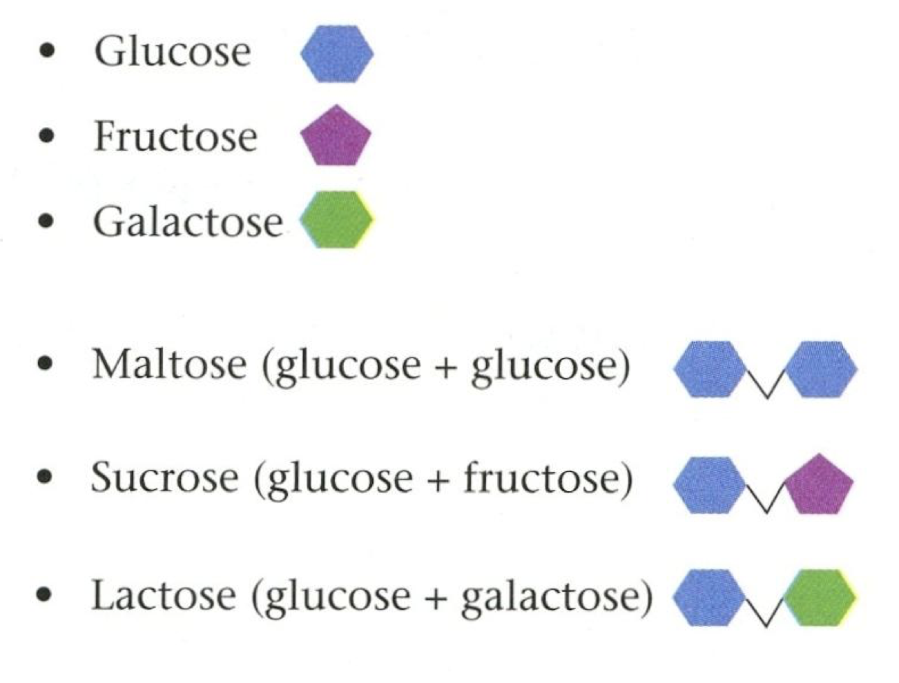
MONOSACHRIDES
Most common monosaccharides are hexoses (made up of 6 carbon atoms)
Cyclic or straight
Monosaccharides with 5 or more carbons form rings (cyclic) in solution

Slide 6
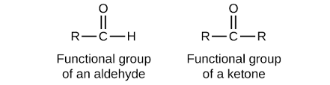
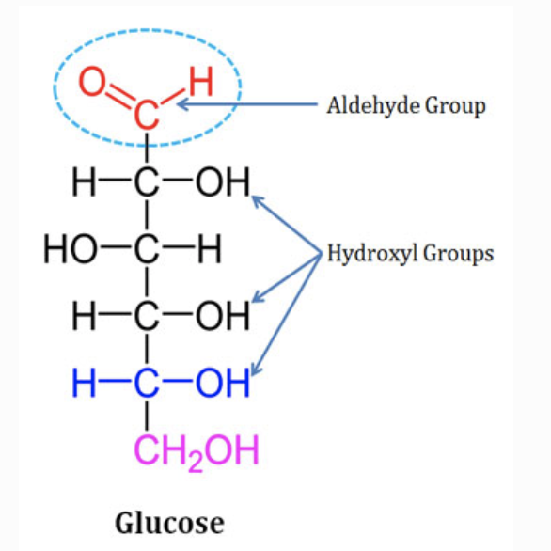
MONOSAHCRIDES
Aldehyde or ketone functional group

Slide 7
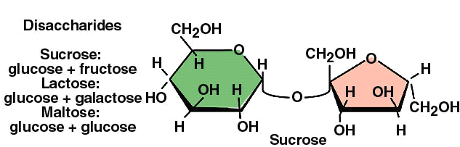
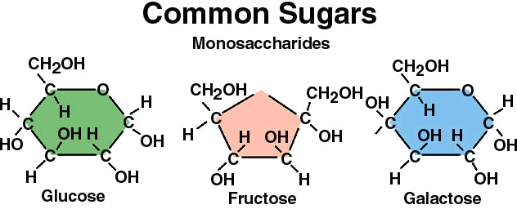
Free monosaccharides are present in honey, fruits, dried fruits and vegetables
Monosaccharides
Fructose is the sweetest monosaccharide
Disaccharides
Made up of two sugar molecules

Slide 8
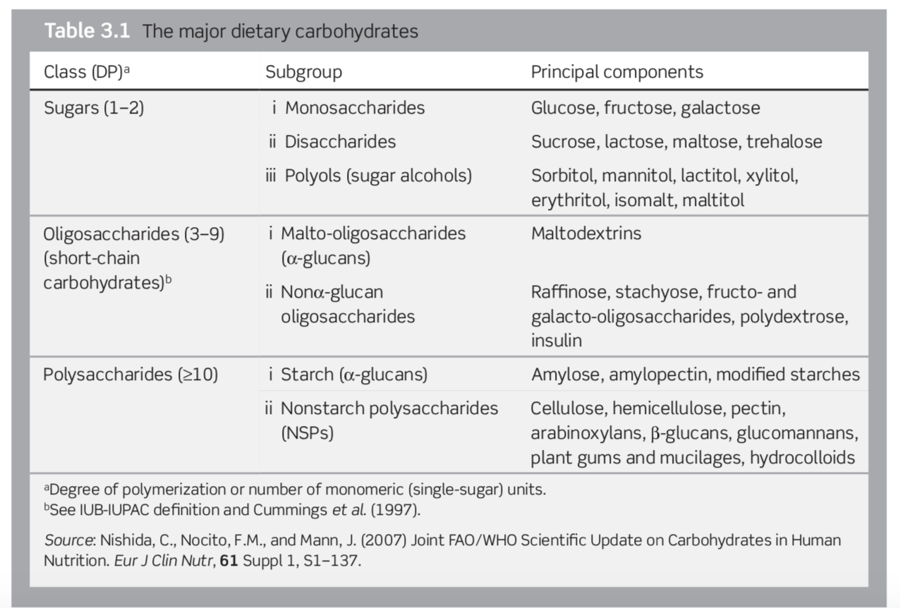

Slide 9
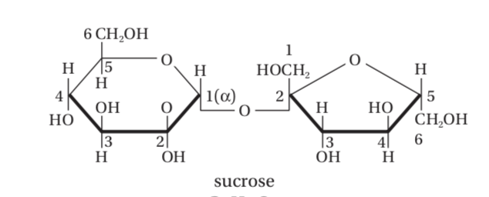
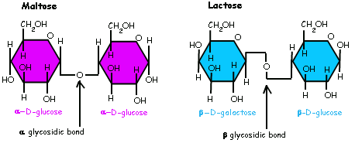
The three main monosaccharides-glucose, fructose, and galactose
building blocks of naturally occurring di-, oligo-, and polysaccharides
Sucrose (αGlucose(1 → 2)β-Fructose)
Lactose: (β-Galactose(1 → 4)βGlucose)
Maltose: αGlucose(1-4) αGlucose

Slide 10
Glucose
Circulate through blood to provide energy for body tissue
Building block of carbohydrates
Corn syrup: a glucose syrup produced by the hydrolysis of corn starch
GALACTOSE
We find monosaccharide, galactose, in the disaccharide lactose ( found in diary products)

Slide 11
fructose
Referred to as Fruit Sugar
Found in Honey and fruits
Sweetest monosaccharide
High- fructose corn HFCS (contains fructose and glucose)

Slide 12
DISACHARIDES
Composed of two linked monosaccharides, at least one of which is glucose.
Maltose (found in sprouted wheat and barley)
Sucrose ( table sugar)
Lactose ( Milk Sugar)

Slide 13
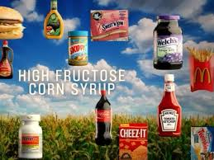
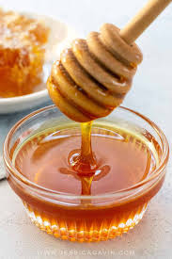
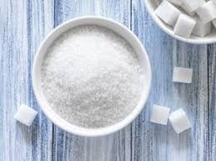
Difference ???
All made up of Glucose and Fructose
Notes:
Honey: 40% fructose + contains antioxidants and some minerals and vitamin/ glucose and fructose = no chemical bond
Table sugar: 50% fructose, glucose and fructose are chemically bounded/ no water so exists as crystals
HFCS: 40-90% fructose, made from corn syrup and by using an enzyme to convert some of the glucose to fructose/ glucose and fructose = no chemical bond

Slide 14
Oligosaccharides (short-chain carbohydrates)
A saccharide polymer containing a small number (typically three to ten) of monosaccharides (simple sugars)
Examples
Inulin (multiple fructose)- non digestible by enzymes in our body.
‘nondigestible oligosaccharides’
prebiotics (a source of food for your gut's healthy bacteria)

Slide 15
Polysaccharides
Many glucose (usually) units bound together
Polysaccharides are divided into
Starch polysaccharides
Non starch polysaccharides
Plant cell wall/ dietary fiber

Slide 16
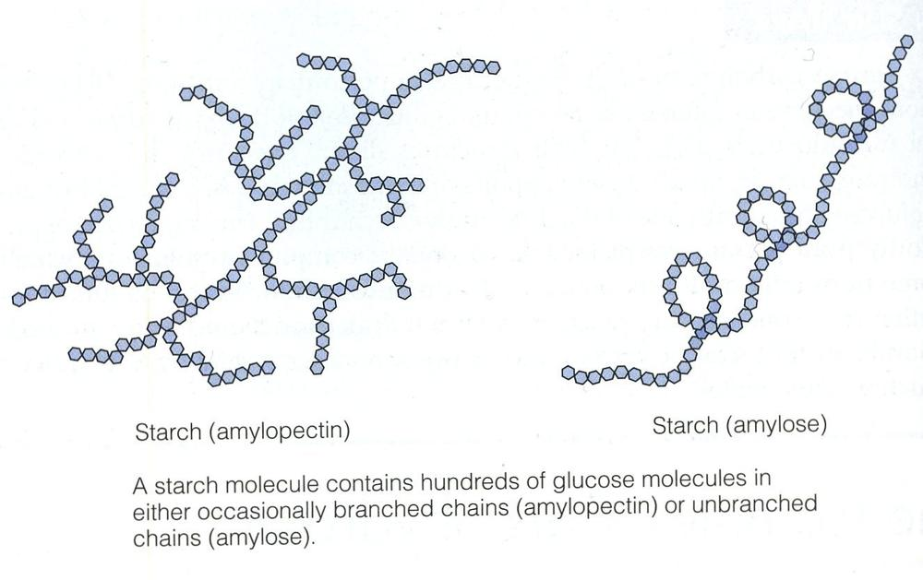
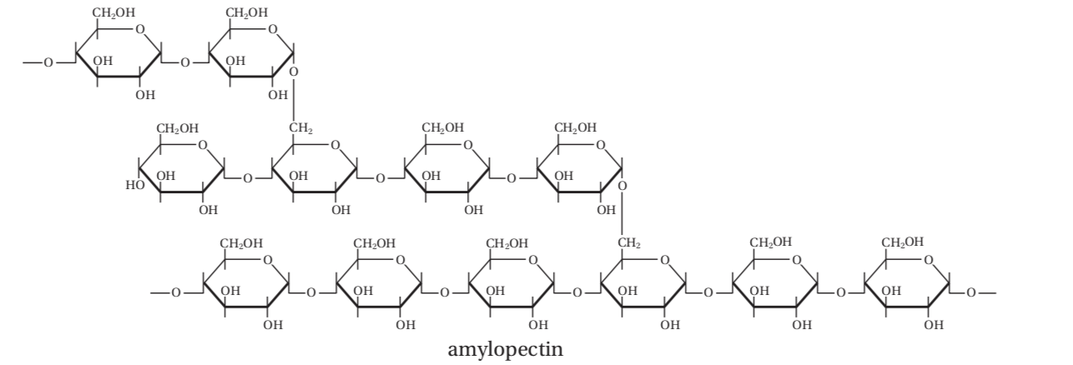
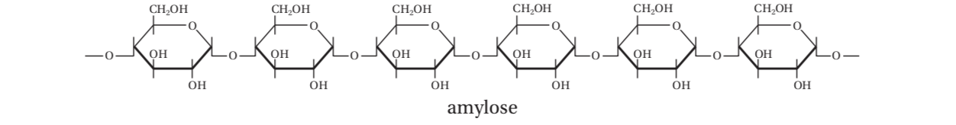
starch
Starch is the storage carbohydrate
Consists of two polymers: amylose and amylopectin
Both α-1,4 and α-1,6 linkages
linked by α-1,4 glucosidic bonds

Slide 17
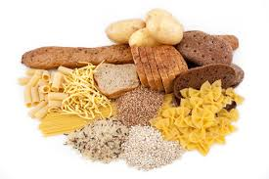
Starch
Food sources :
Grains (wheat, rice, corn, barley, oats)
Potatoes
Dried peas and beans and other starchy vegetables

Slide 18

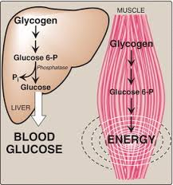
glycogen
In animals and humans
Carbohydrate that is stored in liver and muscle in limited amounts
Highly branched structure
Glycogen is broken down in the liver to glucose when energy is needed. Glycogen in the liver is utilized by all body tissues
Glycogen in the muscles is broken down to provide energy to the muscle only

Slide 19
Nonstarch polysaccharides
Main component of dietary Fiber
Not hydrolyzed by the endogenous enzymes in the small intestine of humans
DIETARY FIBER
classified into
Soluble
Insoluble

Slide 20
Dietary Fiber
Soluble
Pulls in water in stomach and intestine to form a a thick gel- slowing digestion
Soluble fibers are fermented by bacteria in the colon to produce carbon dioxide, methane, hydrogen, and short-chain fatty acids which serve as a source of energy (calories) for the mucosal lining of the colon.
Insoluble
doesn’t dissolve in water. doesn’t pull in water
healthy functioning of the GI tract, increase fecal bulk

Slide 21
Dietary Fiber
Cellulose:
A straight-chain with β-1,4-linkages. The straight chains pack tightly in a three-dimensional lattice work, forming microfibrils
Makes up cell wall of plants
Strength and Stability of Cell wall

Slide 22
Dietary Fiber
Hemicelluloses
polysaccharide polymers that contain a mixture of hexose (6C) and pentose (5C) sugars, often in highly branched chains.
Also found in cell wall
contains both water soluble and water insoluble compounds

Slide 23
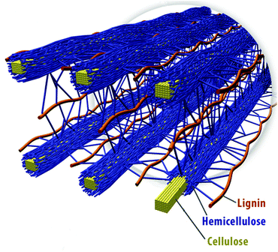
Dietary Fiber
PECTIN
Gel like properties
used in jam making
Inulin: Fructose polymers Wheat, onion, bananas, garlic, chicory root -Enhances the growth and activities of bacteria -Can cause bloating, stomach noises

Slide 24
Health benefits of FIBER
Soluble fiber
Sources :oatmeal, nuts, beans, apples, and blueberries
Cholesterol lowering( Traps cholesterol cholesterol excretion
Improve glucose tolerance ( does not spike up blood sugar),
Slow gastric emptying, feeling full/ associated with weight loss
Insoluble fiber
Sources: seeds and skins of fruit and vegetables ,whole-wheat bread and brown rice
Increase fecal bulk
Prevent constipation

Slide 25
Resistant starch
Starch that is not digested in the human small intestine
Function: Similar to soluble dietary fiber
Contributes to metabolic activity in the colon
Increase fecal bulk, possible protection from colon cancer, improved glucose tolerance, and lower blood cholesterol
Found in
Seeds and grains
Starchy foods: raw potatoes, green bananas
Indigestible starch that forms after heat and moisture treatment (Retrograded starch) in cooked and cooled potato, bread, cornflakes.
Notes:
Retrogradation: when the amylose and amylopectin chains in cooked, gelatinized starch realign themselves as the cooked starch cools

Slide 26
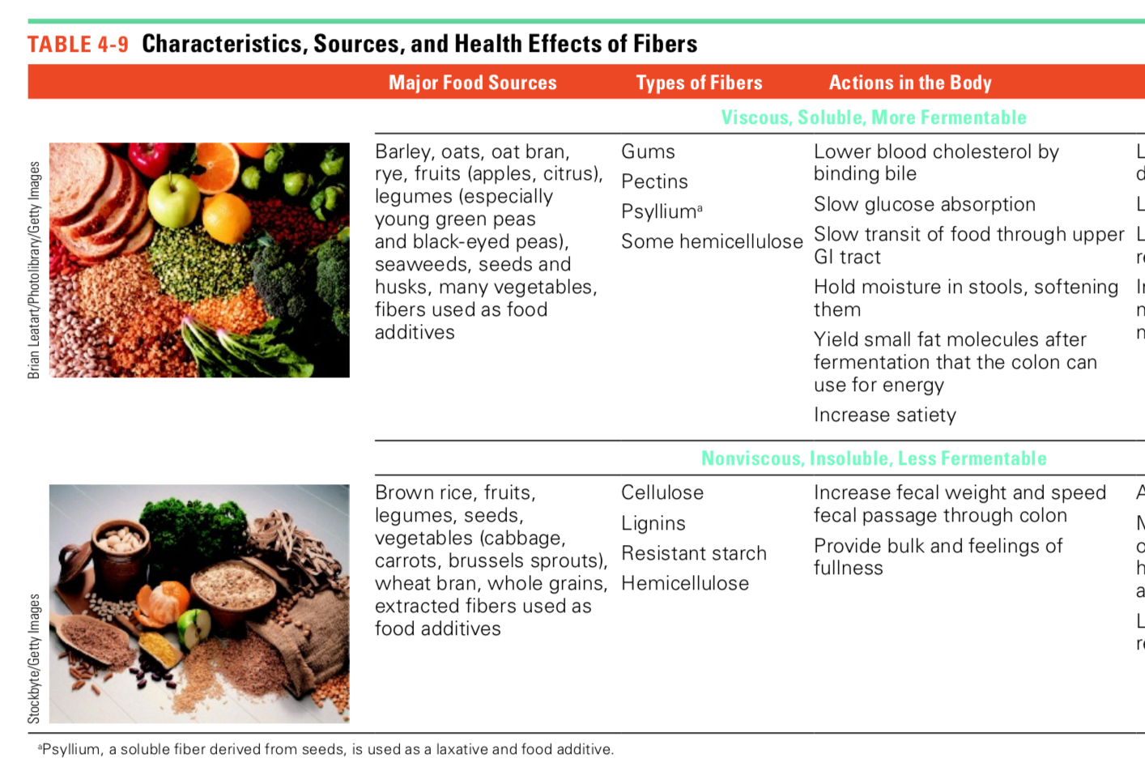

Slide 27
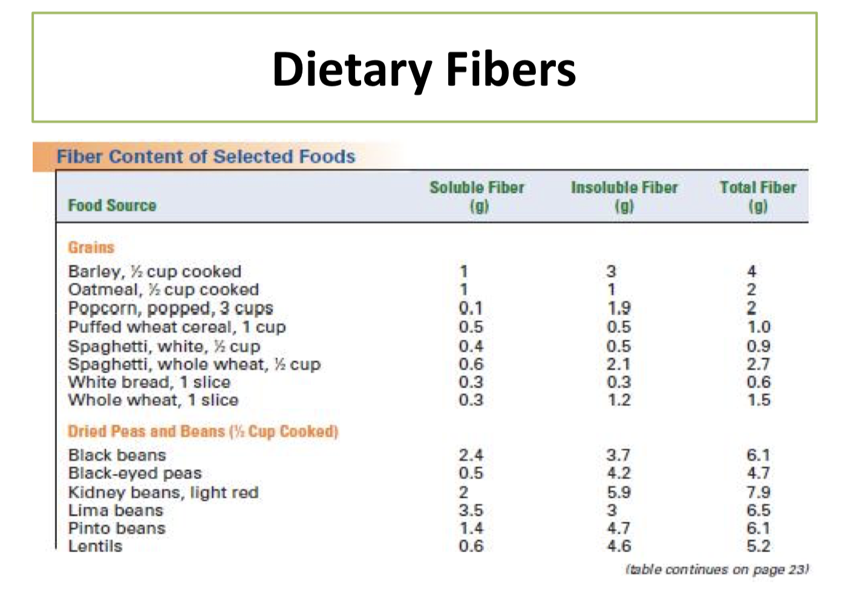
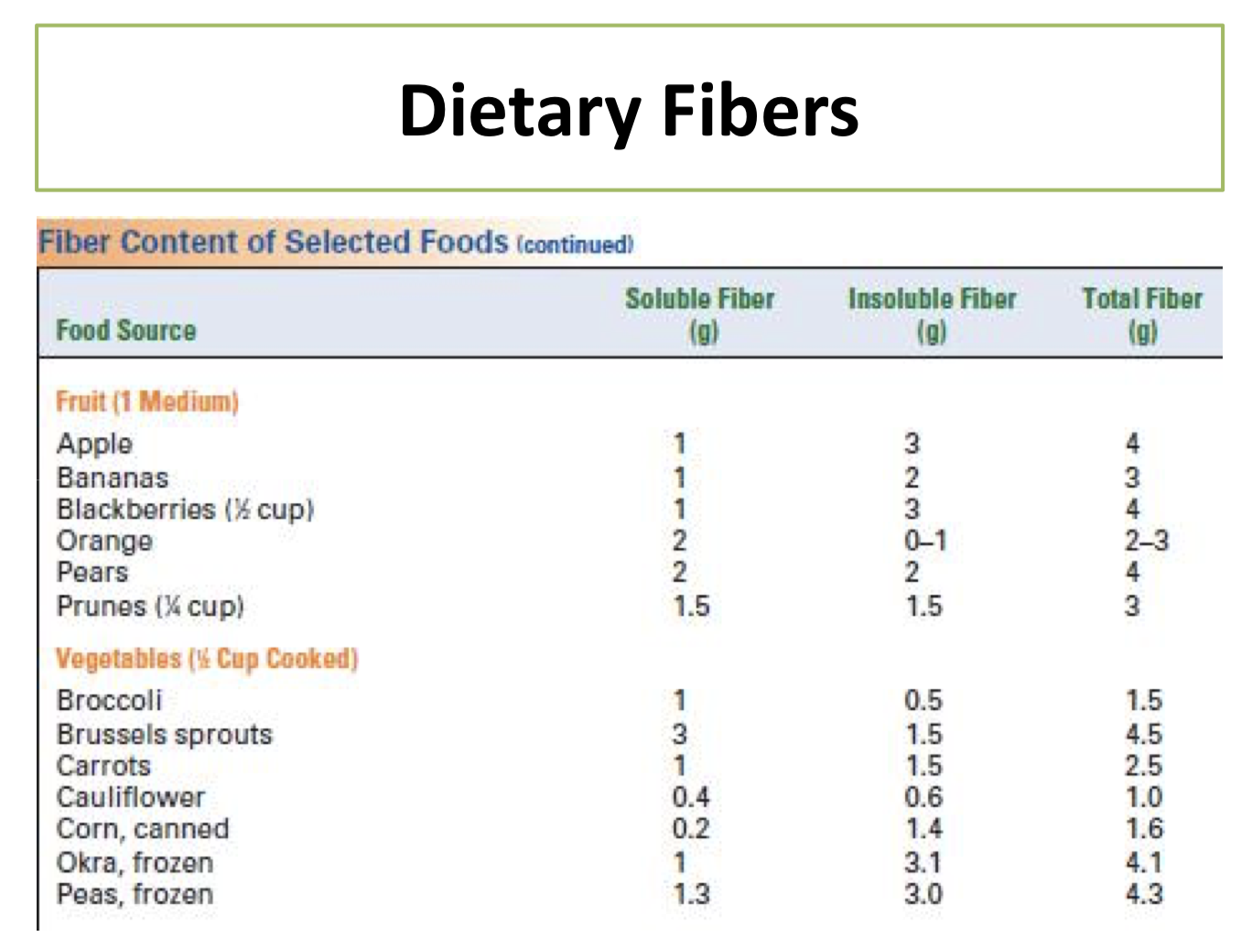
Do you meet the RDA of 25-30 g?

Slide 28
https://www.youtube.com/watch?v=1sISguPDlhY

Slide 29
Sources of Carbohydrates
Main sources:
Grains: (e.g., wheat, barley, oats, rye, corn, and rice)
Products made with flours from grains
(e.g., items made with wheat flour, such as bread, crackers, pasta, and tortillas)

Slide 30
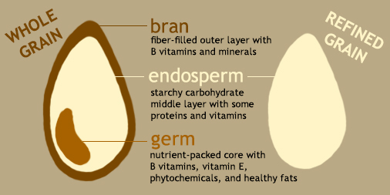
https://www.hsph.harvard.edu/nutritionsource/what-should-you-eat/whole-grains/

Slide 31
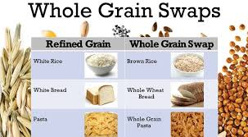
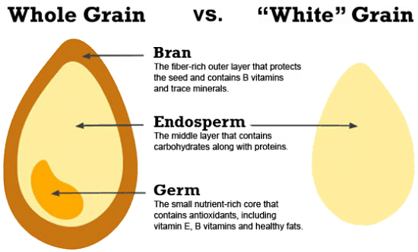
Grains
Refined grains: - Only the endosperm of the grain ( no bran or germ)
Rich in starch Lack fiber, vitamins & trace minerals and phytochemicals found in whole grains

Slide 32
Enrichment and fortification
Enrichment: adding back certain nutrients that were lost during processing
Example: restoring back B-vitamins ( thiamin, riboflavin, niacin) and iron to level prior to processing in grains
Fortification: adding nutrients that are not naturally present in the food or were present in insignificant amounts.
Example: milk with Vit D
orange juice with calcium

Slide 33
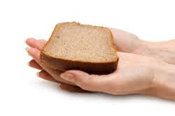
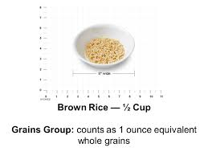
Carbohydrate content of different foods
1 serving of carbohydrates = 15 g
Example
1 ounce of grains contain 15 grams CHO
1 ounce equivalence : 1 slice of bread 1⁄2 cup cereals / cooked rice / pasta

Slide 34
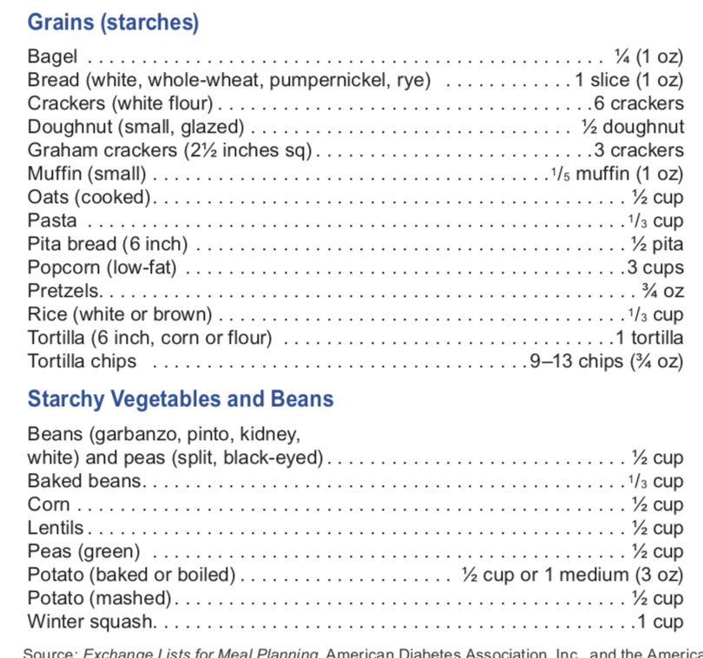

Slide 35
Carbohydrates Digestion & absorption
Mouth
Carbohydrate digestion starts in the mouth, where salivary α-amylase is secreted
starch smaller polysaccharides+ maltose
Fiber is moistened by the enzyme and mechanical action in the mouth, making swallowing easier

Slide 36
Carbohydrates Digestion & absorption
Stomach
The low pH of the stomach inactivates amylase and stops carbohydrate digestion
Fiber is not digested in the stomach either
Churns and mixes food. The HCL acid secreted by cells in the stomach stops any effect of the swallowed amylase

Slide 37
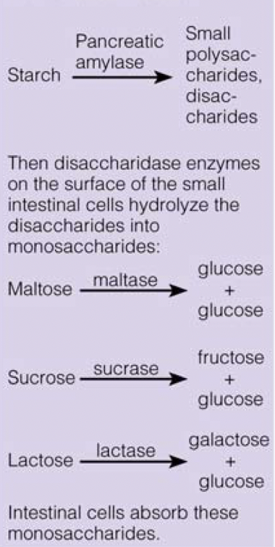
Carbohydrates Digestion & absorption
Small Intestine
The pancreas produces amylase that is released by the pancreatic duct into the small intestines
Amylase continues starch digestion
Alkaline environment
Monosaccharides: the only form our body can absorb
Fiber is not digested in the small intestine

Slide 38
Carbohydrates Digestion & absorption
Large Intestine
Fiber passes intact in the GI tract to the large intestine
Dietary soluble fiber and undigested starch : are fermented by bacterial enzymes̀ to produce Short chain fatty acids (SCFA) +gas

Slide 39
CHO ABSORPTION
Monosaccharides are absorbed by small intensities villi
Travel to the liver via portal vein
In the liver, galactose and fructose are converted to glucose
The liver releases glucose into the blood stream.
After Ingesting CHO, Insulin is released by pancreas to trigger glucose uptake by cells
When glucose levels drop, Glucagon hormones are release from the pancreas . Glucagon stimulates glycogen break down in the liver to release glucose

Slide 40
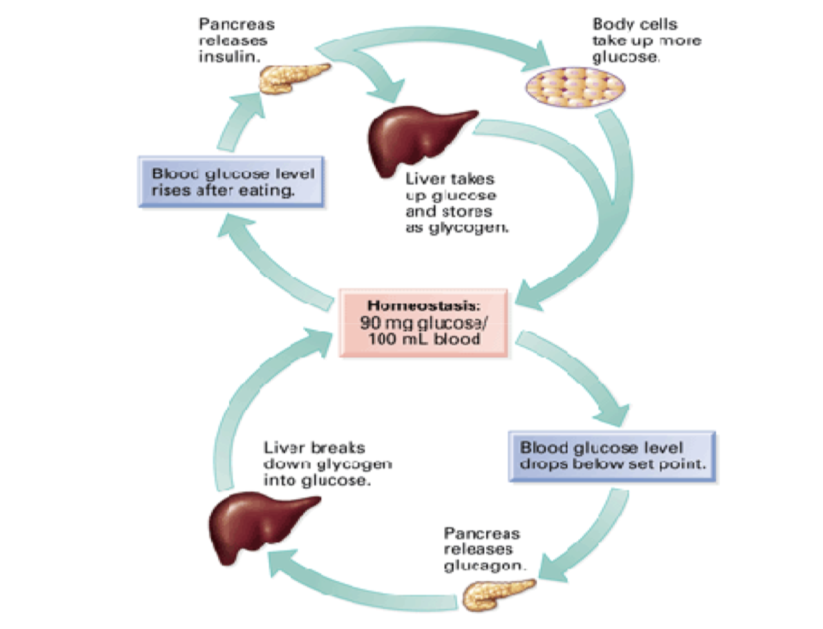
Insulin
Glucagon

Slide 41
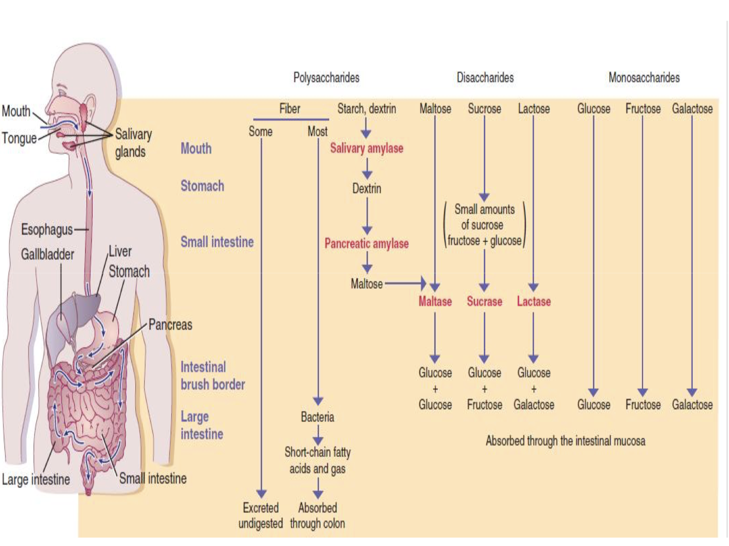

Slide 42
Digestive enzymes for CHO
Location | Enzyme | Target
Salivary gland/ mouth | Amylase | Starch
Stomach | No CHO digestion | No CHO digestion
Pancreas | Amylase | Starch
Intestine | Disaccharidases | Disaccharides

Slide 43
Glycemic Response
Reflect increases in blood sugar over a defined period of time interval post eating an amount of carbohydrates
The type of carbohydrate ingested determine the glycemic index response
How food effect blood glucose concentration
Influenced by:
Fiber, protein and fat content in the food Degree of processing Amount eaten Whether other foods are eaten at the same time

Slide 44
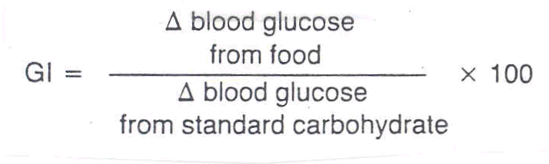
Glycemic index
How do we determine glycemic index?
A 50 g sample of food is ingested
The increase in blood glucose is compared to a reference
The reference is a 50g of pure glucose or white bread

Slide 45
Glycemic Index
Glycemic Load
A food’s glycemic index multiplied by the amount of carbohydrate it contains to determine impact on blood glucose levels
• Not a reliable tool for choosing a healthy diet!

Slide 46
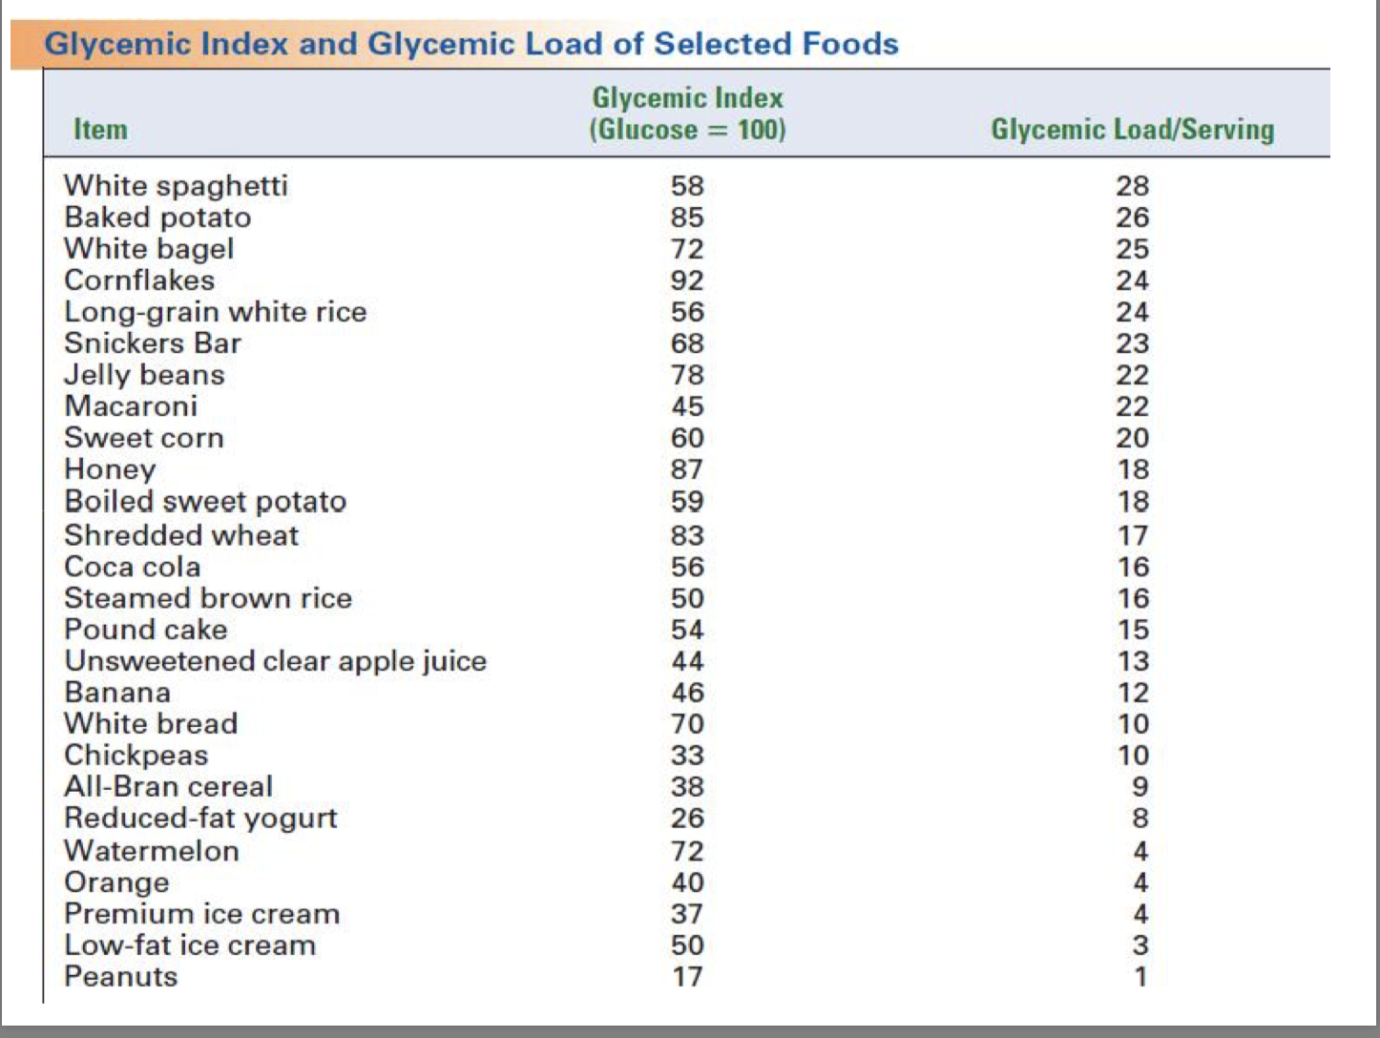

Slide 47
Functions of CHO
Energy
The brain utilizes/ dependent on glucose for energy
CHO= 4 kcal/g
CO₂
15-20 g
2 g
Glucose 90 g
20 g
Glycogen
Adipose Tissue
20-45 g
20 g
ATP
25 g
Glycogen
Triglyceride
Muscle

Slide 48

Functions of CHO
Sparing Protein from being used for energy
Preventing ketosis
Without adequate glucose, fat oxidation prematurely stops at the intermediate step of ketone body formation
Ketone body accumulation can cause
Fatigue, nausea, loss of appetite, ketoacidosis : Keto flue
Dehydration and sodium depletion: excreting ketones in urine

Slide 49
Functions of CHO
Glucose is used to make other compounds such as
Glycogen
Nonessential Amino Acids
Carbohydrate-Containing Compounds – Ribose ( in DNA, RNA)
Fat
Glucose is converted by liver cells to triglycerides and stored in the body’s fat tissue

Slide 50
Recommended intakes of carbohydrates
The minimum amount of carbohydrate required to avoid ketosis is considered to be about 50 g/day.
RDA for CHO : 130g
CHO provides around 45%-65% of total calories ( Higher than 130g/day)
Added sugar: no more than 10% of total kcal
Men: 150 calories per day (37.5 grams or 9 teaspoons)
Women: 100 calories per day (25 grams or 6 teaspoons)
Adequate intake ( AI) for total fiber is 25g/day for women while 38g/day for men

Slide 51
Consequences of excessive sugar intake
Dental caries
Obesity
Type 2 diabetes!

Slide 52
Nonnutritive sweeteners: Artificial sweeteners
Synthetically made sweeteners and don’t provide calories!
Calorie free
Sweeter than sugar
A combination of them: Decrease/enhance sweet taste, minimize aftertaste,
They don’t raise blood sugars: Suitable for Diabetics

Slide 53
Sugar Alcohols
Small amounts are found in some fruits and berries
Commercially synthesized and used as alternative sweeteners
low-calorie sweeteners
absorbed slowly and incompletely
produce a smaller effect on blood glucose levels and insulin secretion

