Slide 1
Chapter 20
Thermodynamics:
Entropy, Free Energy, and the Direction of Chemical Reactions
Copyright ©The McGraw-Hill Companies, Inc. Permission required for reproduction or display.
Notes:
‹#›

Slide 2
Thermodynamics:
Entropy, Free Energy, and the Direction of Chemical Reactions
20.1 The Second Law of Thermodynamics: Predicting
Spontaneous Change
20.2 Calculating the Change in Entropy of a Reaction
20.3 Entropy, Free Energy, and Work
20.4 Free Energy, Equilibrium, and Reaction Direction
Notes:
‹#›

Slide 3
Limitations of the First Law of Thermodynamics
ΔE = q + w
E_{universe} = E_{system} + E_{surroundings}
ΔE_{system} = -ΔE_{surroundings}
ΔE_{system} + ΔE_{surroundings} = 0 = ΔE_{universe}
The total energy of the universe is constant.
However, this does not tell us anything about the direction of change in the universe.
Notes:
‹#›

Slide 4
The Concept of Entropy (S)
Entropy refers to the state of order.
A change in order is a change in the number of ways of arranging the particles and dispersing their energy of motion, and it is a key factor in determining the direction of a spontaneous process.
more order
less order
solid liquid gas
more order
less order
crystal + liquid ions in solution
more order
less order
crystal + crystal gases + ions in solution
Notes:
‹#›

Slide 5
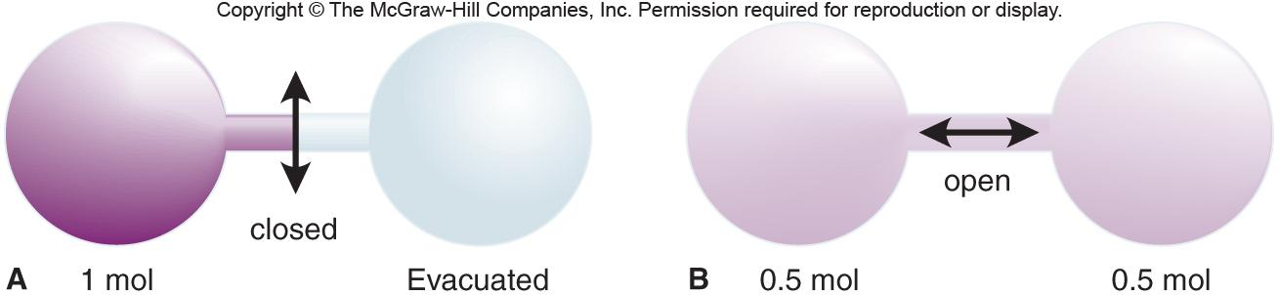
Figure 20.1
Spontaneous expansion of a gas.
evacuated
Notes:
‹#›

Slide 6
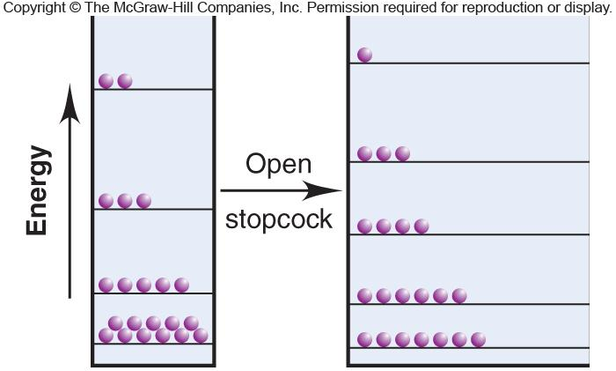
Figure 20.2
The entropy increase due to expansion of a gas.
Notes:
‹#›

Slide 7
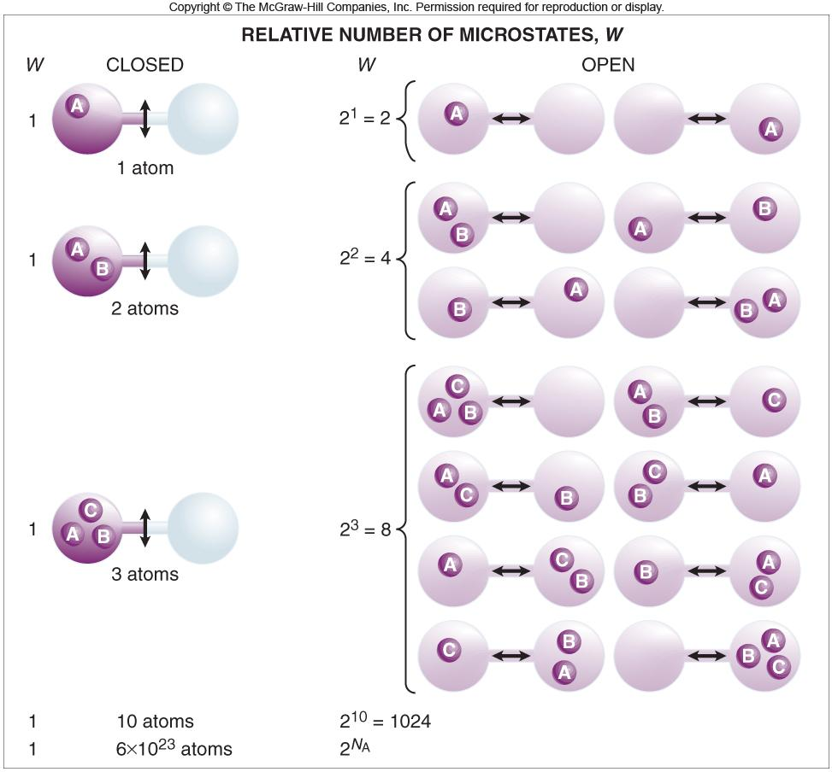
Figure 20.3
Expansion of a gas and the increase in number of microstates.
Notes:
‹#›

Slide 8
1877 Ludwig Boltzmann
S = k 1n W
where S is entropy, W is the number of ways of arranging the components of a system, and k is a constant (the Boltzmann constant), R/N_{A} (R = universal gas constant, N_{A} = Avogadro’s number).
A system with relatively few equivalent ways to arrange its components (smaller W) has relatively less disorder and low entropy.
A system with many equivalent ways to arrange its components (larger W) has relatively more disorder and high entropy.
ΔS_{universe} = ΔS_{system} + ΔS_{surroundings} > 0
This is the second law of thermodynamics.
Notes:
‹#›

Slide 9
Predicting Relative Sº Values of a System
1. Temperature changes
Sº increases as the temperature rises.
2. Physical states and phase changes
Sº increases as a more ordered phase changes to a less ordered phase.
3. Dissolving a solid or liquid
Sº of a dissolved solid or liquid is usually greater than the Sº of the pure solute. However, the extent depends upon the nature of the solute and solvent.
4. Dissolving a gas
A gas becomes more ordered when it dissolves in a liquid or solid.
5. Atomic size or molecular complexity
In similar substances, increases in mass relate directly to entropy.
In allotropic substances, increases in complexity (e.g. bond flexibility) relate directly to entropy.
Notes:
‹#›

Slide 10
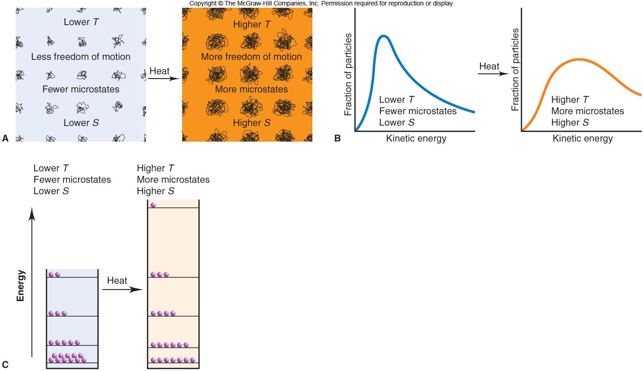
Figure 20.5
Visualizing the effect of temperature on entropy.
Notes:
‹#›

Slide 11
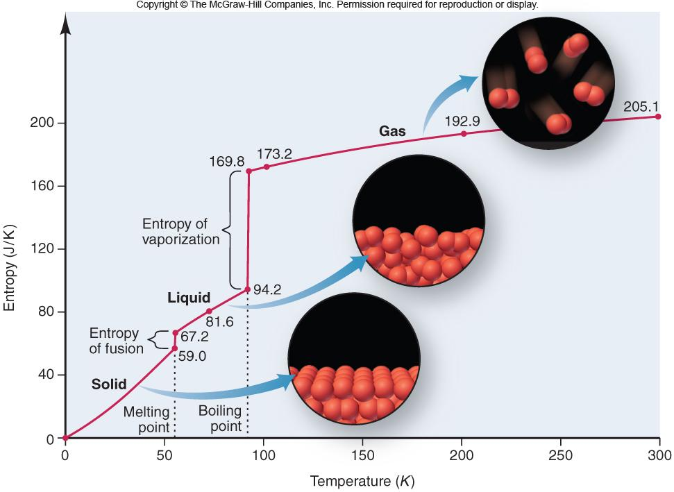
Figure 20.6
The increase in entropy from solid to liquid to gas.
Notes:
‹#›

Slide 12
Sample Problem 20.1
Predicting Relative Entropy Values
PROBLEM:
Choose the member with the higher entropy in each of the following pairs, and justify your choice [assume constant temperature, except in part (e)]:
(a) 1 mol of SO₂(g) or 1 mol of SO₃(g)
(b) 1 mol of CO₂(s) or 1 mol of CO₂(g)
(c) 3 mol of O₂(g) or 2 mol of O₃(g)
(d) 1 mol of KBr(s) or 1 mol of KBr(aq)
(e) Seawater at 2ºC or at 23ºC
(f) 1 mol of CF₄(g) or 1 mol of CCl₄(g)
PLAN:
In general less ordered systems have higher entropy than ordered systems and entropy increases with an increase in temperature.
SOLUTION:
(a) 1 mol of SO₃(g) - more atoms
(d) 1 mol of KBr(aq) - solution > solid
(b) 1 mol of CO₂(g) - gas > solid
(e) 23ºC - higher temperature
(c) 3 mol of O₂(g) - larger # mol
(f) 1 mol of CCl₄ - larger mass
Notes:
‹#›

Slide 13
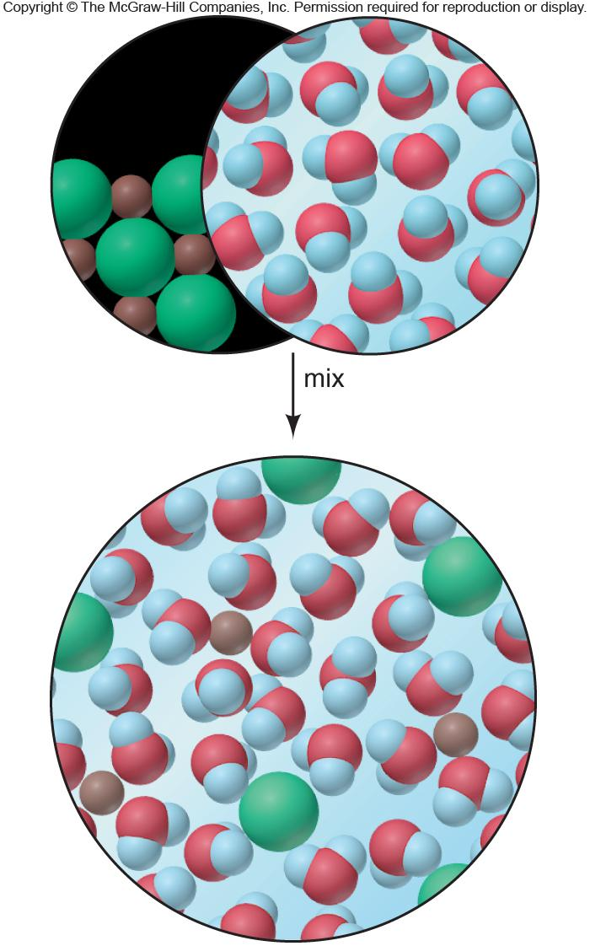
Figure 20.7
The entropy change accompanying the dissolution of a salt.
pure solid
pure liquid
MIX
Notes:
‹#›

Slide 14
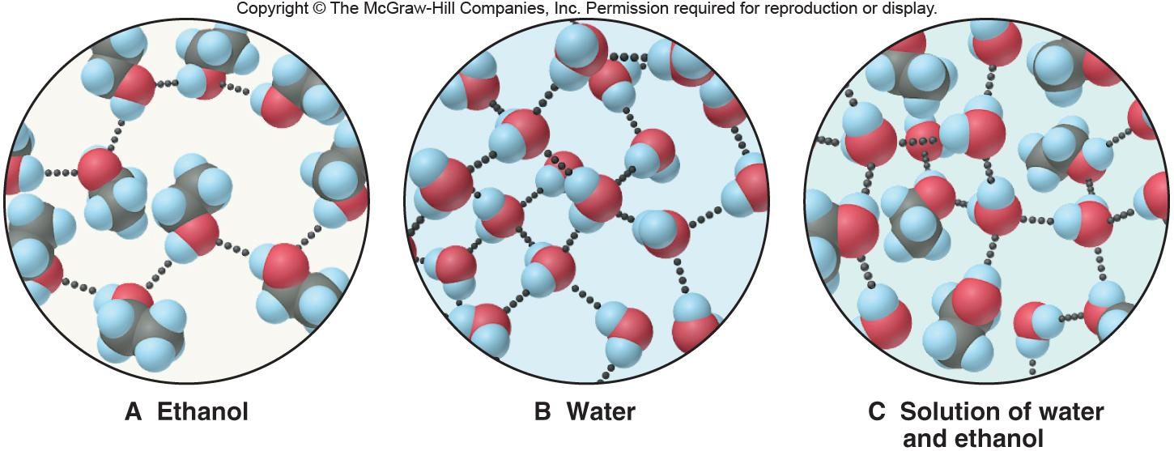
Figure 20.8
The small increase in entropy when ethanol dissolves in water.
Notes:
‹#›

Slide 15
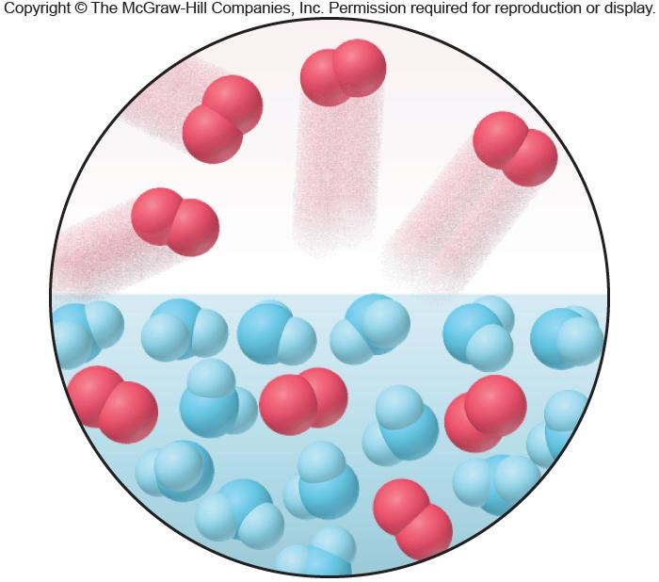
Figure 20.9
The large decrease in entropy when a gas dissolves in a liquid.
O₂ gas
O₂ gas in H₂O
Notes:
‹#›

Slide 16
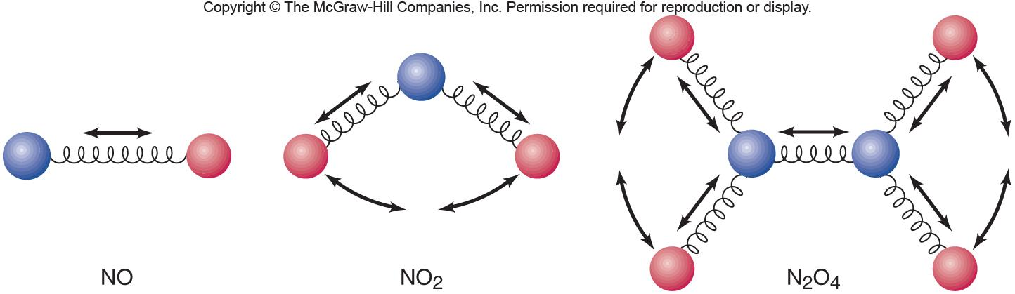
Figure 20.10
Entropy and vibrational motion.
Notes:
‹#›

Slide 17
Entropy Changes in the System
ΔSº_{rxn} - the entropy change that occurs when all reactants
and products are in their standard states.
ΔSº_{rxn} = ΣmΔSº_{products} - ΣnΔSº_{reactants}
The change in entropy of the surroundings is directly
related to an opposite change in the heat of the system
and inversely related to the temperature at which the
heat is transferred.
ΔH_{system}
ΔS_{surroundings} = -
T
Notes:
‹#›

Slide 18
Sample Problem 20.2
Calculating the Standard Entropy of Reaction, ΔSº_{rxn}
PROBLEM:
Calculate ΔSº_{rxn} for the combustion of 1 mol of propane at 25ºC:
C₃H₈(g) + 5O₂(g) 3CO₂(g) + 4H₂O(l)
PLAN:
Use summation equations. It is obvious that entropy is being lost because the reaction goes from 6 mol of gas to 3 mol of gas.
SOLUTION:
Using Appendix B values,
ΔS = [(3 mol CO₂)(Sº CO₂) + (4 mol H₂O)(Sº H₂O)] - [(1 mol C₃H₈)(Sº C₃H₈)
        + (5 mol O₂)(Sº O₂)]
ΔS = [(3 mol)(213.7 J/mol•K) + (4 mol)(69.9 J/mol•K)] - [(1 mol)(269.9 J/mol•K) + (5 mol)(205.0 J/mol•K)]
ΔS = - 374 J/K
Notes:
‹#›

Slide 19
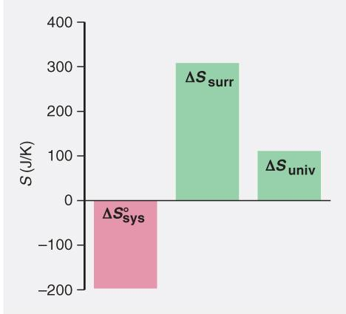
Sample Problem 20.3
Determining Reaction Spontaneity
PROBLEM:
At 298 K, the formation of ammonia has a negative ΔSº_{sys}:
N₂(g) + 3H₂(g) 2NH₃(g) ΔSº_{sys} = -197 J/K
Calculate ΔSº_{univ}, and state whether the reaction occurs spontaneously at this temperature.
PLAN:
ΔSº_{universe} must be > 0 in order for this reaction to be spontaneous, so ΔSº_{surroundings} must be > 197 J/K. To find ΔSº_{surr}, first find ΔH_{sys}; ΔH_{sys} = ΔH_{rxn} which can be calculated using ΔHº_{f} values from tables.
ΔSº_{universe} = ΔSº_{surr} + ΔSº_{sys}.
Notes:
‹#›

Slide 20
Sample Problem 20.3
Determining Reaction Spontaneity
continued
SOLUTION:
ΔHº_{rxn} = [(2 mol NH₃)(-45.9 kJ/mol)] - [(3 mol H₂)(0 kJ/mol) + (1 mol N₂)(0 kJ/mol)]
ΔHº_{rxn} = -91.8 kJ
-91.8x10³J
ΔSº_{surr} = -ΔHº_{sys}/T =
= 308 J/K
298 K
ΔSº_{universe} = ΔSº_{sys} + ΔSº_{surr}
= -197 J/K + 308 J/K = 111 J/K
ΔSº_{universe} > 0 so the reaction is spontaneous at 298 K.
Notes:
‹#›

Slide 21
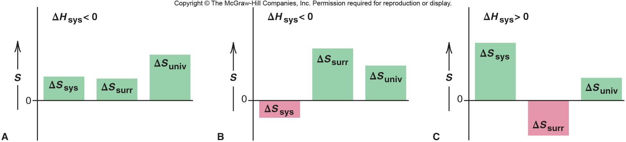
Figure 20.11
Components of ΔS_{universe} for spontaneous reactions.
exothermic
exothermic
endothermic
system becomes more disordered
system becomes more ordered
system becomes more disordered
Notes:
‹#›

Slide 22
Sample Problem 20.4
Calculating ΔGº_{rxn} from Enthalpy and Entropy Values
PROBLEM:
Potassium chlorate, a common oxidizing agent in fireworks and matchheads, undergoes a solid-state disproportionation reaction when heated:
+5
+7
-1
Δ
4KClO₃(s) 3KClO₄(s) + KCl(s)
Use ΔHº_{f} and Sº values to calculate ΔGº_{sys} (ΔGº_{rxn}) at 25ºC for this reaction.
PLAN:
Use Appendix B values for thermodynamic entities; place them into the Gibbs Free Energy equation and solve.
SOLUTION:
ΔHº_{rxn} = ΣmΔHº_{f(products)} – ΣnΔHº_{f(reactants)}
ΔHº_{rxn} = (3 mol)(-432.8 kJ/mol) + (1 mol)(-436.7 kJ/mol)
- (4 mol)(-397.7 kJ/mol)
ΔHº_{rxn} = -144 kJ
Notes:
‹#›

Slide 23
Sample Problem 20.4
Calculating ΔGº_{rxn} from Enthalpy and Entropy Values
continued
ΔSº_{rxn} = ΣmΔSº_{products} - ΣnΔSº_{reactants}
ΔSº_{rxn} = (3 mol)(151 J/mol•K) + (1 mol)(82.6 J/mol•K)
- (4 mol)(143.1 J/mol•K)
ΔSº_{rxn} = -36.8 J/K
ΔGº_{sys} = ΔHº_{sys} - TΔSº_{sys}
ΔGº_{sys} = -144 kJ - (298 K)(-36.8 J/K)(1 kJ/10³ J)
ΔGº_{sys} = -133 kJ
Notes:
‹#›

Slide 24
Gibbs Free Energy (G)
ΔG, the change in the free energy of a system, is a measure of the spontaneity of the process and of the useful energy available from it.
ΔG_{system} = ΔH_{system} - TΔS_{system}
ΔG < 0 for a spontaneous process
ΔG > 0 for a nonspontaneous process
ΔG = 0 for a process at equilibrium
ΔGº_{rxn} = ΣmΔGº_{f(products)} – ΣnΔGº_{f(reactants)}
Notes:
‹#›

Slide 25
Sample Problem 20.5
Calculating ΔGº_{rxn} from ΔGº_{f} Values
PROBLEM:
Use ΔGº_{f} values to calculate ΔG_{rxn} for the reaction in Sample Problem 20.4:
Δ
4KClO₃(s) 3KClO₄(s) + KCl(s)
PLAN:
Use the ΔG summation equation.
SOLUTION:
ΔGº_{rxn} = ΣmΔGº_{f(products)} – ΣnΔGº_{f(reactants)}
ΔGº_{rxn} = (3 mol)(-303.2 kJ/mol) + (1 mol)(-409.2 kJ/mol)
- (4 mol)(-296.3 kJ/mol)
ΔGº_{rxn} = -134 kJ
Notes:
‹#›

Slide 26
ΔG and the Work a System Can Do
For a spontaneous process, ΔG is the maximum work obtainable from the system as the process takes place: ΔG = work_{max}
For a nonspontaneous process, ΔG is the minimum work that must be done to the system as the process takes place.
Notes:
‹#›

Slide 27
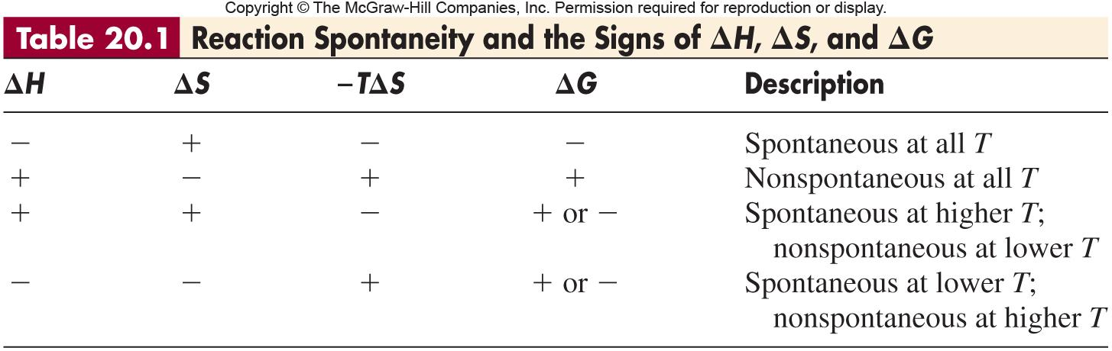
Notes:
‹#›

Slide 28
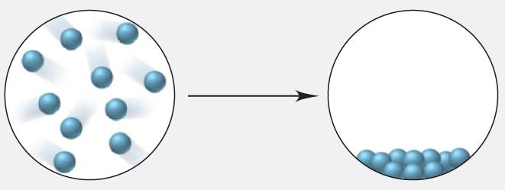
Sample Problem 20.6
Using Molecular Scenes to Examine the Signs of ΔH, ΔS, and ΔG
PROBLEM:
The following scenes represent a familiar phase change for water (blue spheres):
What are the signs of ΔH and ΔS for this process? Explain.
Is the process spontaneous at all T, no T, low T, or high T? Explain.
PLAN:
The process shown is water going from gas to liquid. (a) Determine whether there is an increase or decrease in entropy based on the states. (b) Use Equation 20.6 and Table 20.1 to determine spontaneity by the sign of ΔG.
Notes:
‹#›

Slide 29
Sample Problem 20.6
Using Molecular Scenes to Examine the Signs of ΔH, ΔS, and ΔG
continued
SOLUTION:
(a) The scenes represent condensation of a gas, ΔS < 0 (more order) and ΔH < 0 (exothermic)
(b)
  With a negative ΔS and negative ΔH, ΔG will be negative. Therefore, the process is spontaneous at low T.
ΔG = ΔH - TΔS
Notes:
‹#›

Slide 30
Sample Problem 20.7
Determining the Effect of Temperature on ΔG
PROBLEM:
A key step in the production of sulfuric acid is the oxidation of SO₂(g) to SO₃(g):
2SO₂(g) + O₂(g) 2SO₃(g)
At 298 K, ΔG = -141.6 kJ; ΔH = -198.4 kJ; and ΔS = -187.9 J/K
(a) Use the data to decide if this reaction is spontaneous at 25ºC, and predict how ΔG will change with increasing T.
(b) Assuming ΔH and ΔS are constant with T, is the reaction spontaneous at 900.ºC?
PLAN:
The sign of ΔG tells us whether the reaction is spontaneous and the signs of ΔH and ΔS will be indicative of the T effect. Use the Gibbs free energy equation for part (b).
SOLUTION:
(a) The reaction is spontaneous at 25ºC because ΔG is (-). Since ΔH is (-) but ΔS is also (-), ΔG will become less negative, and the reaction less spontaneous as the temperature increases.
Notes:
‹#›

Slide 31
Sample Problem 20.7
Determining the Effect of Temperature on ΔG
continued
(b) ΔG= ΔH - TΔS
ΔG = -198.4 kJ – [(1173 K)(-187.9 J/K)(1 kJ/1000 J)
ΔG = 22.0 kJ; the reaction will be nonspontaneous at 900.ºC
Notes:
‹#›

Slide 32
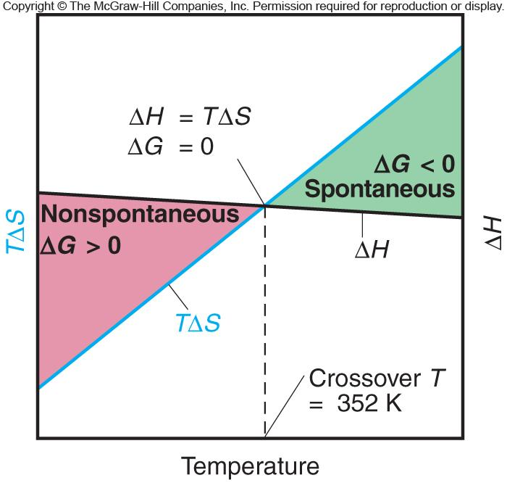
Figure 20.12
The effect of temperature on reaction spontaneity.
Notes:
‹#›

Slide 33
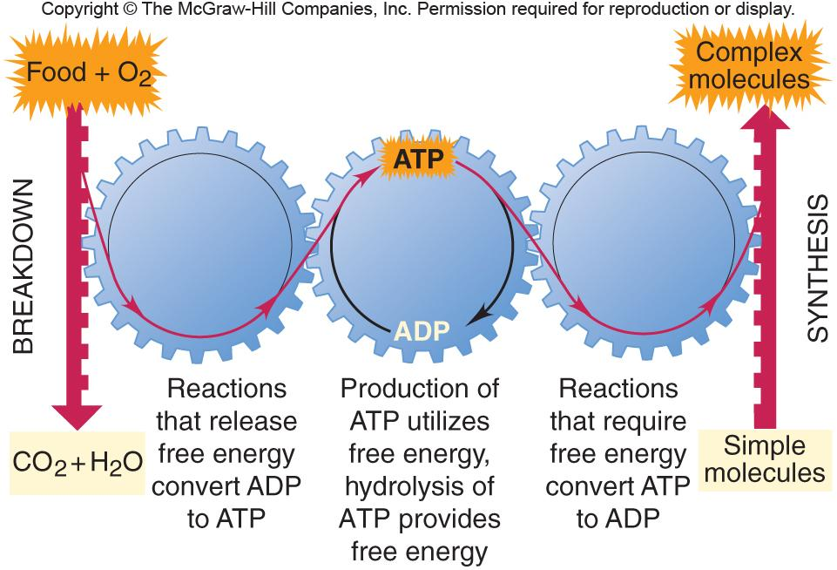
Figure 20.13
The cycling of metabolic free energy through ATP.
Notes:
‹#›

Slide 34
Free Energy, Equilibrium, and Reaction Direction
If Q/K < 1, then ln Q/K < 0: the reaction proceeds to the right (ΔG < 0).
If Q/K > 1, then ln Q/K > 0: the reaction proceeds to the left (ΔG > 0).
If Q/K = 1, then ln Q/K = 0: the reaction is at equilibrium (ΔG = 0).
Q
ΔG = RT ln = RT ln Q - RT 1n K
K
Under standard conditions (1 M concentrations, 1 atm for gases), Q = 1 and ln Q = 0 so,
ΔGº = - RT 1n K
Notes:
‹#›

Slide 35
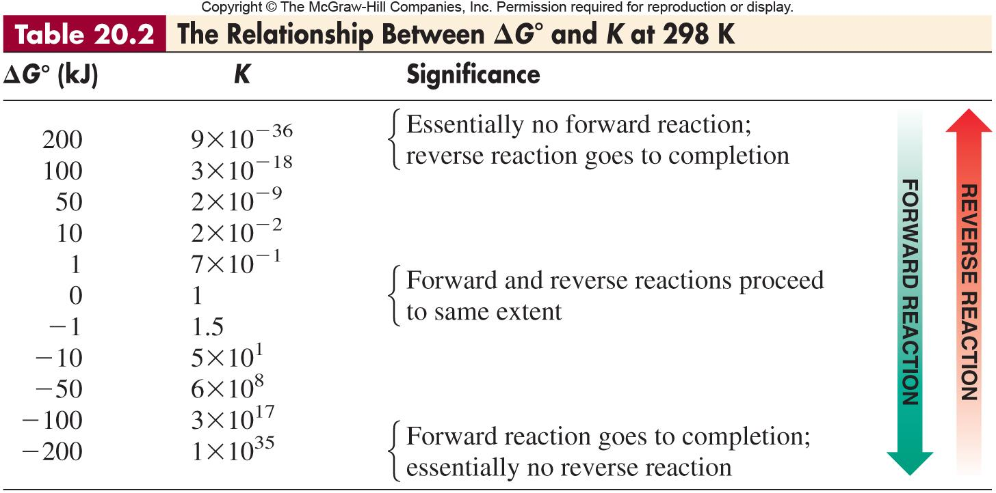
Notes:
‹#›

Slide 36

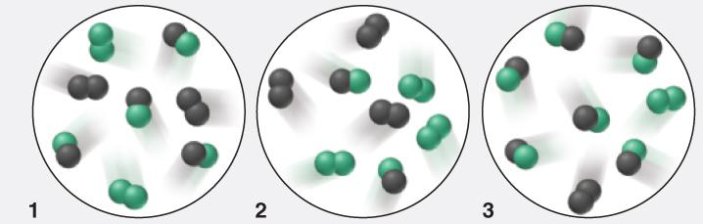
Sample Problem 20.8
Using Molecular Scenes to Find ΔG for a Reaction at Nonstandard Conditions
PROBLEM:
The molecular scenes below represent three mixtures of A₂ (black) and B₂ (green) forming AB. Each molecule represents 0.10 mol, and the volume is 1 L. The equation is A₂(g) + B₂(g) 2AB(g) ΔG° = -3.4 kJ/mol
Mixture 1 is at equilibrium; calculate K.
Which reaction mixture has the lowest (most negative) ΔG, and which has the highest (most positive)?
Is the reaction spontaneous when [A₂] = [B₂] = [AB] = 1.0 M?
Notes:
‹#›

Slide 37
Sample Problem 20.8
Using Molecular Scenes to Find ΔG for a Reaction at Nonstandard Conditions
continued (2 of 4)
Plan:
Write the expression for Q, find the M of each substance, and calculate K.
Calculate T from Equation 20.12 and use Equation 20.13 to determine ΔG, then calculate Q.
1.0 M is standard state; substitute concentrations in Q expression and use Equation 20.13 to solve for ΔG.
SOLUTION:
[AB]²
(0.40)²
(a) K = = = 4.0
[A₂][B₂]
(0.20)(0.20)
ΔGº = -RT ln K = (-8.314 J/K•mol) T ln 4.0
Notes:
‹#›

Slide 38
Sample Problem 20.8
Using Molecular Scenes to Find ΔG for a Reaction at Nonstandard Conditions
continued (2 of 4)
SOLUTION:
(-3.4 kJ/mol)(1000 kJ/J)
(b) T =
  For mixture 1:
  ΔG = ΔGº + RT ln Q = -3.4 kJ + RT ln 4.0
  ΔG = (-3.4 kJ) + (295 K) ln 4.0 = 0.0 J
= 295 K
(-8.314 J/K•mol) ln 4.0
1000 J
-8.314 J
1 kJ
K•mol
Notes:
‹#›

Slide 39
Sample Problem 20.8
Using Molecular Scenes to Find ΔG for a Reaction at Nonstandard Conditions
continued (3 of 4)
SOLUTION:
(b) For mixture 2:
ΔG = -3.4 kJ + RT ln
ΔG = (-3.4 kJ) + (295 K) ln 0.44 =
(0.20)²
= -3.4 kJ + RT ln 4.0
(0.30)(0.30)
1000 J
-8.314 J
-5.4 x 10³ J
1 kJ
K•mol
For mixture 3:
ΔG = (-3.4 kJ) + RT ln = -3.4 kJ + RT ln 36
ΔG = (-3.4 kJ) + (295 K) ln 36 =
Mixture 2 has the most negative ΔG and mixture 3 has the most positive.
(0.60)²
(0.10)(0.10)
1000 J
-8.314 J
5.4 x 10³ J
1 kJ
K•mol
Notes:
‹#›

Slide 40
Sample Problem 20.8
Using Molecular Scenes to Find ΔG for a Reaction at Nonstandard Conditions
continued (4 of 4)
SOLUTION:
(1.0)²
ΔG = ΔGº + RT ln Q = -3.4 kJ + RT ln
= -3.4 kJ/mol + RT ln 1.0 = -3.4 kJ/mol
The reaction is spontaneous when all species are at standard state.
(c)
(1.0)(1.0)
Notes:
‹#›

Slide 41
Sample Problem 20.9
Calculating ΔG at Nonstandard Conditions
PROBLEM:
The oxidation of SO₂, which we considered in Sample Problem 20.7
2SO₂(g) + O₂(g) 2SO₃(g)
is too slow at 298 K to be useful in the manufacture of sulfuric acid. To overcome this low rate, the process is conducted at an elevated temperature.
(a) Calculate K at 298 K and at 973 K. (ΔGº₂₉₈ = -141.6 kJ/mol of reaction as written; using ΔHº and ΔSº values at 973 K, ΔGº₉₇₃ = -12.12 kJ/mol of reaction as written.)
(b) In experiments to determine the effect of temperature on reaction spontaneity, two sealed containers are filled with 0.500 atm of SO₂, 0.0100 atm of O₂, and 0.100 atm of SO₃ and kept at 25ºC and at 700.ºC. In which direction, if any, will the reaction proceed to reach equilibrium at each temperature?
(c) Calculate ΔG for the system in part (b) at each temperature.
PLAN:
Use Equations 20.12 and 20.13.
Notes:
‹#›

Slide 42
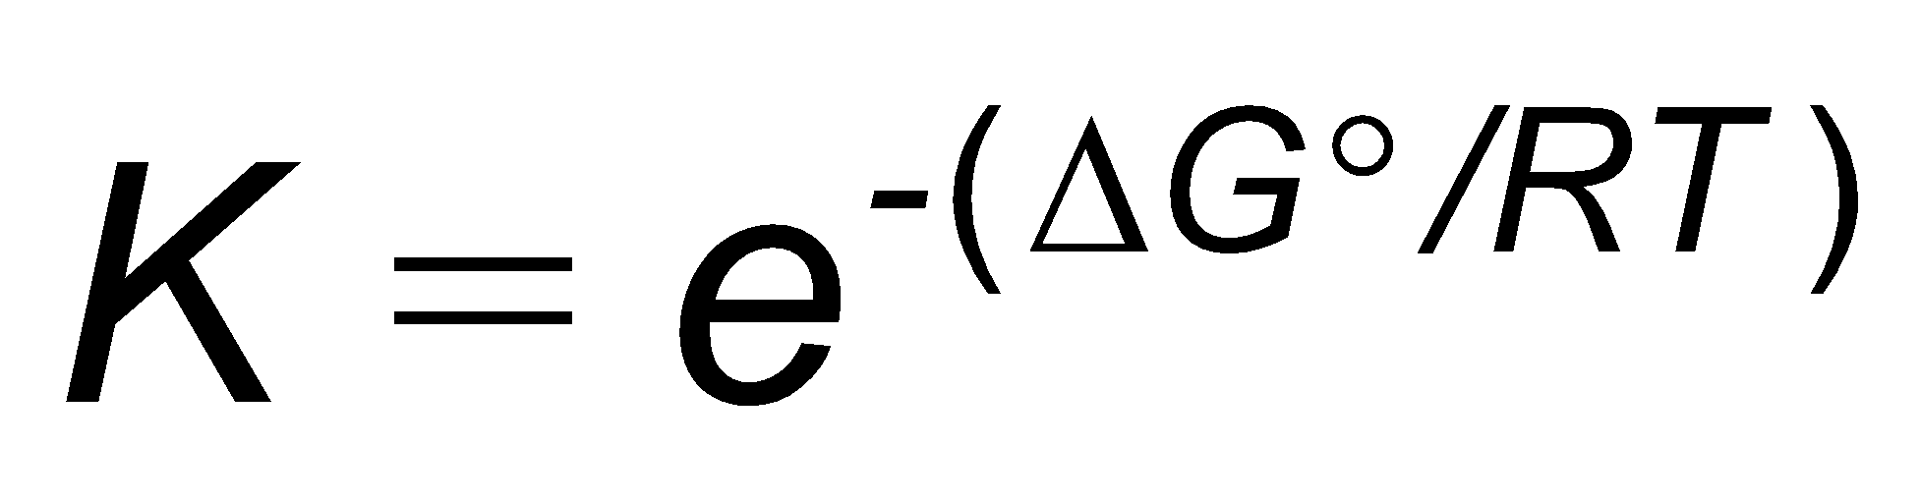
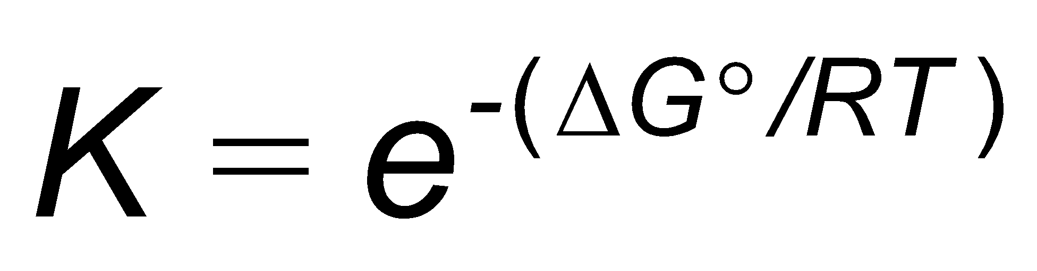
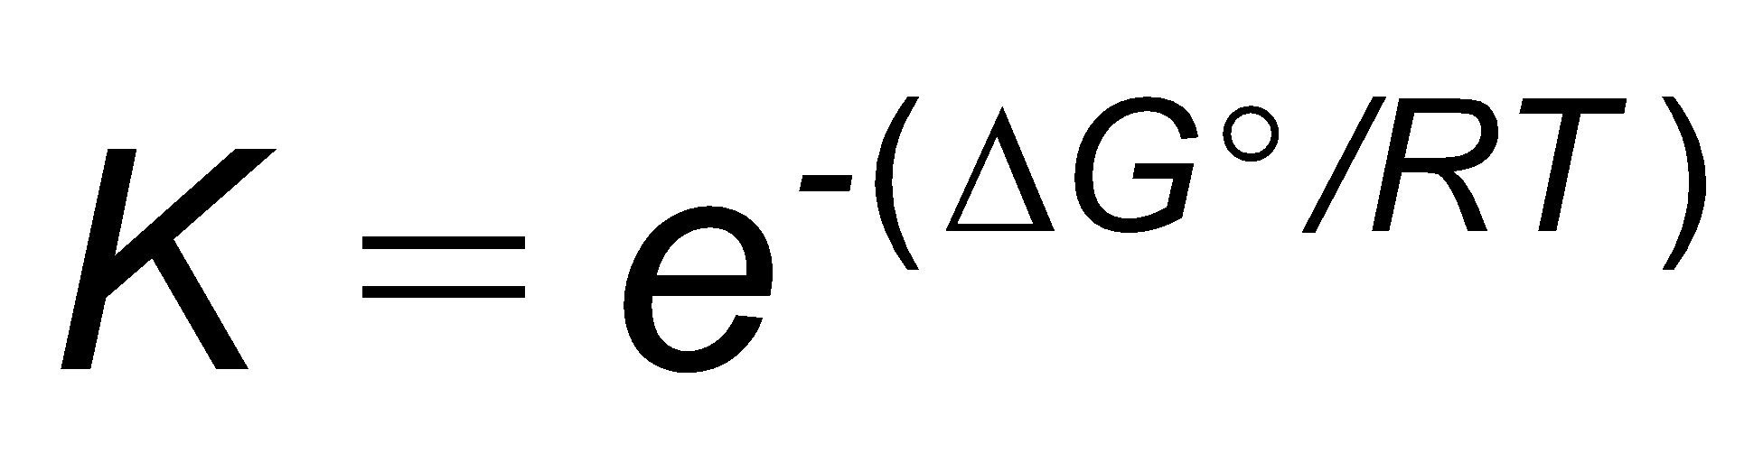
Sample Problem 20.9
Calculating ΔG at Nonstandard Conditions
continued (2 of 3)
SOLUTION:
(a) Calculating K at the two temperatures:
ΔGº = -RT 1n K so
(-141.6 kJ/mol)(10³ J/kJ)
At 298 K, the exponent is –(ΔGº/RT)
= –
= 57.2
(8.314 J/mol•K)(298 K)
= e^{57.2}
= 7 x 10²⁴
(-12.12 kJ/mol)(10³ J/kJ)
At 973 K, the exponent is –(ΔGº/RT) =
= 1.50
(8.314 J/mol•K)(973 K)
= e^{1.50}
= 4.5
Notes:
‹#›

Slide 43
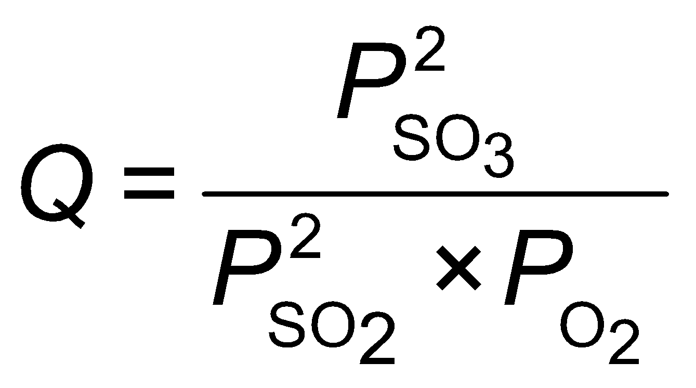
Sample Problem 20.9
Calculating ΔG at Nonstandard Conditions
continued (3 of 3)
(0.100)²
(b) The value of
=
= 4.00
(0.500)²(0.0100)
Since Q is < K at both temperatures the reaction will shift right; for 298 K there will be a dramatic shift while at 973 K the shift will be slight.
(c) The nonstandard ΔG is calculated using ΔG = ΔGº + RT ln Q
8.314 J
1 kJ
ΔG₂₉₈ = -141.6 kJ/mol + x (298 K)(ln 4.00)
K•mol
1000 J
ΔG₂₉₈ = -138.2 kJ/mol
8.314 J
1 kJ
ΔG₉₇₃ = -12.12 kJ/mol + x (973 K)(ln 4.00)
K•mol
1000 J
ΔG₂₉₈ = -0.9 kJ/mol
Notes:
‹#›

Slide 44
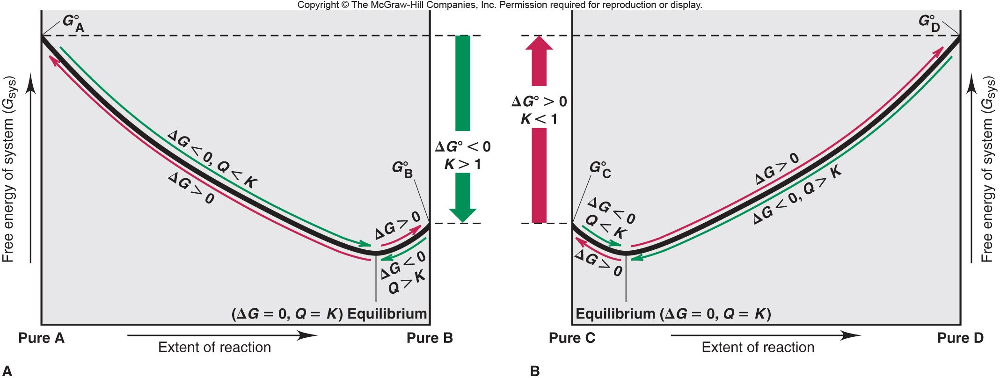
Figure 20.14
The relation between free energy and the extent of reaction.
Notes:
‹#›

