Slide 1
Leadership
Maram Jaghama

Slide 2
Outline
Definition of leadership
Leadership roles
Characteristics of leadership
Leaders vs managers
Leadership styles
Leadership theories

Slide 3
Leadership
Leadership is the art of motivating, encouraging and helping a group of people to act towards achieving a common goal.
OR
The ability to influence, motivate, and enable others to contribute to the effectiveness and success of the organizations of which they are members.

Slide 4
The main difference between leaders and managers is that leaders have people follow them while managers have people who work for them. A successful business owner needs to be both a strong leader and manager to get their team on board to follow them towards their vision of success.

Slide 5
Types of Power
Legitimate | Power based on one’s position in the formal hierarchy
Coercive | Power based on fear
Reward | Power based on the ability to distribute something that others value
Expert | Power based on one’s expertise, special skill, or knowledge
Referent | Power based on identification with a person who has resources or traits

Slide 6
What is Management
Management is the ability to organize resources and coordinate the tasks necessary to reach a goal in a timely and cost effective manner

Slide 7

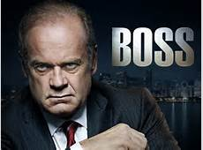
Managers vs Leaders
“Not all leaders are managers, nor are all managers are leaders”

Slide 8
Leadership & Management Skills
Leadership – soft skills
- Communications
- Motivation
- Stress Management
- Team Building
- Change Management
Management – hard skills
- Scheduling
- Staffing
- Activity Analysis
- Project Controls

Slide 9
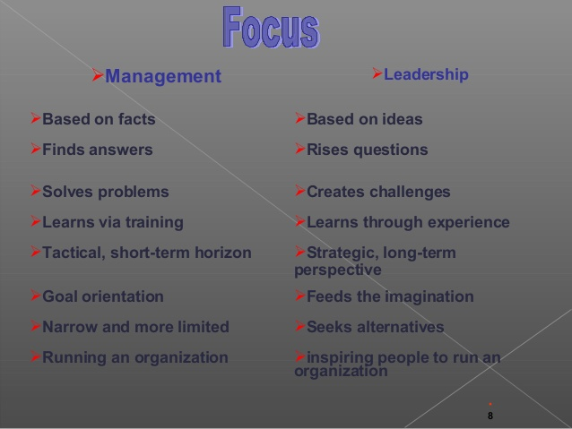

Slide 10
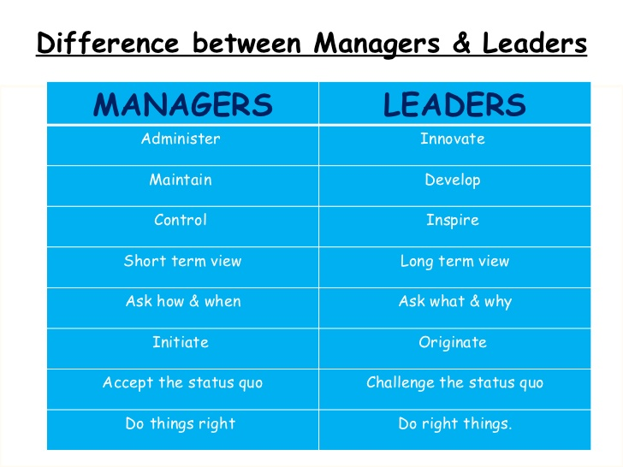

Slide 11
Leadership characteristics
Leaders often do not have delegated authority but obtain their power through other means, such as influence.
Leaders have a wider variety of roles than do managers.
Leaders may or may not be part of the formal organization.
Leaders focus on group process, information gathering, feedback, and empowering others.
Leaders emphasize interpersonal relationships.
Leaders have goals that may or may not reflect those of the organization.

Slide 12
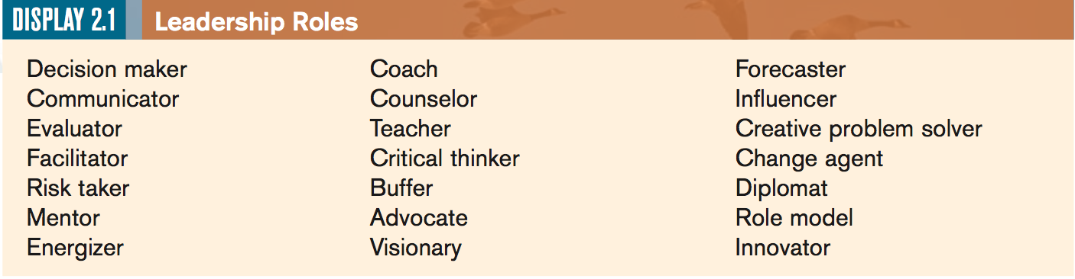
Leadership roles

Slide 13
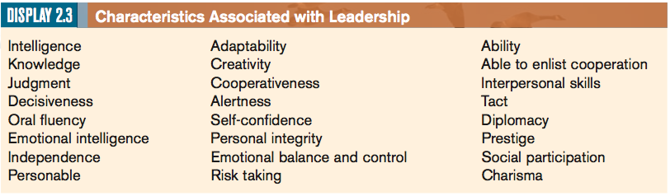

Slide 14
It is important to remember that all it takes to stop being a leader is to have others stop following you
It is important to remember though that a job title alone does not make a person a leader. Only a person’s behavior determines if he or she holds a leadership role

Slide 15
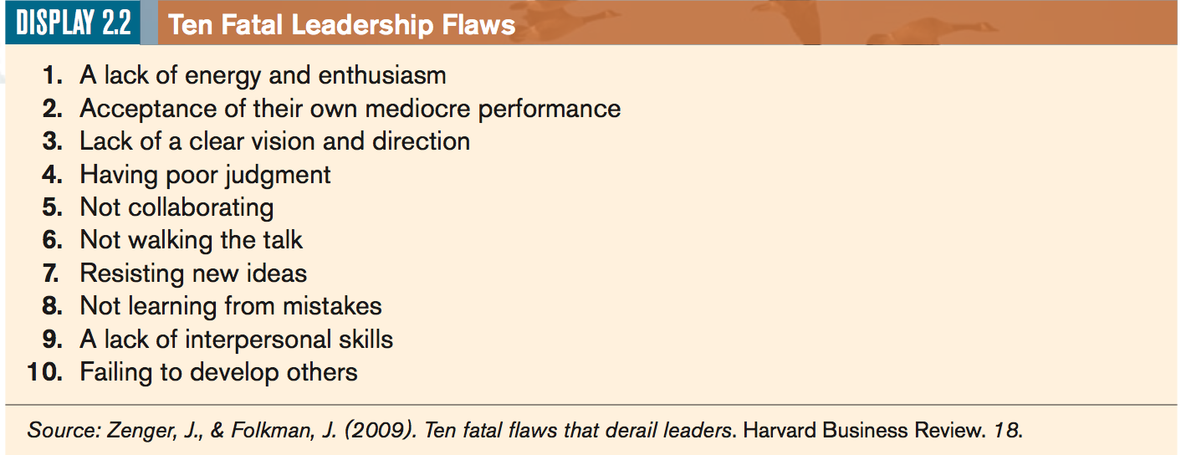

Slide 16
How important is a leader?
In most cases, people will perform at about 60% of their potential with no leadership at all.
Thus, an additional 40% can be realized if effective leadership is available

Slide 17
capability
utilization
40%
Contribution due to leadership
ability of manager
60%
Default contribution due to
need for a job, peer pressure, etc.

Slide 18
Effective leadership is not about making speeches or being liked; leadership is defined by results not attributes.
Peter Drucker

Slide 19

Leadership styles

Slide 20
Leadership styles
Leadership style is the approach for providing the right way to the team members, implementing planning strategies and motivating people by including all the three leadership styles.

Slide 21
3 Main Types of Leadership Styles
The Autocratic or Authoritarian Leader
The Democratic or Participative Leader
The Laissez-faire or Delegative Leader

Slide 22
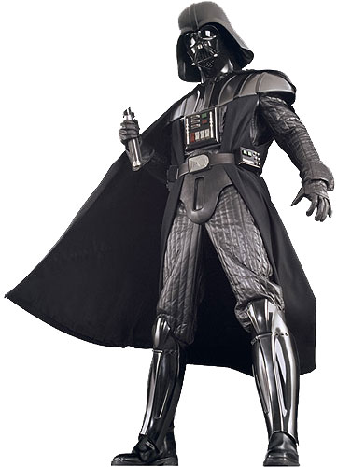
1. The Autocratic or Authoritarian Leader
Given the power to make decisions alone, having total authority.
Closely supervises and controls people when they perform certain tasks.

Slide 23


Slide 24
The authoritarian leader is characterized by the following behaviors:
- Strong control is maintained over the work group.
- Others are motivated by coercion.
- Others are directed with commands.
- Communication flows downward.
- Decision making does not involve others.
- Emphasis is on difference in status (“I” and “you”).
- Criticism is punitive.

Slide 25

When to use Autocratic Leadership Style?

Slide 26
Autocratic style is effective when:
quick decisions are needed
Limited time for decision making
No need for others input
Team agreement is not necessary
When high level of management control is needed
New, untrained employees
Employees do not respond to any other leadership style
High-volume production needs

Slide 27
Authoritarian leadership results in:
well-defined group actions that are usually predictable.
Productivity is usually high, but creativity, self-motivation, and autonomy are reduced.
Authoritarian leadership is frequently found in very large bureaucracies such as the armed forces.

Slide 28

Limitations of Autocratic Leadership

Slide 29

Employees cannot question decisions

Slide 30

Little opportunity to give suggestions

Slide 31

2. Democratic/ Participative Leadership Style

Slide 32
Democratic leadership
Often referred to as participative style
Keeps employees informed
Gathers information from staff members before making decisions
Notes:
Because a democratic leader welcomes team input and facilitates group discussion, it is often referred to as a participative leadership style
Democratic leaders are constantly keeping employees informed about matters that affect them. They are consistently sharing plans with the group and offering multiple options for group consideration.
Even though the Democratic leader still makes the final decision, they use a coaching style to encourage followers to take part in influencing and guiding decision making process. Generally before making a final decision, the leader will consult followers and gather information from them.
There are so many great qualities about the democratic leadership style…that the list goes on…

Slide 33
Help employees evaluate their own performance
Encourages employees to grow on the job and be promoted
Recognizes and encourages achievement
Can produce high quality and high quantity work for long periods of time
Notes:
.
Democratic leaders encourage growth in employees/followers by encouraging them to work freely with each other and leave division of tasks to the group—allowing more sharing and collaboration among followers or group members.
In order to continuously encourage growth, democratic leaders make it a point to praise and offer constructive criticism. In addition, they will join in group activities without over-participating.
Let’s begin thinking about when we might value a democratic leadership style….

Slide 34
The democratic leader exhibits the following behaviors:
Less control is maintained.
Economic and ego awards are used to motivate.
Others are directed through suggestions and guidance.
Communication flows up and down.
Decision making involves others.
Emphasis is on “we” rather than “I” and “you.”
Criticism is constructive.

Slide 35
When to use Democratic
To keep employees informed
To encourage employees to share in decision-making and problem-solving
To provide opportunities for employees to develop a high sense of personal growth and job satisfaction
Complex problems that require a lots of input
To encourage team building and participation.
Notes:
On the other hand, it is sometimes a challenge for democratic leaders to recognize that not all tasks need to be handled by the group, and that sometimes the leader should appropriately address some issues along.
Democratic leadership should not be used when:
--There is not enough time to get everyone’s input.
--It’s easier and more cost-effective for the manager to make the decision.
--The business can’t afford mistakes.
--The manager feels threatened by this type of leadership.
--Employee safety is a critical concern.

Slide 36
Democratic leadership, appropriate for groups who work together for extended periods, promotes autonomy and growth in individual workers.
Democratic leadership is particularly effective when cooperation and coordination between groups are necessary
Wong (2012)

Slide 37

Limitation of Democratic Leadership Style

Slide 38
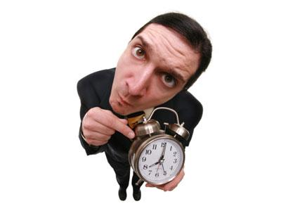
It is a time consuming affair:
Because many people must be consulted, democratic leadership takes more time and therefore may be frustrating for those who want decisions made rapidly

Slide 39

3. Laissez-Faire/ Free Rein Leadership Style

Slide 40
Laissez-Faire
Also known as the “hands-off¨ style
Little or no direction
Gives followers as much freedom as possible
All authority or power is given to the followers
Followers must determine goals, make decisions, and resolve problems on their own.
Notes:
.
The laissez-faire leadership style is also know as the “hands-off” style. It is one in which the manager provides little or no direction and gives employees as much freedom as possible. The authority of power is given to the employees and they must determine goals, make decisions, and resolve problems on their own.

Slide 41
The laissez-faire leader is characterized by the following behaviors:
Is permissive, with little or no control.
Motivates by support when requested by the group or individuals.
Provides little or no direction.
Uses upward and downward communication between members of the group.
Disperses decision making throughout the group.
Places emphasis on the group.
Does not criticize.

Slide 42
when to use Laissez-Faire
Employees are highly skilled, experienced, and educated
Employees have pride in their work and the drive to do it successfully on their own
Outside experts, such as staff specialists or consultants are being used
Employees are trustworthy and experienced
Notes:
Some risks are involved with Laissez-Faire Leadership. Followers may like them, but some people find events around them confusing and chaotic. They also may feel that the leader does not respect their time and energy. Most importantly, they may not see where their contribution fits and slowly become less committed and enthusiastic.

Slide 43
Questions
Which leadership style do you think is the most effective? Why?
Which leadership style do you think is the least effective? Why?
Which style do you like leaders to use when they are in charge of you? Why?
What leadership style best describes you?

Slide 44
Two other styles

Slide 45
Transactional and Transformational Leadership
Transactional leader: is the traditional manager concerned with day to day operations
Emphasizes process in sitting goals, giving directions to control both situation and followers.
They are concerned about the status quo and day-to-day progress toward goals.
Transactional leaders focus on tasks and getting the work done

Slide 46
Transformational leader: who is committed, has a vision, and is able to empower others with this vision.
Transformational leaders do the right thing for the right reason, treat people with care and compassion, encourage followers to be more creative and innovative, and inspire others with their vision.

Slide 47
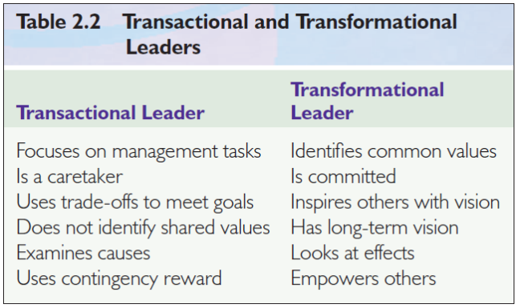

Slide 48
Although transformational qualities are highly desirable, they must be coupled with the more traditional transactional qualities of the day-to-day managerial role or the leader will fail.
https://www.youtube.com/watch?v=ddt_IGMMOrI

Slide 49
Origins of leadership
Are leaders born or made?
  BOTH. Evidence that both inherent personality and environment are factors
What kind of leader would you be?

Slide 50
Leadership theories (1900-present)
The Great Man Theory/Trait Theories (1900 to 1940)
Behavioral Theories (1940 to 1980)
Situational and Contingency Leadership Theories (1950 to 1980)
Interactional leadership theories (1970 To Present)
Transactional and transformational leadership
Full-Range Leadership Theory
Integrating leadership and management

Slide 51
The Great Man Theory/Trait Theories
(1900 to 1940)
Great man theory asserts that some people are born to led where as others born to be led.
“Leaders are born, not made”
It also suggests that great leaders will arise when the situation demands it.

Slide 52
Trait theories assume that some people have certain characteristics or personality traits that make them better leaders than others.
Trait theory of leadership sought personality ,social ,physical or intellectual traits that differentiate leaders from non leaders.

Slide 53
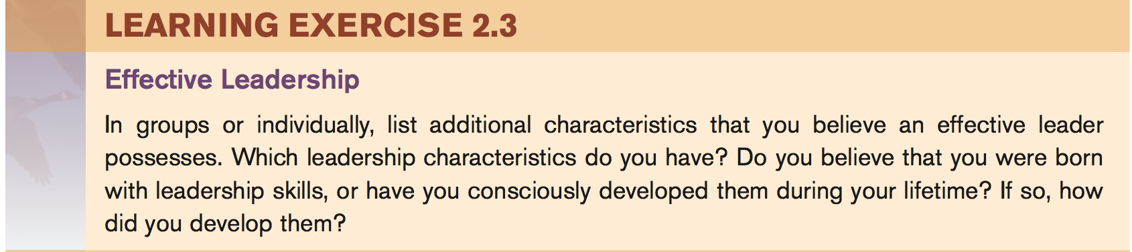

Slide 54
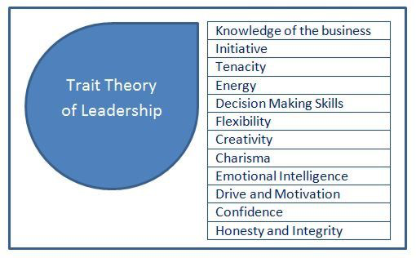

Slide 55
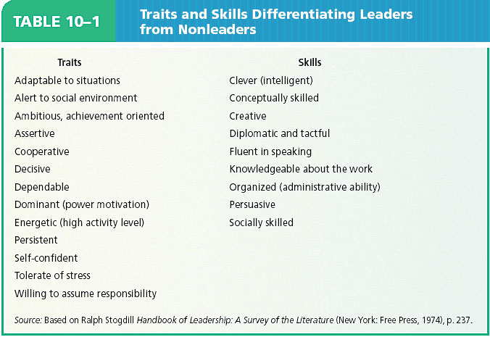

Slide 56
Behavioral Theories
(1940 to 1980)
Researchers moved away from studying what traits the leader had and placed emphasis on what he or she did (the leader’s style of leadership).
Autocratic/ Democratic/ Laissez-Faire.
These theories are based upon the belief that great leaders are made not born.
Focuses on the actions of the leaders not on the qualities
People can learn to become leaders through teaching and observations
Anyone who adopts the appropriate behavior can be a good leader

Slide 57
BEHAVIORAL APPROACHES
LEADERSHIP TYPES:
  1. Production Oriented Leaders:
    Focus on the technical or task aspects of the job
    See people as a means to goal accomplishment
  2. Employee Oriented Leaders:
    Emphasize interpersonal relations
    Take a personal interest in subordinate needs
    Accept individual differences

Slide 58
Situational and Contingency Leadership Theories (1950 to 1980)
The idea that leadership style should vary according to the situation or the individuals involved.
Contingency: is a situation or event that's dependent – or contingent – on someone or something else

Slide 59
Mary Parker Follet:
one of the earliest management consultants, view an organization as a social system of contingencies.
Her law of the situation, which said that the situation should determine the directives given after allowing everyone to know the problem, was contingency leadership.

Slide 60
Contingency theories in general state that the effectiveness of leadership depends upon the situation, and there are numerous factors, such as the nature of the task, leader's personality, and the group’s members.

Slide 61
Fiedler’s (1967): reinforced the findings of Mary , suggesting that no one leadership style is ideal for every situation
contingency approach
claims that there is no best way to organize a corporation, to lead a company, or to make decisions. Instead, the optimal course of action is contingent (dependent) upon the internal and external situation.
the way you manage should change depending on the circumstances.
One size does not fit all.

Slide 62
Fiedler’s contingency model
Identify your leadership style
Identify your situation
Determine the most effective leadership style

Slide 63
Contingency approach model
Identify your leadership style
Fiedler developed a scale called the Least Preferred Co-worker (LPC) scale to measure leadership.
This scale enable you to identify whether an individual's leadership style is relationship-oriented or task-oriented.

Slide 64
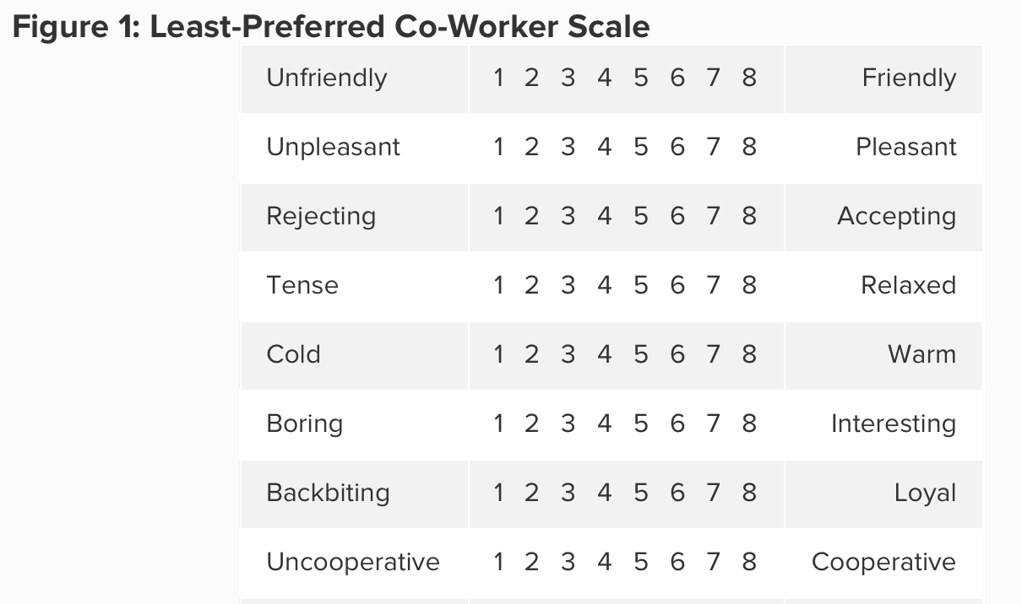
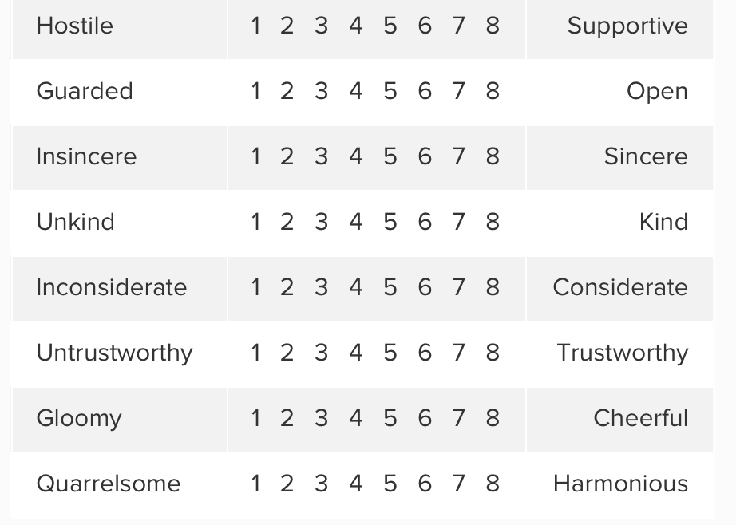

Slide 65
The scale asks you to think about the person who you've least enjoyed working with. This can be a person who you've worked with in your job, or in education or training.
You then rate how you feel about this person for each factor, and add up your scores. If your total score is high, you're likely to be a relationship-orientated leader. If your total score is low, you're more likely to be task-orientated leader.

Slide 66
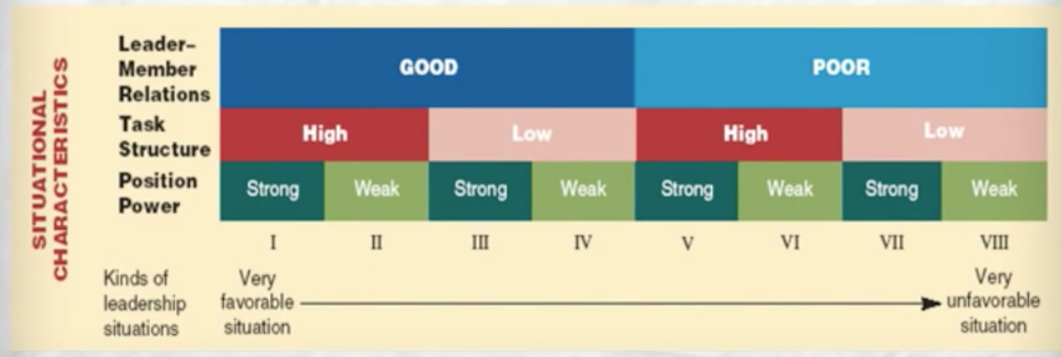

Slide 67
The model says that task-oriented leaders usually view their LPCs more negatively, resulting in a lower score. Fiedler called these low LPC-leaders. He said that low LPCs are very effective at completing tasks. They're quick to organize a group to get tasks and projects done. Relationship-building is a low priority.
However, relationship-oriented leaders usually view their LPCs more positively, giving them a higher score. These are high-LPC leaders. High LPCs focus more on personal connections, and they're good at avoiding and managing conflict. They're better able to make complex decisions.

Slide 68
2. Identify your situation
This depends on three distinct factors:
Leader-Member Relations – This is the level of trust and confidence that your team has in you. A leader who is more trusted and has more influence with the group is in a more favorable situation than a leader who is not trusted.
Task Structure – This refers to the type of task you're doing: clear and structured, or vague and unstructured. Unstructured tasks, or tasks where the team and leader have little knowledge of how to achieve them, are viewed unfavorably.
Leader's Position Power – This is the amount of power you have to direct the group, and provide reward or punishment. The more power you have, the more favorable your situation. Fiedler identifies power as being either strong or weak

Slide 69
2. Identify your situation
Answer the questions:
Are leader-member relations good or poor?
Is the task you're doing structured, or is it more unstructured, or do you have little experience of solving similar problems?
Do you have strong or weak power over your team?
Leader- member relations
Leader’s position power
Task structure

Slide 70
3. Determine the most effective leadership style
Relationship- oriented leader or task -oriented leader
Example:
1- imagine that you've just started working at a new company, replacing a much-loved leader who recently retired. You're leading a team who views you with distrust (so your Leader-Member Relations are poor). The task you're all doing together is well defined (structured), and your position of power is high because you're the boss, and you're able to offer reward or punishment to the group.
The most effective leader in this situation would be high LPC – that is, a leader who can focus on building relationships first.

Slide 71
Example
2- imagine that you're leading a team who likes and respects you (so your Leader-Member relations are good). The project you're working on together is highly creative (unstructured) and your position of power is high since, again, you're in a management position of strength.
In this situation a task-focused leadership style would be most effective.

Slide 72
Criticisms of Fiedler’s Model
Lack of flexibility
Fiedler believed that because our natural leadership style is fixed, the most effective way to handle situations is to change the leader. He didn't allow for flexibility in leaders.
There is also an issue with the Least-Preferred Co-Worker Scale – if you fall near the middle of the scoring range, then it could be unclear which style of leader you are.
the Fiedler Contingency Model is unhelpful in many 21st Century workplaces. It may occasionally be a useful tool for analyzing a situation and determining whether or not to focus on tasks or relationships.

Slide 73
Blake and Mouton’s 1964 grid= Managerial grid
showed various combinations of concern or focus that managers had for or on productivity.
Concern for People: this is the degree to which a leader considers team members' needs, interests and areas of personal development when deciding how best to accomplish a task.
Concern for Results: this is the degree to which a leader emphasizes concrete objectives, organizational efficiency and high productivity when deciding how best to accomplish a task.

Slide 74
Hersey and Blanchard 1977 (situational leadership model)
Developed a situational approach to leadership.
In their situational leadership theory they indicated that the effectiveness of the leadership style is dependent on the situation.
Maturity of the employees and their attitudes determine the style of leadership.
As people mature, leadership style becomes less task focused and more relationship oriented.

Slide 75
Tannenbaum and Schmidt 1958 ‘’Leadership Continuum Theory’’
This theory is based on the idea that many classifications of leadership such as autocratic or democratic are extremes and leadership practices in real life situations lye somewhere between the two extreme
suggesting that managers need varying mixtures of autocratic and democratic leadership behavior.
They believed that the primary determinants of leadership style should include the nature of the situation, the skills of the manager, and the abilities of the group members.

Slide 76
Interactional leadership theories (1970 To Present)
The basic premise of interactional theory is that leadership behavior is generally determined by the relationship between the leader’s personality and the specific situation.

Slide 77
Integrating leadership and management
Theory
For managers and leaders, to function at their greatest potential the two must be integrated.
As Gardner 1990 asserted that integrated leader-manager possesses six distinguishing traits:
1. They think longer term.
2. They look outward, toward the larger organization.
3. They influence others beyond their own group
4. They emphasize vision, values, and motivation
5. They are politically astute
6. They think in terms of change and renewal

Slide 78
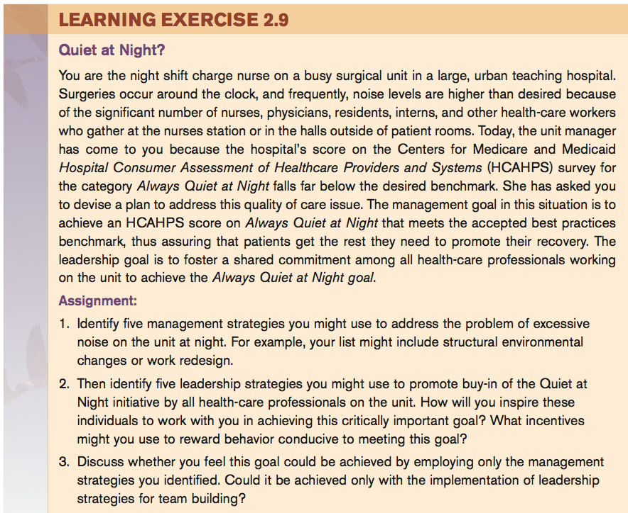

Slide 79
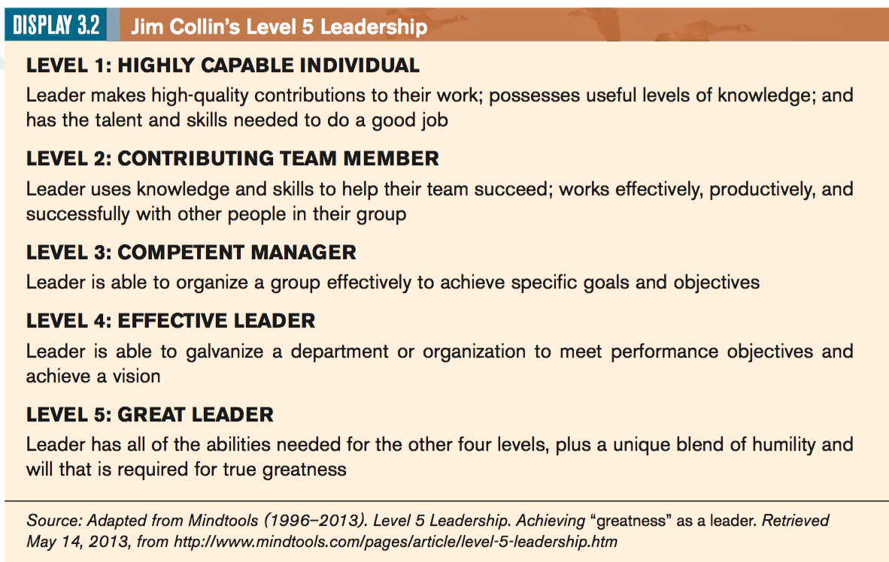
NEW THINKING ABOUT LEADERSHIP AND MANAGEMENT
Level 5 Leadership

Slide 80
2. Servant Leadership:
Developed by Greenleaf (1977)
These managers, which he termed servant leaders, put serving others, including employees, customers, and the community, as the number-one priority
The highest priority of this leader is to encourage, support and enable people to fulfill their full potential and abilities.
Helps people achieve their goals.
Works for the people

Slide 81
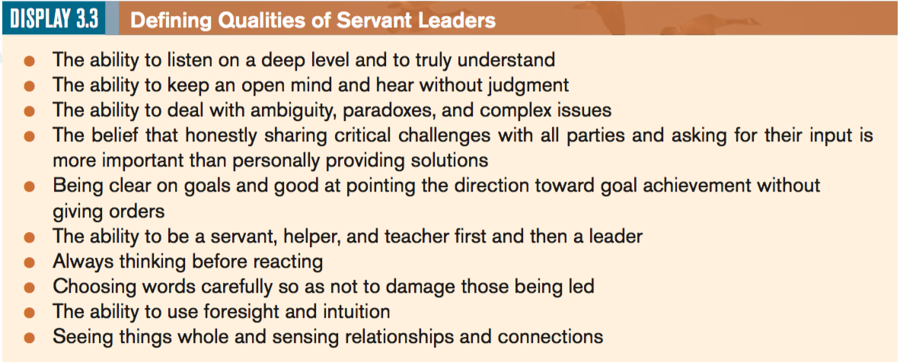

Slide 82
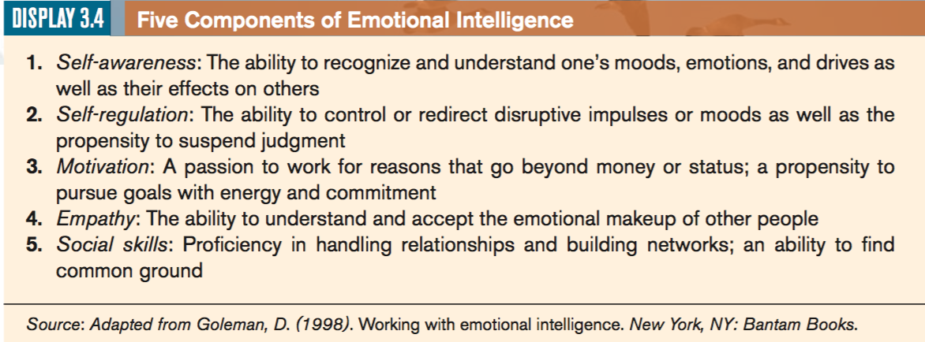
3. Emotional Intelligence theory
refers to the ability to perceive, understand, and control one’s own emotions as well as those of others.
For example, an individual with higher EI might choose to feel useful emotions and regulate them in strategic ways, even if they are unpleasant to experience

Slide 83
4. Quantum Leadership suggests that the environment and context in which people work is complex and dynamic and that this has a direct impact on organizational productivity.
5. Authentic leadership suggests that in order to lead, leaders must be true to themselves and their values and act accordingly.
6. Thought leadership refers to any situation whereby one individual convinces another to consider a new idea, product, or way of looking at things. Thought leaders attract followers not by any promise of representation or empowerment but by their risk taking and vision in terms of being innovative.

Slide 84
